Slide 1
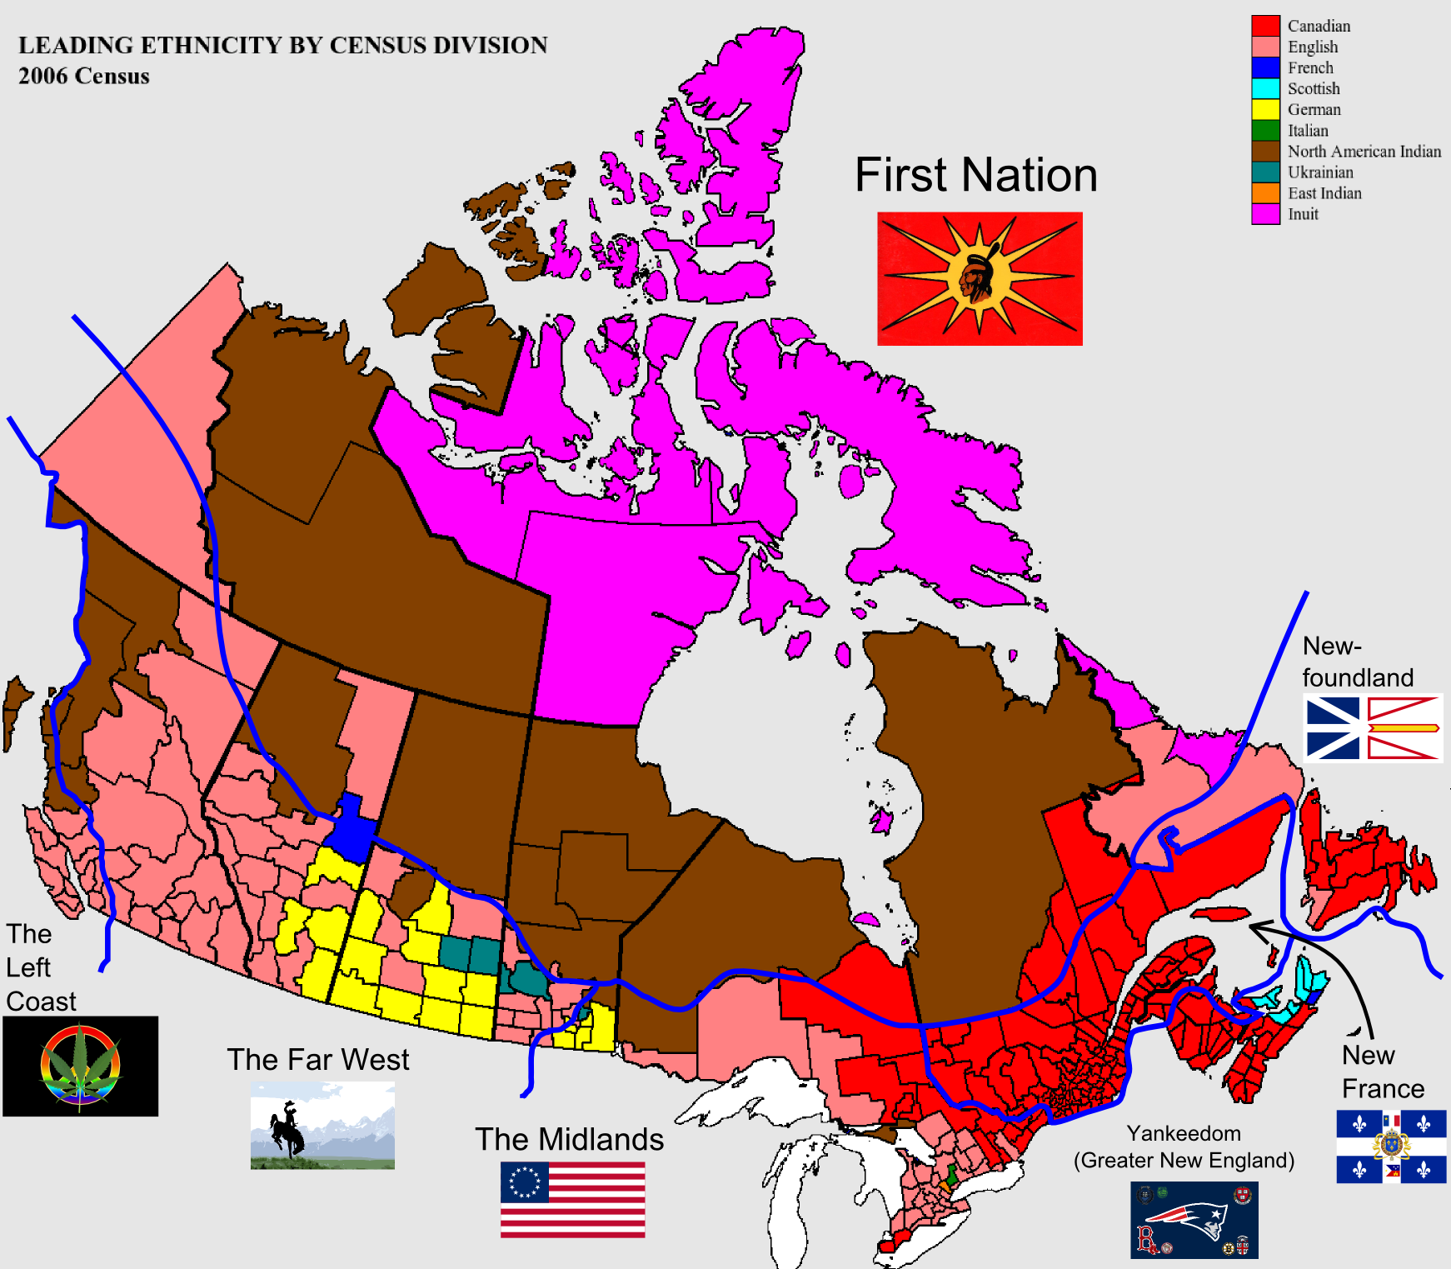
Canada – A state? A nation? A Nation-State? ……..or none of the these? If no, then what, if anything?
a state?
independent, self-governing political community….
institutions capable of making rules that are binding on people residing in a given territory….
the idea that we are a ‘sovereign’ entity whereby the state is the
highest authority of the people in a territory and not subject to
an external authority…..
a nation?
a people who share a sense of common identity and who believe
they share a common identity as members of a particular nation
Does this really sound like Canada?
a nation-state?
a sovereign state based in people living in a country who share a
sense of common identity as members of a particular nation?
What do all Canadians ‘share’ in this context?
…….is it values? Beliefs? Rights? What sets us apart from other nations?
Do all Canadians really view themselves as ‘Canadian?’
If asked to explain what it means to be Canadian, how comfortable would you be in defining a ‘Canadian?’

Slide 2
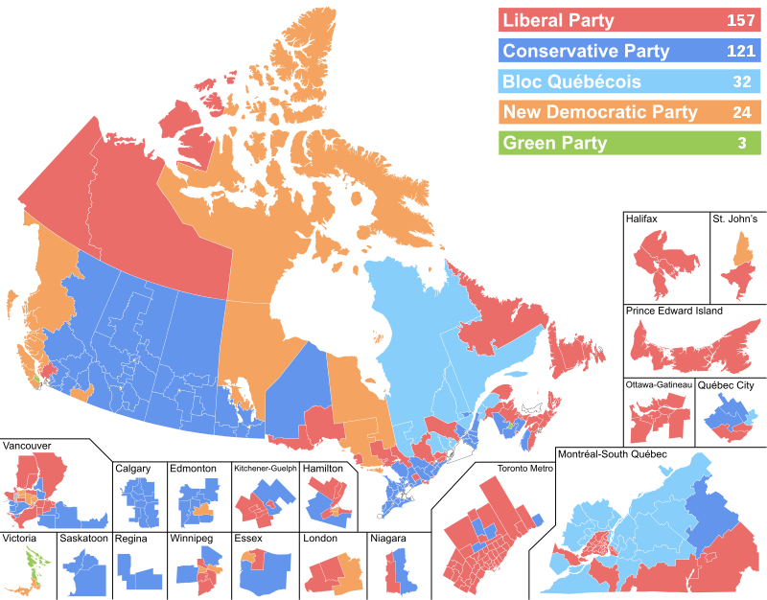
43rd Canadian Parliament – Electoral Results by Region
What do the results suggest about the support for political parties across Canada (and regionalism)?
Liberal – 157 (Red)
Conservative – 121 (Blue)
Bloc Quebecois – 32 (Aqua)
NDP – 24 (Orange)
Green Party – 3 (Green)
Independent – 1 (Gray)
What political party is strongest in cities?
What political party is strongest on the prairies?
What political party is strongest in Maritimes?
What political party is strongest in the north?
Are regions ‘alienated’ from each other?
Are people alienated from each other?

