Slide 1
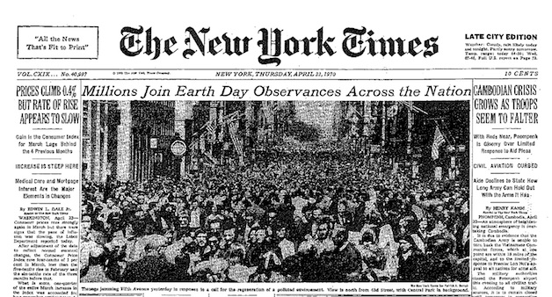
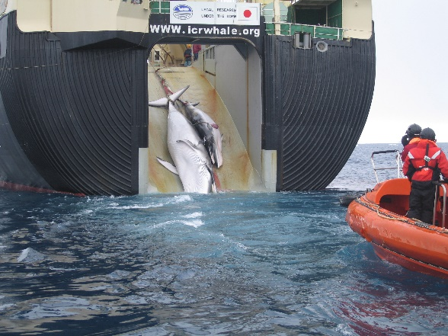
Environmentalism
What are the most pressing environmental issues of our age?
…..a distinct perspective based on the idea that humanity needs
to change its relationship to nature……there are fundamental
environmental problems…..a vision for a ‘sustainable’ world?
Are there limits to economic growth?
What is the ‘value’ of nature? Is it but a commodity?
Rise of Environmentalism
Silent Spring (1962) by Rachel Carson
science as evidence of environmental degradation (pesticides)
anti-capitalist movement of the 1960s…..protest movement
1970s - more focus on enviro problems, still not mainstream….
air pollution use of pesticides in agriculture
depletion of non-renewable resources extinction of plants and animals ozone depletion
1980s – Environment goes mainstream…
something changes…..
symbolism of Greenpeace activists risking there lives to protect whales was powerful
Exxon Valdes Oil Spill (1989)
the imagery is powerful - citizens question previously thought of environmental ethics….
the emergence of an ecocentric ethic…..goes beyond our view of nature as ‘extrinsic’
the idea of ‘sentiency’….the capacity to experience pain and pleasure….forests, for example?
…..thus, (some? all?) economic growth incompatible with environmental protection?
Is Environmentalism an ideology?
whaling

Slide 2
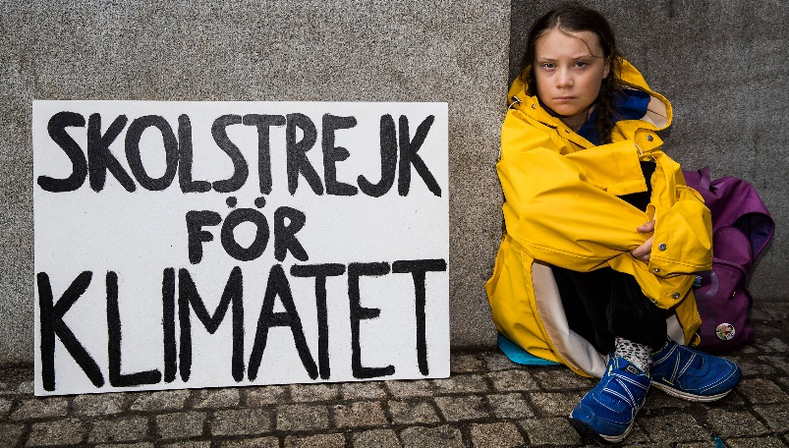
Environmentalism Is it necessary to establish an ecocentric ethic in order to protect the environment?
ex. should forests be protected? Why? – sinks for carbon dioxide? controls rise of temperatures…is intrinsic value relevant?
‘sustainable development’
‘meets the needs of the present generation w/o compromising the ability of future generations to meet their own needs’
World Commission of Environmental Development, 1987
Do you find this definition vague? Unhelpful? Why?
Ecological Moderation?
econ. growth need not depend on non-renewable resources (such as coal & gas)
production of environmental goods (solar panels, etc) can be a source of econ. growth
enviro damage is not cost-free economically…..strong econ. reasons to protect enviro?
Can environmental problems be solved within existing political structures?
Paris Climate Agreement (2015)
Int’l agreements are difficult enough to achieve in the existing state system, event though they are essential…..
Let’s not forget…..Rio de Janeiro (1992), Kyoto (1997), Copenhagen (2009)
none of the above conferences resulted a definitive agreement among developed and developing nations
Optimism existed and negotiations were different – nations set their own targets and money transferred to poor nations
US is now withdrawing from the Paris Agreement…Obama was supporter, Trump is not...does US involvement matter?
Who is likely to bring about change?
Which social class or grouping is more likely to bring about change?

Slide 3
Challenges to Traditional Ideologies…..
Feminism
Paradigm Shift?
gender roles?
work?
societal organization?
Patriarchy
system of power that has been dominated by men
decision-making
laws
agenda setting
history-making
gendering….
Do men and women learn gender roles or are differences inherited from nature?
Examples?
Results
women’s lives controlled by patriarchal system….
women suffer worse outcomes – wealth, employment, health, physical security
What does the word ‘feminism’ mean to you?
Basic goal of feminism?

Slide 4
Feminism
Are fundamental changes needed to improve the position of women in society?
Has feminism achieved its objectives?
a perspective that views society as patriarchal….and challenges traditional views held about women……
Liberal Feminism……also referred to as ‘first-wave’ feminism
late 19th century – mid 20th century
political, legal rights –
suffragette movement
marriage laws
equal rights = equal opportunities?
Economic rights –
closing the wage gap?
equal pay legislation
the focus by ‘first-wave’ feminists had been on increasing access and representation for women in the world as it was….
‘Radical’ Feminists/ Second Wave Feminists
Postwar (1960s)
problem is not merely ‘inequality’ – but the nature of the public realm itself – ‘patriarchal’ – as well as in family life
Its not ‘equality’ that women want, but ‘liberation’.......
The Feminine Mystique (1963)
The Female Eunuch (1970)
…the oppression of women through fundamental transformation of social institutions, values, relationships

Slide 5
Notes:
Poll Title: What from Adam Olsen's talk resonated most with you? https://www.polleverywhere.com/free_text_polls/LxBBIGiy5HeNoWm3M0vuE

Slide 6
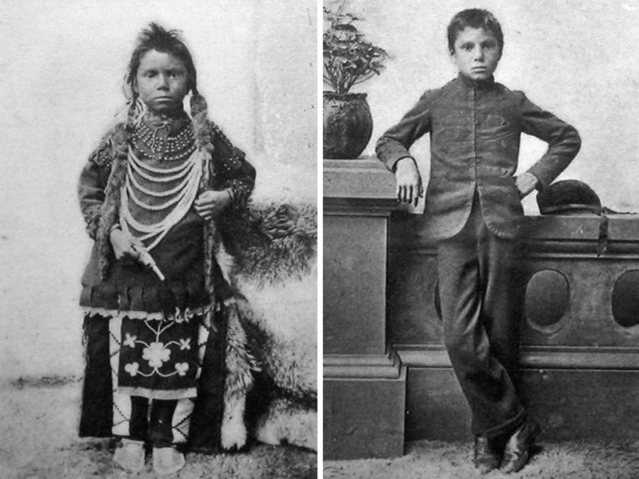
Indigenous Relations
‘Reconciliation?’
....reconciliation is about establishing and maintaining a mutually respectful relationship between Aboriginal and non-Aboriginal peoples in this country. In order for that to happen, there has to be awareness of the past, acknowledgment of the harm that has been inflicted, atonement for the causes, and action to change behaviour…. Truth and Reconciliation Commission, 2015
Indian Act, 1876
Residential Schools
United Nations Declaration of Rights of Indigenous Peoples (UNDRIP) (2007)
Major clauses and articles refer to:
rights of self-determination
rights of individuals and people to protect their culture through practices, languages, education, media, and religion
asserts peoples’ right to own type of governance and to econ development
health rights
protection of subgroups – ex. elderly, women and children
land rights from ownership (including reparation, or return of land) to environmental issues
For a closer look - UNDRIP
To suggest these were examples of assimilationist policies is incorrect……
…..such policies were designed to ‘kill the Indian’….
‘Thomas Moore’ before and after his entrance into Regina Indian Residential School, Saskatchewan 1874
BC NDP make UNDRIP law in Canada (2019)
BC is first jurisdiction in Canada to enshrine UNDRIP as law…..
Self-determination equates to self-government, but there remain complexities to these ideas…..
Example – Wet’su’we’ten Dispute

Slide 7
Notes:
Poll Title: What does the Wet'su'we'ten dispute signal about the current state of reconciliation efforts? https://www.polleverywhere.com/free_text_polls/g7ZtKJ9SUWUrl4MssRTFY

