Slide 1
Chapter 13 Blood

Slide 2
Introduction
Bloodstains are a key piece of evidence when investigating any type of violent crime.
Shape and location of blood provide clues about where victim and suspect were located when crime took place.
Blood also reveals presence of disease, drugs, or alcohol that can be used to determine the identify of the victim.

Slide 3
Bloodstain Patterns or Spatter
Blood can leave your body in many ways – drip, ooze, flow, gush, spurt.
Can divide into two main categories
Passive: depends upon the action of gravity alone
Oozes and drips
Projected – when a person or object applies force.
Aterial spurts, cast-off, impact

Slide 4
Information
Bloodstains can provide a lot of information:
Origin of bloodstains
Type of instrument that caused the bloodstains
Direction from which an object struck the victim
The relative position of the victim, assailant(s) and bystanders
The location and movement of the victim and assailant during the attack.
Number of blows or gunshots the victim received
Truthfulness of any suspects and witnesses.

Slide 5
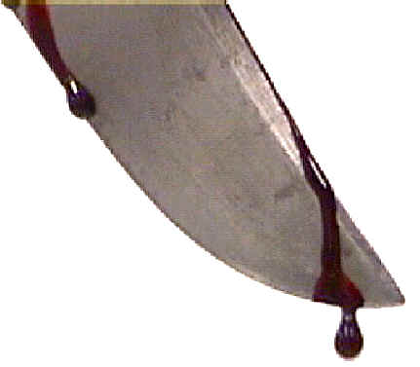
Passive Blood Spatter
Passive Bloodstains are drops created or formed by the force of gravity acting alone.
This category can be further subdivided to include;
Drops, Drip patterns, Pools

Slide 6
Passive Blood Spatter
Occurs when a falling drop of blood hits a surface.
The shape and size of the spatter pattern depends upon:
The size of the drop
How fast it is falling
At what angle it hits the surface
The kind of surface it hits

Slide 7
Passive Blood Spatter – Distance and Speed
The terminal velocity of a drop of blood is roughly 25 ft/sec.
Can reach this speed after falling 20-25 feet.
The diameter of a blood spatter will increase in size as the drop increases from 1in – 7ft.
Greater than 7ft and no change occurs.
Diameter can range from 13mm to 22mm

Slide 8
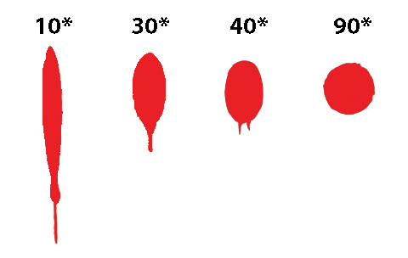
Passive Blood Spatter - Angle
90 degrees – spatter forms an even circle.
Less than 90 degrees – spatter becomes elongated, or oval in shape.
Will have a narrow or pointed end aiming in the drop’s direction of travel.

Slide 9
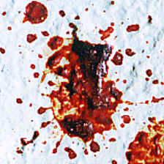
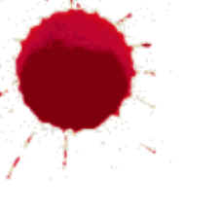
Passive Blood Spatter - Surface
Hard smooth surfaces like glass, tile, polished marble create small, cause little distortion.
Rough surfaces such as concrete or wood will cause greater distortion.

Slide 10
Projected Blood Spatter
Occurs when something other than gravity apples force to a blood source.
Naturally occurring: arterial bleeding, expirated blood (that which is expelled from lungs through exhaling)
External force: gunshot or blunt-force trauma, cast-off, etc.

Slide 11
Projected Blood Spatter – Point of Origin
Impact angle and directionality of spatter is determined.
Strings are attached at calculated angle.
The location or origin of the blood source (victim) is where the strings converge.

Slide 12
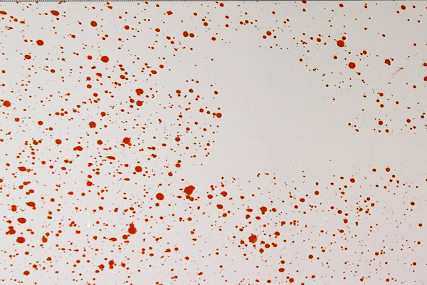
Projected Blood Spatter – Void Patterns
An absence of blood spatter where you’d otherwise expect to see them.
Void often suggests where the attacker stood.

Slide 13
Classifying Projected Spatters
Velocity
What was the velocity of the impacting object?
What was the velocity of the blood as it left the source?
Divides spatter into low, medium, and high velocity.
Type
Impact: when a foreign object impact the victim
Projection: caused by arterial bleeding, cast-off, or expirated blood.

Slide 14
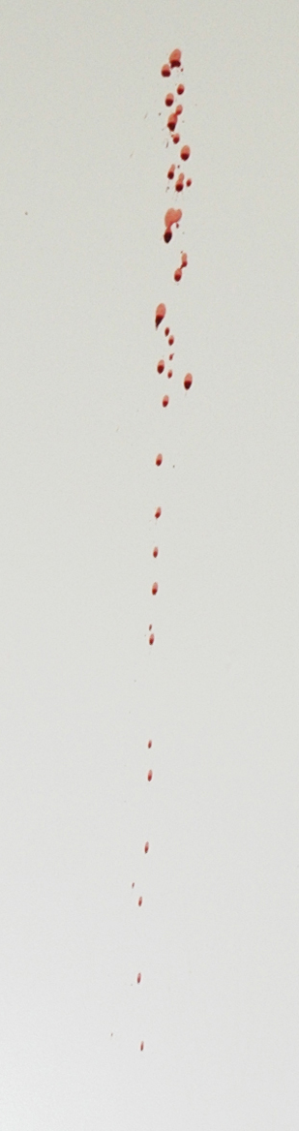
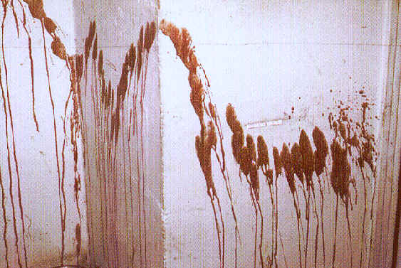
Low Velocity Blood Spatter
Object is moving at less than 5 ft/sec.
Results in fairly large spatter.
Arterial bleeding – blood that gushes or spurts from an artery
Castoff – blood that is flung form an object

Slide 15
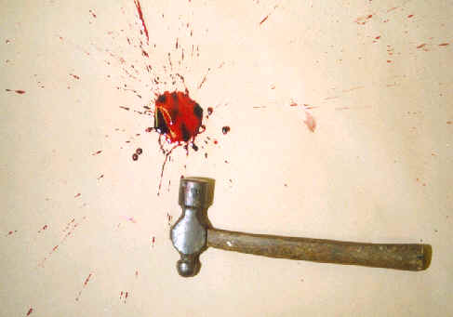
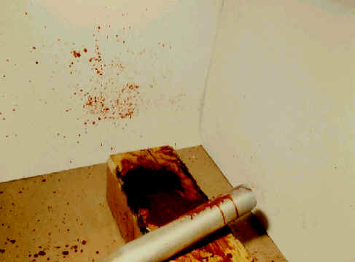
Medium Velocity Spatter
Object is moving between 5-100ft/sec
Smaller spatters – 1-4 mm in diameter
Blunt force trauma

Slide 16
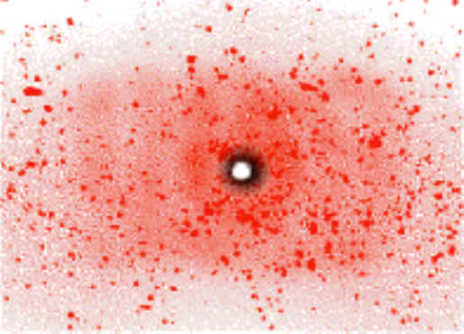
High Velocity Spatters
Object is moving faster than 100ft/sec
Spatter tends to be very small – less than 1mm
Gunshot wounds

Slide 17
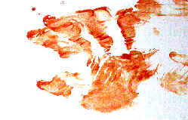
Transfer Patterns
When an object soaked in blood comes into contact with an unstained object.
Fingerprints, shoeprints,

Slide 18
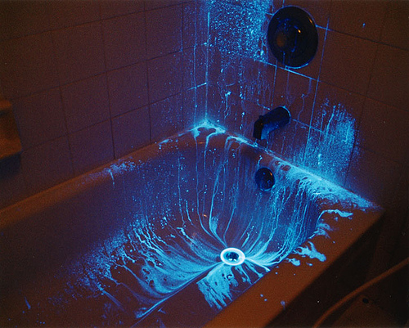
Revealing Latent Spatters
Luminol
Chemical the reacts with the hemoglobin in blood, and causes it to glow in a dark room.
Extremely sensitive: detects blood in concentrations as low as one per 5 million.

