Slide 1
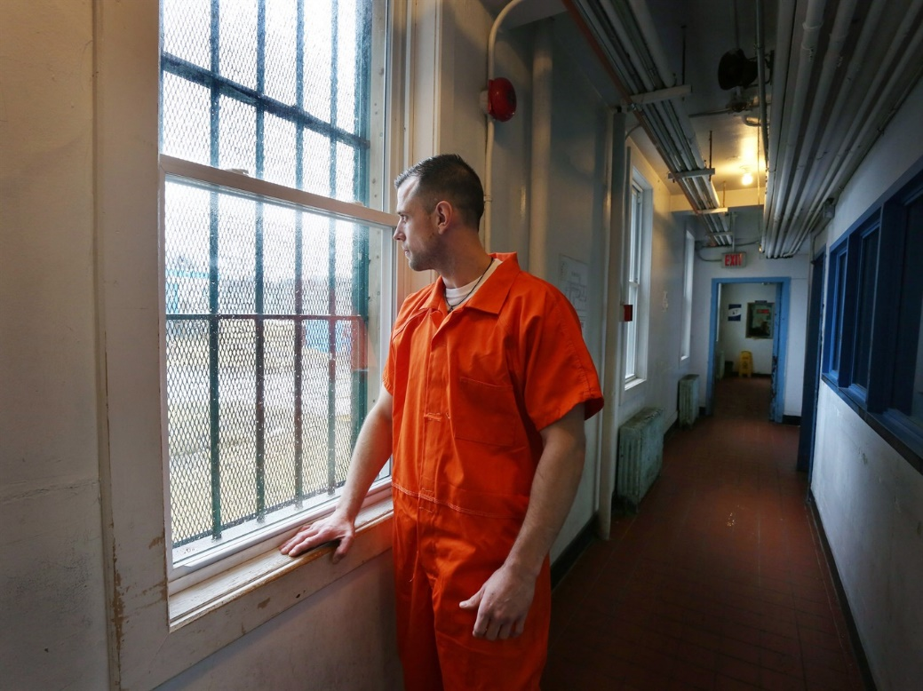
Correctional System
Sentencing What should be the purpose of sentencing?
specific deterrence?
general deterrence?
denunciation?
incapacitation?
reparation?
rehabilitation?
Judges must also:
consider aggravating and mitigating factors….
use comparable sentences for similar offenders committing similar crimes
use alternatives to incarceration if at all possible…..
how might unwarranted sentencing disparity occur?
systematic factors?
unsystematic factors?
Sentencing Options?
absolute or conditional discharge?
probation?
restitution? ….property damage? financial loss?
fines and community service?
conditional sentence …….ex. treatment for substance abuse, curfews and/or community service….
imprisonment
fundamental to sentencing is that it be proportionate to the gravity of the offence and the degree of responsibility of the offender
Debate – deterrence v. rehabilitation?
Do ‘get tough’ strategies reduce crime?
Can rehabilitative efforts reduce crime?
Inmate Kevin Roberts is shown at Her Majesty's Penitentiary in St. John's, N.L. on Tuesday, March 29, 2016.

Slide 2
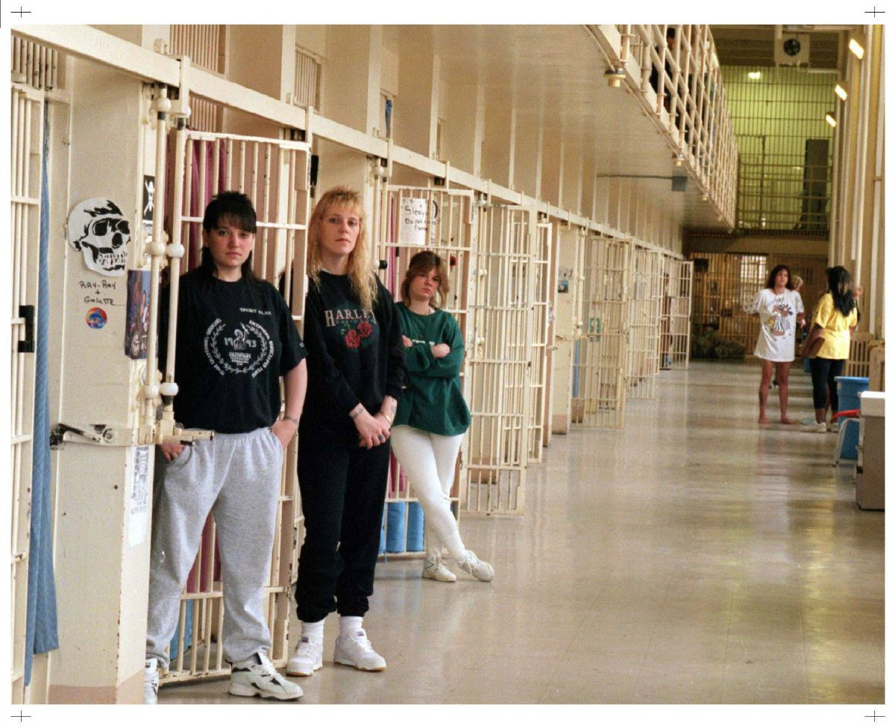
Correctional System
Dangerous Offenders Are some criminals beyond rehabilitation? Approaches?
requires a determination of ‘dangerousness
can result in a term of indefinite imprisonment
Long Term Offender
sentence of 2+ years is appropriate
risk of re-offending
possibility of eventual control of risk
Effects of Punishment?
recidivism? What works in offender treatment?
Need Principle?
Risk Principle?
Responsivity Principle?
Parole?
conditional release into community?
rehabilitation?
a high degree of supervision?
return to prison if conditions are breached?
Who decides?
Risk Assessment?
criminal history?
mental health?
performance on earlier releases
Myths?
parole reduces sentence crime?
automatically granted when inmates become eligible
parole is granted if remorse is shown….
offenders released on parole frequently re-offend….
victims do not play a role in parole….
information from victims
institutional behaviour
feasibility
Conditions of Parole?

Slide 3
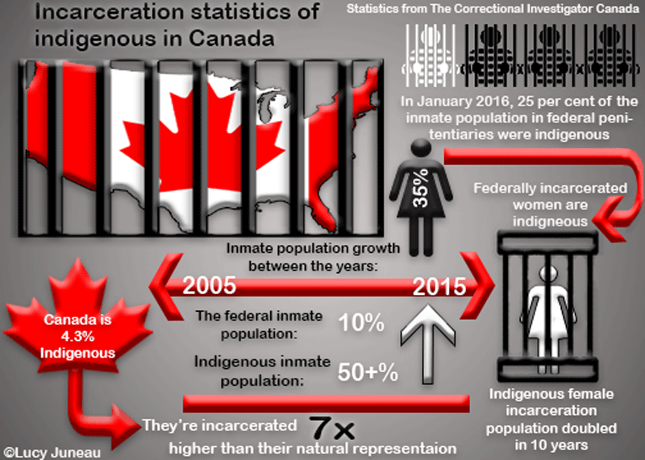
Prison Populations in Canada
Stats:
70% of federal inmates have unstable work history…
80% have a serious substance abuse issue….
50% of female inmates have diagnosed mental health illness
40% of male inmates have similar diagnoses
60% have a history of violence
Aboriginal Inmates approx. 4% of population to 25% of prison pop
Disproportionate representation in Canadian institutions….
Why?
Female Inmates
Not a significant proportion of inmate population (7-8%)
Low numbers tends to see fewer programs/ resources, however…..
most likely to be a single parent….
in need of more health care
again, aboriginal women overrepresented….
history of abuse….less educated/fewer skills/higher poverty
mental health issues…..self-harm (25% have engaged in self-harming behaviour)
The Problem?
reluctance of governments to reform sentencing and prison system – why?

