Slide 1
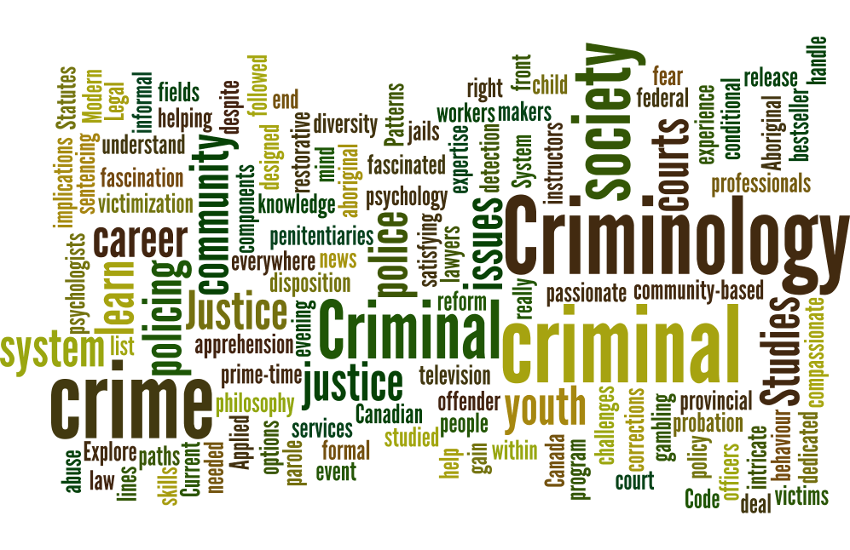
Criminology?
a multidisciplinary field – it draws on a variety of subject areas –
a scientific study of ‘crime’ and the ‘criminal justice system’?
Criminology:
the study of causes of crime and types of criminal activity
the study of statistics, patterns of crime and victimization
the study of law – in historical and contemporary contexts
the study of theories of crime causation
involves the investigation of deviant to criminal behaviours
assessing laws and other measures of social control….
the study of criminal justice policy
involves the examination of agencies; such as….
the police – the courts – correctional services, particularly
in how they respond to criminal behaviours, prevent crime,
protect society, punish or treat criminal offenders….
involves the study of particular groups of Canadians, for example,
indigenous peoples, with the criminal justice system.
this list is not exhaustive…..
***Although study of crime and the search for the causes of criminality are centuries old, it is only in the last 50 years that the field of ‘criminology’ has emerged in Canada. Criminology is defined by what it studies – ‘crime.’ Thus, it is diverse in its scope.
Law Sociology
Economics Anthropology …..and more!
History Archaeology
Psychology Geography

Slide 2
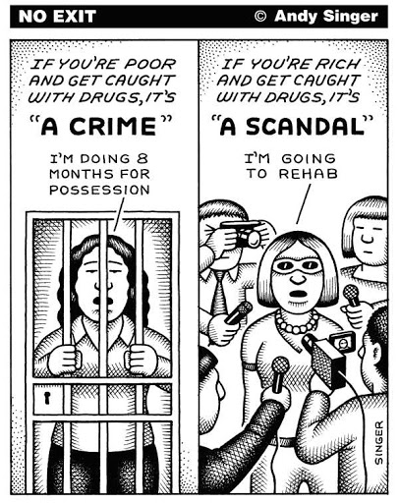
What is Crime?
how do we define crime?
what are some specific criteria that must be met in order for an action to be ‘criminal?’
a complex concept?
‘an action or an instance of negligence that is deemed injurious to the public
welfare or morals or to the interests of the state and that is legally prohibited’
Random House Dictionary (1993)
A crime occurs when a person (or persons):
commits an act, or fails to act when under a legal responsibility to do so;
has the ‘intent’ to commit the act;
does not have a legal defense or justification for committing the act;
violates a provision of the criminal law.
the ‘Rule of Law’ …..why bother?
A principle of justice stating that the law is:
necessary to regulate society,
that law applies equally to everyone,
and that people are not governed by arbitrary power.
A system of law – the following are pillars of the Canadian justice system…..
establishes rules of conduct…
provides a system of enforcement…
protects rights and freedoms….
protects the individual and society….
resolves disputes…

Slide 3
Defining Deviance and Crime
Deviance: Behaviour which does not conform to society’s norms and values.
Crime: An illegal act, or an omission of an act, or state of being that is punishable by law.
Some acts can be both deviant and criminal….
Is deviance always illegal?
Is crime always deviant?
Whether an action is criminal or deviant depends on:
Time
Place
Situation
Culture
Deviance and Social Context
Variation in the very definition of ‘deviant behaviour’
between age groups
Economic/ Social status
between sexes (male/female)
Setting is important
Change of values/norms over time

Slide 4
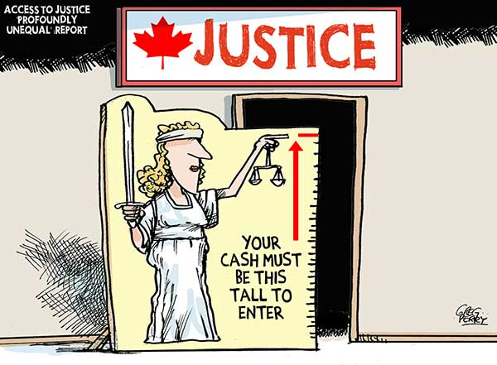
Criminal Law
a set of rules legislated by the state in the name of society, enforced by the state through threat or application of punishment
Four Characteristics of Criminal Law
a political process?
what are problems with legislating (and regulating) moral standards?
consensus and conflict approaches – who benefits from existence and enforcement of law?
specificity
criminal law has two major objectives….. crime control and the preservation of due process
prohibited acts must be clearly specified, so to must the punishment
uniformity
equality? but, equity?
penal sanctions
the severity of the punishment reflects the seriousness of the crime?
what’s important? retribution?
rehabilitation?
restitution?

Slide 5
Elements of a Crime
Actus Reus Mens Rea
+ = Crime
‘the guilty act’ – demonstrates a voluntary action, omission, or state of being is that prohibited by law
‘the guilty mind’ – demonstrates that the act was intentional, knowing, negligent, reckless, or willfully blind
Intent:
a state of mind in which someone desires to carry out a wrongful action, knows what the results will be, and is reckless regarding the consequences.
general intent: the desire to commit a wrongful act, with no ulterior motive/ purpose
specific intent: the desire to commit one wrongful act for the sake of accomplishing another
Note that intent is not the same as motive. Intent involves the anticipated direct outcome of an act, in the specific and general sense. Motive on the other hand, is the underlying rationale (reason) for committing a crime. While a motive may be useful evidence in a trial, it is not one of the elements of the offence that the Crown must prove in order to convict the accused.

Slide 6
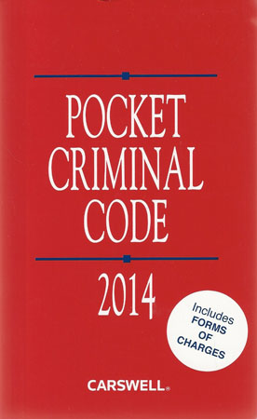
Criminal Code of Canada
Section 91 (27) Constitution Act, 1867
1892 – Criminal Code of Canada enacted.
1955 – Reduced from 1100 sections to 753
1986 – Revised draft to make less complicated
Parliament failed to implement revisions
A federal statute that contains the majority of the criminal laws passed by Parliament.
The Criminal Code lists not only the offences, but also the sentences to be imposed and the procedures to follow when trying those accused of crimes.
The Code is meant to reflect the social values of the majority of Canadians.
Parliament may amend the Code to reflect the change in values or to ensure the protection of Canadian society. More often, however, the Courts (the Sup. Court) have struck down laws that infringe on Charter Rights of Canadians…..
this is a contentious issue, some argue ‘political,’ and that ‘judicial activism’ has taken precedence over the role parliamentarians should serve vis-à-vis the law
but – politicians would rather not deal with contentious issues – why?
Canadian Criminal Code:
http://laws-lois.justice.gc.ca/eng/acts/C-46/

Slide 7
Summary Conviction vs. Indictable Offences
Summary Conviction Offence:
a minor criminal offence with less severe punishments, which is usually tried soon after the charge is laid (summarily) without a preliminary hearing or jury
Ex. heckling or bullying; soliciting prostitution; causing a public disturbance; speeding ticket
there is a 6 month limitation period for laying a charge for a summary conviction offence
Indictable Offence:
a serious offence with a severe penalty, proceeding by way of a formal court document called an indictment. the Criminal Code sets a maximum penalty for each offence.
Ex. robbery, murder, breaking and entering, assault,
there is no statute of limitations (time limit) for laying a charge of an indictable offence
For serious indictable offences, the accused can choose whether to be tried by a prov. Court judge alone, by a judge of the superior court of the province or territory alone, or by a judge of the higher court with a jury.
Hybrid Offence:
a criminal offence proceeding by way of a summary conviction or an indictable offence; the Crown decides which way to proceed. the Crown often bases its decision on the previous record of the accused.
Ex. impaired driving, assault, public mischief, and theft under $5000
penalties vary…..from two years imprisonment to 10 years

Slide 8
Criminal Code of Canada: Selected Sections
Criminal Negligence
219 (1) Every one is criminally negligent who
(a) in doing anything, or
(b) in omitting to do anything that it is his duty to do,
shows wanton or reckless disregard for the lives or safety of other persons.
(2) For the purposes of this section, duty means a duty imposed by law.
220 Every person who by criminal negligence causes death to another person is guilty of an indictable offence and liable
(a) where a firearm is used in the commission of the offence, to imprisonment for life and to a minimum
punishment of imprisonment for a term of four years; and
(b) in any other case, to imprisonment for life.
221 Every person who by criminal negligence causes bodily harm to another person is guilty of
(a) an indictable offence and liable to imprisonment for a term of not more than 10 years; or
(b) an offence punishable on summary conviction.
Identify:
Mens Rea (intent/knowledge/recklessness)
Actus Reus (action/omission/state of being)
Punishment

Slide 9
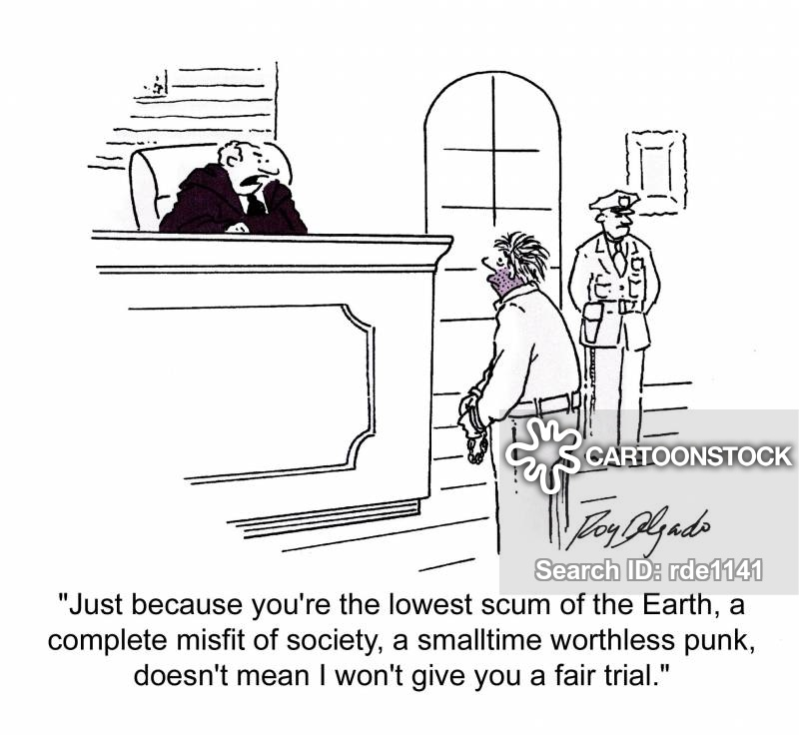
Criminal Defenses
Alibi
Self-Defense
Legal Duty
Excusable Conduct
Mental Disorder
Intoxication
Automatism
Consent
Entrapment
Mistake of Fact
Double Jeopardy
Criminal Defense Lawyer?
What are unique challenges to being a defense lawyer?
What role do defense attorneys play in the legal system?
Should individuals have the right to represent themselves?

Slide 10
Defenses: Alibi ‘Elsewhere’
the best possible defense
must be offered as early as possible to maintain credibility
offers an explanation as to whereabouts of the accused at the time of the offense
there is no onus on accused to prove an alibi
if it is believed by jury, accused is not guilty
even if jury doesn’t believe evidence, if a reasonable doubt exists – ‘not guilty’
when alibi is falsely given (proven), this amounts to a consciousness of guilt
Defenses: Self-Defense
may defend: yourself, those under your protection, movable and real property, home
force must be ‘necessary’
force must be ‘reasonable’
Section 35 – Defense of Property?
Section 43 – Correction of Child by Force? ……Does this protect Mr. Campbell from use of force with student?

Slide 11
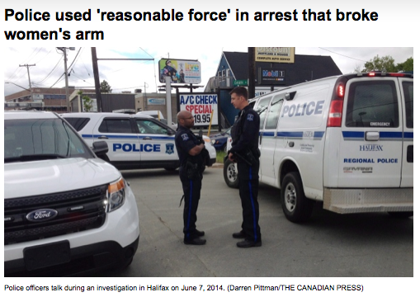
Defenses: Legal Duty
certain people, by virtue of their profession, in certain situations….
police officers – speeding, force in arresting…..
Is the guilty verdict for George Floyd’s murder a turning point?
Defenses: Duress or Provocation
provocation
would a ‘reasonable person’ lose self-control?
R v. Morgentaler:
‘urgent situations of clear and imminent peril when compliance with the law is demonstrably impossible.’
honest mistake?
but not ignorance of law….

Slide 12
Defenses: Mental Disorder
Section 2 of Criminal Code – Interpretations
fitness to stand trial?
forensic psychiatry?
understanding proceedings?
understanding consequences of proceeding
communicating with counsel
fitness at time of offense? Vincent Li
Defenses: Intoxication
General v. Specific Intent Offences
limitations, especially in sexual offense cases – why?
recall, intoxication itself can be an offense (in public, while driving, etc…)

Slide 13
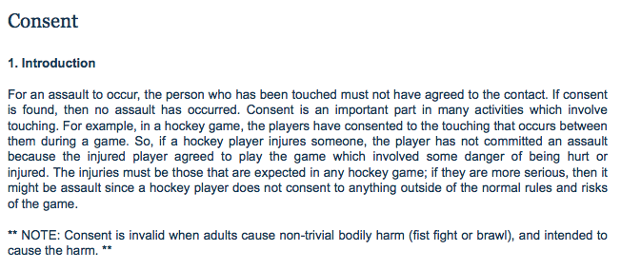
Defenses: Automatism R. v. Parks – Sleepwalking case
‘unconscious, involuntary behaviour….the state of a person who, though capable of action, is not conscious of what he is doing.
element of consciousness… where else do we see this?
sleepwalking, convulsions, psychological stress… cases?
Defenses: Consent
used in assault cases (professional sports), some sexual offenses….
may never be used for firearms, murder or sexual offenses under the age of consent….
Jian Ghomeshi case
this case highlighted the challenges of having sexual assault victims take the stand in such an adversarial setting.
Ghomeshi was found not guilty
Critics suggest that this case demonstrates that our court system does not acknowledge the unique circumstances involved in sexual assault victims claims…

Slide 14
Defenses: Entrapment
CBC – Fifth Estate ‘Mr. Big’ Stings….
abuse of police power
not a true defense; results in a stay of proceedings….
Defenses: Mistake of Fact
New Brunswick Python Case
generally, ignorance of the law not acceptable – why?
Mistake of Fact accepted if:
genuine and not a result of neglect
law states this defense is acceptable
counterfeit money?
possession of stolen goods?

Slide 15
Defenses: Double Jeopardy
Charter of Rights and Freedoms – Section 11
is a procedural defense that forbids a defendant from being tried
again on the same (or similar) charges following a legitimate
acquittal or conviction.
Two Options:
Nature of protection afforded by section 11 of Charter:
‘autrefois acquit’
a defendant's plea stating that he or she has already been tried for
and acquitted of the same offense
‘autrefois convict’
a defendant's plea stating that he or she has already been tried for
and convicted of the same offense
Alex Trebek has nothing to do with this type of criminal defense, but we miss him…

Slide 16
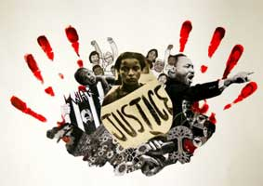
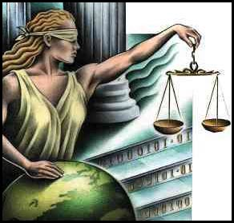
Foundational Principles of Canadian Justice System
What does ‘justice’ look like?
How do we define ‘justice?’ And for whom is justice being served?
Everyone is Innocent Until Proven Guilty
the justice system treats everyone equally (but does it, really?)
there is a standard in assessing an accused’s behaviour
Everyone is Legally Accountable
Case Study Selections?
Checks and Balances
Sovereignty
these two principles are focused on the functions of government and governance….
Notes:
On Justice – Everyone knows what the law is not the same thing as ‘justice.’ Is the law fair? Justice is an elusive word…..’the point of view on a particular issue that I hold myself,’ as in what is fair to oneself, or party? It’s a bit like finding the ‘truth. Or, is it ‘righteousness,’ ‘equitableness,’ or moral rightness?’ how is it upheld?

Slide 17
Assignment – Case Study Review What is Justice?
Learning Outcomes
to gain experience assessing and analyzing issues through a legal or justice focused lens
to formulate and identify personal conceptions of ‘justice’ and the ‘rule of law’
Case Profiles:
R. v. Latimer, 2001 .....Saskatchewan farmer convicted of murdering his disabled daughter – mercy killing?
R. v. Morgentaler, 1988 ……the case that struck down abortion laws in Canada – women’s right to security of person
R v. Hart, 2014 .......Hart’s conviction for murder of his twin daughters (drowning) overturned – entrapment?
R. v. Li, 2009 .....Li killed Tim McLean aboard a bus in 2008 – insanity plea?
R v. Daviault, 1994 ….self-intoxication case involving sexual assault by Daviault of a woman – automatism like state?
R v Ghomeshi, 2016 …..popular CBC radio host argued ‘consent’ in face of sexual assaults by women
Go to my website: www.campbellswebsoup.weebly.com and review the articles that outline the issues. What interests you?
These cases are controversial in that there is some dispute as to what ‘justice’ is being served - how, then, do we define justice?
On Justice – Everyone knows what the law is not the same thing as ‘justice.’ Is the law fair? Justice is an elusive word…..’the point of view on a particular issue that I hold myself,’ as in what is fair to oneself, or party? It’s a bit like finding the ‘truth. Or, is it ‘righteousness,’ ‘equitableness,’ or moral rightness?’ how is it upheld?

Slide 18
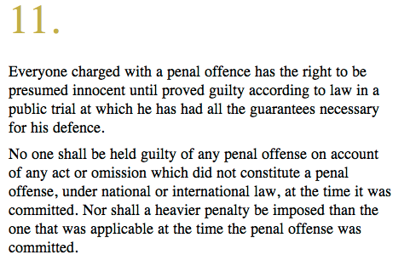
Principles of Justice
Innocent Until Proven Guilty
What does it mean?
Why is it important?
How is it challenged or compromised?
The Charter of Rights and Freedoms
Why do human rights and freedoms matter?
habeas corpus?
the right to challenge being ‘detained’ – brought before a court
Ghomeshi case?
clearly, viewed as guilty in the arena of public opinion, but not so in a court of law
Does it matter?

Slide 19
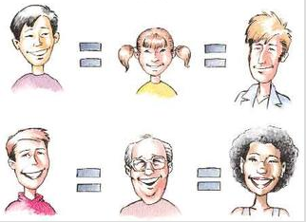
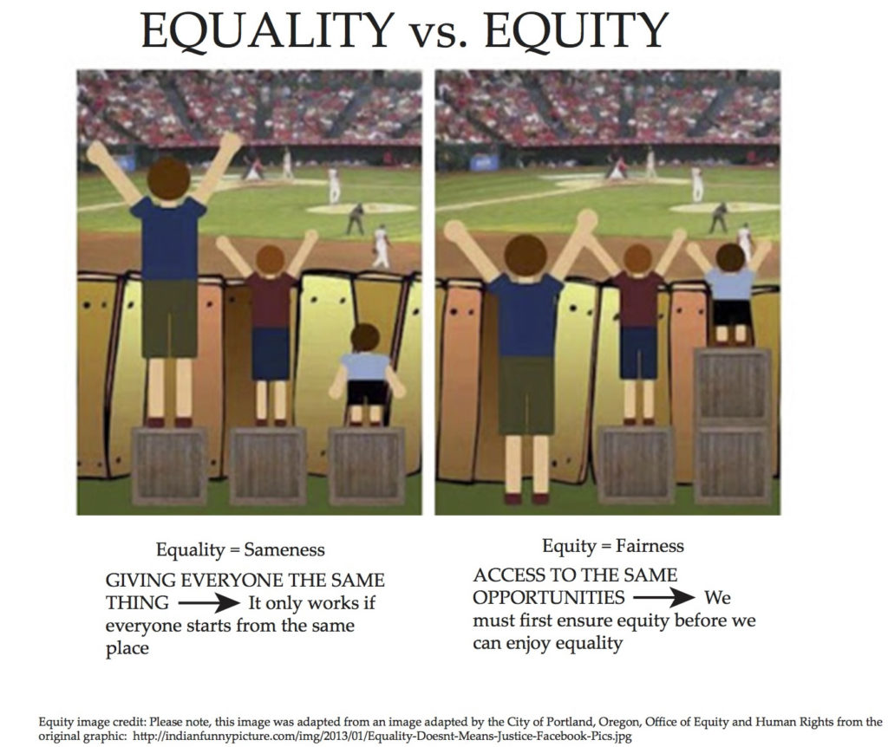
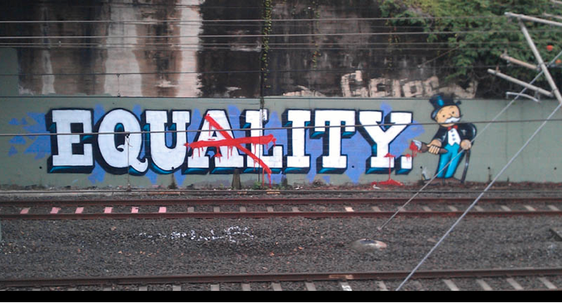
Principles of Justice
The justice system is based on the idea that everyone is Equality (if not, equity?)
What does it mean?
Why is it important
How is it challenged or compromised?
Charter of Rights and Freedoms
Section 15. Every individual is equal before and under the law and has the right to the equal protection and equal benefit of the law without discrimination and, in particular, without discrimination based on race, national or ethnic origin, colour, religion, sex, age or mental or physical disability.
Li case?
Hart case?
Can this principle be applied to the accused in these cases? Yes?

Slide 20
Principles of Justice
There are standards in assessing an accused’s behaviour….
What does it mean?
Why is it important?
How is it challenged or compromised?
Is criminal law objectively or subjectively based? ……a little of both, actually!
‘subjective standard’ requires the prosecutor to prove, beyond a reasonable doubt, that an accused intended his or her actions.
‘objective standard’ requires the prosecutor to prove, beyond a reasonable doubt, that a reasonable person would not have acted as the accused did in the circumstances of the case.
case example – Latimer?
So….
It is easier for a prosecutor to prove a standard of ‘reasonableness’ than it is to prove a particular accused’s awareness of what that is – make sense?
but, indictable offences carry maximum sentences…..life in prison?
The objective standard is harsh and can result in a conviction of a person, who due to personal frailties and inabilities, could never come up to the standard of a reasonable person. These individuals may be viewed as morally innocent as they do not have the intention to commit the prohibited act.
Could the Latimer example be such a case?
The Hart case?
The Li case?
Daviault case?

Slide 21
Principles of Justice
Accountability
What does it mean?
Why is it important?
How is it challenged or compromised?
“A body of men holding themselves accountable to nobody ought not to be trusted by anybody.” ― Thomas Paine
It is wrong and immoral to seek to escape the consequences of one's acts.” ― Mahatma Gandhi
Li case?
Hart case?
Ghomeshi case?
Latimer case?
Daviault case?
International Law Example
“In our tribunal, we look only at personal criminal responsibility in a very tightly defined, narrow way and we demand proof beyond a reasonable doubt about the involvement of the individual. We do no have a mandate to establish the moral responsibility of those who saw things happen and did nothing, including people who might have had the capacity to stop the process and did nothing. But we have to be careful in thinking that just because we focus on individual criminal guilt we therefore absolve the community. The old distinctions are too simplistic when we move up the chain of command and witness the merging of the collectivity into the personae of these charismatic political and military leaders.‘
Louise Arbour, Chief Prosecutor for International Criminal Tribunal for the Former Yugoslavia”

Slide 22
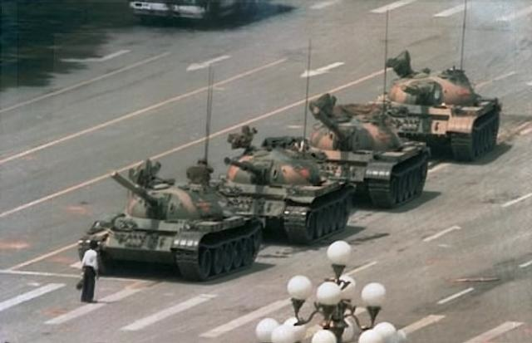
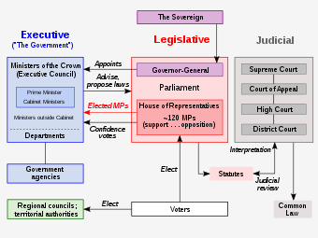
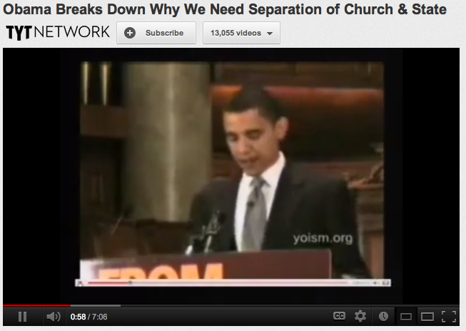
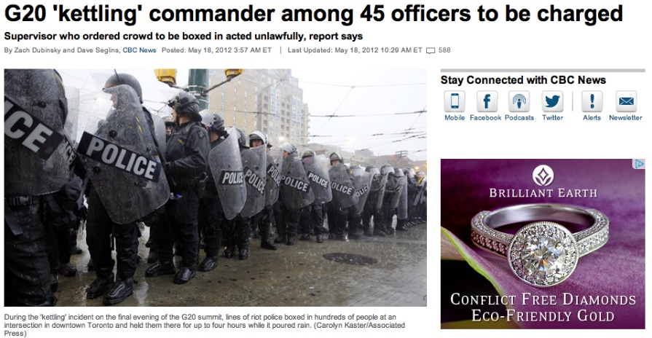
Principles of Justice
Checks and Balances
What does it mean?
Why is it important?
How is it challenged or compromised?
Checks and balances, a principle of government which separate branches are empowered to prevent actions by other branches and are induced to share power. Checks and balances are applied primarily to constitutional governments – Canada, the USA, Britain, France – where the rule of law is clearly outlined.
‘separation of powers?’
Does Trump know this?

Slide 23
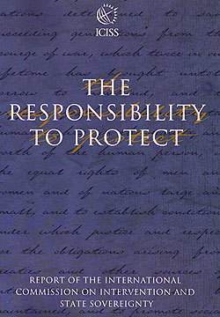
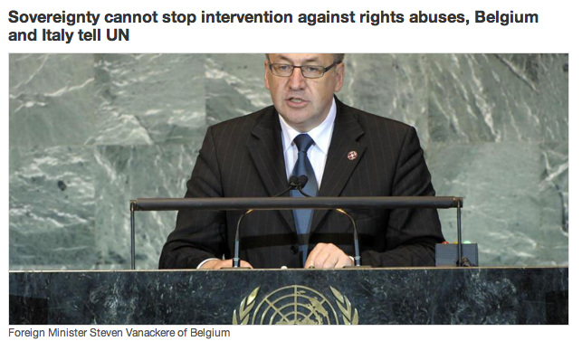
Principles of Justice
Sovereignty
What dos it mean?
Why is it important?
How is it challenged or compromised?

Slide 24
Principles of Justice

