Slide 1
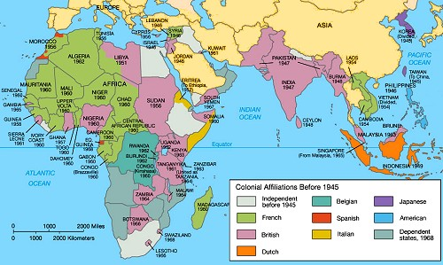
Decolonization

Slide 2
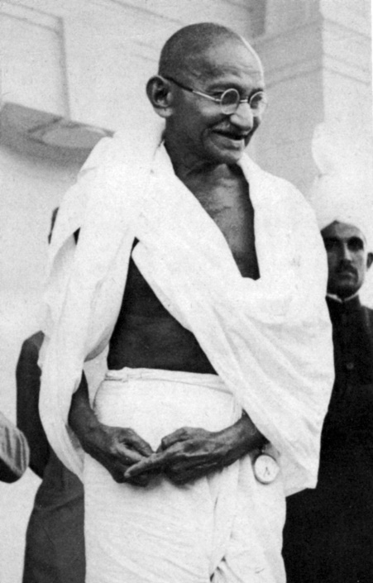
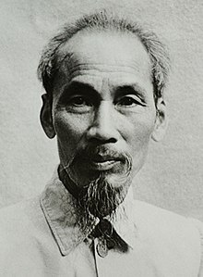
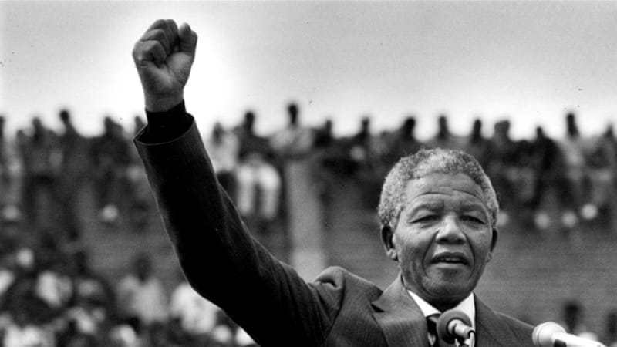
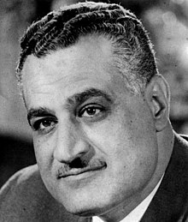
Decolonization
After WWII – two Dominant themes in 20th Century History Emerge…..sometimes intertwined
the Cold War – conflict and competition between USA and USSR (and allies of each…)
Based on:
Ideology – capitalism (democracy?) v. communism
spheres of influence – where one nation has a level of cultural,
political, economic and/or military exclusivity
over another nation...in terms of a ‘superpower’
II. Decolonization* – the dismantling of colonialism and imperial control of lesser nations
History of Colonialism
Imperialism – from 15th Century to early 20th Century, a policy
European nations embraced and which involved
extending their rule over regions inhabited by
indigenous populations, usually by force or by
gaining political and economic control of a region
Self-Determination
the free choice of a people of a region to determine
their own political future – a right to a nation-state?
first proposed by US Pres. Woodrow Wilson at Paris
Peace Conference, 1919 – but not granted by European
nations at that time – still engaged in ‘colonialism’
*Disclaimer – I find John Green really annoying, but his overview is the best I could find….
Mahatma Gandhi (India)
Ho Chi Minh (Vietnam)
Nelson Mandela (S. Africa)
Gamal Nasser (Egypt)

Slide 3
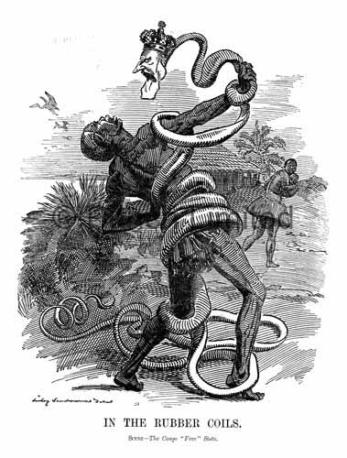
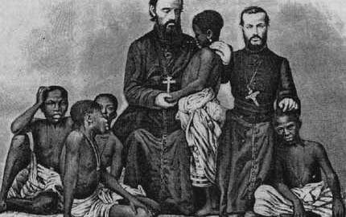
Imperialism
Imperialism – the takeover of a region by a great power (think: European context), spurred on by the following factors…..
a desire to exploit (take advantage of) natural resources
ethnocentricity (or Eurocentrism)
the belief that Europeans, their culture or ethnicity, was superior to all others
‘White Man’s Burden’ – in keeping with ethnocentric (Eurocentric) ideals…..
the ‘missionary’ prevails…..indigenous inhabitants defined as ‘savages’
the ‘savage’ had to be ‘civilized’ and this was the responsibility of missionaries
just as Europeans were exploiting regions in all corners of the world for resources,
they also desired markets across the globes for manufactured goods produced in Europe
the philosophy of imperialism amounted to – ‘Civilization, Christianity and Commerce’
Colonial Domination
colonialism led to breakdown of traditional values….
ideas related to identity and nation among indigenous populations replaced with European concepts….these were imposed by means of missions, schools, courts, governing structures, businesses and so on….imperial powers came to control all aspects of life in their colonies…
some indigenous peoples, impressed by the wealth and power of Europeans, rejected their traditional lifestyles in favour of European (Western) ways….sometimes with devastating consequences, as in the Atlantic (African) Slave Trade….
Satirical cartoon (Punch, 1906) – Belgian Congo

Slide 4
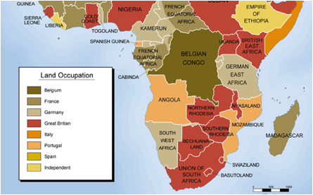
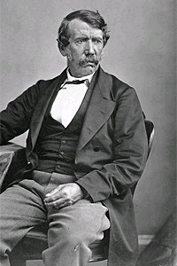
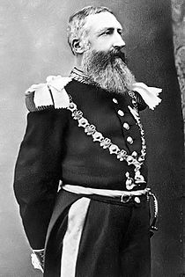
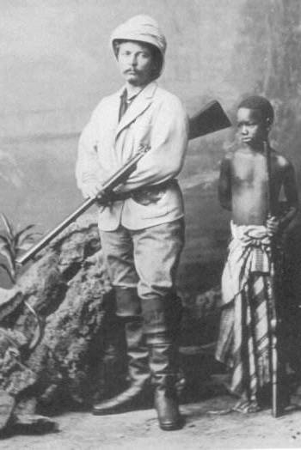
the Belgian Congo – A Case Study of Colonialism?
King Leopold II of Belgian – ‘Scramble for Africa’
Leopold hires Henry Stanley, American explorer and missionary,
to survey the Congo River and its course. He hires Stanley as a
result of Stanley’s much publicized search for David Livingstone,
an English missionary and explorer. Stanley a suspicious character.
Stanley signs ‘treaties’ with over 450 native chiefs in the Congo
Leopold gained rule of these lands ‘given up’ by the chiefs
Were they treaties or agreements?
Did the local chiefs really ‘give up’ their title to the land??
In 1885, after the Berlin Conference, Leopold was given personal rule over the newly declared Congo Free State
European powers recognized his hold over Congo
Patterns of Takeover
In many cases Europeans managed to secure colonial acquisitions by forging alliances with local rulers.
Europeans would promise to sustain the local ruler against his enemies in exchange for a degree of control and supply of labour (the slave trade is built on this model)
Livingstone King Leopold II Stanley

Slide 5
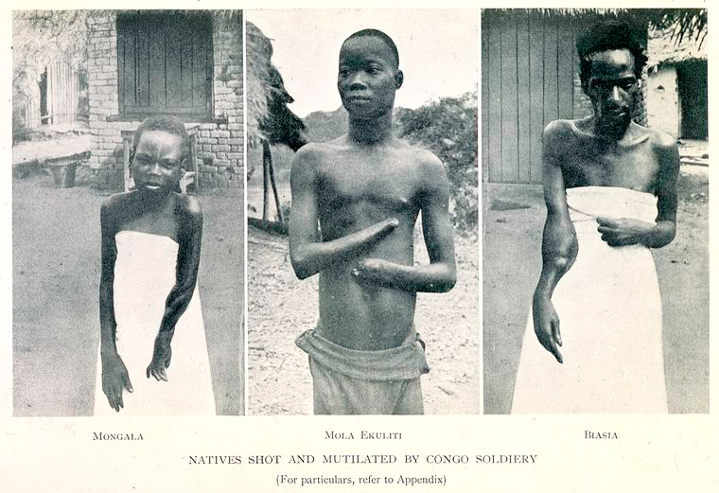
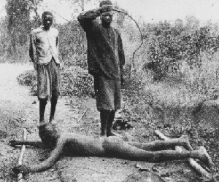
the Belgian Congo (1908-1960)
King Leopold’s Ghost
1885 – Berlin Conference
Leopold granted ‘Congo Free State’
to control the land of the Congo, Leopold establishes the
International Association of the Congo, a private company
……very similar to the Hudson Bay Company of Canada….
Ivory and rubber were main exports
Slave labour controlled by Leopold’s agents
Elephant depleted to virtual extinction
Pneumatic tires increase demand for rubber
gold, diamond mining becomes lucrative….
Est. 10 million natives of the Congo die as a result
Families kidnapped to force people to harvest rubber
Belgians were known to cut peoples hands as punishment…
1908 - the Congo was surrendered by Leopold to Belgium
‘Belgian Congo’
the worst abuses were eliminated, but the Belgians
still desired copper, oil, diamonds and other minerals
Congolese peoples began to demand self rule….

Slide 6
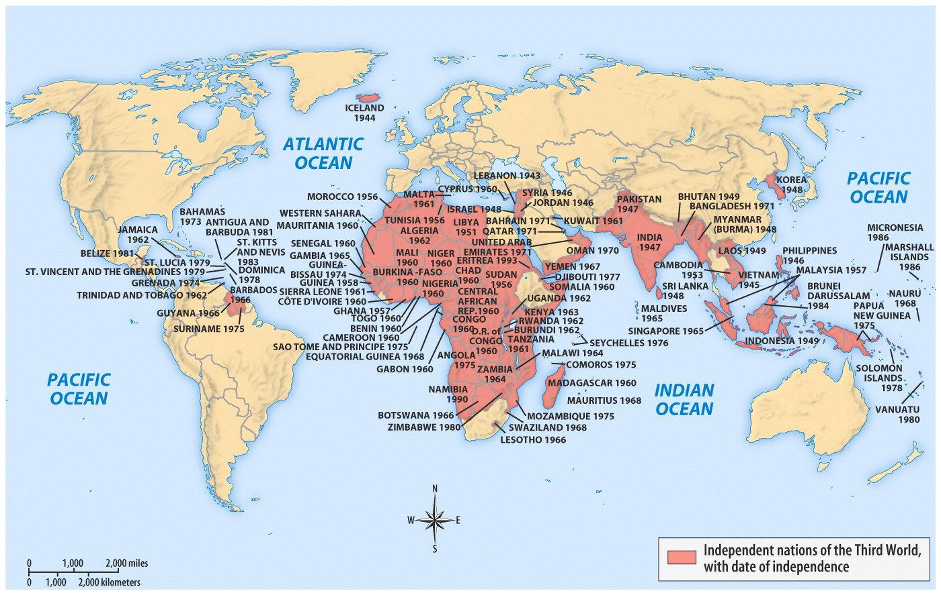
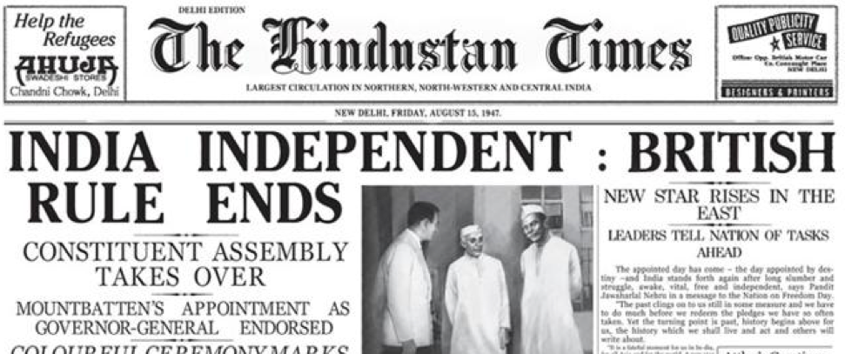
Decolonization and Nationalism
‘Nationalism’
a powerful force in colonies around the world postwar (WWII)
pride in one’s culture, ethnicity, language and a collective identity
but – how do ‘nations’ achieve independence from colonial masters?
also – why were imperialist nations (ex. Britain) willing to let go?
Europe was impoverished after WWII (both wars, actually…)
increased political and racial consciousness in colonies
this consciousness leads to a realization of the economic exploitation nationalists in the colonies see across society…
So, how do ‘nations’ achieve independence from their colonial masters?
Violence
by means of rebellion and/or revolution….guerilla warfare?
occurs where democratic institutions are non-existent
and whereby ‘state violence’ by colonial masters exists….
once successful, state violence can be institutionalized…
Civil Disobedience
resistance by means of public demonstrations; law breaking
‘meeting physical force with moral force’ – Ex. Gandhi
Transfer of Power to ‘friendly’ Local Elites
these new governments were seen as ‘collaborators’ of the colonial power. Many are overthrown by Nationalists….
in many cases, the colonial power still exerted control over new governments – economics and thru local elites.
Nationalist ‘coup d'états’ often occur as a result…..what follows is the entrenchment of dictators – Ex. Idi Amin

Slide 7
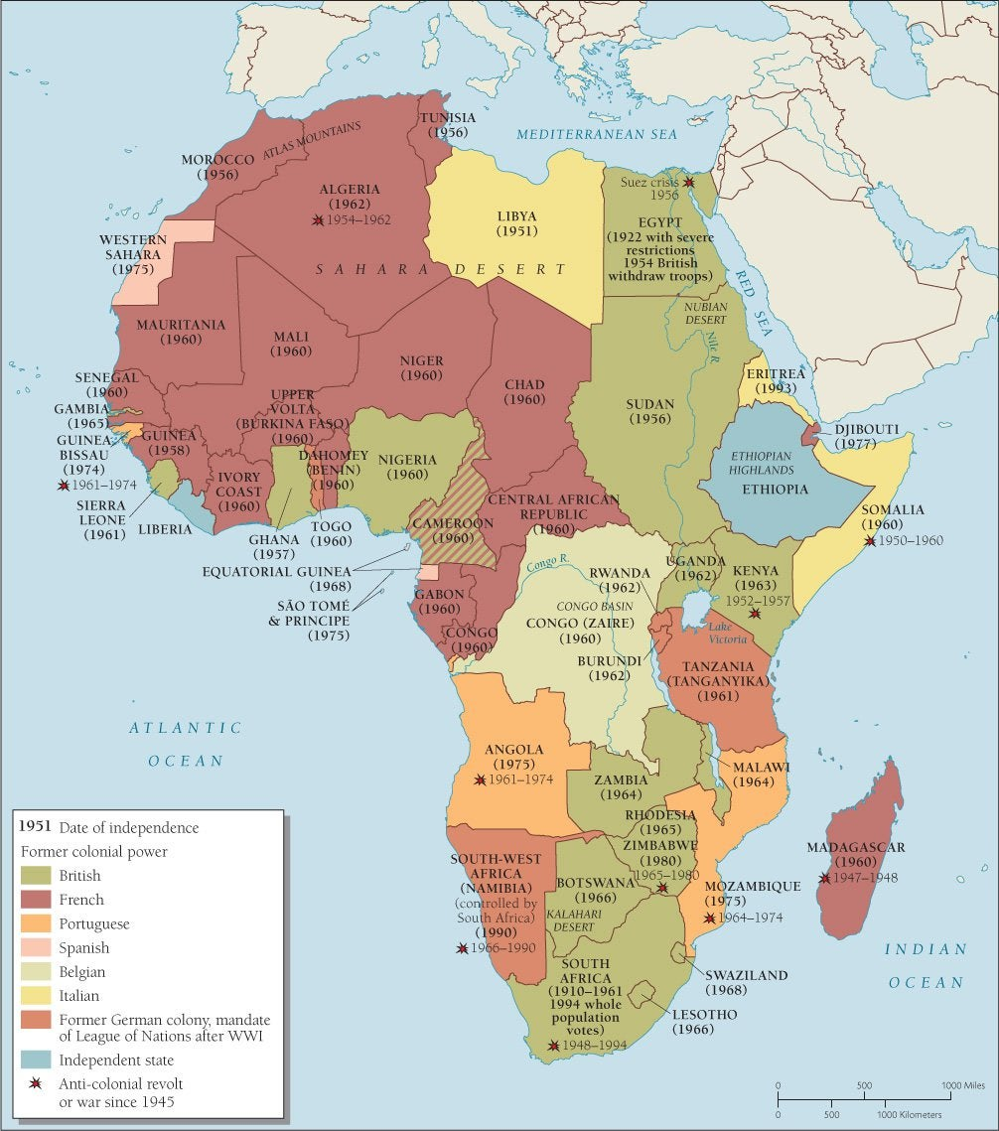
Decolonization in Africa
‘The wind of change is blowing through this continent.’ – British PM Harold Macmillan, 1960
‘It is no ordinary wind, but a raging hurricane.’ – Ghana PM Dr. Kwame Nkrumah, 1960
the rise of African Nationalism….
took European colonial powers by surprise….
Self-determination
Europeans (the West) still viewed themselves as a ‘civilizing’ force for African peoples….’eurocentric?’
Europeans viewed self-determination differently…
believed it should be granted to colonies through a slow and deliberate transition…..
African nationalists were, however….determined to gain their freedom & independence more quickly
the desire of independence was intensely desired though the legacy of colonial rule would be hard to overcome – no matter how the colonies were able to throw off the yolk of colonialism
the Map of Africa
ethnic rivalries were exacerbated by borders decided on by European colonizers….within these new nations, many varied linguistic groups existed and vied for influence….in general, people identify with those who speak their language and don’t want to be ruled by thoe who speak another language…..
By the mid 1960s –
what colonies remained were ‘settler colonies,’ that is colonies in which the interests power of the European settler community kept the majority African population from gaining their political freedom….
South Africa – Angola – Mozambique – Zimbabwe – Namibia
was the franchise (vote) not the right of all Africans?

Slide 8
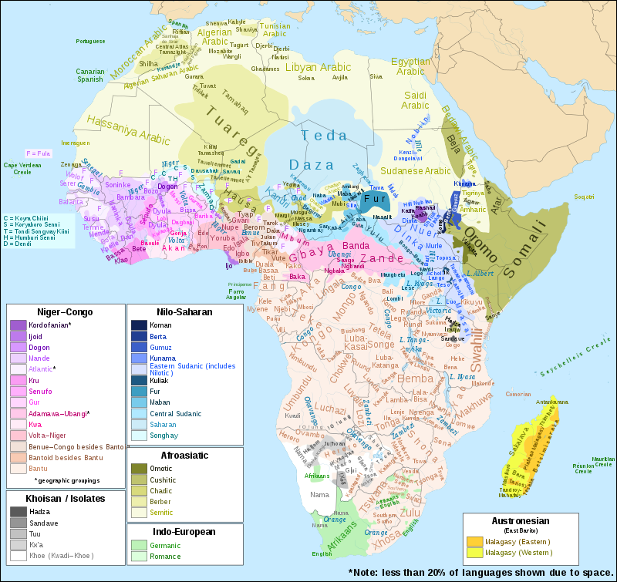
Nations within a Nation-State – Ethnic Rivalry?
Nationalists often want to unify all the people who speak a certain language together in a nation…..but state borders arbitrarily laid out by European powers that left Africans bunched into ‘nation-states’ don’t reflect their heritage –
a contradiction that still troubles them today….
How, then, could these borders create problems?
Read: The Dividing of a Continent
Ethnic conflict is common in sub-Saharan Africa…
most nations have diverse ethnic groups
ethnic rivalries have been an impediment to economic growth, as well as social and political stability….
particular ethnic groups are favoured and receive preferential treatment by national leaders & governments from one nation to the next….
this has led to a psychology of fear across Africa and within nation-states as they have transitioned out of colonial rule….

Slide 9
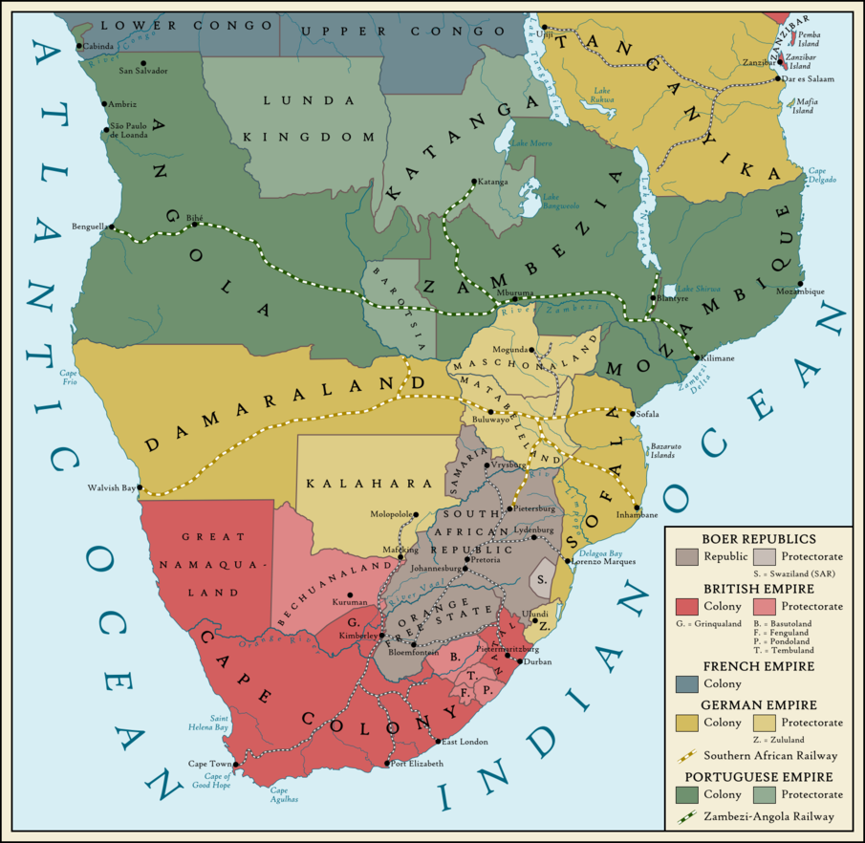
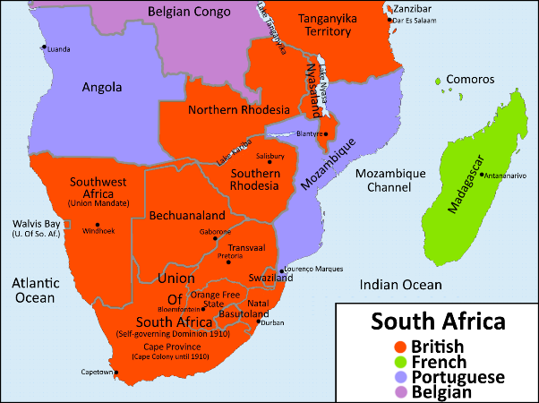
South(ern) Africa
Settler Rule in Southern Africa
postwar (WWII) European settler colonies (whites) kept African populations from gaining political freedoms…
Angola (Portuguese)
Namibia (South Africa Mandate)
Zimbabwe (British)….formerly ‘Rhodesia’ incl. Botswana
South Africa (Afrikaans, or ‘Boer’ settlers)
Mozambique (Portuguese)
for many years, white settlers monopolized the vote….
elected representatives protected rights of settlers over the African majority...discriminating against their populations…
African nationalist leaders believed that if franchise was the right of all citizens, the majority population would use their vote to bring in majority, independent African rule.
these nations saw a more prolonged, protracted
campaign by Nationalists against Settler Rule
Independence did not come easily and in most cases,
violence – civil war, rebellions, protest movements –
continued well into the 20th Century……
….let’s consider the history of South Africa…

Slide 10
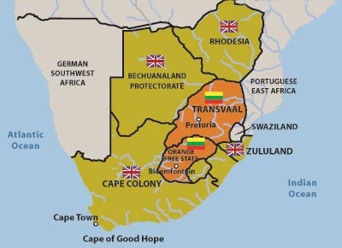
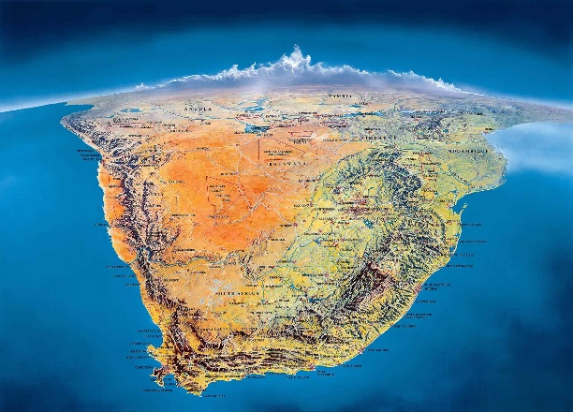
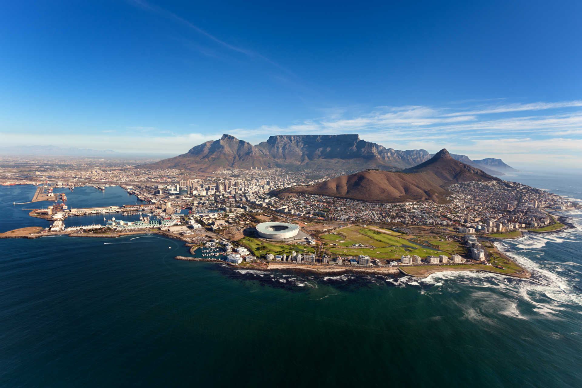
South Africa – the Roots of ‘Apartheid’ ……’apartness’
Boer War, 1899-1902
the ‘Boers’ (farmers) or Afrikaans, were descendants of Dutch settlers to the Cape going back to the 17th and 18th Centuries…Dutch East Indian Co.
they had always had contentious relations with the British, and when the British outlawed slavery, Boers would move & form their own Republics…
they fought and lost a war against the British in the early 20th Century
Republic of South Africa, 1910
the British and Boer colonies joined in a union, with South Africa becoming an independent dominion (Canada?) within the Empire in 1926
the National Party (1914), reflected the desires of the Afrikaaners, the Boers, who had held a grudge since losing to the British in the Boer War
Afrikaaners looked to pry political control from the British; meanwhile…
Africa National Congress (ANC) (founded in 1912)
its primary mission was to bring all Africans together as one people…
this included giving full voting rights to all black South Africans and mixed-race South Africans; and, after 1948 onwards, to end the system of apartheid introduced by the Nationalist Party after their victory in 1948.
Apartheid ….’separate’ or ‘apart’
as policy it is institutionalized post WWII by the Nationalist Party, but has roots going back into the 1920s with so-called ‘pass laws,’ which required all non-whites to carry documents that proved their residence in special reserves or resettlement camps established for them….restrictions on non-whites only increased as the years wore on….

Slide 11
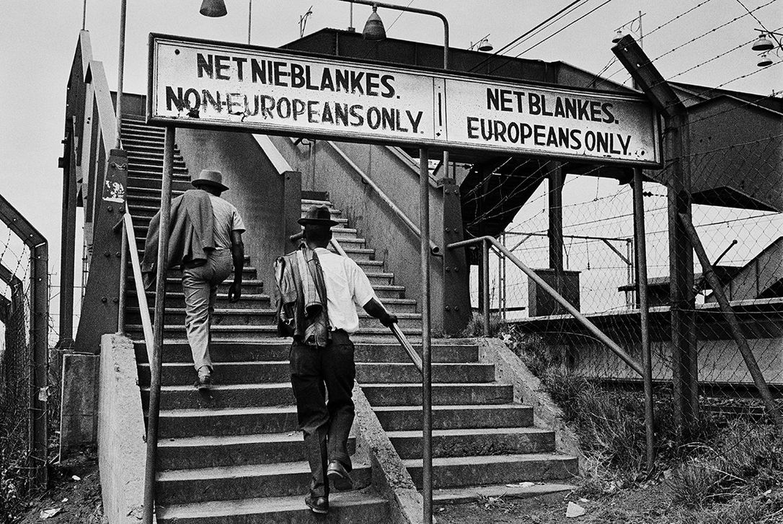
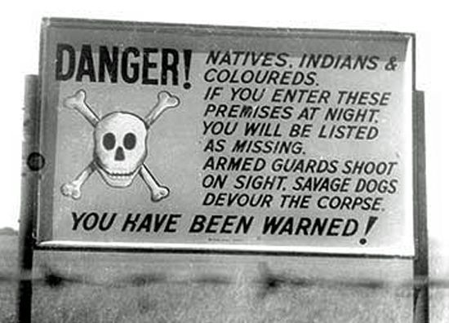
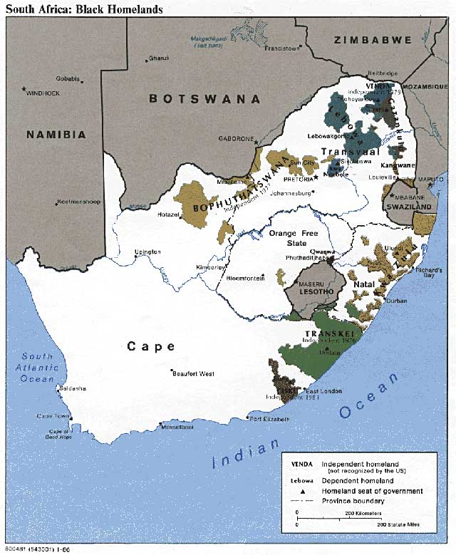
Apartheid
1948 – Apartheid Laws ……National Party (Afrikaans)
racial policy classified all South Africans into four categories:
Whites
Black
Coloured (people of mixed ancestry…)
Asians
Whites controlled the political, educational and economic instituions
separate schools, workplaces and residences for all racial groups
Illegal for people of different races to mix together in public (or marry….)
1951 – Bantu Authorities Act
a series of ‘homelands’ or ‘Bantustans’ created to isolate Blacks & Coloureds
think of the Indigenous experience in Canada….
a reserve system that became ghettoized….
located far from urban centres, but not too far away so as to secure cheap black labour….
the police were used to relocate many blacks from urban centres, usually by way of force
the South African state was willing to use violence so as to secure the Apartheid system
Apartheid was supported by the majority of the white population and by the nation’s social institutions, including the Dutch Reform Church

Slide 12
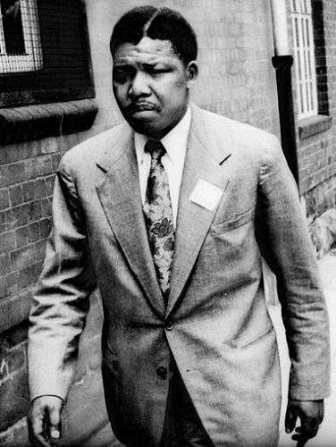
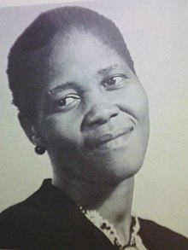
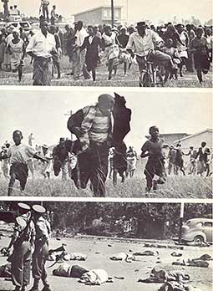
Opposition to Apartheid
Lilian Ngoyi (to the right), a garment worker, joins ANC in early 1950s, leads peaceful protests against the
South African state system of Apartheid. In 1956, she led 20 000 women in a protest against the pass laws,
For which she was charged with high treason…..she became a symbol of resistance and an inspiration.
Sharpeville Massacre, 1960
police open fire on peaceful demonstrators opposed to the pass laws – 249 shot, 69 fatally….
30 000 Africans march on Cape Town – a state of emergency is declared by South Africa
18 000 people later arrested…..more repressive measures issued by the state:
public meetings banned – dissidents arrested without charge – ANC banned
Nelson Mandela
following the Sharpeville Massacre, he decided ‘non-violent’ protest was ineffective…..
he was eventually arrested in 1962 and imprisoned, first for five years, then again for life…
he spent the next 27 years in captivity…his convictions elevated him to mythical status among Africans
International Sanctions
1961 – British Commonwealth Conference sees South Africa withdraw from the Commonwealth
1962 – the United Nations voted to impose sanctions upon S. Africa.....
USA, Britain, France refuse to participate…..USA facing its own internal strife – ‘Civil Rights?’
Other African countries that were fighting nationalist struggles, supported the ANC and South Africans
Many violent attacks against the South African gov’t were launched from Mozambique, Zimbabwe and other South African nations…..this led to the South African Army raising these nations in search of rebels….
‘Leaders are important but history is ultimately not made by kings and generals. It is made by the masses.’ Nelson Mandela
Mandela
Ngoyi
Sharpeville Massacre, 1960

Slide 13
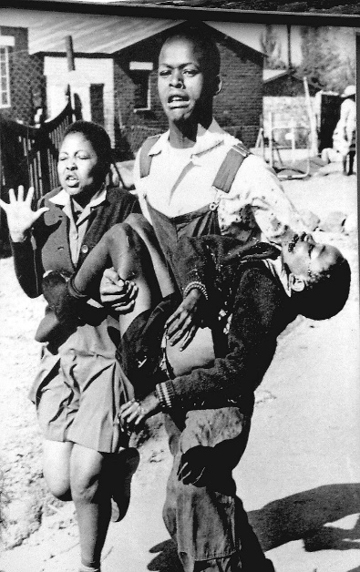
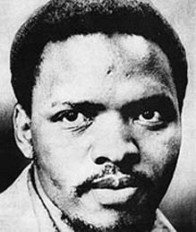
The End of Apartheid
Soweto Massacre, 1976 (SOWETO – ‘South West Township’ ……outskirts of Johannesburg)
thousands of black high school students protest the introduction of ‘Afrikaans’ in schools
their protest was in defiance of the introduction of the language of their oppressor and apartheid
riots grew out of these protests and lead to a crackdown by the South African authorities….
23 killed in June, including several teenagers; later, 566, mostly black die as a result of crackdown…
Steven Biko (1946-77)
a noted anti-apartheid activist in the 1960s and 1970s, formed the Black Consciousness Movement
arrested and later, dies in police custody….police claim his death was a result of a ‘hunger strike’
an autopsy reveals he succumbed to a brain hemorrhage, the result of massive injuries to his head
clearly, he had been beaten brutally by his captors – int’l condemnation was swift….
the Reform Movement
1978 – S. African President Botha relaxes some apartheid laws – the ban on racial marriages, for example...still no rights!
67% of S. Africans were Black, however…..and still denied voting rights – the ANC stepped up protests….
strike actions, riots and acts of sabotage continued against the South African government by South Africans denied rights
1985 – Both declares a state of emergency…..hundreds of black nationalist leaders arrested again….
1986 – Pass Laws were ended – S. African gov’t eases up on harshness of apartheid laws, but still, segregation continues
International Developments
Economic sanctions imposed by USA (thanks to influence by Canada) and other nations and int’l institutions on S. Africa
with the Cold War on the wane (ending) in the late 1980s, the West would turn its eyes upon the villainous state of S. Africa – a state that practiced an immoral political system that prevented black, colours and Asian Africans from equality

Slide 14
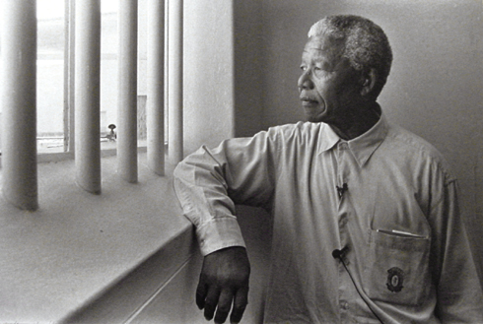
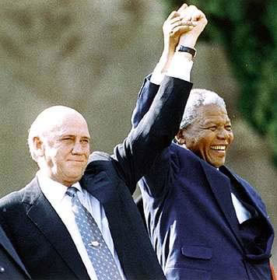
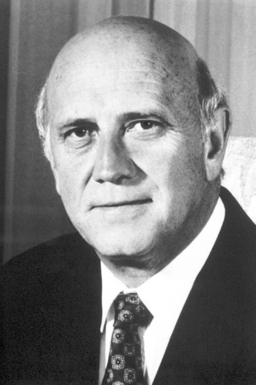
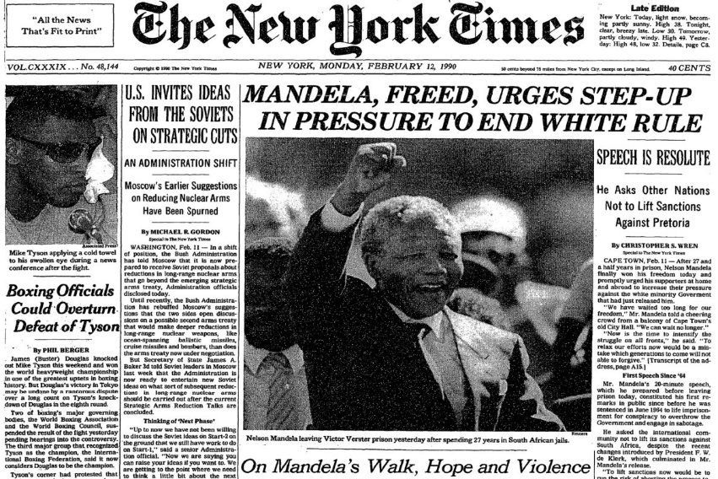
the Return of Madiba ….Mandela released after 27 years in prison…..
1989 – F. W. de Klerk becomes President of South Africa
he promises a program of gradual reform……in hopes of reducing civil strife
repeals many laws that maintained racial segregation in public facilities
lifts ban on African National Congress (ANC) and frees Nelson Mandela (1990)
‘Madiba’ –a Xhosa word meaning, ‘father’…..an endearment for Mandela – revered by all…
Mandela emerges from prison as the de facto leader of the movement…..
1991 – the de Klerk gov’t introduced new laws to end the racial divisions across S. Africa
many whites opposed de Klerks initiatives…fearful of the black majority
1993 – de Klerk (Afrikaaner Nationalist) and Mandela (African Nationalist) reach agreement
they collectively announced the nation’s first democratic elections, with voting privileges for all citizens regardless of colour – to take place in April 1994….
Mandela’s African National Congress wins a historic elections (63% of popular vote)
Mandela becomes President...de Klerk made Vice-President – Apartheid no longer….
Not all blacks, however, supported the ANC – some limited violence occurs
Heads of state arrive to witness Mandela’s inauguration…..
Truth and Reconciliation Commission, 1994-99
led by Catholic Archbishop Desmond Tutu
‘Without forgiveness there can be no future. Without confession there can be no forgiveness.’
credited with limiting retaliation by blacks on whites…

Slide 15
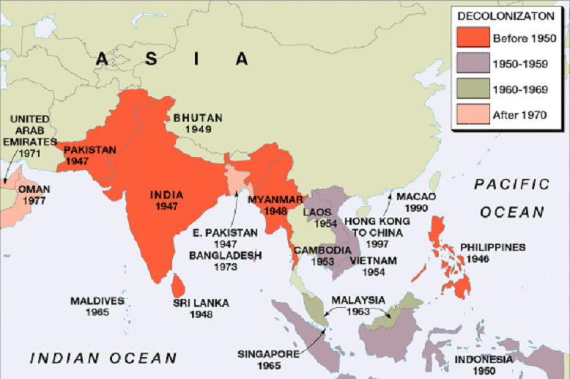
Decolonization in Asia
the End of Imperialism
Nationalist Movements
Spheres of Influence – USA v. USSR?
WWII –
the colonies contributed to the defeat of Japan
the cost of war – European nations weakened
opposition to imperialism among Europeans…
USA v. USSR
spheres of influence?
both wanted the breakup of colonies
both supported independence movements
both had interests in Asia
USA – Domino Theory?
USSR – support for Communist regimes
Nationalist leaders, many educated in Europe, used their
Understanding of liberal, Marxist and other intellectual
Ideas against their European ‘masters’……
“What I did was a very ordinary thing. I declared that the British could not order me around in my own country.”
Mahatma Gandhi, 1947

Slide 16
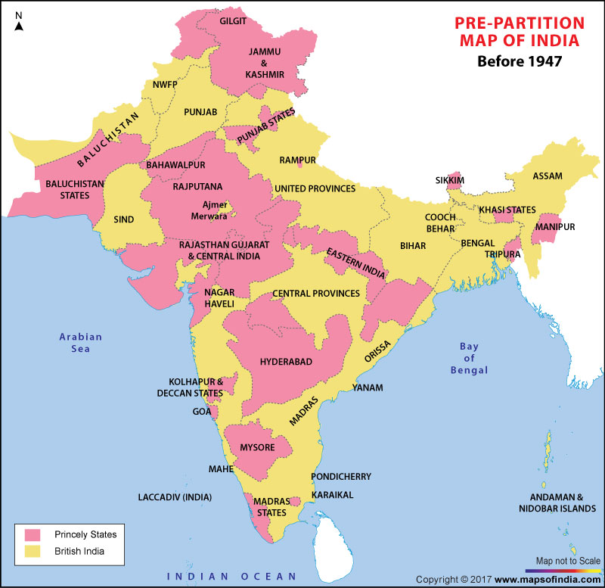
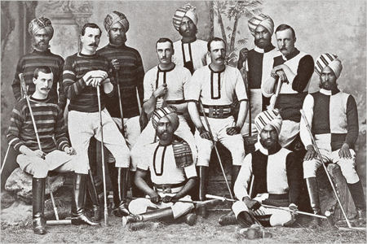
Indian Subcontinent Before Independence
the British Raj – the Jewel in the Crown of British Imperialism?
British Imperialism
British East Indian Company – since 1600s….
India as a source of raw materials...
British see India as theirs….by conquest and other means…
Indian Subcontinent
Direct rule by Britain (colony) by 1858
Hindu majority with Muslim minority
Some states in India regarded as ‘Princely States’
All attempts at ‘self-determination’ by Indians met with force
Amritsar Massacre, 1919
British ‘law and order’ in action
Some 379 killed by British army; 1200 injured
Protests against British Raj spread
“No romance can compare with the story of the handful of Englishmen…who, beginning with as mere traders & merchant settlers, have in barely two centuries built up the majestic structure of an imperial system under which peace, order and good government has been secured for 350,000,000 people.”

Slide 17
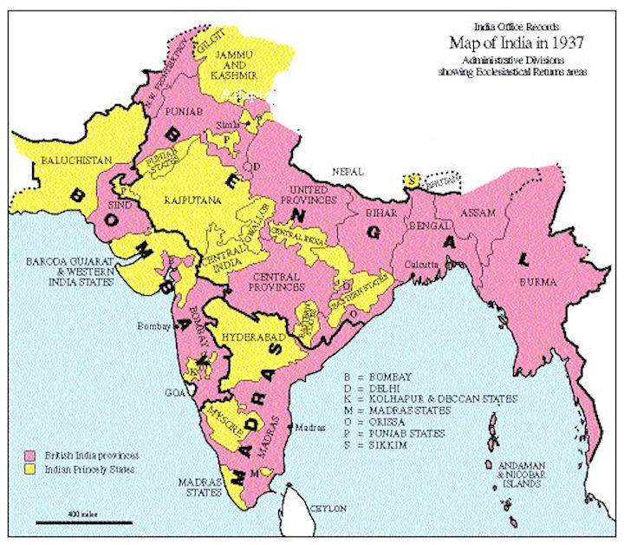
the Road to Self-Determination?
Montagu-Chelmsford Reforms, 1919
‘Dyarchy’ – Eleven provinces with 2 levels of gov’t
Indians control health, education & agriculture
British control finance, law and order
Indian nationalists believe reforms were lacking….
British conservatives believed they went too far….
Nationalist Movements
Indian National Congress (INC), 1885
Hindu orientation and majority
advocate of Hindu-Muslim unity to British Raj
‘One India’ policy…..
Muslim League (1906)
Muslim orientation and majority
fearful of a Hindu majority….
Desired separate homeland for Muslims
the Government of India Act (1935)
British relinquish control of the provinces
this ends the system of ‘Dyarchy’
the vote is extended to more Indians….
British still control central government
British can suspend ‘responsible government’
….a lukewarm reception by Indians who desire the end of British rule, but also too radical for many in Britain to process…..

Slide 18
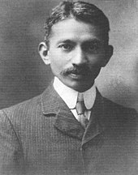
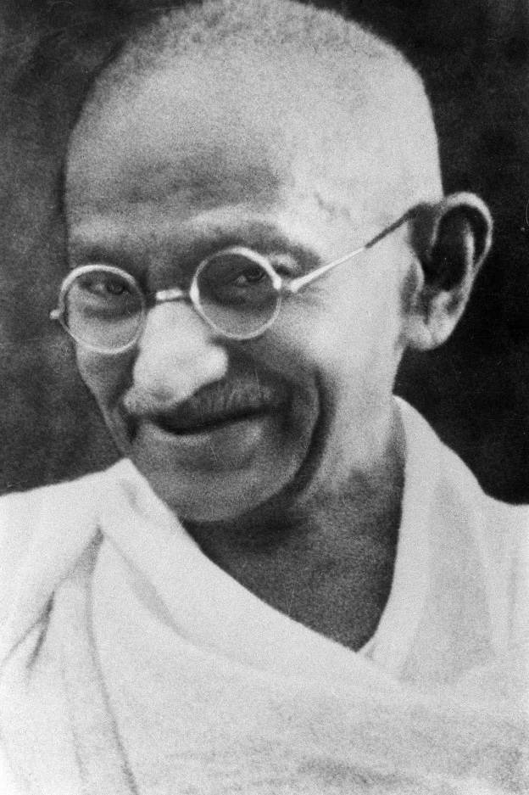
the Mahatma – Mohandas Gandhi (1869-1948)
Early Years
Hindu
arranged marriage at 13yrs to 14yr old….they had their first child at 16 and 17, respectively
Educated – traveled to London and trained as a Lawyer in his early 20s
traveled to Durban, South Africa and worked there as lawyer – where politics, ethics were formulated
In response to racial prejudice of S. African society – began ‘non-cooperation’ protest movement
Fact: Gandhi was a stretcher-bearer during the Boer War
Gandhi returned to India at the outset of the Frist World War
Satyagraha (Sanskrit: सत्याग्रह satyāgraha)
loosely translated as "Soul Force,“ "truth force," or "holding on to truth"
a philosophy and practice of nonviolent resistance developed and conceived by Gandhi
Gandhi deployed satyagraha in the Indian independence movement.
Satyagraha theory influenced Nelson Mandela’s struggle in South Africa under apartheid, Martin Luther King, Jr's campaigns during the civil rights movement in the USA, and many other social justice and similar movements…throughout the 20th Century
the Salt March (1930)
to break the British tax on salt, Gandhi and followers march to the ocean and make salt….a symbolic act, the event itself had little economic value, but it created a grassroots movement among Indian people - United we can defy the Raj.
became leader of the Indian National Congress in 1921 - pivotal to India’s self-rule…
imprisoned several times, both in S. Africa and India for ‘civil disobedience’

Slide 19
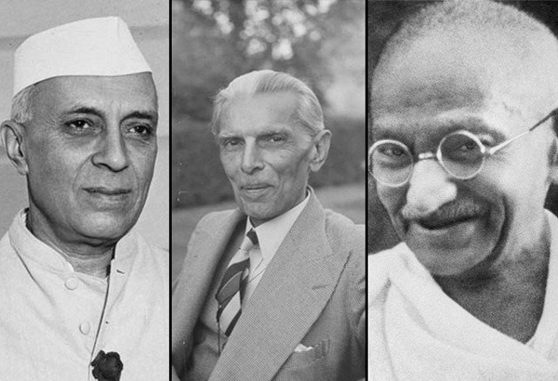
the Hindu-Muslim Spilt
Indian National Congress
1919 – Jawaharlal Nehru, Hindu Nationalist, joins Congress Party
heavily influenced by Gandhi…repeatedly imprisoned too
1928 – Nehru elected leader of Congress Party in place of Gandhi
Gandhi is ‘figurehead’ of a movement for Independence
follows Gandhi’s ‘One India’ dream…all of subcontinent
Opposed to dividing the subcontinent along religious lines
Muslim League
Muhammad Ali Jinnah, a sceptic of Hindu-Muslim unity
Fact – Jinnah was once a member of the INC
some agreement with Nehru, but wide divergence too….
fearful of a Hindu dominated India once British are gone
1937 Elections
1st provincial elections see Congress Party dominate….
Jinnah pushes for a two state solution to British Raj
‘….so long as the Hindus and Muslims are not united we shall remain slaves of the foreigner…’
Nehru Jinnah Gandhi
British Realism
Nationalist movement made independence inevitable…..
Despite Gandhi’s ‘One India’ idealism, two nations would emerge. The questions - whether it could be done peacefully?
the colony was no longer economically profitable to the British and it was quite problematic to govern over….
the British, however, felt they could not pull out without instilling order to the subcontinent – ‘White Man’s Burden?’

Slide 20
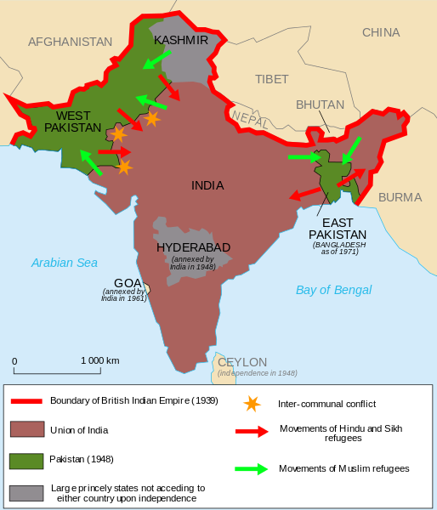
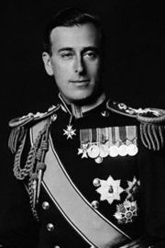
Indian Independence Act, 1947
Post WWII –
Efforts at compromise between Muslim and Hindu leaders fail…
Significant violence sweeps across the subcontinent
Hindu on Muslim, reprisal attacks and so on….
Mountbatten Plan, 1947 –
Two Nations are created:
India (Hindu) led by Nehru and the Congress Party
Pakistan* (Muslim) led by Jinnah and Muslim League
West Pakistan
East Pakistan
Mass Migration – estimates of 12 million people…
Hindus and Sikhs move from Pakistan(s) to India
Muslims move from India to Pakistan(s)
1971 – civil war erupts between Pakistans over secession of E. Pakistan, leading to creation of Bangladesh….India helps Bangladesh defeat Pakistan….1000’s killed & 10 million migrate to India…..religious violence
Lord Mountbatten
Last Viceroy of India
As populations move, a ‘frenzy of slaughter’ ensues...unprecedented violence
1 000 000 killed….difficult to quantify, though….
Gandhi on hunger strike in opposition to violence in Calcutta & Delhi
still more die of hunger and disease…an auspicious beginning?
Jan. 1948 – Gandhi assassinated by militant Hindu Nationalist opposed to his acceptance of Muslims……

Slide 21
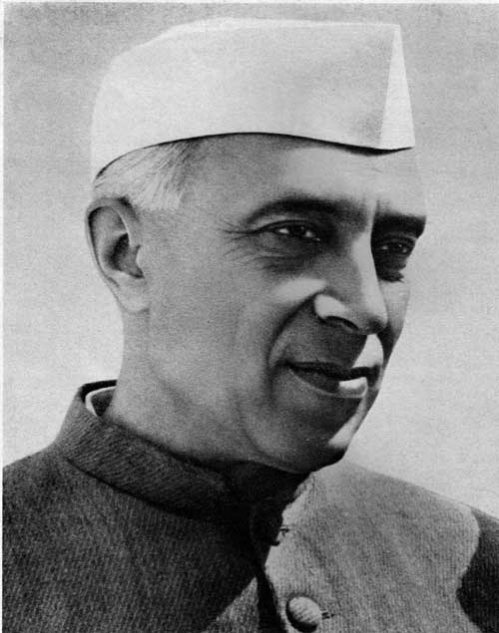
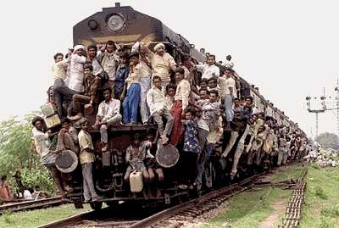
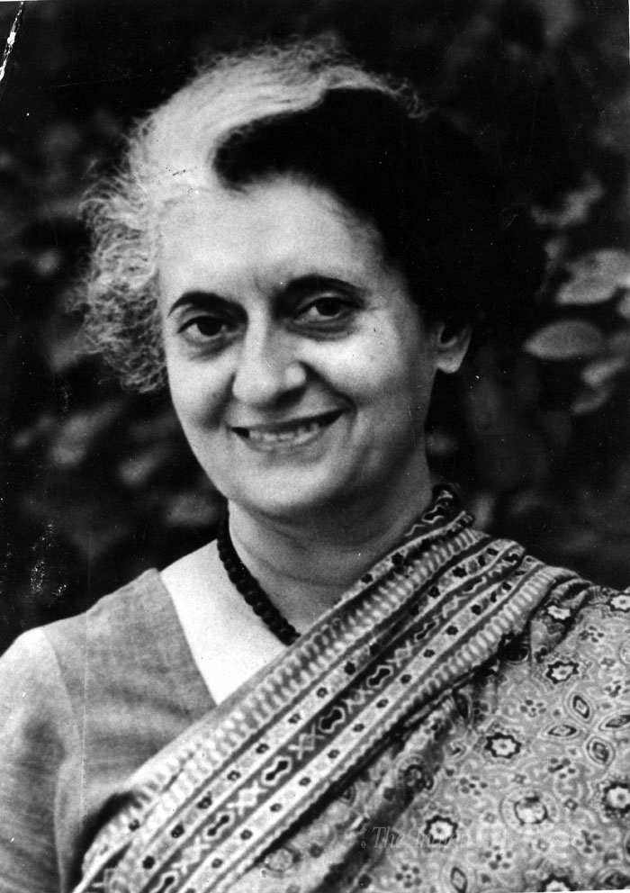
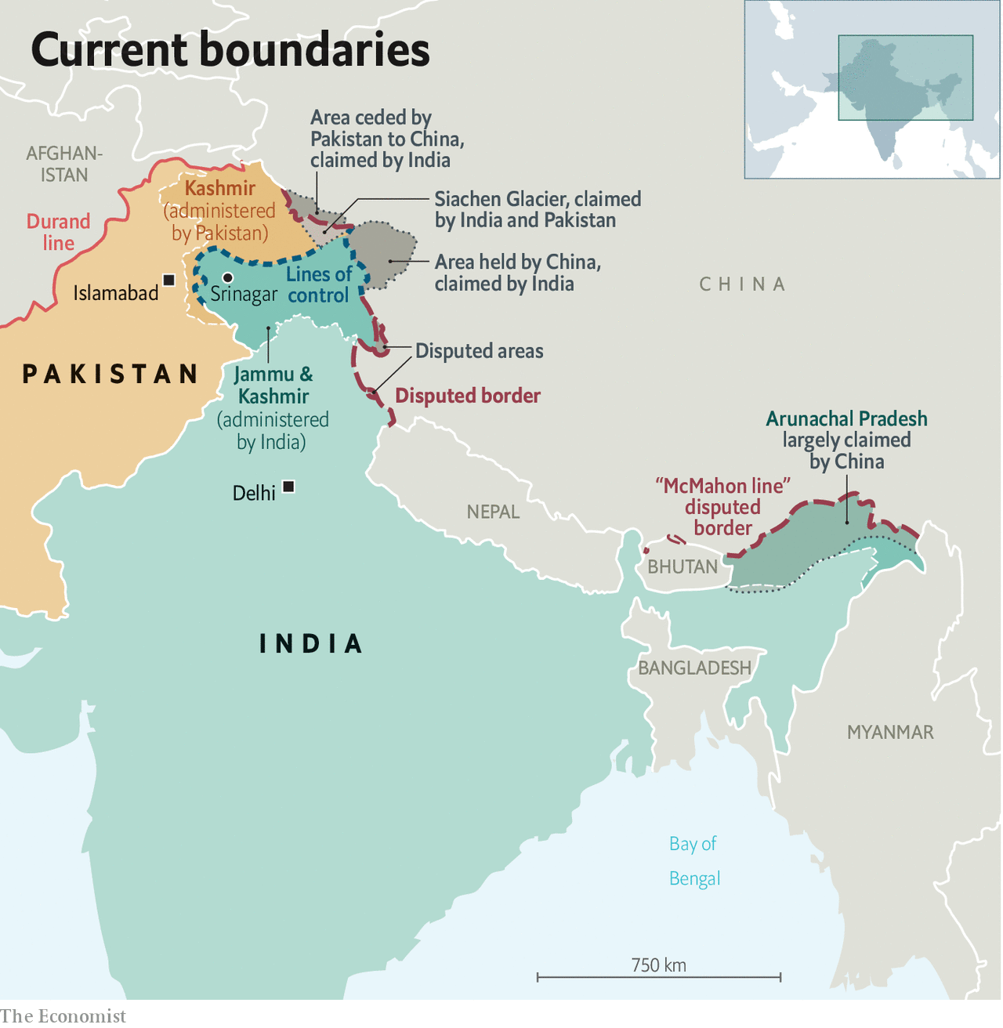
Post Independence in the Subcontinent
India and Pakistan among the largest democracies in the world…..
social problems – Caste System & Hindu-Muslim Split
Economic underdevelopment and impoverishment
Gender Issues – Dowry & Honour Killings
Overpopulation? - 1.3 Billion and counting…..in India alone…
Nehru Dynasty (India)
Jawaharlal Nehru – 1st Prime Minister of India, 1947-64
Indira Gandhi (daughter), PM – 1966-77; 1980-84
assassinated 1984 by Sikh separatists….
Rajiv Gandhi (grandson), PM – 1984-89 (assassinated 1991…)
…..assassination came at the hands of Tamil separatists
In Pakistan –
a history of political assassination exist too…..
along with military coup d'états (takeover)
Border Disputes & Border Wars
Punjab – partitioned between India and Pakistan
Kashmir
India-Pakistan Wars– ’47, ‘65, ’71, ’99
Diplomatic Talks Ongoing…..sometimes not!
India-China War – ’62
Arunachal Pradesh
Disputed with China
Nuclear Arms –
China – 1964
India – 1974
Pakistan – 1998

