Slide 1
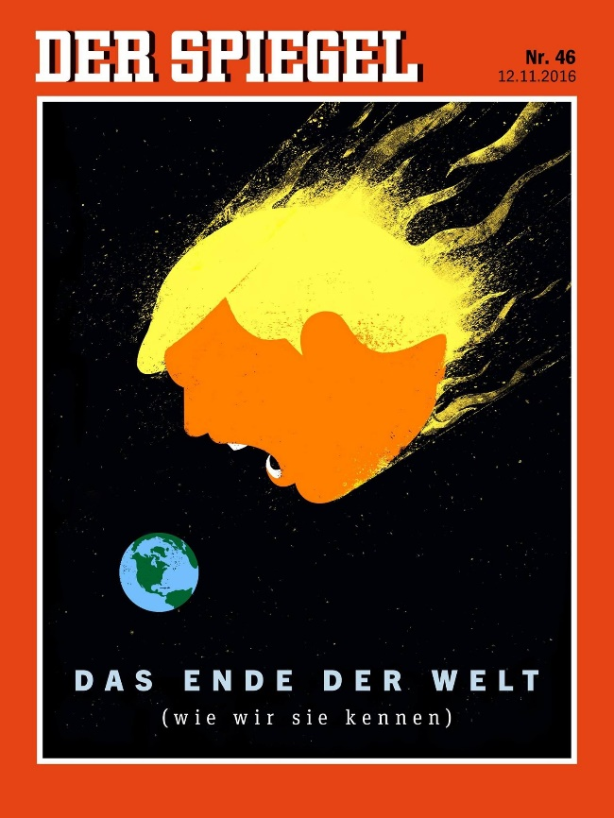
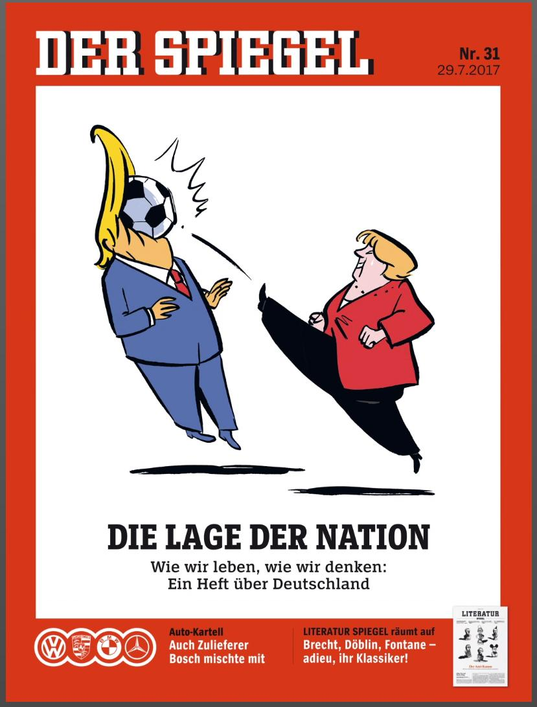
Diplomacy
Statecraft – ‘steering the ship of state?’
how to best serve the preservation and aggrandizement (advancement) of one’s state
raison d'état – the ‘reason of state’
the state amounted to more than its ruler…..the state above all else!
Ex. Canadian-US Affairs – the relationship of PMs and Presidents?
how important is the relationship between leaders to the health of a nation? Or, not?
power politics – the realist paradigm? ‘realpolitik?’
national self-interest? ……the face of power politics today?
balance of power system?
historic precedence? – the Concert of Europe (established by Congress of Vienna, 1815)
an early attempt to institute a formal structure for conducting int’l relations...its decline in the late 18th C is attributed to the rise of nationalism - sound familiar?
the League of Nations was brought down by a rise of nationalism in the 1930s….
Will the United Nations succumb to the machinations of nationalism?
Diplomacy
involves a broad range of actors, incl. professional diplomats, special envoys, heads of government, the UN, NGOs, and regional bodies such as the EU and ASEAN
varied nations or regions are said to possess certain diplomatic styles – cultural differences?
can also incl. informal or unofficial diplomacy, preparing the ground for more formal talks…

Slide 2
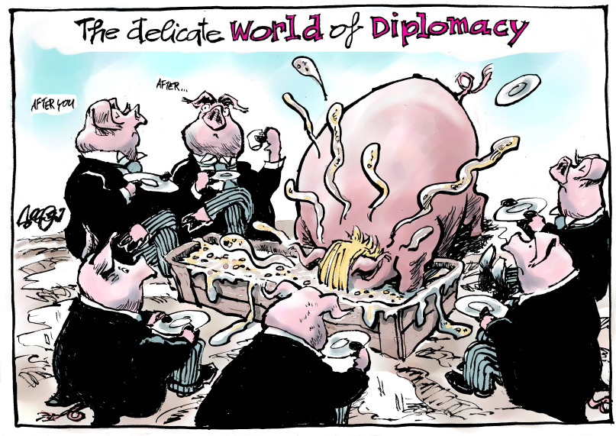
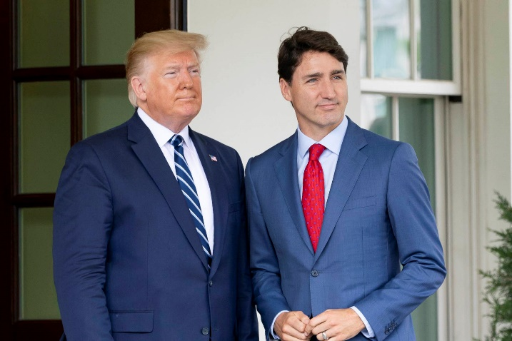
Foreign Policy ….links domestic and international spheres of politics
a gov’t’s interaction with other actors in the international system
foreign policy is designed to protect and advance a nation’s
national interests – what are a nation’s interests?
national security – how is national security secured?
ideological goals – what is a given nation’s ideological context?
economic prosperity – how important are trade agreements?
this can be obtained thru diplomacy (negotiation and cooperation),
though foreign policy includes acts of aggression and exploitation…war?
‘War is not an independent phenomenon, but the continuation of politics by different means.’
Carl von Clausewitz, 1832
how important is a state’s regional or geopolitical location to its foreign policy?
Canada’s ‘special relationship’ with the USA?
…..the Canada-US relationship is interdependent and sustains a number of varied forms, purposes, meanings, aspects and/or principles – no matter who is PM or President…..
……how are our economics, military defense, culture and institutions interconnected?
how comfortable are we (as a nation) with this special relationship?
why are we so distrustful of the US (not just under Trump presidency…)?

Slide 3
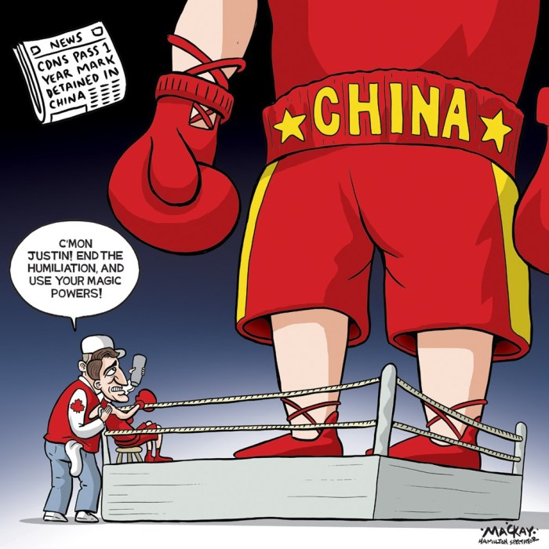
Canada as a Middle Power (and beyond?) – Our Foreign Policy
post WWII
Cold War
Canada emerged as a leading "middle power," assuming the role of peacekeeper and negotiator in international disputes
In reality – Canada aligned most often with US/Western Alliance
PMs prominent in int’l affairs, taking part in visits to/from foreign heads of state, summit and public diplomacy – ‘soft power?’
Pearson – UN, ‘Peacekeeping,’ Vietnam War
P. Trudeau – Denuclearization, China, Cuba
Legacy of the Cold War?
Is Canada’s role diminished? (think beyond our idealism……)
Alliance Systems?
continuities evident in recent diplomacy?
Ex – North Atlantic Treaty Organization (NATO)
Trump as an agent of change?
Wither multilateralism?
Concert Diplomacy
the idea that great powers tried to avoid war, protect the status quo and, if this was impossible, to arrange for change by multilateral agreement ……..rules based order diminished?
the rise of nationalism in the 21st Century?
Trudeau faces a particularly belligerent China on the world stage
Realpolitik?
Are states the only relevant actors in the international sphere? UN? NATO? G7? WTO?
Are states the most effective when it comes to diplomatic activity?
What role do non-governmental organizations (NGOs) have in int’l affairs?

Slide 4
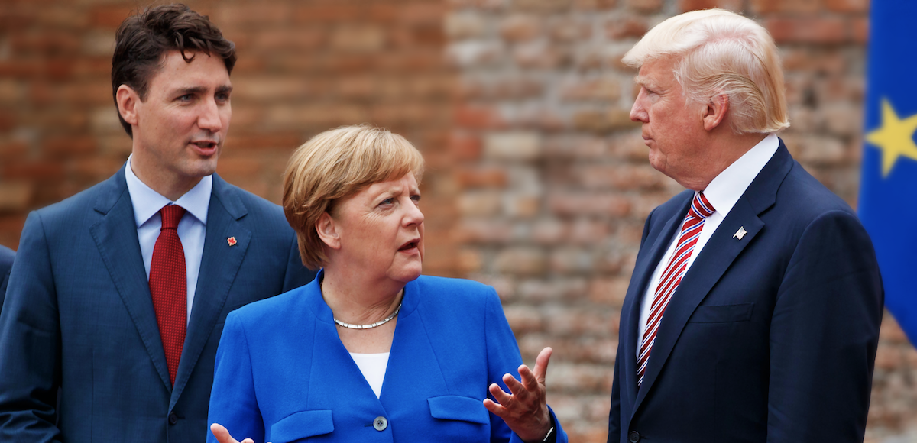
Summit Diplomacy
Under what circumstances is ‘summit diplomacy’ likely to be effective?
Churchill coined the phrase…..postwar feature?
Bilateral – between two states…
Multilateral – between multiple states…
‘Diplomatic Socialization’ builds international society?
Group of Seven (G7)
Est. 1975 – Fr, Br., USA, Italy, Japan, Germ., Canada
meets annually to discuss economic and trade issues
also, enviro, int’l security, and other issues as they arise
Trump Foreign Policy (2016 -????)
has consistently acted ‘unilaterally’ in relation to its relations with Allies
those Allies – Germany, France, Britain and Canada, have grown weary and disillusioned of Trump’s America
Ex. Trump’s unilateral decisions to enact trade tariffs on Allies – more recently, Trump invited Putin* to join G7 this year
North Atlantic Treaty Organization (NATO – created 1948)
multilateral military org. involving Western Allies – a mainstay of the Cold War era…founded on principle of ‘collective security’
American engagement and leadership in NATO is critical to its success…….can NATO survive without US participation?
recent summits have highlighted the divisions between the USA and longtime allies – Canada, Germany, France....
Notes:
Vladimir Putin – President of Russia: Russia was formally kicked out of the G8 for its invasion and occupation of Crimea (part of the Ukraine) in 2014/15

Slide 5
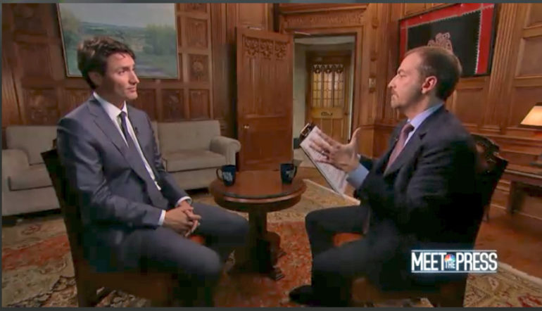
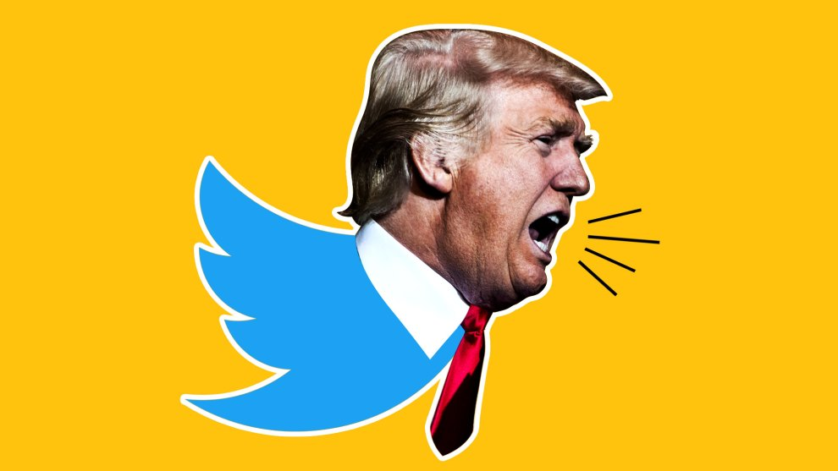
Public Diplomacy
the ways in which governments attempt to influence public opinion
‘soft power’
winning the ‘hearts and minds’ of the people
seduction more powerful, effective than coercion?
Trudeau on Meet the Press (US Media) – why?
….but, attraction can turn to repulsion if we act in an arrogant manner and destroy the real message of deeper values…..
Role of Culture?
the branding of diplomacy? competing cultural values?
Emergence of new technologies……
new type of public diplomacy?
Aim is not so much to indirectly influence governments, but to shape the attitudes of other societies in a more direct state to society intervention…….more often this occurs covertly.
Brexit?
2016 US Presidential Election?
Propaganda?
What is the line between public diplomacy (usually perceived as a positive thing) and propaganda (usually perceived negatively)?

Slide 6
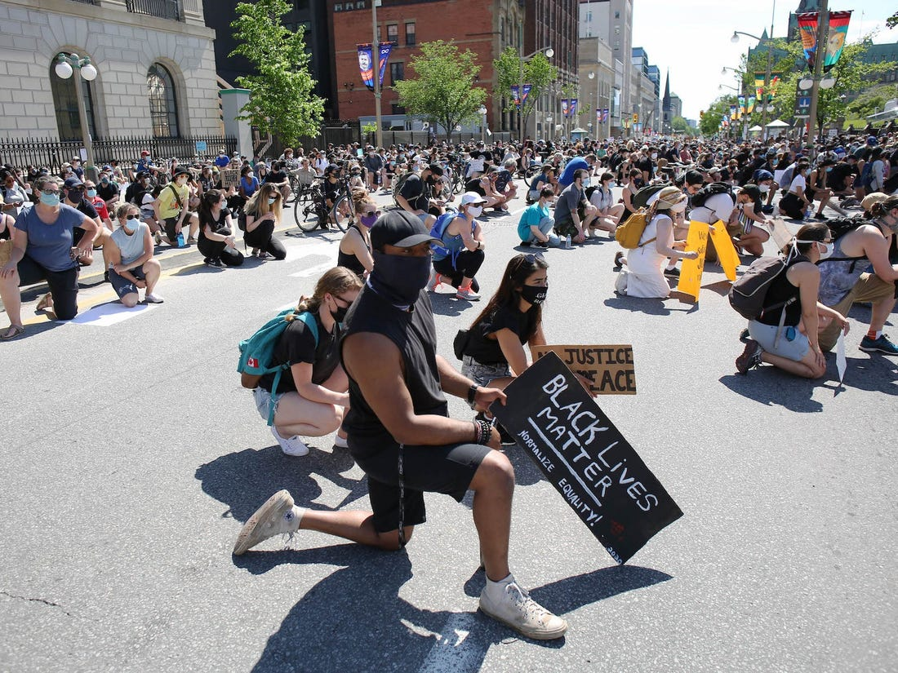
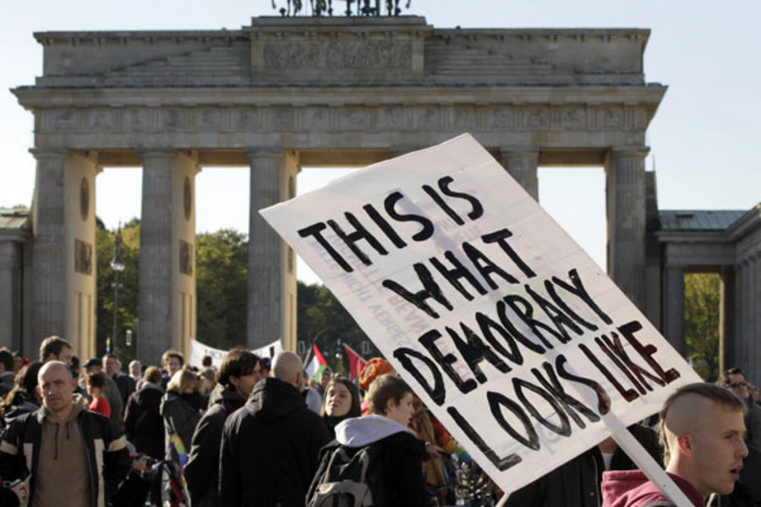
Social Movements and International Civic Society?
Social/Protest Movements
seek major social and political changes thru collective action…..
….outside of established political institutions…
A response to Elitism?
social/protest movements share the view that elites dominate society and politics
Why do people protest?
Are there limitations to conventional political organizations?
hierarchy?
Institutional politics?
direct action?
pace of change?
New politics?
the power of activism to force change?
more flexible structures ….but, broadness of a movement can be confusing….
Occupy Wall Street?
Over time…..from protest to power?
how do we institutionalize protest movements and the desire for change?
Black Lives Matter (2020) – the reaction to the death of George Floyd – the protests – are the latest in this social movement…
a manifestation of grassroots democracy that transcends the domestic sphere of the USA…..a product of globalization?
How do the protests we are currently seeing worldwide inform our understanding of politics? Democracy? Authoritarianism?

