Slide 1
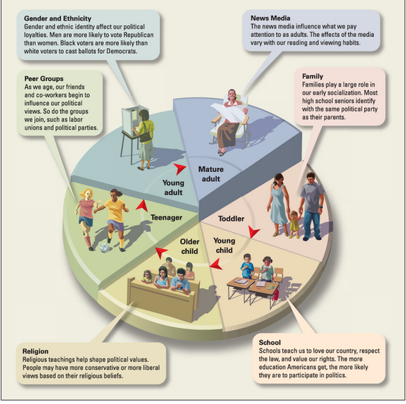
Political Culture, Socialization & Participation
political culture
sum total of political values, beliefs, attitudes, orientations….
basic norms for political activity in a society….
what is acceptable? not?
based on –
population characteristics, history, political experiences…
Example: United States of America?
political socialization
‘culture’ transferred to a political community?
how?
family
peer groups
educational system
mass media
many basic values are acquired at an early age……
Notes:
family….absorbed as much by osmosis than by deliberate transmission; family structure, decision-making processes, tolerance/acceptance of diversity?
Peers….susceptible at any age to influence; opinion leaders – social status, strength of character?
Schools….subjects studied? Values instilled?

Slide 2
Notes:
Poll Title: Are political ideas a regular topic of discussion in your home? https://www.polleverywhere.com/multiple_choice_polls/4WE2PPjzBkd0iVg

Slide 3
Notes:
Poll Title: Who are the dominant influences (opinion leaders) in your grad class? Based on.... https://www.polleverywhere.com/multiple_choice_polls/5Myjh40zOH0RhGF

Slide 4
Notes:
Poll Title: What subjects were deemed important early on? https://www.polleverywhere.com/multiple_choice_polls/hceonLo7ASA3qdW

Slide 5
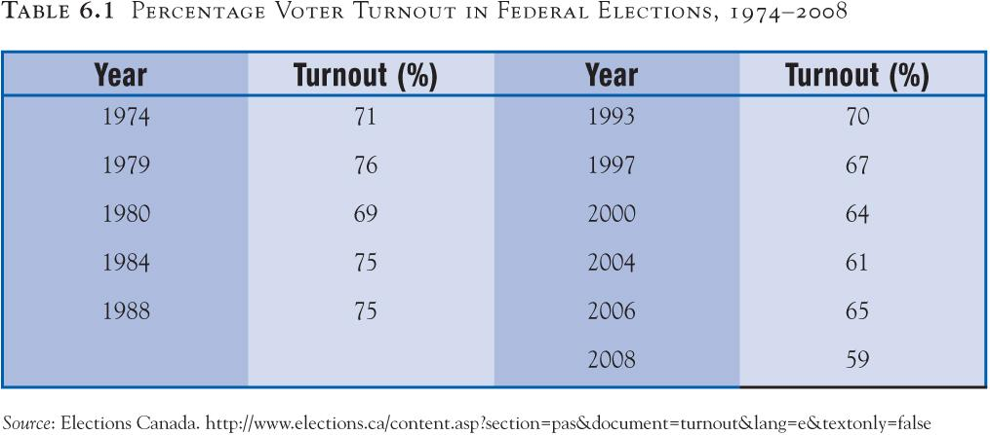
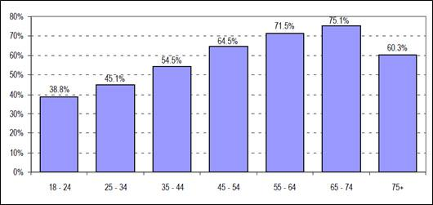
Political Participation
many forms of political participation…….can you name a couple?
Voting
most basic form of political participation?
voter turnout…..has been on steady decline since 1993….why?
Why did voter rate go up in 2015?
As people age, they tend to vote more………
But…….is there a generational effect?
baby boomers (1946-196?)
Gen X (Mr. Campbell)
Gen Y (1980-1994)
Life Cycle Effect?
related to social status…..
education
spousal relationship
home ownership
employment
Retirement

Slide 6
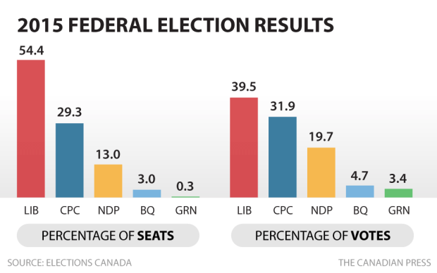
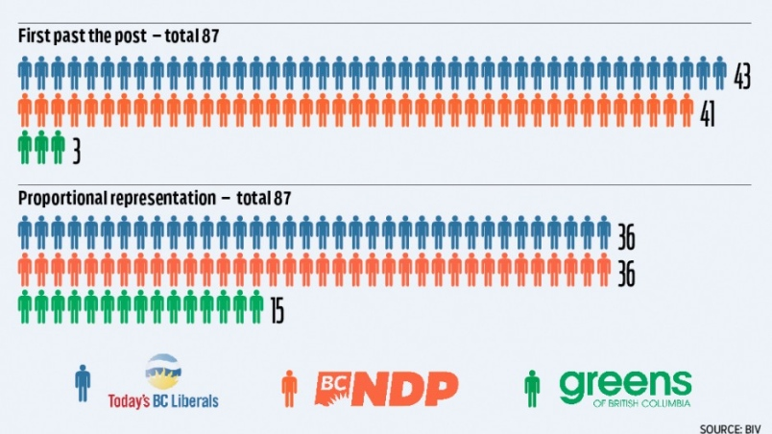
First-Past-The-Post System (Single Member Plurality – (SMP))
Canada, UK, USA, India……
voters in each electoral district elect single representative….
Simplicity?
In theory, allows voters to choose individual candidates based on their own merit….
Reality is….party solidarity diminishes ‘direct democracy’
produces minority gov’ts, but often gives winning party a majority
Decisive style of governance?
Minority gov’ts can lead to coalitions, however – fragility? ……is this such a bad thing though?
Facilitates a strong opposition and broad based political parties
Disadvantage to ‘fringe’ parties of the left and right
Elected representatives generally represents a particular district
Ex. Canada – MP represents a riding of 100 000 persons
Distortion in the First-Past-The-Post System?

Slide 7
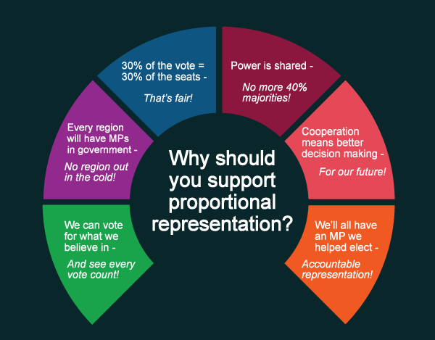
Electoral Reform …What is the best ‘representative government?’
Proportional Representation (PR)
electoral system where the proportion of seats party receives in the legislature reflects the proportion of votes obtained
How it works….
Voters cast vote for a party (not a candidate)
electoral districts are larger
many representatives from same area
not a single representative from single area (FPTP)
Votes counted and seats divided by % gained by each party
makes % of votes = %of seats in legislature
used by other liberal democracies
Israel, Netherlands, Peru, Slovakia, Sweden, etc….
Goal:
reflect as wide a range of opinions as possible…..
Pros:
reduces % of wasted votes
greater representation of minority parties
tends to create coalition governments (or is this a con?)
Cons:
tends to fragment party system
can give small parties power out of proportion to % electoral support
elections centered even more on party, not individuals
parties have greater control of who fills seats
coalition governments tend to be politically unstable…..
….but, don’t be swayed by this graphic alone…..bias?!!

