Slide 1
Notes:
Poll Title: Do cliques exist at our school? https://www.polleverywhere.com/multiple_choice_polls/8Fxpp6Qlc6qHZPXfFE6l0

Slide 2
Notes:
Poll Title: Identify one 'clique' at our school. https://www.polleverywhere.com/free_text_polls/jyvqe9A5C4NpG8O47LZfM

Slide 3
Notes:
Poll Title: Has there ever been a time when you were excluded from a group/clique/club at school? Briefly explain. https://www.polleverywhere.com/free_text_polls/cMx5LORiB6IETVZG4nBSC

Slide 4
Notes:
Poll Title: Do you belong to a 'clique' at Reynolds? Explain.... https://www.polleverywhere.com/free_text_polls/gIrsZ5kU2CUIbThpIWBuN

Slide 5
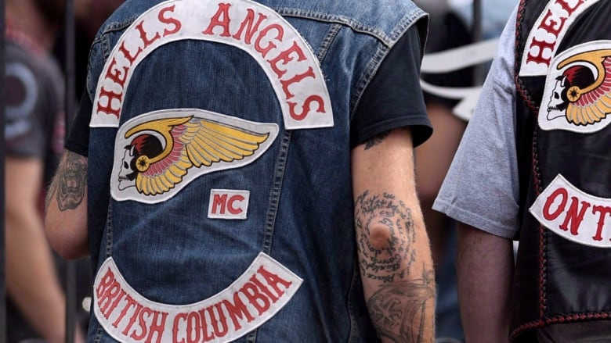
Gangs in British Columbia Intro
Defining ‘Gang?’
Crim Code:
a group of three or more people with the main purpose of committing or facilitating serious offences for financial benefit
What factors might lead someone to join a ‘gang?’
Why is BC unique to other jurisdictions in North America re: gang culture?’
How do we know someone is in a ‘gang?’
What criminal organizations are active in British Columbia?
What illegal activities are gangs in BC involved in? Legitimate too?
Notorious Gangs of British Columbia
Est. 120 gangs across British Columbia….many/most do not self-identify
most well-known gangs are not always the most dangerous or most powerful
membership can be ‘fluid,’ with various levels of gang affiliation…..gang members do collaborate (like Band Students and CSE)
some gangs are home-grown, while others are offshoots of international criminal organizations
major areas of operation, predominantly connected to illicit drug trade across British Columbia
many criminal organizations will operate legitimate businesses that are intended to facilitate criminal activities (nightclub?)
Tracking the rise in gang violence since 2016
the response? – Combined Forces Special Enforcement Unit (CFSEU) established in 2018

Slide 6
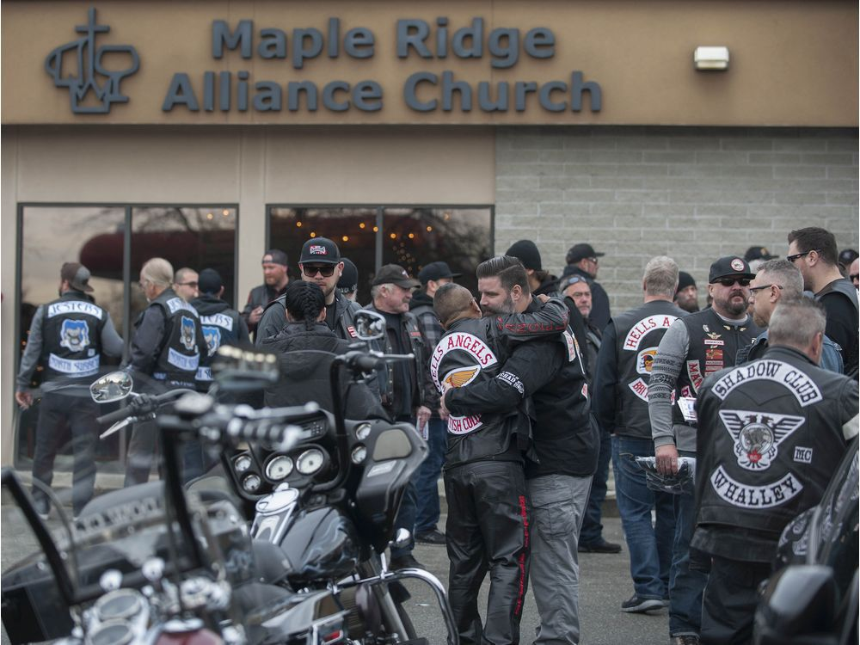
Hells Angels Origins: California, 1940s (post WWII)
the one percenter motorcycle club…..an ‘outlaw’ biker club?
an international criminal organization….more than 100 ‘charters’ spread over 29 nations
In British Columbia - some 10 chapters known to police (36 in Canada) ……likely the largest ‘gang’ in the nation
est. late 1970s (Vancouver) *splinter groups
Vancouver (1983)
White Rock (1983) – West Point* (2012)
Nanaimo (1983)
East End Vancouver (1983) – Nomads* (1998)
Haney (1987) – Hardside* (2017)
Mission City (1999)
Kelowna (2007)
each chapter maintains a President with veto powers
a sergeant-at-arms is responsible for ‘discipline’
secretary-treasurer who manages finances
road captain who organizes ‘club runs’
close relations with ‘traditional’ organized crime – social/ business ties
not easy to become a full ‘patch’ member
motorcycle w/ driver’s license
sponsor – must have known for 5 years
two-year indoctrination
male only – cannot have applied for job as police officer
full-patch members operate independently, but use ‘associates’ and
non-members for criminal activity they are into…..
drug-trafficking, prostitution, money laundering….
Women – HA use women to acquire intelligence regarding rivals, police
About 250 members of the Hells Angels motorcycle club from BC and across Canada, including members of affiliated support clubs, attended the funeral for slain HA Hardside chapter member Chad Wilson, at the Maple Ridge Alliance Church in Maple Ridge, BC Saturday, December 15, 2018. Wilson was found murdered under the Golden Ears bridge November 18, 2018. There was a heavy police presence at the church during the service.

Slide 7
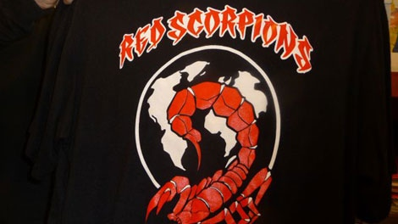
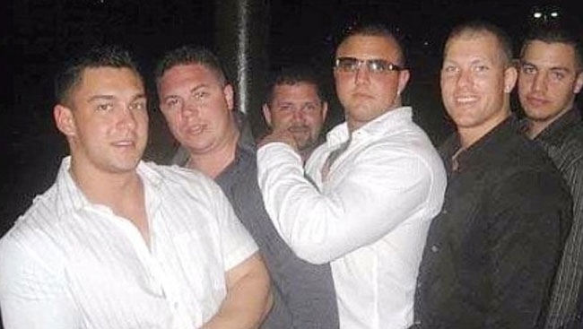
Red Scorpions
Est. 2005
formed after meeting of founders in a youth detention centre (BC)
multi-ethnic backgrounds – race secondary to loyalty and respect
identified by ‘RS’ tattoos on arms and necks; skull tattoos = killings
‘Dial-a-Dope Lines’ – that is, drug-trafficking in suburbs of Vancouver
Bacon Bros. ‘completely fearless’
middle-class background; Abbotsford, BC
merge, align with Red Scorpions to compete against Hells Angels (c.
had been associates of United Nations gang, then rivals….
linked to some of the bloodiest shootings in lower mainland….
Surrey Six Gangland Murders – October 19, 2007
Jamie Bacon, (23), angry at Corey Lal, (22), for selling drugs on
Scorpion turf and refusing to pay a $100 000 ‘tax’ for doing so….
Bacon sent a hit squad to kill Lal……spun out of control
hit squad kills innocents and associates of Lal….
BC’s worst gangland slaughter?
Bacon, in 2020, receives 18 year sentence for ‘conspiracy’ to commit
murder, minus more than 12 years credit for his time in pretrial custody
It would appear the Red Scorpions are ‘out of it’ in terms of BC’s gang hierarchy……or are they?
Red Scorpion Insignia
Bacon Brothers
Jonathan (far left) – shot, killed 2011 in Kelowna
Jamie (middle) – incarcerated, serving time for Surrey Six Murders
Jarrod (second left) – incarcerated, sentence extended for violating parole

Slide 8
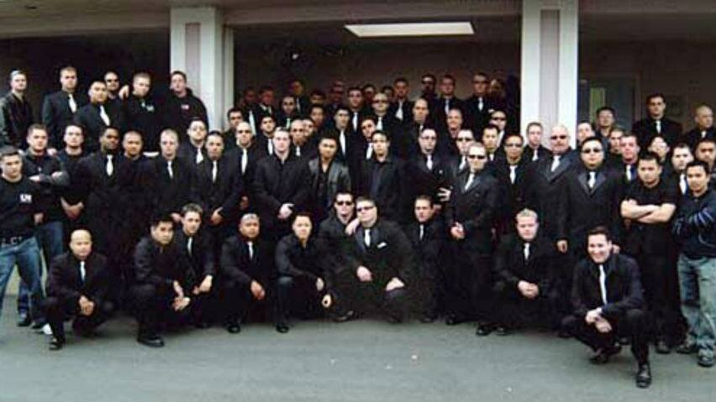
United Nations Gang aka – Global United Nations Syndicate (GUNS)
Est. in Vancouver circa 1990s
territory – across Canada and into the United States
founded by Clay Roueche (white-Canadian), but surrounded himself with Vietnamese and Lao-Canadians
Roueche borrowed much from Asian cultures for his gang…..
tattoos – Chinese calligraphy
Bushido – the way of the warrior?
mixed-martial arts training
Initiation similar to Chinese Triads
‘cloaked’ themselves by wearing high end expensive and luxury brands
Hierarchy
expansion lads to structure – similar to military ranks
each prov. Had a ‘commander’ who appointed ‘generals’ to a city
Involved in arms trafficking, drug-trafficking (go hand in hand, actually…), money laundering, illegal immigration, etc….
a significant rival to Red Scorpions – much of the gangland violence of the late 2000s (2008-10) attributed to them
Roueche, arrested in US for trafficking cocaine (2008) – incarcerated in Seattle detention centre
currently – many of the original members in prison, deported or disappeared….some members continue, but marginalized relative to its notoriety in the mid 2000s….

Slide 9
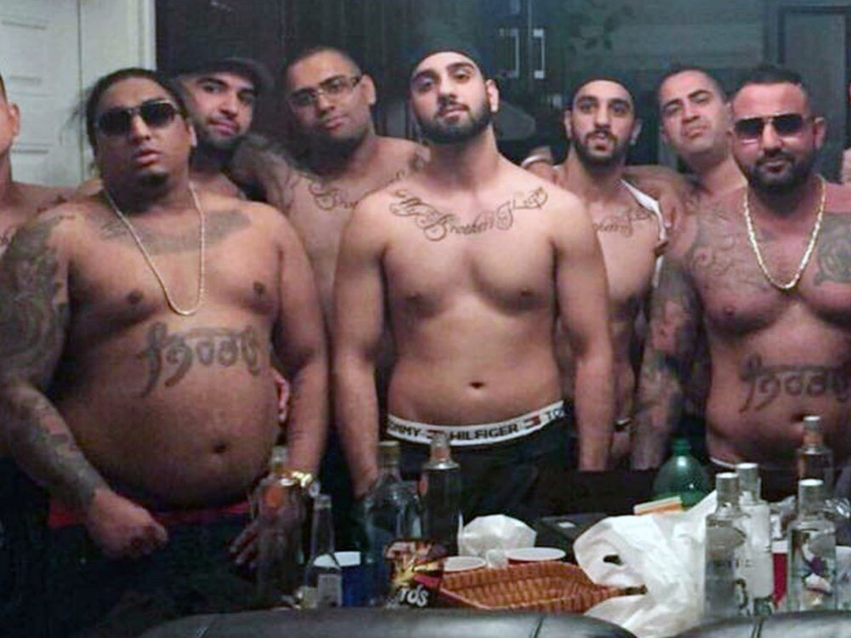
Brothers Keepers
Est. 2010’s (2017?)
Indo-Canadian origins ……..in the early 2000s, similar styled – ‘Independent Soldiers’ Gang
former alliance with Red Scorpions and its membership
12 ‘Executive’ members ……some 200 criminal associations
Activities
drug-trafficking; heroin, in particular….
utilizing family connections in Punjab to traffick
from Afghanistan, Pakistan and Iran….
extortion, kidnapping, money laundering, contract killings….
smuggling – connections w/ Mexican drug cartels – cocaine & hashish
Rap Music to threaten enemies…..
Expansion efforts to interior of BC, Vanc. Island, Alberta, Ontario….
Combined Forces Special Unit of BC (CFSEU)
Est. 2009 (in response to gangland wars b/w Red Scorpions and UN Gang)
an integrated anti-gang police agency w/ some 400 members
members affiliated with local police departments –
from about 2017, CFSEU has been focused on Brothers Keepers expansion efforts
sophisticated use of analytical tools of social media to uncover criminal networking…..
$30 Million Dollar Drug Bust – VicPD And CFSEU coordinated
fentanyl drugs and guns…
Brothers Keepers

Slide 10
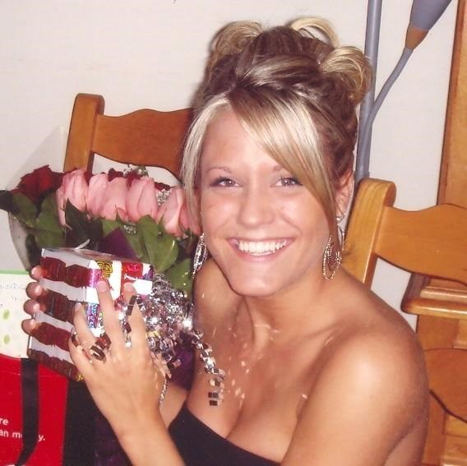
Women and Gang Life Is gang life inherently ‘sexist?’
Are women exploited? Always the victim? Subservient?
Machismo?
a strong sense of being ‘manly?’
an exaggerated masculinity?
how does this impact gang culture?
how does this impact women in gangs?
Female Gangs?
still too little research on this…. ‘bias?’
young women do join gangs and play important roles….leadership?
Rationale?
Why do young women ‘join’ gangs?
Roles?
‘mules’
‘nurses’
‘queens’
Young women will make their gender more masculine – why?
dark clothing
minimizing sexual attributes
becoming ‘invisible?
Brianna Kinnear, 2009
‘They don’t murder girls.’
Shot and killed in targeted hit (Coquitlam, 2009)
Women are victims of violence, both from within a gang and from reprisal attacks….
sexual assault
assault
torture
murder

