Slide 1
March for our Lives
By: Maddy and Brooke

Slide 2
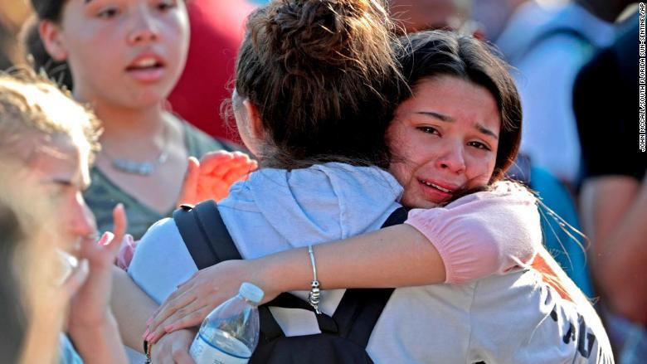
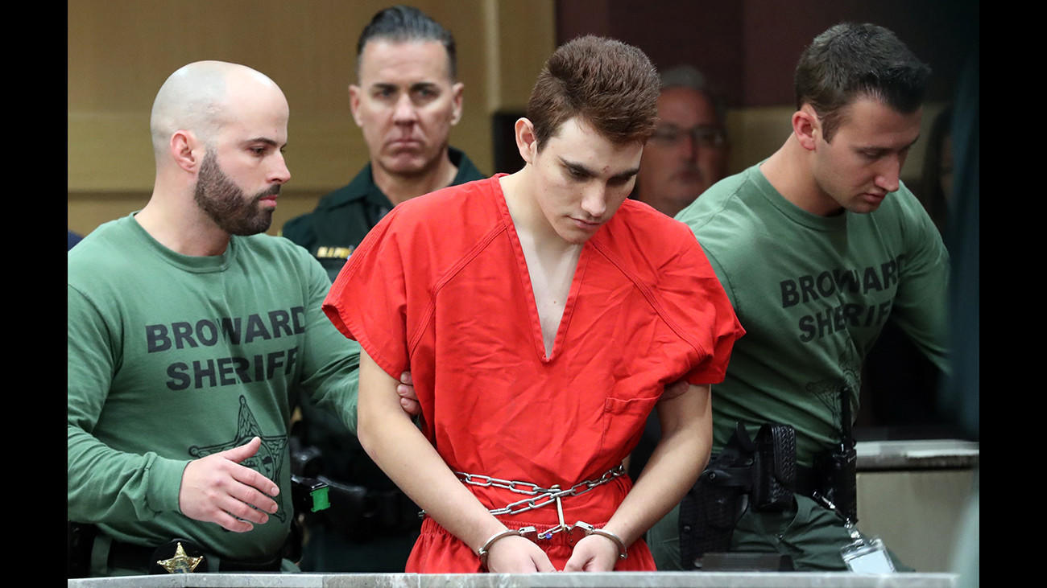
Catalyst
School shooting in Parkland Florida
February 14th, 2018 at Marjory Stoneman Douglas High School
Shooter was an ex- student named Nikolas Cruz

Slide 3
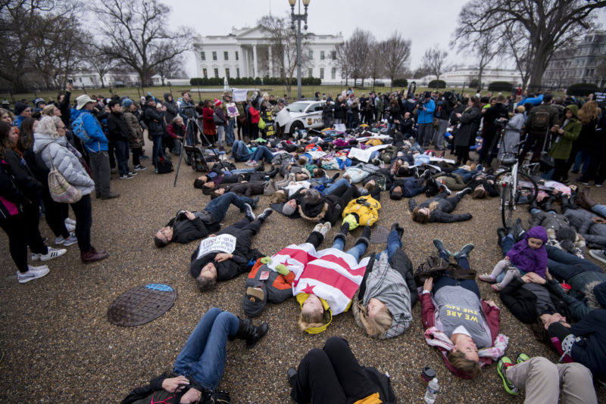
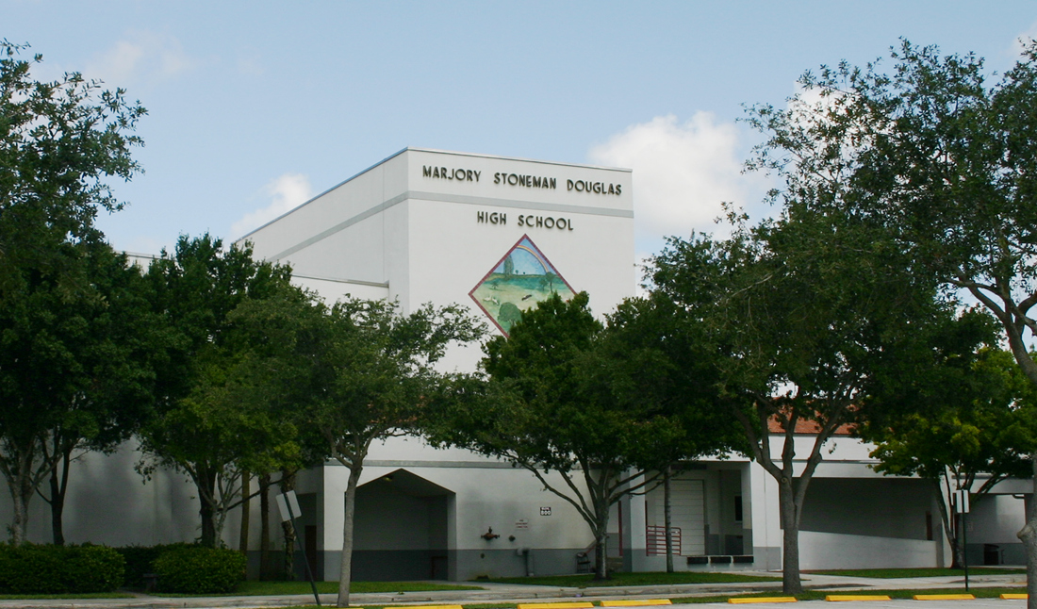
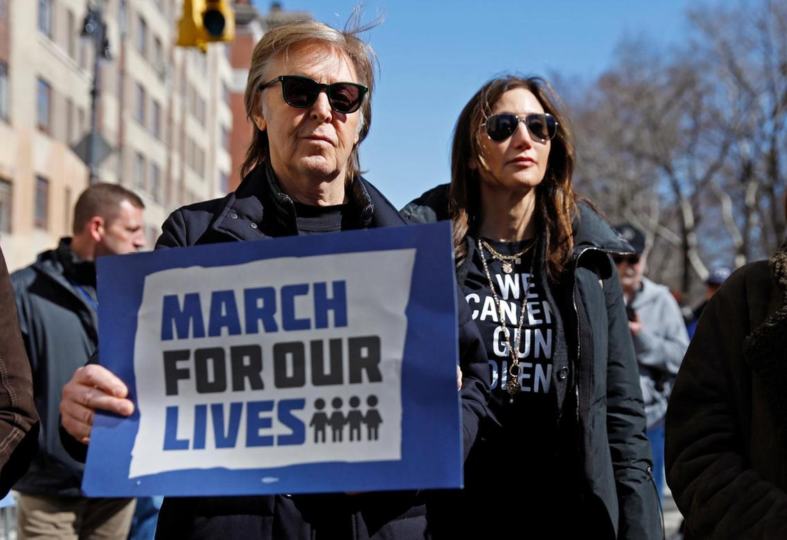
Factors
Student survivors of the parkland shooting
Lack of gun control
Celebrity involvement

Slide 4
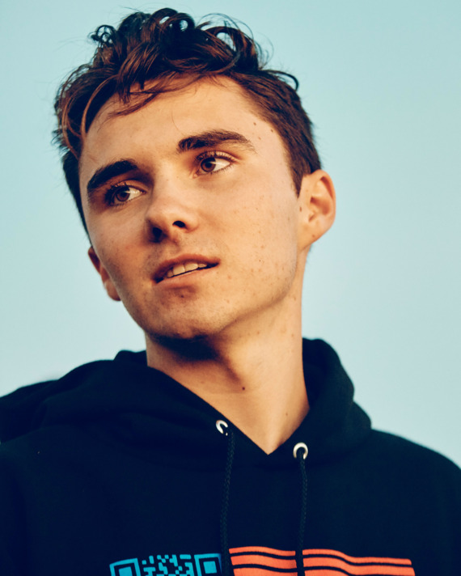
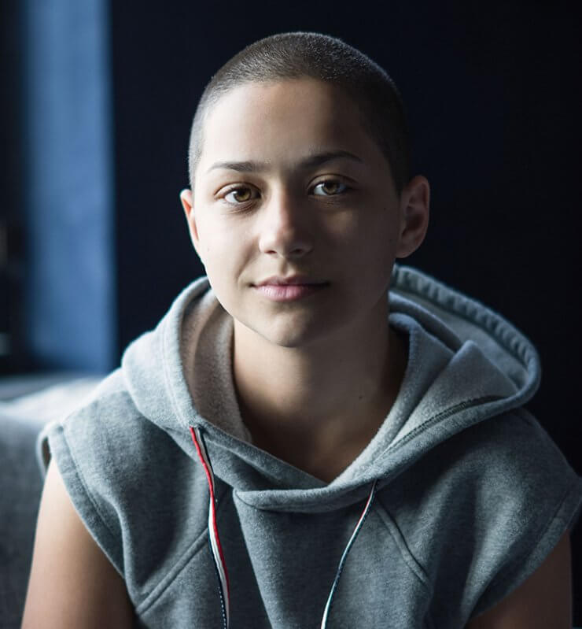
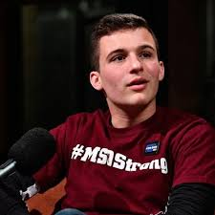
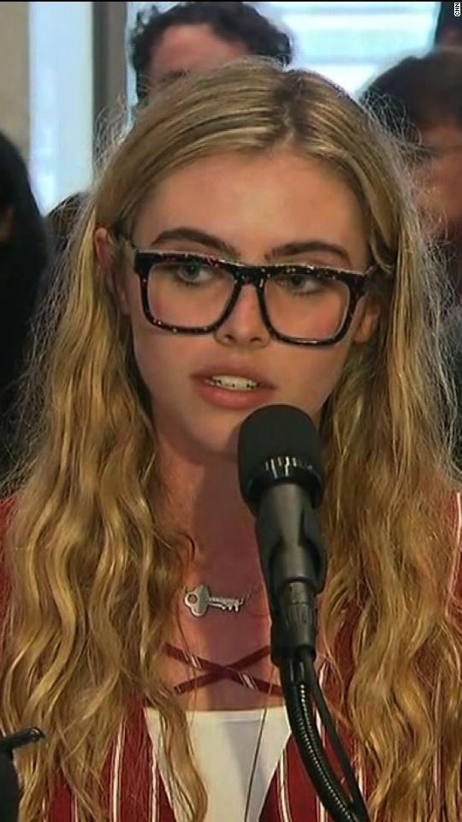
Seeking Change
Student activists- David Hogg, Emma Gonzalez, Cameron Kasky, Delaney Tarr, among others
“Common sense” gun laws
Stricter background checks
To raise public awareness about the issue

Slide 5
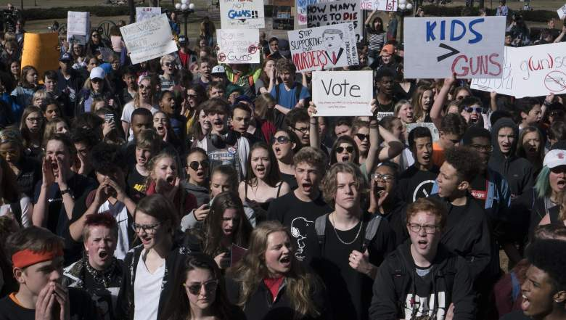
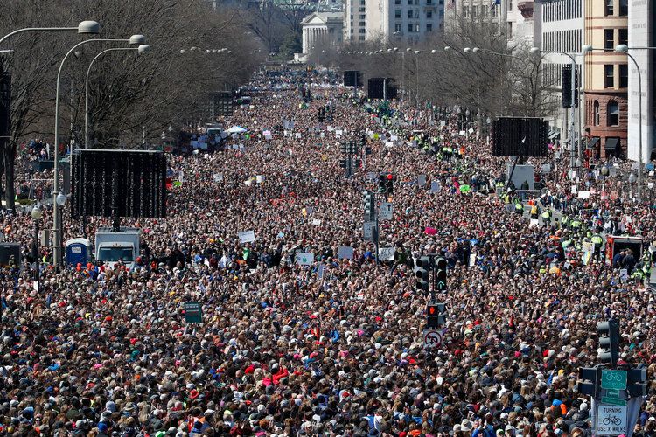
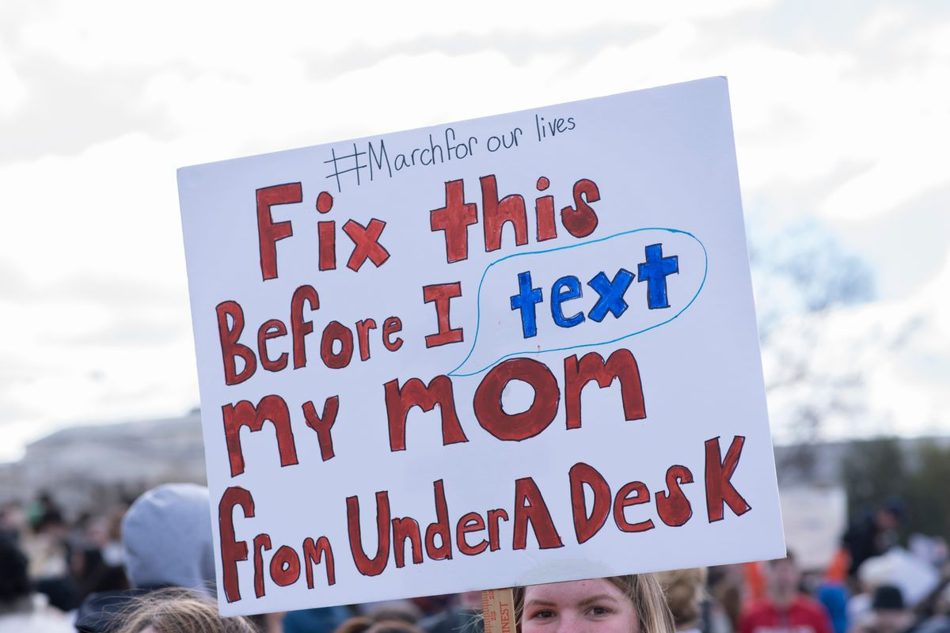
Violence
Non Violent
Organization had a lot to do with it
Important because of the dilemma they were addressing

Slide 6
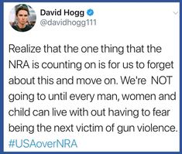
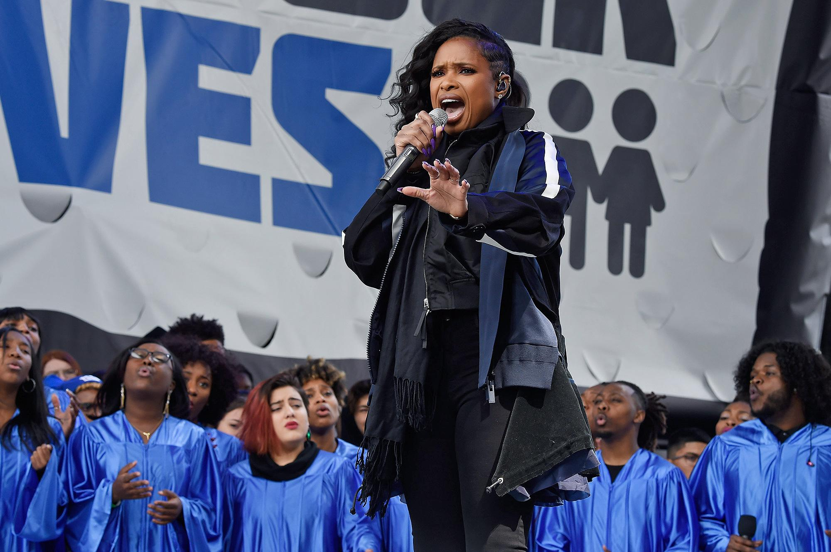
Tools
Social media (Twitter, Instagram)
TV interviews and press conferences
Support from celebrities (Paul McCartney, MLK’s granddaughter, Jennifer Hudson)

Slide 7
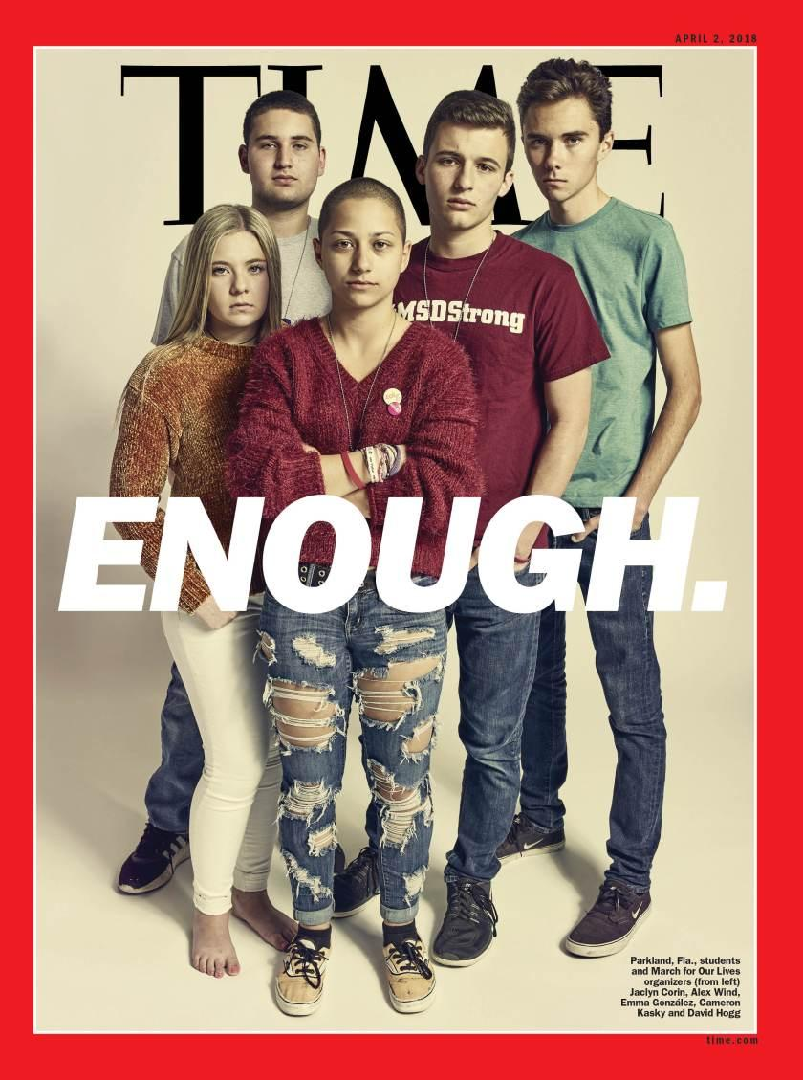
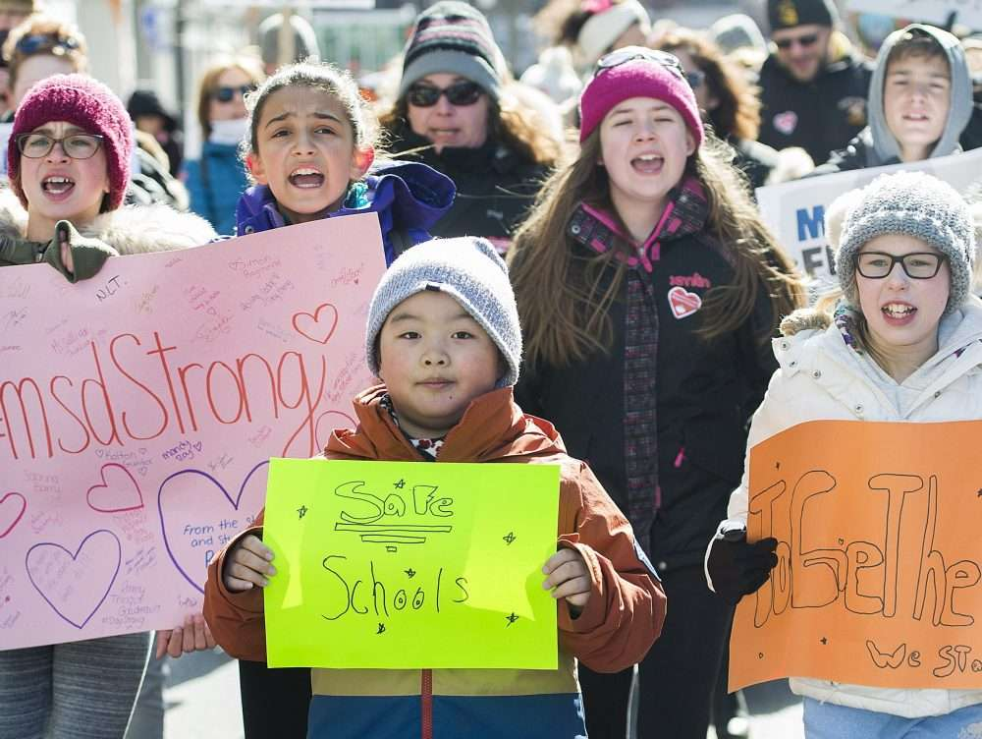
Impact
A new template for protest
A new conversation about gun control
Addressing and correcting mistakes in the past that should’ve been dealt with by previous generations

Slide 8
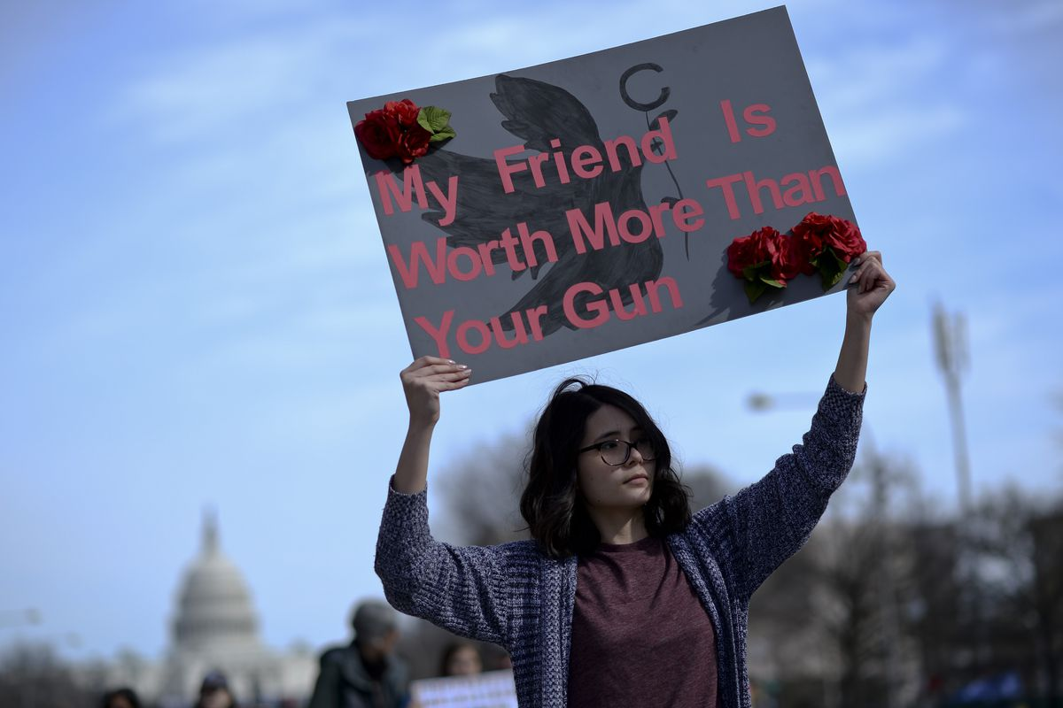
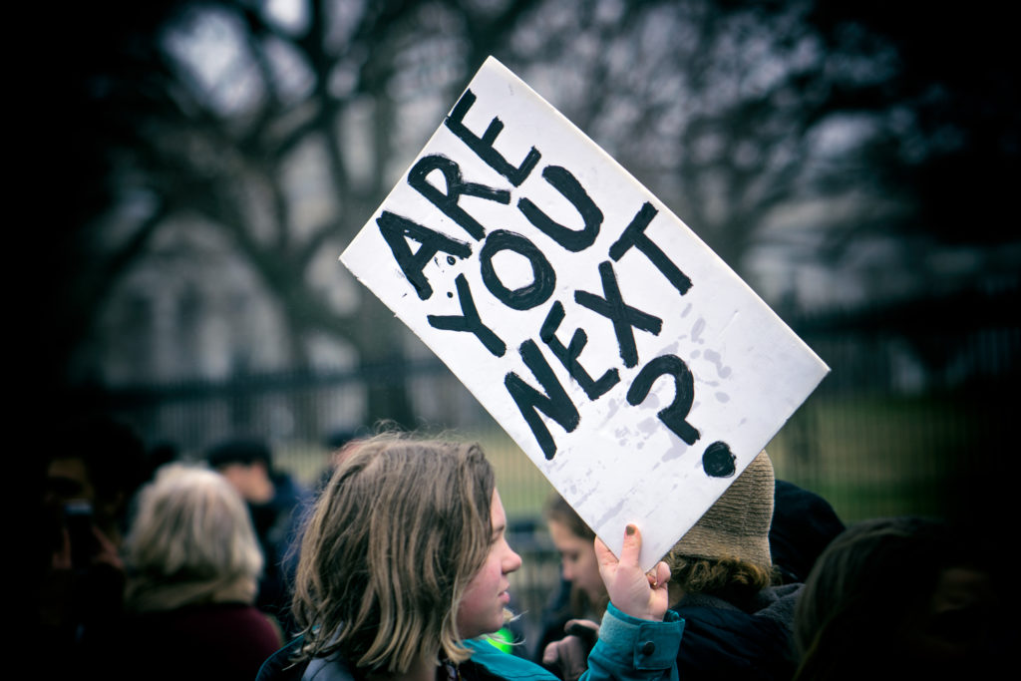
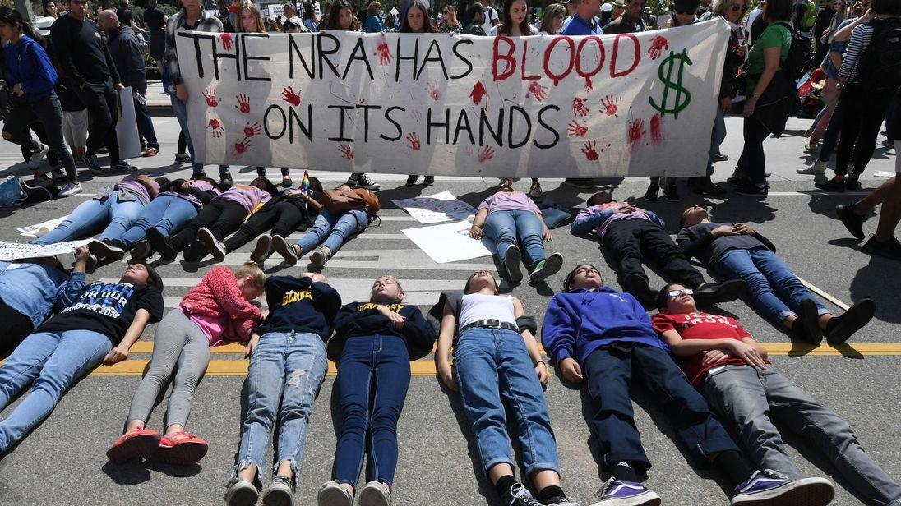
Significance
The importance of youth voice
Breaking stereotypes around political involvement from the youth
The first movement organized by people born in 1999

Slide 9
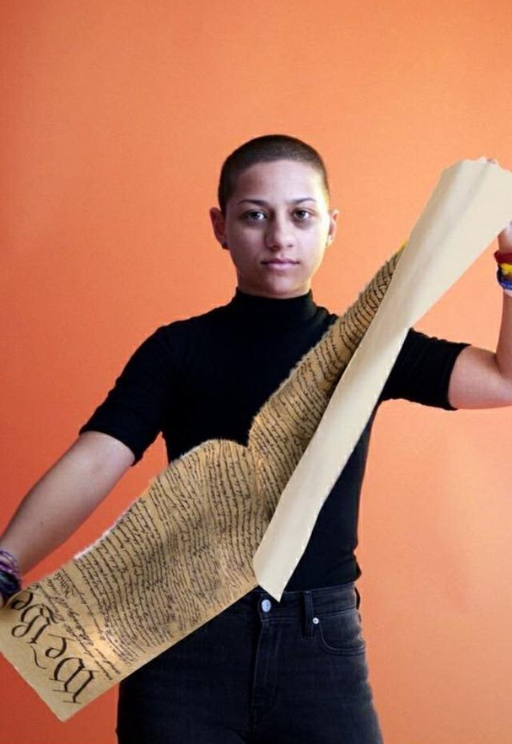
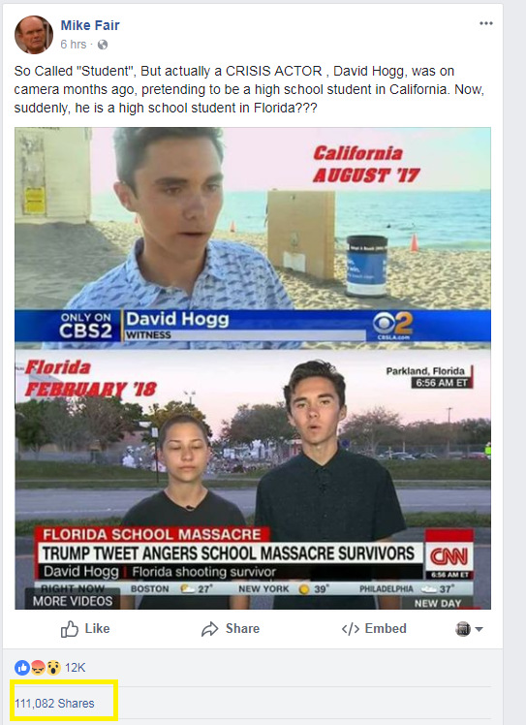
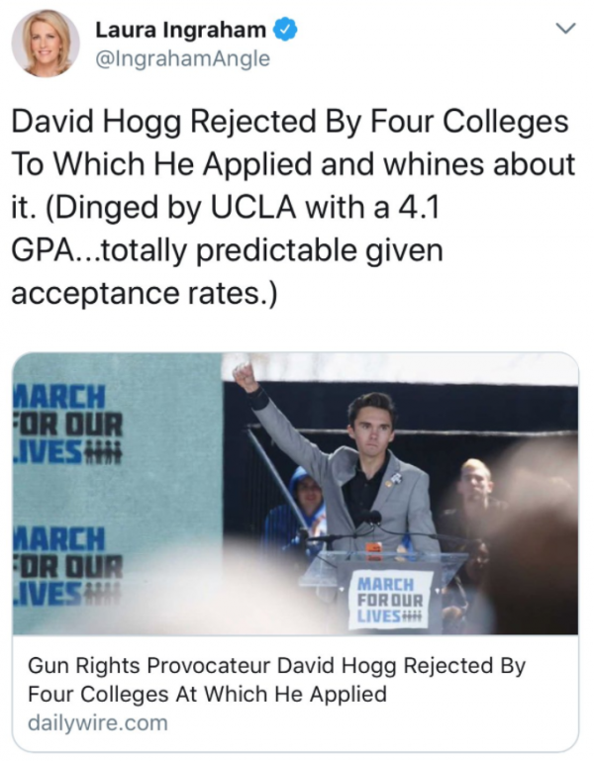
Problems
Politicians failing to change gun laws
NRA is very powerful
Fox News and other right-wing news outlets
Conspiracy theories questioning the credibility of the child activists

Slide 10
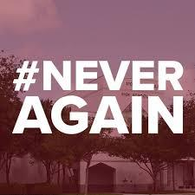
Influence
Activists did a good job of raising awareness through social media and TV interviews
However not much real change happened
The activists could have focused more on directly addressing politicians and making the issue more non-partisan

Slide 11
Discussion Questions
What do you think will happen now? Will gun laws ever change?
What do you think is the best way to motivate politicians to change gun laws?
What can America learn from this?

Slide 12
Bibliography (Maddy)
Account, Laura IngrahamVerified. "Laura Ingraham (@IngrahamAngle)." Twitter. November 27, 2018. Accessed November 27, 2018. https://twitter.com/IngrahamAngle?lang=en.
Arkin, Daniel, and Ben Popkin. "How the Fake "crisis Actors" Conspiracy Took off on Social Media after Florida School Shooting." NBCNews.com. February 21, 2018. Accessed November 27, 2018. https://www.nbcnews.com/news/us-news/how-internet-s-conspiracy-theorists-turned-parkland-students-crisis-actors-n849921
Arneson, Krystin. "No, Emma Gonzalez Isn't Tearing Up the Constitution in That Viral Video." Glamour. March 26, 2018. Accessed November 27, 2018. https://www.glamour.com/story/emma-gonzalez-not-tearing-up-constitution-in-viral-video.
Class, Jessenia. "March for Our Lives Is Great, but Not Enough." The Harvard Crimson. April 23, 2018. Accessed November 27, 2018. https://www.thecrimson.com/article/2018/4/23/class-march-for-our-lives/.
Gonzalez, Emma. "Emma Gonzalez's Powerful March for Our Lives Speech in Full - Video." The Guardian. March 24, 2018. Accessed November 27, 2018. https://www.theguardian.com/us-news/video/2018/mar/24/emma-gonzalezs-powerful-march-for-our-lives-speech-in-full-video.

Slide 13
Bibliography
"March For Our Lives." March For Our Lives. Accessed November 27, 2018. https://marchforourlives.com/.
Witt, Emily. "How the Survivors of Parkland Began the Never Again Movement." The New Yorker. April 17, 2018. Accessed November 27, 2018. https://www.newyorker.com/news/news-desk/how-the-survivors-of-parkland-began-the-never-again-movement.

Slide 14
Bibliography (Brooke)
Rose, Joel, and Brakkton Booker. "Parkland Shooting Suspect: A Story Of Red Flags, Ignored." NPR. March 01, 2018. Accessed November 27, 2018. https://www.npr.org/2018/02/28/589502906/a-clearer-picture-of-parkland-shooting-suspect-comes-into-focus.
Ryan@lisarya, Lisa. "Here Are All the Celebrities at the March for Our Lives." The Cut. March 24, 2018. Accessed November 27, 2018. https://www.thecut.com/2018/03/march-for-our-lives-2018-celebrities-performers.html.
Schuster, Kathleen. "8 Facts about Gun Control in the US | DW | 08.11.2018." DW.COM. November 08, 2018. Accessed November 27, 2018. https://m.dw.com/en/8-facts-about-gun-control-in-the-us/a-40816418.
Stevens, Shamika. "Reflections on the March for Our Lives: The Importance of Youth Voice." American Youth Policy Forum. September 28, 2018. Accessed November 27, 2018. https://www.aypf.org/blog/blog-reflections-march-for-our-lives/.
"These Are the Victims of the Florida School Shooting." Google Search. Accessed November 27, 2018. https://www.google.ca/amp/s/amp.cnn.com/cnn/2018/02/15/us/florida-shooting-victims-school/index.html.
"Why Gun Background Checks Don't Work." Google Search. Accessed November 27, 2018. https://www.google.ca/amp/s/amp.cnn.com/cnn/2018/02/26/opinions/why-background-checks-dont-work-opinion-mihalek/index.html.

Slide 15
Bibliography
"Why Gun Background Checks Don't Work." Google Search. Accessed November 27, 2018. https://www.google.ca/amp/s/amp.cnn.com/cnn/2018/02/26/opinions/why-background-checks-dont-work-opinion-mihalek/index.html.
"3 Reasons Gen Z Activists Have Changed the Gun Control Conversation When No One Else Could." Google Search. Accessed November 27, 2018. https://www.google.ca/amp/s/www.cnbc.com/amp/2018/03/23/how-the-march-for-our-lives-organizers-changed-the-gun-control-conversation.html.

