Slide 1
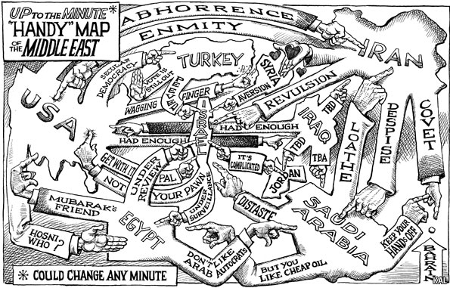
Map of the Middle East?

Slide 2
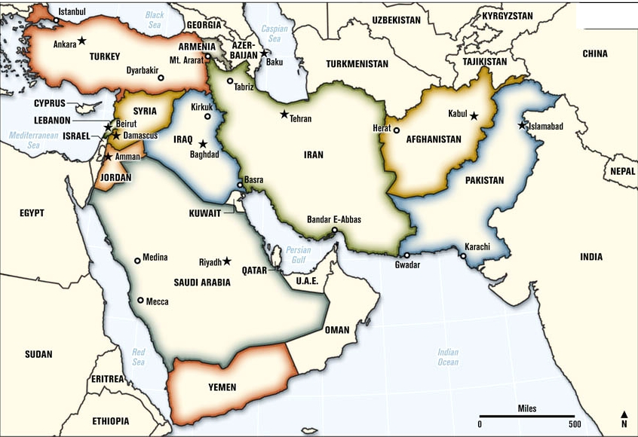
Middle East

Slide 3
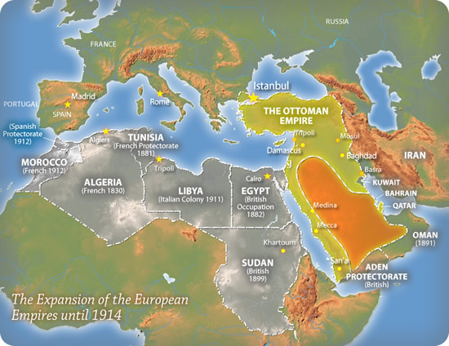
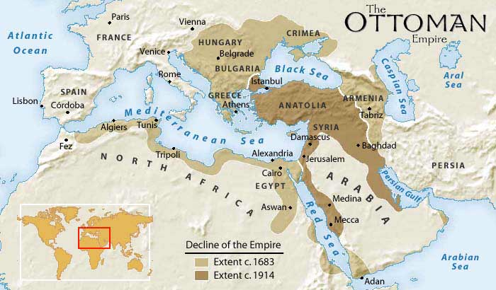
The Middle East
What would replace the Ottoman Empire?

Slide 4
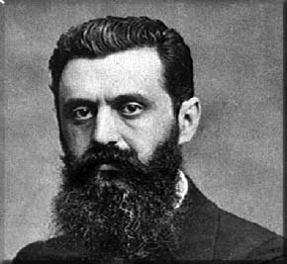
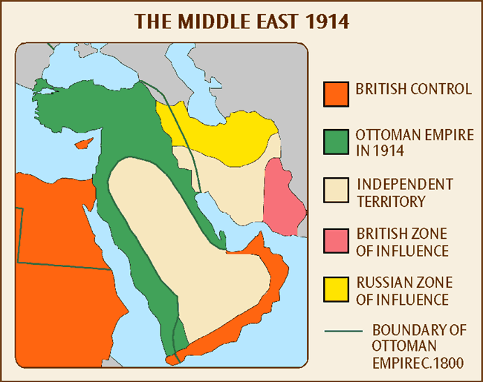
The Middle East
https://www.youtube.com/watch?v=EIvFj0abW7Y&list=PLPvkBEWSL5pKelZ5rXDwFTerxuq9rlUKk&index=5
Zionism (late 19th century)
a political movement & ideology that supported a Jewish homeland in Israel free from anti-Semitism
Jewish Diaspora –
Biblical homeland? (Jerusalem)
Migrations to northern Europe
Early 20th century –
Jewish migrations to Trans-Jordan and Palestine
Theodore Herzl
Re-Emerging Colonialism
1914 - WWI breaks out and the Arabs help the British to win control of the Middle East from the Ottoman Empire, with the hope of gaining independence.
Gradually, the Arabs came to realize that European promises were worthless—France and England had other plans for the Middle East.

Slide 5
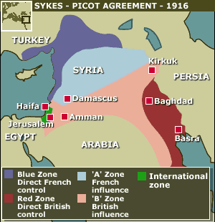
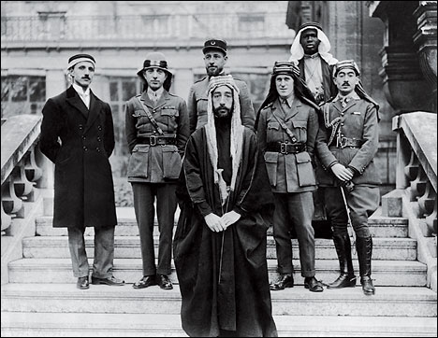
Imperial Claims – Why? – Oil, Suez, Mandates…
https://www.youtube.com/watch?v=B8NGe9p6Y_g&index=6&list=PLPvkBEWSL5pKelZ5rXDwFTerxuq9rlUKk
Sykes-Picot Agreement, 1916
British & French split up Ottoman Empire in secret deal
No provisions for either Jewish or Arab states
Balfour Declaration, 1917
British Foreign Secretary, Lord Balfour,
‘views, with favour, the establishment in Palestine of a national homeland for Jewish people’
McMahon Letters, 1918
British High Commissioner in Egypt states that Britain ‘promises to recognize and support the independence of Arabs in the mid-east region.’
Paris Peace Conference, 1919
Mandate System
Middle East is split according to Sykes-Picot
British support Zionist desire for Jewish homeland in Palestine in return for support for British interests in Suez Canal
Arab delegation views this as a betrayal –
for they had fought for Britain in WWI
https://www.youtube.com/watch?v=Y3_5nTRu0O8&list=PLPvkBEWSL5pKelZ5rXDwFTerxuq9rlUKk&index=7
Britain – Palestine & Trans-Jordan
France – Syria & Lebanon

Slide 6
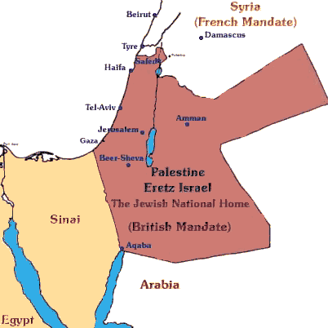
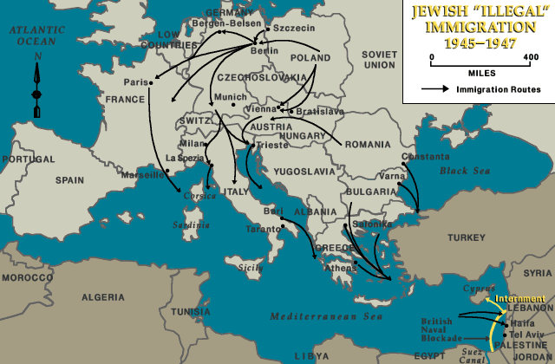
The British in Palestine, 1917-1947
How did Britain’s actions in Palestine lay the groundwork for the on-going conflict between Jews and Arabs in the Middle East?
1920 – 1 Jew for Every 10 Arabs
1947 – 1 Jew for every 2 Arabs
Palestinian-Arab Revolt (1936-39)
British White Paper (1939)
Strict limits on Jewish immigration to Palestine
Ends Jewish purchasing of land
Br. do not agree that Palestine should be Jewish state
‘Exodus’ (1945-57)
Holocaust
Aliyah Bet : Illegal Jewish Immigration
British Naval Blockade
Quarantine Camps (Cyprus)
Jewish ‘freedom fighters’ (terrorists?)
Can British hold on to mandates?
Britain turns to the United Nations (1947)
Why should he (Palestinian) give away half of is land, when in his mind he owns it all?

Slide 7
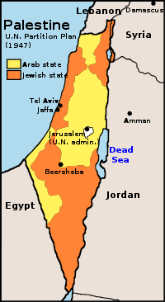
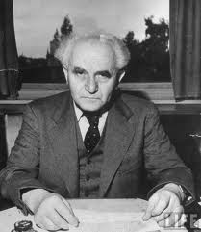
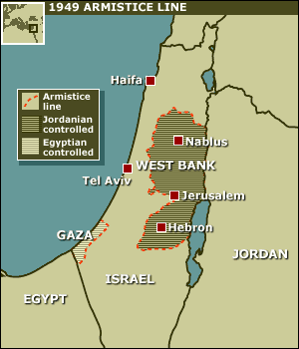
Partition
1947 – United Nations Partition Plan
David Ben-Gurion, a Zionist leader, accepts plan
Arab League (1945) rejects partition plan
Creation of Jewish homeland
Remainder of Palestine to Arabs
Jerusalem an UN administered city
Ben-Gurion declares a ‘State of Israel’ reborn
1948 – Arab-Israeli War
Egypt, Jordan, Syria, Iraqi & Saudis invade ‘Israel’
1949 – Armistice signed
West Bank (Jordan)
Gaza Strip (Egypt)
Palestinian refugees (diaspora)
100’s of 1000’s escape/exiled to
nations around the Middle East
West Bank
Gaza
Jordan
Syria
Lebanon
Arab-Israeli Conflict from 1947 -
http://www.youtube.com/watch?v=D0IlCl9ODiw

Slide 8
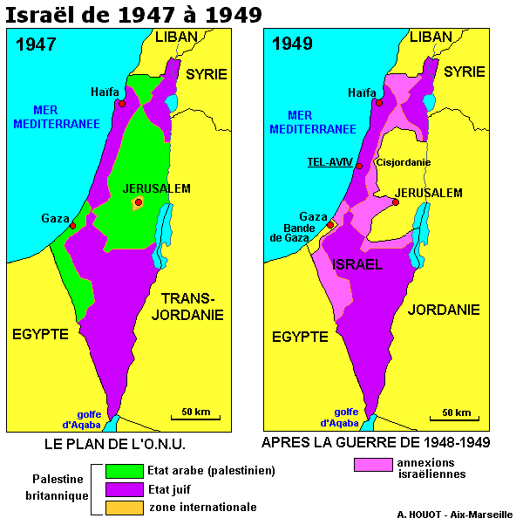
War of Independence/Palestinian War (1948)
Demographic Change:
700 000 Palestinian (Arab) refugees flee or were expelled from area that became Israel
700 000 Jews flee or were expelled from Arab states in the region; migrate to Israel
Historiography –
In the West, the majority view was of a tiny group of vastly outnumbered and ill-equipped Jews fighting off the massed strength of the invading Arab armies
The Palestinians regard Israelis as the conquerors and themselves as the true victims of the first Arab-Israeli war which they call al-Nakba or the disaster. Palestinian historiography reflects these perceptions.
Palestinians, in spite of fellow Arab support in various wars, are not particular welcome anywhere they go – because of their own extremist actions – But it is obvious that there is no peace in the Middle East without agreement regarding Palestinian refugees.
Israel
The Israelis, whether conquerors or not, were the indisputable victors in the 1948 war which they call the War of Independence. Because they were the victors, among other reasons, they were able to propagate more effectively than their opponents their version of this fateful war.

Slide 9
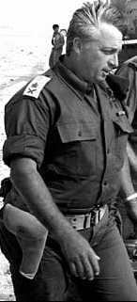
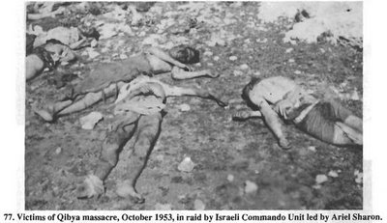
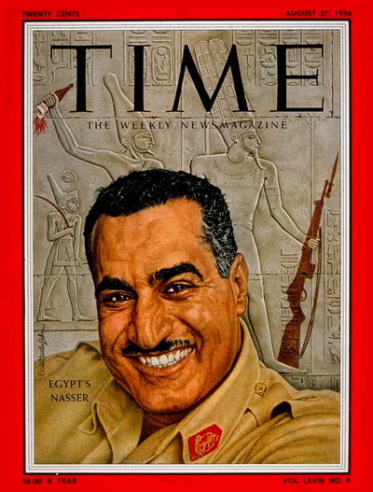
The Uneasy Truce
1949 – Israel and Arab states sign a truce
For Arabs – an inglorious defeat
Palestinians formed organizations and attacked Israel from neighbouring states (Lebanon, Jordan, Syria)
1951 - Israeli Defense Force (IDF) begins raids on Palestinian and
Jordanian villages in the West Bank
1953 – Qibya Massacre
1952 – Egypt sees King Farouk overthrown by Egyptian Army
Military regime led by General Naguib, but Egypt is really controlled by Colonel Gamal Abdel Nasser
Ariel Sharon

Slide 10
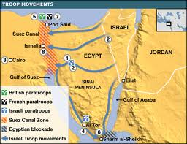
Suez War, 1956
Key Issues:
USA and USSR enter Middle East conflict
Think: Cold War – ‘sphere of influence’
Eisenhower Doctrine
Use of military force if requested by
any Middle East nation (in order to
prevent further Soviet expansion)
Exit of France and Britain as meaningful players
Closure of Suez Canal (to 1957) and impact of
Israeli possession of the Gaza Strip
Role of United Nations
Pearson’s Peacekeepers (UNEF)
El Fatah – Palestinian Liberation Organization (PLO)
Leader: Yasser Arafat
Arab/Palestinian frustration with results of war(s)
‘terrorism’ becomes and remains a permanent feature of affairs in the Middle East
Terrorism or Nationalism?
Tactics: Airline hijackings/ hostage taking
For Israel –
Emerged victorious yet again
Demonstrates military prowess of Israel
Its stubborn refusal to withdraw without guarantees, even in defiance of the United States and United Nations, ended all Western efforts, mainly American and British ones, to impose a political settlement in the Middle East without taking Israel's security needs into consideration

Slide 11
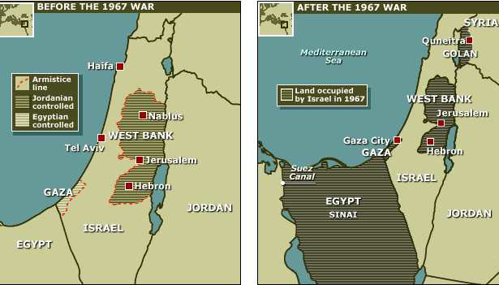
Six Day War, 1967
Background:
PLO attacks of Israelis
Escalation:
Israeli raids into Jordanian West Bank
Israeli flights/aerial clashes over Syria
Syrians launch rockets at Israeli civilian targets
Israelis respond against Syrian positions in the Golan Heights
Egypt blocks Israeli shipping - Strait of Tiran
Egypt mobilizes army along Sinai Peninsula
UN Forces ordered out
Failure of UN due to peace agreement
5-10 June 1967 –
Israel stages ‘preemptive attack’ catching most of the Egyptian Air Force on the ground, destroying it
Israel wins ‘decisive victory’
Occupies: West Bank – Golan Heights – Gaza Strip
Significance:
USSR mobilizes forces to assist Egypt
USA becomes the staunchest of allies with Israel
Suez Canal closed to 1975
Palestinians give up trying to kick Israelis out/call for homeland, rather than all of traditional Palestine
https://www.youtube.com/watch?v=1wo2TLlMhiw

Slide 12
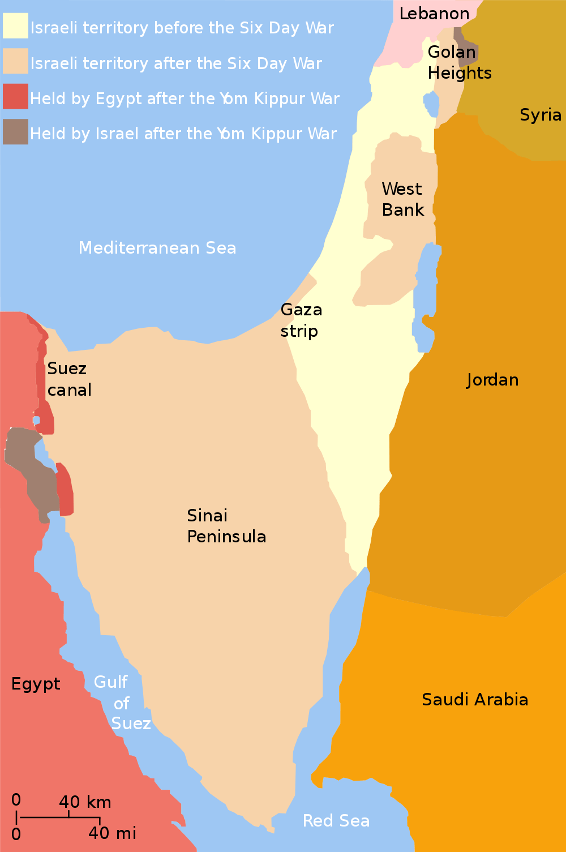
Yom Kippur War, 6–25 Oct 1973
Egypt & Syria launch surprise coordinated attack on Israeli occupied territories (Sinai, Golan Heights), on Yom Kippur, the holiest day in Judaism
Initially, Egypt regained control of Sinai –
Israelis, push back Syrians all the way to Damascus
Egyptian President Anwar Sadat fails in second offensive to fortify position in Sinai
Israelis push Egyptians back across Sinai, encircle Suez and slowly begin advance on Cairo
Significance:
Militarily, this war was a draw – BUT
Israelis had once again routed Arab alliance
Yet, still no guarantee Israelis could dominate
Arab oil embargo: OPEC
Arabs are in no position to fight Israel and US, so they cut oil production thus squeezing US economy
Embargo lasts 5 months, oil price rises for two years, sparking the energy crisis of the 1970’s in USA
Instability in the Middle East gave the U.S.A. reason to get politically involved in the region.

Slide 13
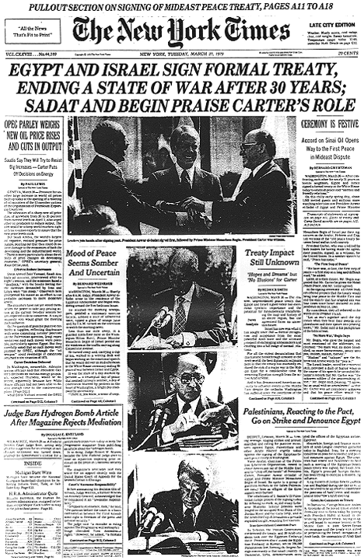
Camp David Accords
Peace in the Middle East?
Sadat (Egypt) realizes that an Israeli state backed by the U.S. could not be defeated, so he begins negotiations with Israeli PM Menachem Begin (against the advice of the other Arab states)
Sadat (1977), first Arab leader to go to Israel
1979 - US President Jimmy Carter & Secretary of State Henry Kissinger broker the Camp David Peace Accords with Sadat & Begin
Outcomes:
Israel and Egypt agree not to make war
Issue of Palestinian refugees is not addressed.
Egypt is expelled from OPEC
Sadat is assassinated by his own honor guard
Begin is shot (not killed) by a Israeli nationalist
How would other Arab states view these developments? Egypt? Israel? USA?
Rise of Islamic Fundamentalism

Slide 14
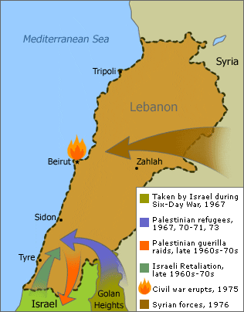
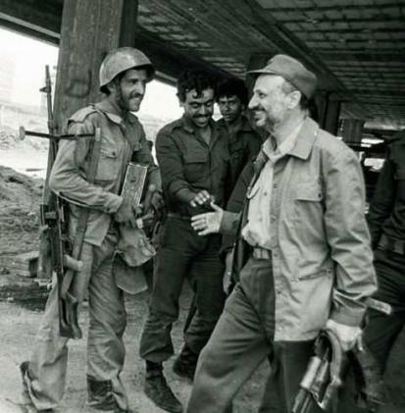
Lebanon
By 1975 – 300 000 Palestinian refugees
PLO based out of Beirut, is a kind of ‘state within a state’
Continual violence near the Lebanese border occurred between Israel and the PLO starting from 1968
1980-82 United Nations Interim Force in Lebanon (UNIFIL)
Ceasefire: Yasser Arafat, leader of the PLO, tries to maintain control, but the splits in the PLO are along fundamental lines based on how to deal with Israel
Hezbollah (Iranian backed, Syrian support)
Palestinian Liberation Front (PLF) (1961)
Radical PLO guerillas in southern Lebanon rocket attacks of Israeli settlements along the Israeli-Lebanon border
https://www.youtube.com/watch?v=D0IlCl9ODiw
1982-85 – Israeli invasion of southern Lebanon
Significance:
Israeli strategic and political failure
Sabra and Shatila Massacre (Ariel Sharon)
Syrian political victory – Hafez Al-Assad (Bashar’s daddy-oh)
Increased Syrian influence in Lebanon
PLO expelled from Beirut (to Tunisia)
200 American Marines killed during truck bombing of American base in Beirut (1984) – Hezbollah found out to be perpetrators

Slide 15
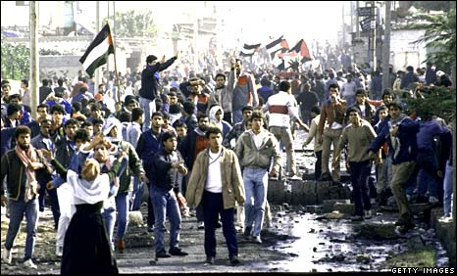
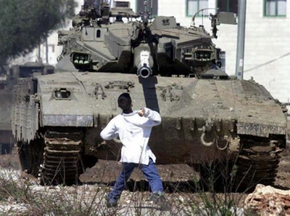
Intifada
a key concept in contemporary Arabic usage referring to a legitimate uprising against oppression
First Intifada, 1987
Palestinian uprising against the Israeli occupation
of the West Bank and Gaza
Civil disobedience, strikes, boycotts, throwing of
stones and Molotov cocktails at IDF
Over six years the IDF killed an estimated
1150–1200 Palestinians. Among Israelis, 100 civilians
and 60 IDF personnel were killed.
Intra-Palestinian violence was also a prominent feature of the Intifada
Second Intifada, 2000-2005
Begins when Ariel Sharon made a visit to the Temple Mount, seen by Palestinians as highly provocative; and Palestinian demonstrators, throwing stones at police, were dispersed by the IDF, using tear gas and rubber bullets
Both parties caused high numbers of casualties among civilians as well as combatants: the Palestinians by numerous suicide bombings and gunfire; the Israelis by tank and gunfire and air attacks, by numerous targeted killings, and by reactions to demonstrations. The death toll, including both military and civilian, is estimated to be about 3,000 Palestinians and 1,000 Israelis, as well as 64 foreigners

Slide 16
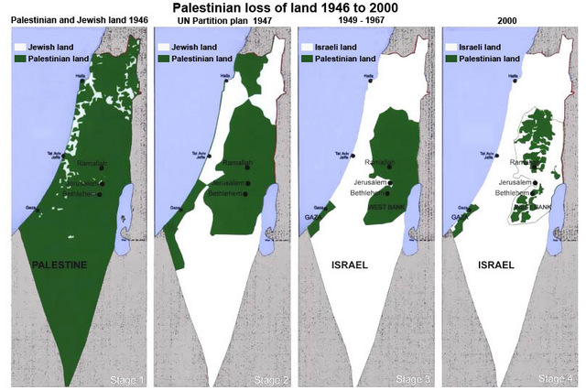
Israeli-Palestinian Conflict https://www.youtube.com/watch?v=iRYZjOuUnlU

Slide 17
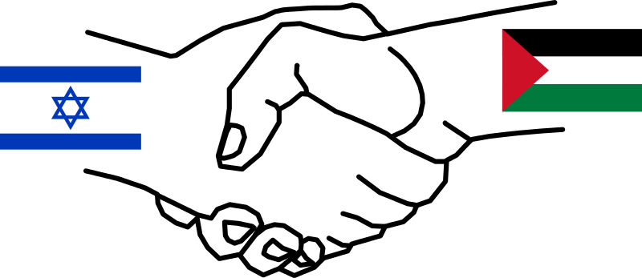
Middle East Peace Process
Since the 1970s there has been a parallel effort made to find terms upon which peace can be agreed to in both the Arab–Israeli conflict and in the Palestinian–Israeli conflict. Some countries have signed peace treaties, such as the Egypt–Israel (1979) and Jordan–Israel (1994) treaties, whereas some have not yet found a mutual basis to do so.
American Involvement –
All recent US Presidents have maintained a policy that Israel must give up some of the land that it conquered in the 1967 war in order to achieve peace; that the Palestinians must actively prevent terrorism; and that Israel has an unconditional right to exist.
Some difficulties with the peace process
both Israelis and Palestinians have grown weary of the process
Israelis point out the fact that the Gaza Strip is fully controlled by the Hamas who do not want peace with a Jewish state
The Palestinians point out to the extensive and continuing Israeli settlement effort in the West Bank restricting the area available to the Palestinian state

Slide 18
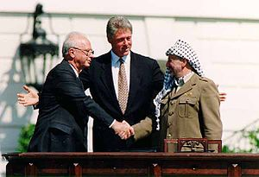
ATTEMPTS TO MAKE PEACE
Oslo Accord (1993)
a plan discussing the necessary elements and conditions for a future Palestinian state "on the basis of Security Council Resolutions 242
Adopted after 1967 Six Day War –
Withdrawal of Israel armed forces from territories occupied in the recent conflict;
Termination of all claims or states of belligerency and respect for and acknowledgment of the sovereignty, territorial integrity and political independence of every State in the area and their right to live in peace within secure and recognized boundaries free from threats or acts of force
Problems –
Jewish claims to occupied territories by Jewish settlers that have made their home in areas gained by Israel in the Six Day War
Internal Israeli politics between ‘hawks’ and ‘doves’
Yitzak Rabin, Pres. Bill Clinton, Yasser Arafat
Palestinians achieved self-governance of major cities in the West Bank and the entire Gaza Strip
Israel maintained and continues to maintain a presence in the West Bank for security reasons
2013 Israel still has control of 61% of the West
http://www.youtube.com/watch?v=gw3uOo21fFA
https://www.youtube.com/watch?v=iRYZjOuUnlU&list=PLmx4ZUNcXQZhG-x3kUexiVKLfLpwPXkq_

Slide 19
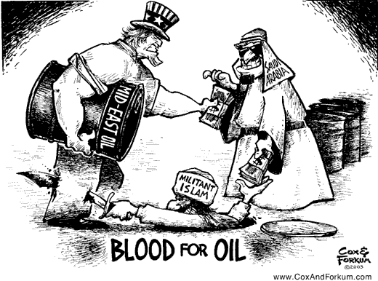
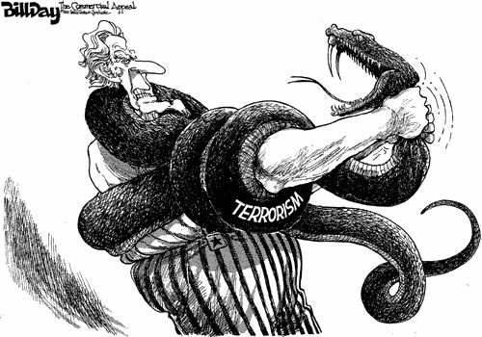
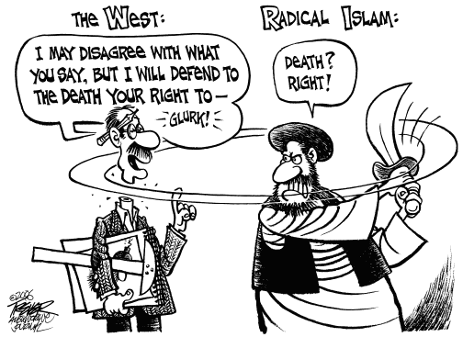
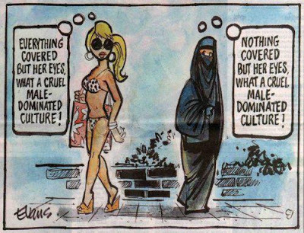
Middle East

Slide 20
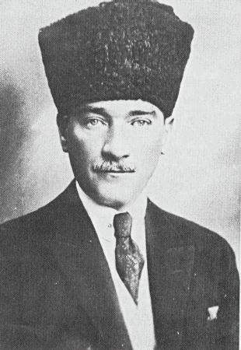
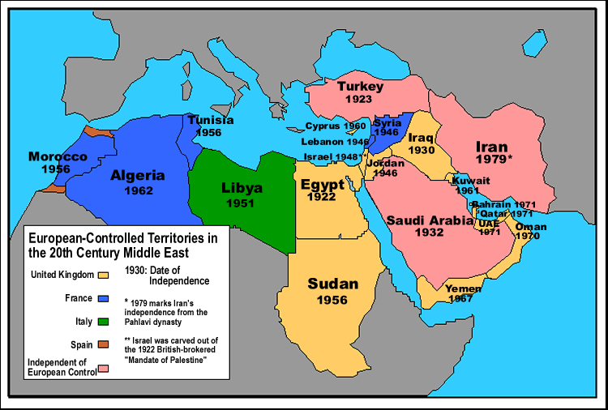
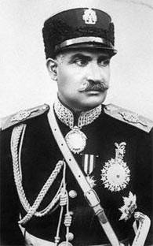
Interwar Period
Turkey (1923)
Treaty of Lausanne
Mustafa Kemal Ataturk
Westernization & Nationalism
compulsory secular education
western clothing
Women unveiled, given full citizenship and the right to vote
Iran
Rezah Khan (1921)
‘Shah’ (1925)
Reforms:
Secularization
Education
French Civil Code
Trans Iranian Rail
Pahlavi Dynasty (‘79 Iranian Revolution)
Western biases? Ignorance of Islamic religion?
West separated church and state
Middle East
To varying degrees, there is the belief that religion and government can/should be interconnected
West has rejected this system
Not ‘right or wrong,’ but rather, whether we understand how Muslims view the role of the world powers during the last century -

Slide 21
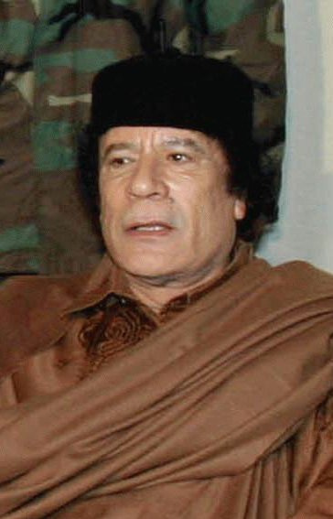
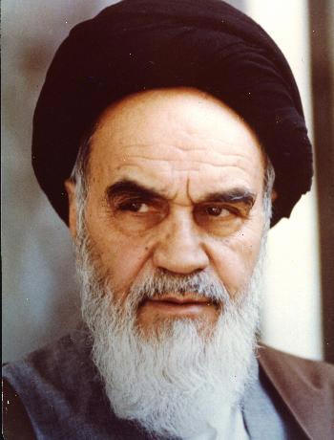
Case Studies: Libya & Iran
1969 – Colonel Moamar Gaddafi leads overthrow in Libya
Gaddafi supports Islamic Fundamentalists & PLO
Blends Arab Nationalism with “Islamic Socialism”
For his anti western policy, Gaddafi gains a negative reputation in western media and diplomatic circles
http://www.biography.com/people/muammar-al-qaddafi-39014
Gaddafi changes course….
Following the attacks of 11 September 2001, Gaddafi made one of the first, and firmest, denunciations of Al-Qaeda bombers by any Muslim leader – Gaddafi is worried for his regime
Arab Spring (2009) and Libyan Civil War (2011)
Gaddafi captured, beaten to death
1979 Iranian Revolution – http://www.youtube.com/watch?v=uHIHUKwh3rQ
Islamic Fundamentalists overthrow wealthy US puppet autocrat, the Shah of Iran
Ayatollah Khomeini leads fundamentalists in overthrow and the taking of US Embassy hostages – held for one year – this is a huge embarrassment to USA and Pres. Jimmy Carter (leads to Carter’s defeat to Ronald Reagan in 1980)

Slide 22
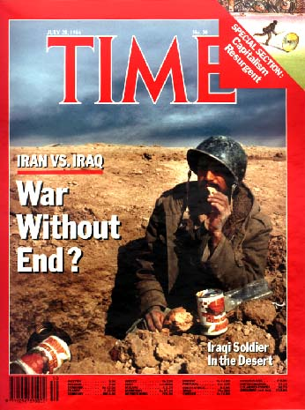
Iran-Iraq War, 1980-88
Brutal War –
Not since WWI were chemical weapons were used.
With the Iranians buying arms from the USSR and the Iraqis buying arms from the US and British, the conflict raged on with both sides suffering huge losses and almost bankrupting both nations.
Saddam Hussein (Sunni) is allied with the USA
The war began when Iraq invaded Iran, launching a simultaneous invasion by air and land into Iranian territory on 22 September 1980 following a long history of border disputes, and fears of Shia insurgency among Iraq's long-suppressed Shia majority influenced by the Iranian Revolution.
Iraq was also aiming to replace Iran as the dominant Persian Gulf state.

Slide 23
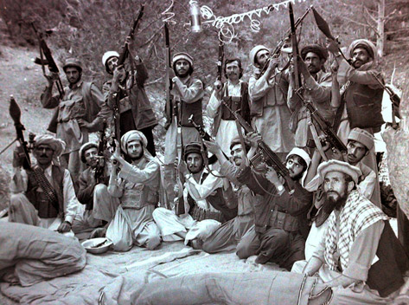
Afghanistan, 1980-89
http://www.youtube.com/watch?v=7FBwj0FJfAg
http://www.history.com/topics/osama-bin-laden
1980 – Soviet invasion of Afghanistan
Soviet equivalent to US Vietnam War
Russia was looking to expand its southern border by invading Afghanistan
USSR quickly take control of urban centers, but are unable to control countryside
Mujaheddin (soldiers of God), supplied by the USA fight a guerilla war against the Soviets
Like Vietnam, the USSR won all major battles, but lost numerous soldiers to the Mujaheddin.
1989 the USSR pulls out of Afghanistan
KEY: In the disorganization that followed the Soviet withdrawal, Islamic Fundamentalism grew. The new government, Taliban, took control and began a hard-line Islamic state that actively supported Islamic Fundamentalism (i.e. Al Qaeda)

Slide 24
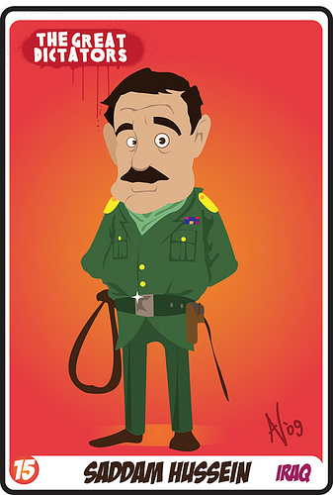
Persian Gulf War, 1990-91
http://www.biography.com/people/saddam-hussein-9347918#awesm=~oEPlA5QNefWcvI
Iraq, led by Saddam Hussein, invades Kuwait, claiming historical territorial rights and accuses Kuwait of drilling for oil under Iraq
The west, led by George Bush (I), builds up a massive coalition and forces Iraq out of Kuwait
Although the bulk of Iraqi forces are destroyed, the coalition does not take Baghdad and leaves Saddam Hussein in power.
US imposes economic sanctions in Iraq. This has one major effect: the people of Iraq begin to starve.
Fundamentalism grows
NOTE: At this point in global affairs, the USSR is now broken-up. Although they protest the western actions, they no longer have international teeth.

Slide 25
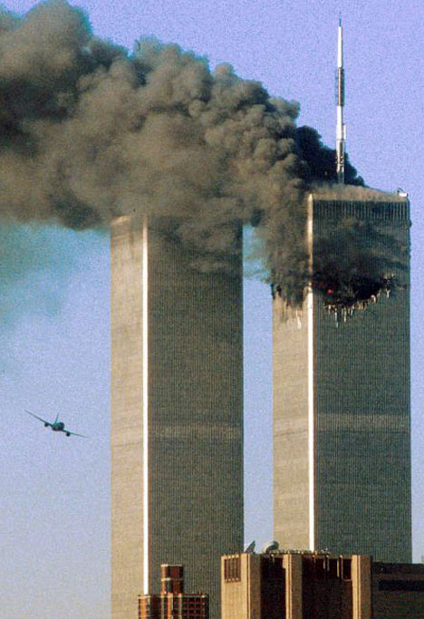
World Trade Center, 9/11/01
http://www.history.com/topics/9-11-attacks
http://www.cbc.ca/player/Shows/Shows/Doc+Zone/2012-13/ID/2308210709/
1989 – Al Qaeda founded
Al Qaeda operates as a network comprising both a multinational, stateless army and a radical Sunni Muslim movement calling for global Jihad (holy war)
Osama Bin Laden is commander or emir
9/11/01 - a series of coordinated suicide attacks by Al Qaeda upon the USA
United States responded to the attacks by launching the War on Terror, invading Afghanistan to depose the Taliban, who had harbored al-Qaeda terrorists, and enacting the US Patriot Act. Many other countries also strengthened their anti-terrorism legislation and expanded law enforcement powers.

