Slide 1
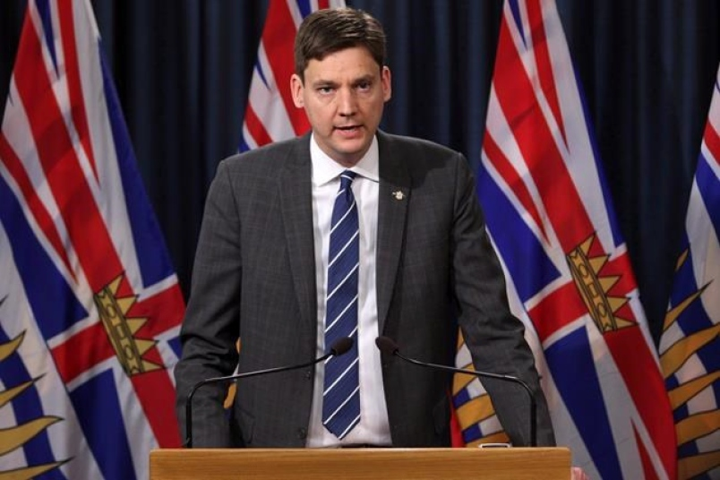
In the News….
BC Politics
Proportional Representation (PR) Referendum – October/November 2018
See also: http://www.cbc.ca/news/canada/british-columbia/pr-referendum-reaction-1.4684593
British Columbians will be asked whether they want to switch to PR and to rank a preferred system –
Option #1: Dual Member
Two ridings become one, Two candidates voted in, but wait…..
Second candidate allocated based on provincial results
Second choice by constituents may not actually fill that seat….
Option #2: Mixed Member
Elements of FPTP and PR….
Additional MLAs would be appointed from party lists to larger ridings
Option #3: Rural Urban
Two MLAs – in two ways….
In rural areas – ‘mixed member’ vote (as above)
In urban or semi-urban regions – Single Transferable Vote (STV), which requires the ranking of candidates
Note:
If voters decided to adopt a proportional representation system, a second referendum
would be held after two general elections, so voters could return to first-past-the-post
Attorney General David Eby (NDP)

Slide 2
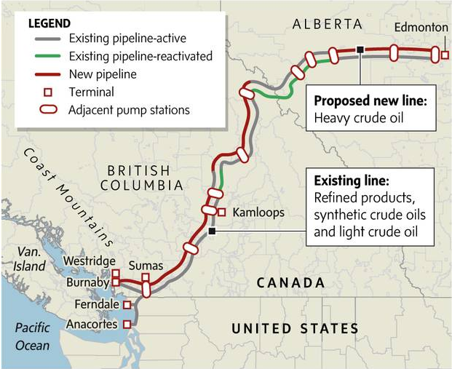
Canadian Politics: Trans Mountain Pipeline
Trudeau’s Liberal Gov’t purchased TM from Kinder Morgan for $4.5 Billion
A vital piece of energy infrastructure? An investment in Canada’s future?
Kinder Morgan has estimated the cost of expansion at $7.4 Billion
The federal government had looked at three options moving forward:
compensating Kinder Morgan — or any other company — for financial losses caused by British Columbia's attempts to block the project;
buying and building the expansion itself, and then selling it once the work is complete, or;
buying the project from Kinder Morgan, then putting it on the market for investors willing to pick up the project and build it themselves.
Bitter Dispute
BC Premier Horgan steadfast in staying the course – legal opposition
Alta Premier Notley aggressive in supporting TM – ‘trade war’
Trudeau has said, ‘this pipeline will be built…’

Slide 3
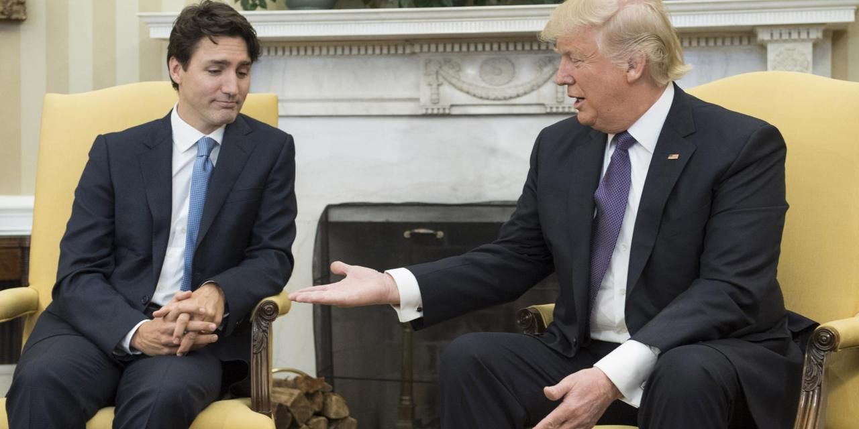
International Affairs: Canada-US Relations
Amid NAFTA renegotiations……
Trump administration
has cited a ‘threat to its national security’ for enacting sudden decision to place tariffs on steel and aluminum from Canada
Trump administration has also done so for EU and Mexico
25% duties upon steel, 10% upon aluminum entering USA
Effective June 1, 2018
"The idea that we are somehow a national security threat to the United States is quite frankly insulting and unacceptable.“
Prime Minister Justin Trudeau, on Meet the Press (NBC)
There is a harshness to Trudeau’s tone we haven’t seen before re: Trump and Trump administration – What’s up?
Trump been in office 16 months now…..Trudeau has been good about not ‘poking the bear’
Is that all about to change?
Group of Seven (G7) Summit, Quebec City – June 6-8
Summit Diplomacy?
G7 finance ministers met this past weekend in Whistler, BC in lead up to summit – unanimous rebuke of US trade policy
Effective July 1st, Canada responding with matching tariffs on a host of products entering Canada from US
Trade War?

