Slide 1
The Police
What is the role of police in society?
What police organizations exist in Canada?
What constitutes a legal arrest?
What are the rights of an accused during arrest?
What are the rights of the police during an arrest?
Where do we draw the line between protection and freedom?

Slide 2
What is the role of police in society?
Roles/Functions
Positive Examples
Negative Examples

Slide 3
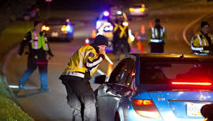
Duties of a Police Officer
Are we asking police forces to do too much?
‘Common Law Duties’ How can we properly assess policing and police officers?
Preserve the Peace
Protect Life & Property
Prevent Crime
Enforce the Law
Apprehend Offenders
Roles and Responsibilities:
Crime Prevention
Investigations
Emergency Response
Re-Evaluating the Role of Police What does ‘defund the police’ really mean?
‘Defund the Police’ Is it a slogan or something more?
no single definition…..covers a spectrum of ideas, from redistribution of police resources ($$$) toward social services to abolishing the institution altogether.
Is ‘abolishing’ community policing really an option?
Mental Health Crises
Opioid Crises (Drug Addiction)
Social Welfare Services
more conversation needed across and involving diversity of community

Slide 4
The Police –
The most expensive component of the criminal justice system is policing.
In 2007, Canada’s police forces cost about $10 billion annually and included almost 64 000 police officers at three different levels – federal, provincial/territorial and municipal.
Federal Police
Royal Canadian Mounted Police (RCMP)
Serve as provincial police in all provinces
and territories except Ontario, Quebec,
Newfoundland and Labrador
Serve as municipal police too
Mandate:
Border Integrity
Customs
Immigration and Passport Branch
Marine and Ports Branch
Drugs and Organized Crime
Drug Enforcement
Organized Crime Branch
International Policing
INTERPOL
International Operations
Financial Crime

Slide 5
The Police
The Provincial Police
The Ontario Provincial Police as an example....
Police Services Act –
Policing municipalities that are not required by law to maintain their own police force;
Responding to municipal police requests for special assistance in emergencies;
Providing traffic control on all 400 series and major highways, including those sections that are within the jurisdiction of municipal police forces;
Providing investigative services on request, to the coroner’s office and to other provincial ministries; and
Performing other assigned duties, such as maintaining the provincial firearms registry, providing security at Queen’s Park, and protecting Ontario government officials and dignitaries

Slide 6
The Police –
Municipal Police
Each municipality funds its own police force.
Smaller communities that do not have municipal funds
for their own forces use the services of the provincial
police or the RCMP.
A municipal police officer’s duties may include:
preserving the peace
preventing crimes occurring
assisting victims of crime
apprehending criminals
laying charges and participating in prosecutions
executing warrants
enforcing municipal bylaws
In 2007, municipal police services employed 66 per cent of all police officers in Canada.
Aboriginal Police
The goal of such police forces is to offer services that are professional and in touch with the culture and needs of the community.

Slide 7
For Monday, January 11th
Choose one of the three ‘Arrest Detention Police Situations’
Investigate and explain what rights and responsibilities are present for the identified parties……in Canada, the Youth Criminal Justice Act applies to youth at least 12 but under 18 years old, who are alleged to have committed criminal offences. See ‘Judicial Measures’ and Right to Counsel, Notice to Parents, as well as ‘Sentencing’ in the act.
Also, See ‘Legal Rights’ (sec. 7-14) of Charter of Rights and Freedom
Identify legal and moral issues present
Specifically, what criminal code section applies?
Summary Conviction, Indictable Offence, etc
Sentencing/Punishment (in accordance with YCJA?), if any…..
Moral Issues – Ethical….beyond what the law says – what do you think?
Concluding Question:
To what extent are police required to use discretion in fulfilling their legal duty? Do you value this (discretion, I mean) or do you see it as problematic? Explain.
Structure and Assessment: /15
Identify Situation
Identify ‘Parties’ /3
Rights and Responsibilities of Parties Involved (Charter Rights?) /2
Legal Issues – (Criminal Code Section Applicable?) /3
Moral Issues – Ethics? /2
Concluding Question /5

Slide 8
Arrest
Must go beyond suspicion
Must establish: (mens rea or actus reus?)
An offense has been committed
Reasonable grounds that the suspect committed the offense
Action options
Appearance notice: legal document stating criminal charge & court date (no threat)
Summary conviction, hybrid, less serious indictable offence
Names offense, time/place/location of appearance
Accused must receive a copy and sign
Warrant for arrest: an order by a judge to arrest
If arrest is impossible at the scene
Summons issued to appear, delivered by representative of court
Arrest
Notice of Arrest
Advising the Accused
Right to Counsel
Right to Remain Silent
Physically touching the accused to signify custody

Slide 9
Arrest
Action options
Arrest
Purpose: lay charges, preserve evidence, preventative
Can be done without warrant if sufficient evidence exists that an offense has, is or will occur.
Musts:
Identification by police officers
Advise of arrest
Inform of charges (section 10 (a) of Canadian Charter of Rights and Freedoms)
Inform of rights (section 10 (b) of Canadian Charter of Rights and Freedoms)
Mays (Legal Duty?):
Use as much force as is necessary to prevent escape
Use deadly force if: harm/death to others, flees to escape arrest, no alternative means of preventing escape
Criminal
Liability
Exists

Slide 10
Legal Rights and Search Laws
Section 8 of the Charter states:
Everyone has the right to be secure against unreasonable search and seizure
What is ‘unreasonable and probable?’
Searching a Person
The police do not have to obtain a warrant to search a person they have just arrested.
The police have to satisfy three conditions for this exception to be legal:
the arrest must be lawful
the search must be connected to the lawful arrest
the manner in which the search is carried out must be reasonable
Other than that…..
Police cannot demand that you tell them your name or even make you stand still
EXCEPT……
In driving a car – they can ask for your license, ownership, and insurance papers
they can also stop your car and check the mechanics, but they cannot ‘search’
If police see something in your car, they may ask about it, but it must be visible
Ex. Police are not allowed to look inside a bag that is visible in your car

Slide 11
Searching a Place
In most cases, police must obtain a search warrant before searching places such as residences, an office, or a storage area. In R. v. Buhay, 2003, the Supreme Court of Canada said that the search of a bus locker without a warrant was a violation of s. 8 of the Charter.
To obtain a search warrant:
Police officer must deliver a sworn information to a judge or justice of the peace
the information will specify:
the crime;
the items the police are looking for; and,
reasonable grounds they have for believing items will be found there
search warrant will specify a date and time the police are permitted to conduct a search
Police may confiscate other items that are not listed in the search warrant, as long as these items are related to the crime and are in plain view
telewarrant: a search warrant obtained by phone
EXCEPTIONS
S. 529 (3) of the Criminal Code
Police may have reasonable grounds to enter the dwelling if it is necessary to prevent i) imminent injury or death to any person; or
ii) the destruction of evidence relating to an indictable offence
Controlled Drugs and Substances Act

Slide 12
Rights on Being Detained
Section 9 of the Charter states:
Everyone has the right not to be arbitrarily detained or imprisoned
Before arresting an individual, police will often ask questions…..
thus, when a police officer stops someone for questioning, that person is ‘detained’
people who are detained, but not arrested, do not have to answer any questions
Note: It is advisable to co-operate with the police officer rather than be antagonizing
Rights on Being Arrested
Police are good at encouraging to talk
60 per cent of accused persons gave verbal statements before contacting a lawyer
Why?
Section 10 of the Charter:
On arrest or detention, everyone has the right to the following:
to be informed of the reasons
to retain and instruct counsel (and to be informed of that right)
to have the validity of the detention determined by way of habeas corpus and to be released if the detention is unlawful (illegal)

Slide 13
Citizen’s Arrest
The most common form of citizens arrest involves incidents of shoplifting.
Immediately after a citizen’s arrest is made, the suspect must be turned over to police.
Section 494 of the Criminal Code:
Anyone may arrest without arrant
A person whom he finds committing an indictable offence; or
A person who, on unreasonable grounds, he believes
has committed a criminal offence; and
is escaping from and freshly pursued by persons who have lawful authority to arrest that person.
If an individual is committing a criminal offence on or in relation to property, that person may be arrested without a warrant by
the owner or a person in lawful possession of the property; or
a person authorized by the owner or by a person in lawful possession of the property.

Slide 14
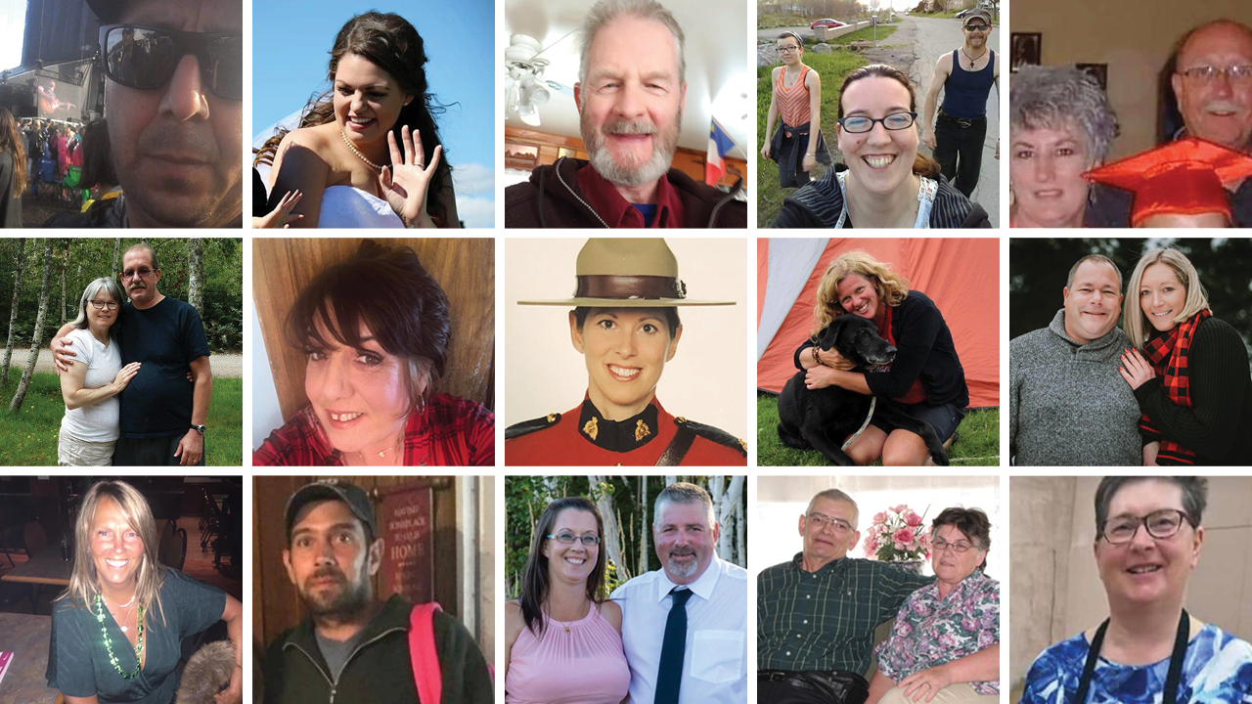
Case Study – the Nova Scotia Mass Shooting
‘13 Deadly Hours’
April 18-19, 2020
Gabriel Wortman commits multiple shootings and set firesat 16 locations across Nova Scotia, killing 22 people and injuring three others before he is shot and killed by RCMP in Enfield, NS.
Deadliest mass shooting in Canada history….
Wortman impersonated a police officer
replica car
wearing a police officer’s uniform
RCMP criticized for their handling of the crime and reports of Wortman’s behaviour prior….
Wortman had a history of ‘strange behaviours’ that concerned residents
He had been reported to Police for previous acts of domestic violence
During the rampage, police did not use the Alert Ready to warn public…..
an investigation into law enforcement’s response is underway – and a public inquiry as well….
Did the RCMP fulfill their obligations as detailed in the Common Law Duties?
Preserve the Peace?
Protect Life & Property?
Prevent Crime?
Enforce the Law?
Apprehend Offenders?

Slide 15
Starting a Police Investigation
What happens when the police first arrive at the scene of a crime?
Assist injured at the scene
Call in reinforcements to eliminate any hazards that pose a risk
Search crime scene – officers assume suspects are present and armed – secure it
Protecting and Preserving the Crime Scene
Officers must establish two boundaries:
the centre
the perimeter
Preserved for three reasons:
to allow for a thorough search of the scene
to seize and collect physical evidence
to ensure that the scene is not managed properly
Contamination: the loss, destruction, or alteration of physical evidence
Police log: a daily written record of what an officer has witnessed

Slide 16
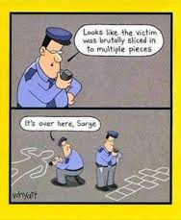
Officer’s Roles at a Crime Scene
Four types of Police officers –
patrol officer
secures crime scene
ensures no evidence is lost or tampered
arrests suspects if crime in progress
witnesses?
detain person who reported crime
Why?
Forensics officer
searches crime scene
gathers, analyzes physical evidence
collects evidence
photographers
fingerprints, foot and tire impressions
blood, hair evidence
criminal investigator (Detective)
expert in particular crimes
supervises, investigates, interviews victims and witnesses, interrogates suspects
draws conclusions
arrests suspects

Slide 17
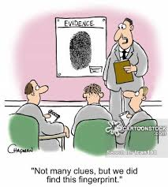
Identifying and Collecting Evidence
Collection, preservation, and analysis of physical evidence is a crucial aspect of police work.
physical evidence: any object, impression, or body element that can be used to prove or disprove facts relating to an offence
forensic science: the use of biochemical and other scientific techniques to analyze evidence in a criminal investigation
Impressions
an indentation or print – footwear, tires, markings….
class characteristics (make? model?)
individual characteristics (uniqueness?)
Fingerprints
visible fingerprints
latent fingerprint
prints can be ‘dusted’ using a powder
‘iodine fuming’ on paper or cloth
laser beam
****fingerprint patterns never change and are usually the last surface to decompose after death

Slide 18
Body Elements and DNA (deoxyribonucleic acid)
Blood is the most common body substance found at a crime scene.
Bodily fluids or other bodily elements can be used in DNA testing –
The DNA of every cell in a person’s body is identical. However, the pattern of the DNA is different for each person, with the exception of identical twins.
Suspect’s DNA ‘print’ can be compared with the DNA profile of a sample from a crime scene
One important advantage to DNA testing is the DNA molecules are stable. If properly preserved, they can be use in an investigation decade after the crime occurred.
Procedures for Labeling Evidence
chain of custody: the witnessed, written record of the people who maintained unbroken control over an item of evidence
It must show:
who had contact with the evidence
the dates and times the evidence was handled
the circumstances under which the evidence was handled; and,
what changes, if any, were made to the evidence

Slide 19
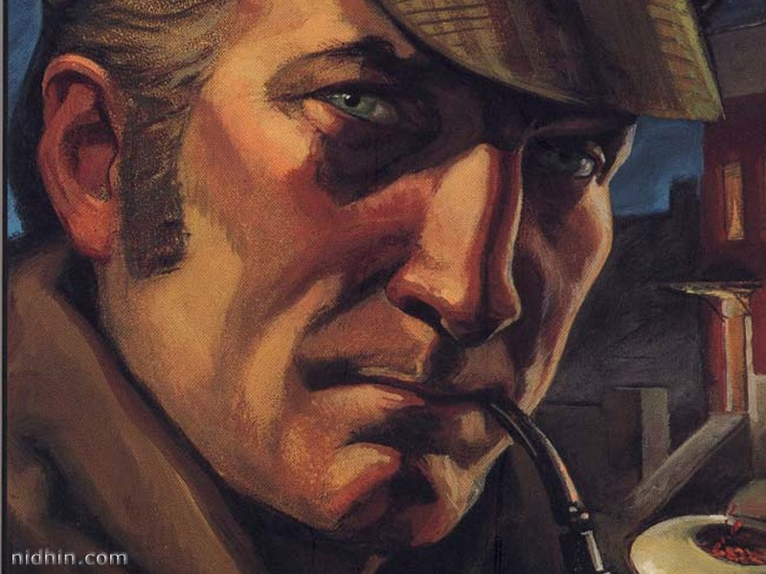
Forensics
Follow the rules of scientific inquiry:
gather, observe and test data → formulate, modify, and reject hypotheses, until only one remains
not an exact science and far from the glamour of ‘CSI’ or ‘Criminal Minds,’ or other television shows
Purpose?
to contribute to law enforcements effort to take criminals of the street
Examples of Subdivisions of Forensic Science
Forensic Anthropology
study of bones
identity, trauma and post-mortem mutilation
Forensic Ondontology
the study of the uniqueness of dentition (teeth)
Trace Evidence
hairs, fibres, pollen, paint, soil and glass
Ballistic Experts
tools and weapons
Sherlock Holmes – Fact or Fiction?
Forensic Biologists
blood, saliva, semen
Forensic Psychology
the study of the mind of an individual
Blood Splatter Analysis
the scientific examination of blood spatter patterns found at a crime scene to reconstruct the events of the crime

Slide 20
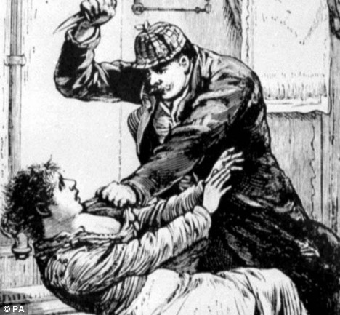
‘Jack the Ripper’ (1888-?) why not……’Jill the Ripper?’
‘serial killer’ active in the largely impoverished areas in Whitechapel (London)
not the ‘first,’ but first in an urban setting with a
largely literate population that had access to media
engages, fascinates populace? media sensation?
Does this ‘inspire’ further killings?
East London
Impoverished, immigrant (Irish, Jewish) population
55% of children in E. London died before 5 yrs….
robbery, violence, alcohol dependency commonplace
women forced into prostitution to survive - brothels
Murders
many attacks against women in East End – hard to know how many for certain….
Eleven separate murders b/w – April 1888 and Feb 1891 – ‘Whitechapel Murders’
Canonical Murders
Mary Ann Nichols
Annie Chapman
Elizabeth Stride
Catherine Eddowes
Mary Jane Kelly
Letters
to police and newspapers
………’Jack the Ripper’
no connection b/w the victims….
prostitutes – thought to be drunk at time of killing
strangled
throats cut while on the ground
blood pooled beside neck…
no evidence of rape
body parts removed – for trophies?
precision in which he removed organs suggested anatomical knowledge…..
Yorkshire Ripper (1970s)

Slide 21
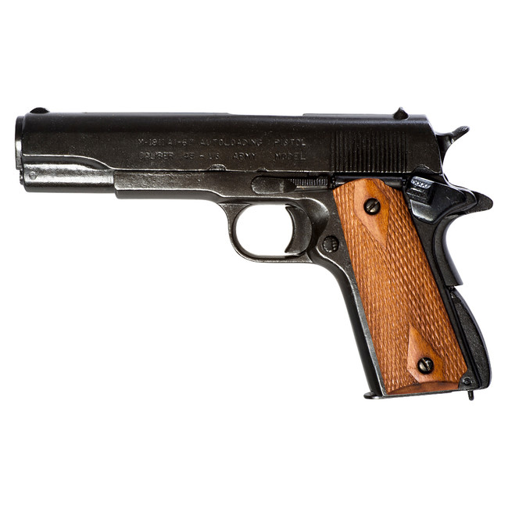
Crime Scene Construction and Investigation Assignment
Prep Guide – Due: Tuesday, January 19th 20 marks
Clarity: as much detail as you can provide…..
Evidence Example:
Evidence #1: the Smoking Gun
Crime, Suspect, Victim?
Evidence will show bullet that killed victim Imade
Upaname was from a Colt .45. A suspect was apprehended at
his home and search warrant was granted. A Colt .45 was found in the
suspect’s bedroom closet. Taken to the lab for inspection.
Collection and Analysis
We will show a match from bullets at crime scene and the Colt .45. Explain ‘rifling’ process. The grooves from the bullet, specifically, match the barrel of the Colt .45 (6 grooves, counterclockwise). We know this after having used a helixometer, that allows us to inspect the barrel of the gun. Additionally, silver nitrate (reacts with perspiration) sprayed on the Colt shows fingerprints under ultra-violet light. Fingerprints match those taken from suspect.
Show you have an understanding of the analysis and collection of evidence
the textbook – Hidden Evidence – has a lot of info that you can use to show….
Colt 45

