Slide 1
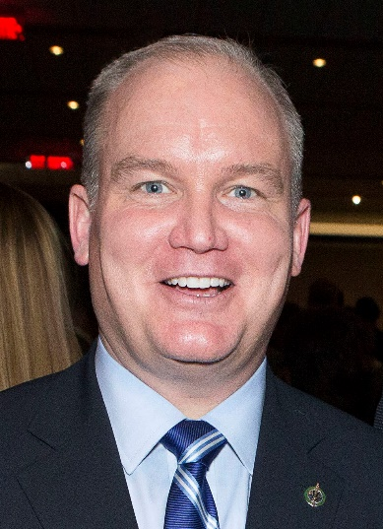
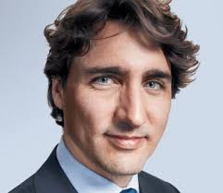
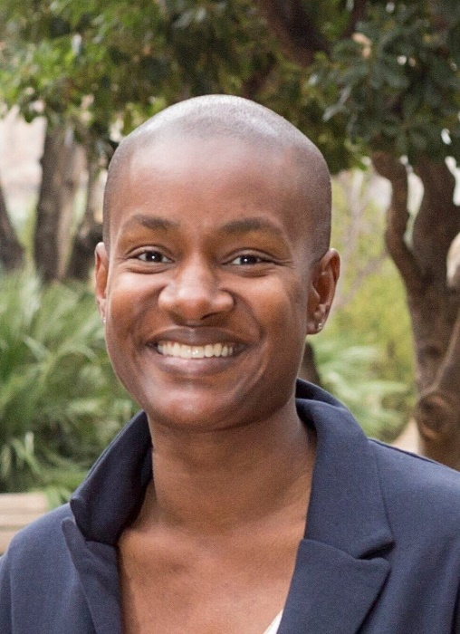
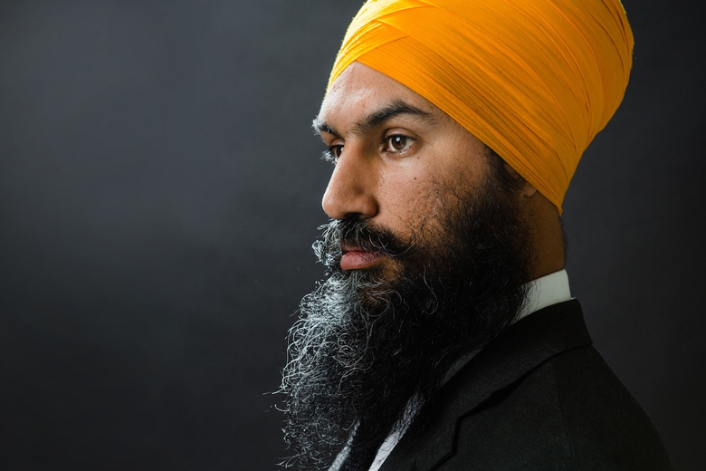
Political Parties & Party Systems Intro
Mass Parties
challenge elite domination of political life?
organized to gain support of the masses….’big tent’ parties
translate a movement into a political party?
Define ‘political party’….
Assumptions?
distinct, consistent, coherent ideological agendas?
but, do party’s follow strict adherence to ideology?
Are federal parties in Canada compatible with provincial parties?
Ex. BC Liberals v. Trudeau Liberals?
BC NDP v. Alberta NDP
What policy differences, if any?
Federal Parties in Canadian Parliament
Liberal Party of Canada
Conservative Party of Canada
New Democratic Party
Green Party of Canada
Bloc Quebecios
People’s Party of Canada (2018)
Erin O’Toole – Conservative Party
Justin Trudeau – Liberal Party
Jagmeet Singh – New Democratic Party
Annamie Paul – Green Party
What kind of party system best describes Canada?
Consider: What parties have dominated Canadian politics historically?
How many?

Slide 2
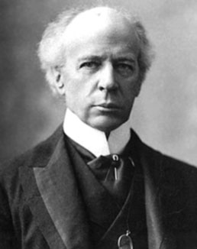
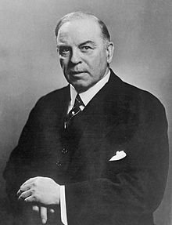
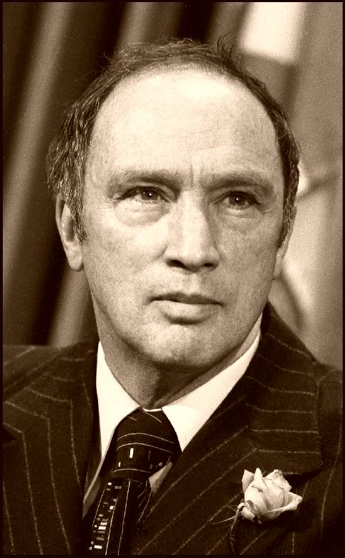
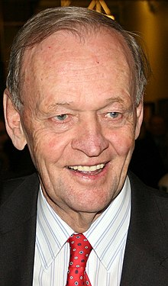
Liberal Party of Canada …..the natural governing party of Canada?
Brokerage Theory?
a party with few coherent ideological interests?
essentially pragmatic and opportunistic…..can campaign from left or right….sway of electorate?
Notable Eras
Mackenzie King (1921-26; 1926-30; 1935-48)
longest serving prime minister (22 years!) …….séanced with the dead too!
‘Conscription if necessary, but not necessarily Conscription’
Lester Pearson (1963-68) & Pierre Trudeau (1968-1984)
reform liberalism and emergence of a ‘welfare state?’
bilingualism
multiculturalism
Charter of Rights and Freedoms, 1982
Jean Chretien (1993-2002)
deficit reduction and rightward shift…..following Mulroney (Conservative) years
North America Free Trade Agreement
Return of ‘Trudeaumania’?
Election 2015 – From 3rd party status to majority government……

Slide 3
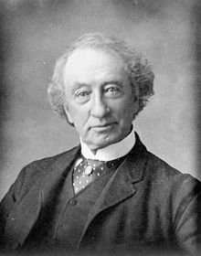
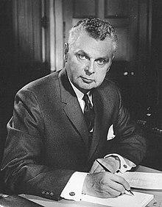
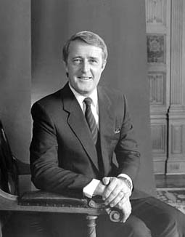
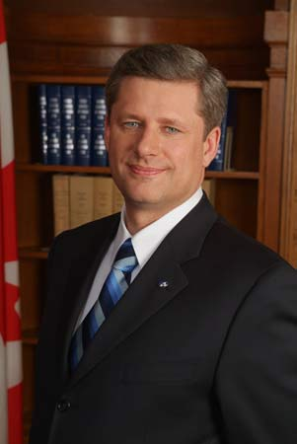
Conservative Part(ies)y of Canada ….Canada’s National Business Party?
Canada’s first organized political party……
‘cadre party’- elites provide prestige, financial support at election time
Notable Eras
John A. Macdonald (1867- 1873; 1878-1891)
confederation, yo
nation building…..railroad, tariffs, ‘taming’ the west (RCMP)
John Diefenbaker (1957-1963)
populist
nationalist ……relations with USA sour
Bill of Rights (1960)
Brian Mulroney (1984-1992) – ‘Progressive Conservatives’ (PC’s)
US-CAN Free Trade Agreement (NAFTA)
Constitutional Debate – Meech Lake & Charlottetown Accords
1st female prime minister – Kim Campbell (1992-93)
Regional split – Reform Party (West), PC’s (Maritimes), Bloc Quebecois?
Stephen Harper (2006 – 2015)
small government
lower taxes
base supports trad. Social values

Slide 4
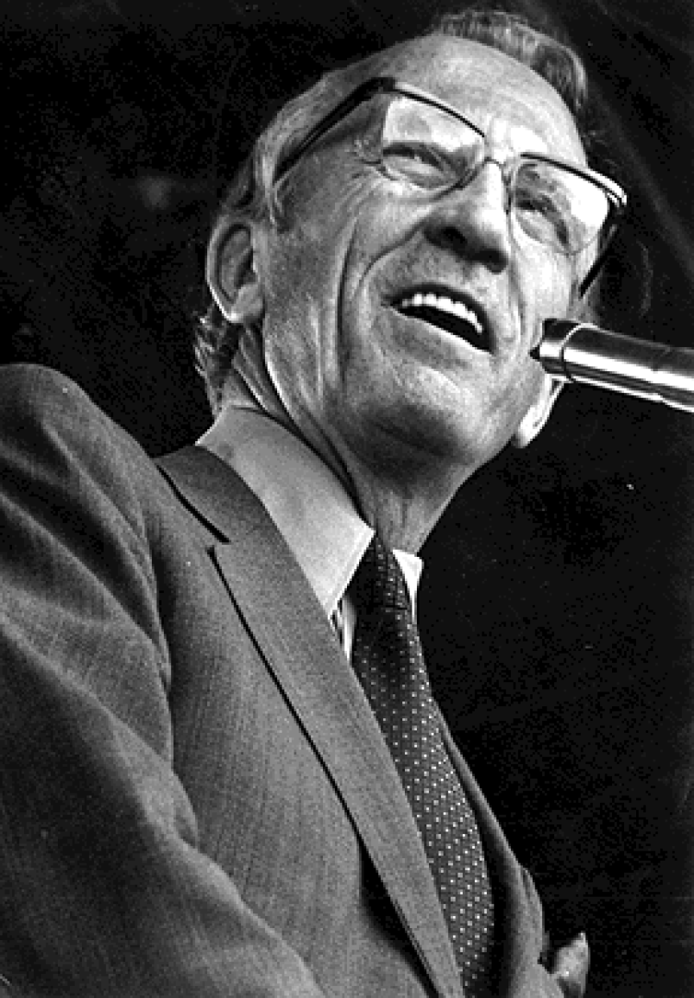
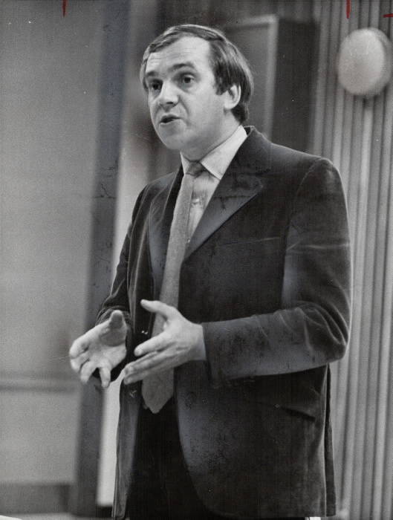
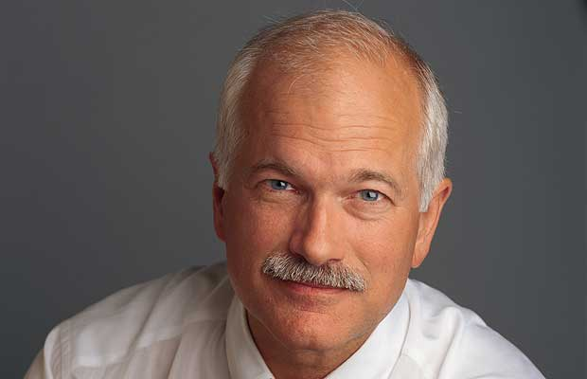
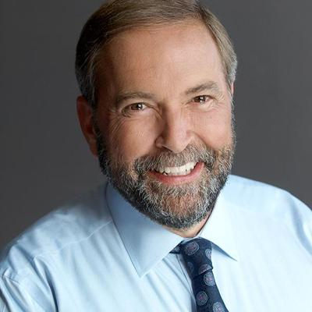
New Democratic Party of Canada ….the social conscience of the nation?
formed in 1961 Tommy Douglas: the Greatest Canadian?
Cooperative Commonwealth Federation (CCF)
Canadian Labour Congress
limited electoral success federally (better provincially….)
but, its policies and platforms have been implemented by Liberal gov’ts
medicare
old age pensions
numerous social reforms and social programs….
Election 2011 – ‘Orange Wave’
Jack Layton (makes significant gains in Quebec….58 seats alone…103 total)
Official Opposition status (not just a 3rd party?)
Layton died of cancer in 2011….shortly after the campaign!
Election 2015
Tom Mulcair – great opposition leader in the House of Commons
Mulcair was outfoxed by the charismatic Trudeau…
NDP relegated to 3rd party status once again…..
Mulcair loses leadership vote in 2016
NDP consider the Leap Manifesto

