Slide 1
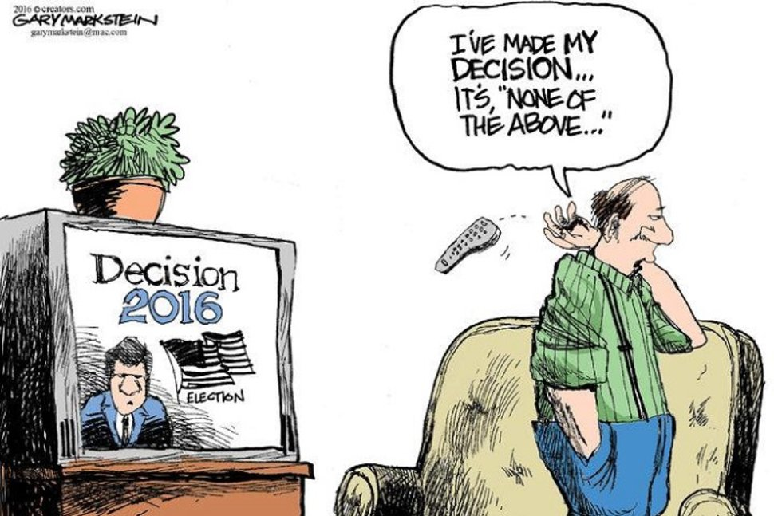
Political PartiesJuli
What do citizenries find lamentable about political parties?
political parties are corrupt, self-interested, elitist
political parties do not stand for anything; no difference among them
political parties waste time on petty grievances, not constructive or cooperative
political parties become active only at election time
political parties are ill prepared to govern
Are political parties by nature ‘divisive’ for society?
‘To try and import the idea of a parliamentary opposition into Africa may very likely lead to violence – because the opposition parties will tend to be regarded as traitors by the majority of our people, or at best, it will lead to the trivial manoeuvrings of ‘opposing’ groups whose time is spent in the inflation of artificial differences into some semblance of reality.’
Juluis Nyerere, Tanzanian Prime Minister, on British-style parliamentary system, 1963
Or….Are political parties vital in modern political systems?

Slide 2
Emerging Canadian Political Parties
Cadre Parties:
Pre and post-confederation (1867) franchise (right to vote) was exclusive, inconsistent, & piecemeal
Sought local elites to provide:
Prestige & financial support during elections
Short term organization
election to election

Slide 3
Mass Parties
Mass Parties
Late 1800’s – franchise expands to mostly European male citizens
1910 – 1920’s: franchise expands to most European women
Mass parties challenge elite domination of political life
Organize to gain support of masses
Organized to translate a movement into a successful political party

Slide 4
Contemporary Political Parties Programmatic Parties
Key Assumptions:
Parties articulate distinct, consistent, and coherent ideological agendas
Policies & promises follow strict ideological standard.
Splitter!
Example:
US Green Party

Slide 5
Contemporary Political Parties
Brokerage Theory:
Chocolate Bar Theory
Parties have few coherent ideological interests
Instead parties select ideas w/
widest appeal amongst targeted voters
Parties essentially pragmatic and opportunistic look to attract widest electoral universe.
Parties do not have ideological coherent programs
Examples:
Federal Liberals
Most party systems feature some degree of ideological competition
Canadian parties tend to have:
Soft, sticky, wide appealing exterior
Chewy, crunchy ideological core

Slide 6
Party Systems
basic pattern of relationships among political parties
Pattern established over several elections –
subject to transformation over time
How many political parties should we have?

Slide 7
1 Party Dominant
https://www.youtube.com/watch?v=K-fr3OPCffg
An elected government normally dominated by one party
highly unlikely to change:
African National Congress (ANC) - South Africa
Indian National Congress – India (1947 – 1988)
Progressive Conservatives – Alberta (1971 –2015)
LDP – Japan (1955 - 2000’s)
Notes:
Since 94 elections, never had less than 62% vote

Slide 8
Two-Party System:
2 main parties compete, although other parties are present
USA (Republican vs. Democrats)
2012 US Presidential Election

Slide 9
Two-And-A-Half Party System:
Pattern of electoral competition where:
2 major parties win at least 2/3 of vote
But a third party receives a smaller, but significant, share of votes
The Scottish National Party served exactly this role in UK’s 2015 election.

Slide 10
UK General Election - 2015
Conservative Party
Total Seats: 330
% of total vote: 36.9%
Labour Party
Total Seats: 232
% of total vote: 30.4%
Scottish National Party
Total Seats: 56
% of total vote: 4.7%

Slide 11
Multi-Party System:
No dominant party
3 or 4 parties must come together to form governing majority
Examples:
Israel
Denmark
France
New Zealand
Israel 2015 Election Results
Notes:
Conservative Likud government coalition sits at 61 to Zionist Unions 59.

Slide 12
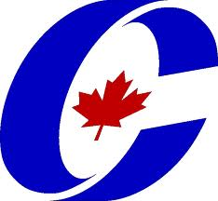
Conservative Party: Canada’s national business party
Canada’s first organized political party
originated as a elite cadre party with strong business ties
1867: First PM - John A Macdonald unites Canada in Confederation.
1980’s: PC’s introduce Free Trade Agreement and NAFTTA
1990: Regional splits divide and destroy Progressive Conservatives
2003: Conservative Party created
A neo-liberal / New Right brokerage party that favours
smaller government
lower taxes
Base supports traditional social values
2011: Leader Stephen Harper win majority gov.
lead minority governments in 2006 & 2008
2016: lost election, but maintained raw vote #

Slide 13
The Liberal Party - Pragmatism and Power
Classic brokerage party:
Liberals take ideas from left and right following sway of electorate
1921 - 1948: Mackenzie King - longest serving PM - “Conscription if necessary, but not necessarily conscription.”
1960s -1970s: Introduce Welfare State
1970 - 1980s: Promote bilingualism, multiculturalism, and the Constitution and Charter of Rights and Freedoms
1990’s: Deficit reduction begins rightward shift
2000’s: Declined from natural governing party of Canada to 3rd party status in 2011 elections
2016: Justin Trudeau returns party to surprise majority election victory

Slide 14
New Democratic Party: Social Democratic Conscious of Canada
Formed in 1961 when the Cooperative Commonwealth Federation (CCF) joined w/ Canadian Labour Congress
Played influential role as “social conscience of the nation”.
Introduced Medicare, Old Age Pensions, and numerous social reforms in Canada
Electoral success limited to provinces
2011 – NDP made surprising gains in Quebec (+58 seats) to rise to Official Opposition status w/ 103 seats
Popular Party Leader, Jack Layton, dies of cancer 2011
2015: Despite early poll lead, NDP falls to 3rd place showing
2106 - Thomas Mulcair loses leadership vote
Party considers Leap Manifesto

Slide 15
The Green Party: Programmatic (?) politics in Canada
1983: Founded as part of global environmental movement.
1997 - 2011: broadened platform beyond ecological activism to include:
human rights, poverty, health care, and anti-globalization.
2000 – 2008: electoral support grew from less than 1 percent to about 7 percent
2011 – Elects first MP, Leader Elizabeth May
Support down to 4%
2015: Support drops to 3.4, but May re-elected
Tends to draw support away from NDP, but not exclusively.

Slide 16
The Bloc Quebecois: Brokering Independence?
A brokerage party from Quebec that draws from a wide ideological base
Established to achieve an independent Quebec
A significant political force in Quebec
diverts support from federalist parties
2011 – Suffered serious set back
from 47 – 4 seats in HOC
2016 – Party struggles to 10 seats

Slide 17
Unit Quiz (General) Comments & Feedback
Good Overall Results
good understanding of concepts - definitions stronger than significance
Good use of examples and tie-ins from the course
Students linked together different sections of the theories unit
Sometimes offered their own examples too
Length
For future tests, aim for a page or so response
Some students did not offer enough information to give points
Repetition
In some ways unavoidable, but points for as many varied points as possible
Vague answers/claims/not specific enough responses
Most significant problem across class
If EU is challenging sovereignty of the UK, explain how/why
If talking about different types of liberalism (classic or welfare/reform) or liberal ideas (rule of law, individual freedoms), explain them, explain them, in addition to listing them
Some responses on power especially vague and don’t reflect discussions, readings in class (i.e. – types of power, positive/negative power, institutional power or social forces)

Slide 18
Typologies of Political Parties
Liberal
equality, legal and political rights, free trade
Conservative
traditional forms of social relations, nationalism, neo-liberal & free-market econ.
Christian Democrats
Catholic influenced, btw liberalism and conservatism, trad. authority relations
Socialist/Social Democratic
worker’s rights and trade unions, control means of production, welfare systems
Communist
democratic centralism, party discipline, command economy, no private ownership
Regional
establishment of own state, popular in Europe, see Lega Nord (northern Italy)
Environmental
skeptics of free-market, advocate consensus-based decision-making, social justice
Nationalist
‘national values,’ former colonies, Eastern Europe w/ fall of communism
Islamic
like nationalist parties – seek to speak for whole nation, banned in secular regimes

Slide 19
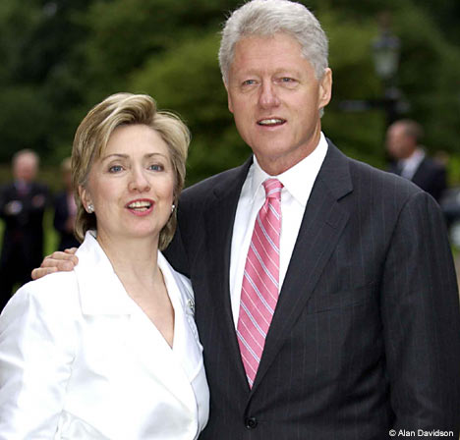
The ‘Political Class’
Self-interested, self-aware and dependent on the state for its moral and economic status
OECD Democracies (the West, basically) –
emergence of political professionals skilled in the art of winning elections
candidates and advisers who have never held any other jobs
Japan & Ireland
high proportion of members of national legislator are children of former legislators
How to reverse this phenomenon?

Slide 20
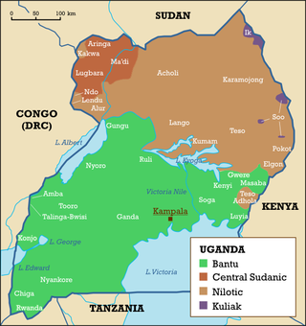
Case Study: Uganda as a Non-Party State
1962 – Independence from Britain
Colony of former tribal kingdoms & principalities
No tradition of democracy, even after 70 years of British rule
Parties formed, elections held –
1963 - Milton Obote (PM)
One-Party State
1971 – General Idi Amin overthrows Obote
‘President for Life’
tyranny, chaos, violence and economic collapse
1979 – Amin overthrown; exiled – Obote returns
Est. of multiparty political system fails
1971-1986 – 1 million Ugandans killed
1986 – Yoweri Museveni of National Resistance Movement sworn in as President
to prevent further violence, he announces political parties will not contest elections
Est. a system of local councils in keeping with local traditions and tribal consultation
2005
Referendum held; return to multiparty democracy - Museveni remains Pres

Slide 21
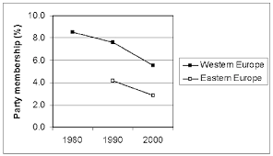
Problems Facing Parties
party memberships on the decline
but not in China – why?
Why lack of enthusiasm for party activism?
A responsive electoral system?
Minimum voting age lowered to 16 years?
State funding for parties?
Power Inquiry (UK), 2006
In USA –
2004 Presidential Election
$880 million spent b/w Democratic and Republican candidates
2008 Presidential Election
$1.6 Billion (McCain, Obama & other candidates running….)
party professionals v. party membership?
Role of party professional class reflects declining party membership
Ex. Democratic and Republican Parties
Critics argue parties have reduced their presence in society, become part of the state
Within politics, parties are either all governing or waiting to govern

Slide 22
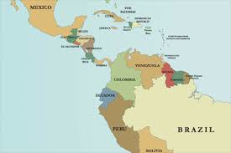
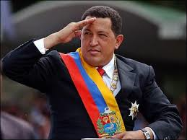
Venezuela and the Downfall of Liberal Democracy
Liberal Democracy or Popular Democracy?
1958 –Perez Jimenez overthrown in military coup
Democracy re-established – ‘pacted democracy’
Accion Democratica
Comitida de Organizacion Politica Electoral
Parties extended reach into many organizations
professional associations, peasant federations
Oil wealth
1970s – stagnating economy, price of oil falls
corruption and waste
popular dissatisfaction, parties became isolated
1998 – Lt. Colonel Hugo Chavez elected President
‘Bolivarian’ revolution
Attacks ‘partocracy’ of two party system
populist regime that promoted social polarization rather than consensus
new constitution that removed checks on presidential powers……
Old party system fragmented
https://www.youtube.com/watch?v=KPdvYW4iwjc
http://www.aljazeera.com/programmes/talktojazeera/inthefield/2016/07/life-line-venezuela-crisis-160715173158110.html

