Slide 1
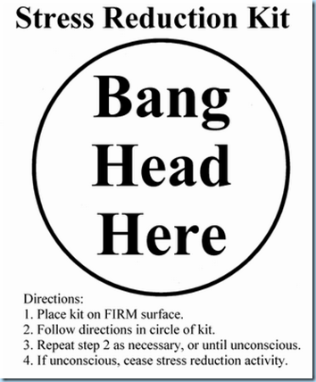
The Essay Writing Process

Slide 2
The Task:
In your newly formed groups for the ‘Book Buddies Project,’ you will piece together an essay outline on the following topic:
‘THINGS WE NOTICED ABOUT CHILDRENS BOOKS’
In your grouping, you will:
THINK
PAIR
SHARE
This is a COLLABORATIVE exercise that requires you and your partner(s) to work together to accomplish a goal (constructing an essay outline).
NOTE: Each of you will be writing an essay from your shared outline!
ESSAY WRITE WILL TAKE PLACE IN CLASS ON WEDNESDAY!

Slide 3
Essay Writing Process
Step 1: Analyze the essay topic/question
What is being asked of you?
THINGS WE NOTICED IN CHILDREN’S BOOKS
What do we need or want to prove?
Step 2: Brainstorm
Read and review children’s books with a more critical eye
Text
Images
Storytelling
Dialogue
Character
List examples/ideas and support with evidence

Slide 4
Essay Writing Process
Step 3: Thesis (the central, controlling idea!)
Say what you are going to say about childrens books!
This is the main point/idea of your essay
Step 4: Attack the Outline
Introduction: Opening Remarks, including thesis statement
Body Paragraphs: 3 Paragraphs, please
Topic Sentence: Main Idea/Point of Paragraph (Relates to Thesis?)
Choose 3 examples in support of the above idea
Evidence from childrens books?
Explain why/how these examples relate to your point (and thesis)
Conclusion: The Big Takeaway
Summarize main points and how they support thesis
Why important?

Slide 5
Rough Draft
Yes, you will write an individual essay on Wednesday based on the outline you and your partner(s) have put together this afternoon!

