Slide 1
Rational Choice Theory
Because they want to.

Slide 2
Introduction
Choice theory is the underling belief that dictates much of our deterrent strategy.
Criminal weighs potential benefits against potential consequences.
If punishments are severe enough, people will choose NOT to commit crime.

Slide 3
Criminal Choices
How great are my personal needs?
How well is the target protected?
How efficient is law enforcement?
Risk of apprehension
Seriousness of expected punishment
What is the potential gain of this crime?

Slide 4
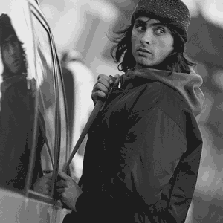
Criminal Choices cont.
Choosing the place
Drug dealers work in the middle of long blocks so they can see both directions
Choosing the target
Burglars know the affluence of targets, when they will be home, their routines, if they have a dog, etc.

Slide 5
In the words of a criminal…
“I feel more safer doing a robbery because doing a burglary, I got a fear of breaking into somebody’s house not knowing who might be up in there… On robbery I can select my victims, I can select my place of business. I can watch and see who all work in there or I can rob a person and pull them around in the alley or push them up in a doorway and rob them.”

Slide 6
Considering personality and skills
Personal characteristics influence the decision to commit crime.
Those with a reduced ability to delay gratification are far more likely to commit crime.
Some people have greater skills, which provide them with a better chance of successfully committing a crime.

Slide 7
Meeting the offender’s needs
The benefit one hopes to receive, determines the type of crime they chose, and how they commit it.
Generally, people who commit property crime don’t commit violent crime.
Violent crime is a much greater risk, with much harsher punishments.
Property criminal can choose to rob a jewelry store at gun point, or break in at night.

Slide 8
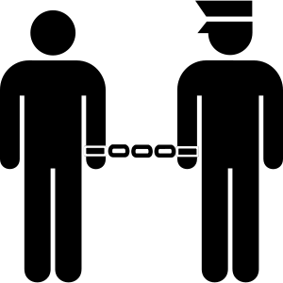
Rational Deterrents to Crime
Creating a high risk of apprehension and punishing convicted criminals severely.
The disapproval of family and peers.
Moral and religious objections.
Recognition that, in the long run, crime doesn’t pay.

Slide 9
Why don’t rational deterrents work?
Criminals may be desperate and believe no reasonable alternative exists.
Some suffer from mental disorders that impair judgment or makes them incapable of making rational decisions.
Psychologists suggest chronic offenders may be incapable of fearing punishment.

Slide 10
Why don’t rational deterrents work?
The threat of punishment must be certain and come at a reasonable speed.
Canada’s legal system is not very effective.
Only 40% of crimes are reported.
Police only make arrests in 20% of those crimes.
1000 crimes, 400 reported, 80 arrests made.
Police may also chose to warn rather than arrest.
Many criminals have little respect for the laws ability to punish.

Slide 11
American Clearance Stats
Murder and manslaughter 61.2%
Aggravated Assault 54.1%
Rape 40.0%
Robbery 25.9%
Larceny-theft 18.6%
Motor Vehicle theft 12.6%
Burglary 12.4%

Slide 12
Preventing the Rewards
If rewards are reduced, reasonable adults are less likely to commit crime.
Theft prevention strategies
Alarms systems
Security guards
Etc.

Slide 13
Limits of Rational Choice Theory
Not everyone is rational:
Drugs, alcohol, mental illness, extreme emotional distress.
Crime may pay
If it does, a rational (immoral) person may very well choose a life of crime
Some people value being a criminal

