Slide 1
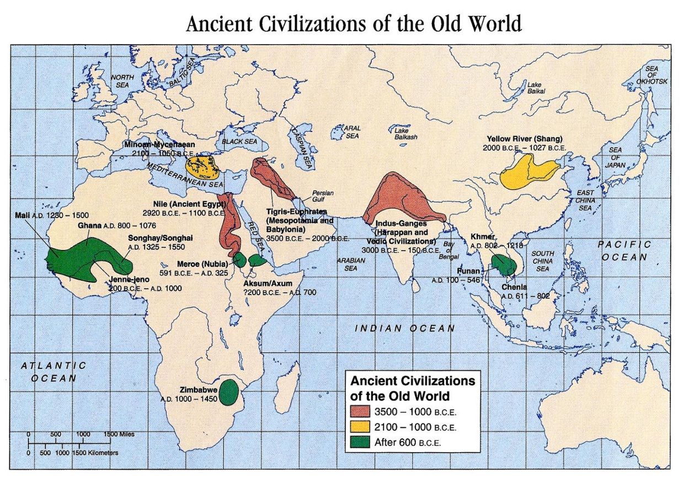
What is a ‘Civilization?’
What makes one group ‘civilized’ and another not?
Or is this a relevant question? https://www.youtube.com/watch?v=HYaC6CgTPCQ
River Valley Civilizations, 3500 to 1500 BCE
Importance of Geography – to Civilization
fertile soil
warm climate
water
drinking
eating
transportation
wood or stone for building
natural barriers against invasion
Four Old World River Valley Civilizations
Mesopotamia (Tigris & Euphrates Rivers)
Egypt (Nile River)
India (Indus & Ganges Rivers)
China (Yellow River)
More on ‘civilization’ and those that would live outside an ‘civilized social order’
https://www.youtube.com/watch?v=wyzi9GNZFMU

Slide 2
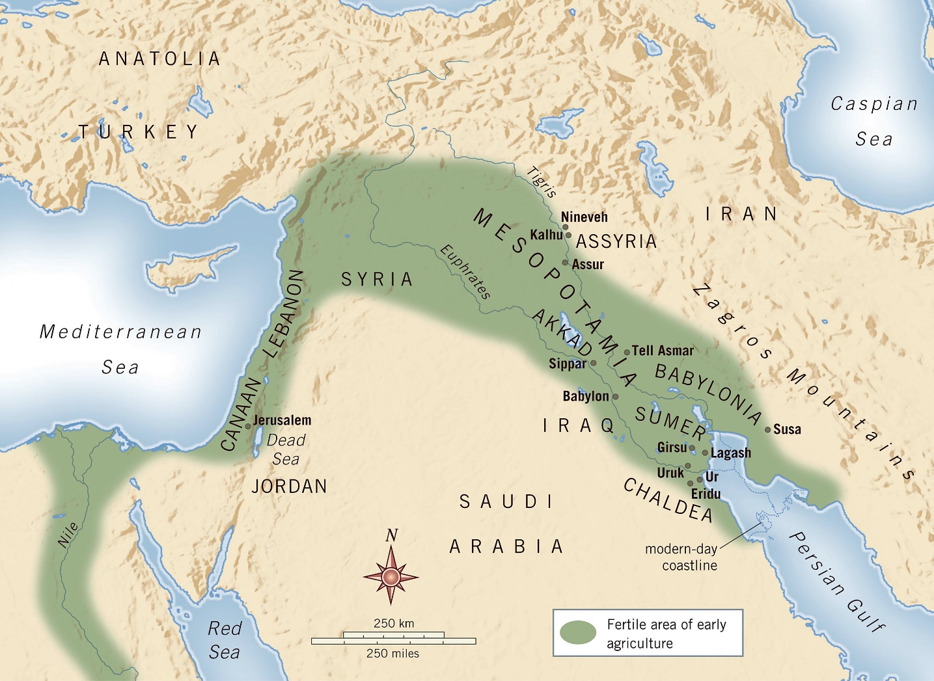
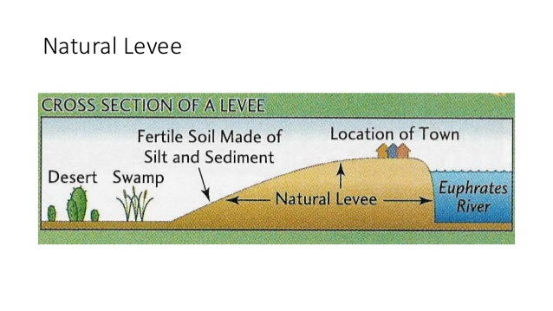
Mesopotamia (‘land between two rivers’)
Tigris and Euphrates Rivers
Alluvial Plain
hot and dry climate (arid)
no minerals, no stone or timber
Winter – unpredictable downpours
Spring – catastrophic flooding
high and safe flood plain
makes irrigation and canal construction easier
natural defense?
swamps full of waterfowl and fish
reeds provide food for sheep & goats
reeds also used as building materials
Problems of the land
Desert and swamplands
Sudden floods
Isolation and Vulnerability

Slide 3
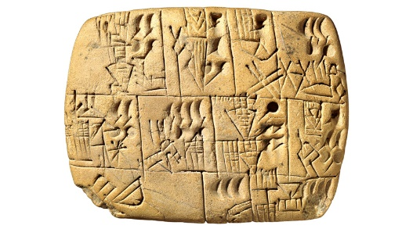
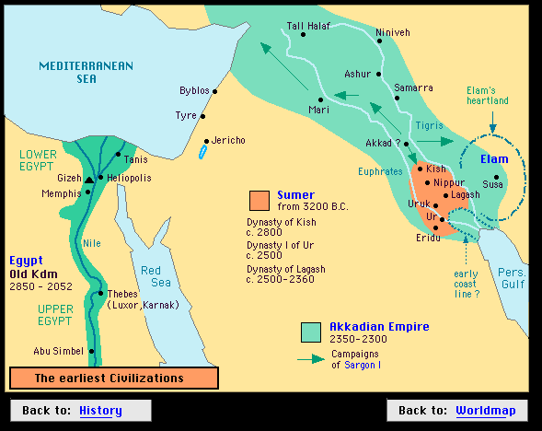
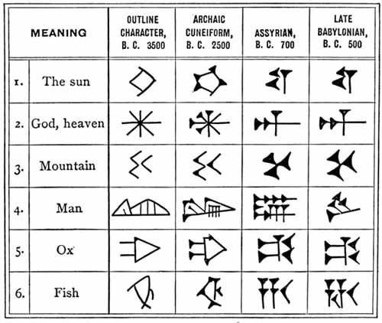
Sumer (Sumeria) – the World’s First Civilization
‘City-State’
a city and surrounding countryside which supplies it, all under one government (but hereditary and despotic….)
Sumer was never a nation, rather independent city-states trading & quarrelling with one another
Sumerian Society – hierarchical: Nobility, Priests, Commoners, Slaves…..specialization of labour?
Irrigation Farming – the burden of maintenance to the land and crops ……..the food surplus? Labour?
A complex society and complex undertakings see the evolution of technological advancements….
Sumerian Writing – Four Step Development – borne out of a need to track taxes paid or not; storehouses
Pictograms – picture writing
Ideograms - pictures – learned to have special meanings to describe something abstract
Syllabic writing – each character stand for a spoken syllable
Phonetic alphabet – each letter stands for a spoken sound
Cuneiform
from latin ‘cuneus’ – meaning ‘wedge’
pressing letters into wet clay with a shaped stylus
baked in oven and stored in ‘envelopes’
few literate in Sumerian society…….’Scribes’
600 characters in written form, so hard to learn, eh?!!
Wealthy people had ‘signet rings’ or ‘cylinder seals’
Writing marks the boundary between prehistory and history…….

Slide 4
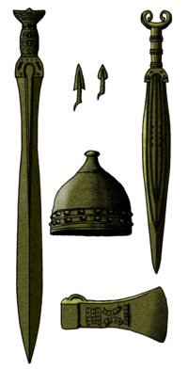
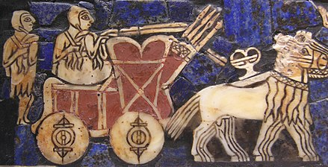
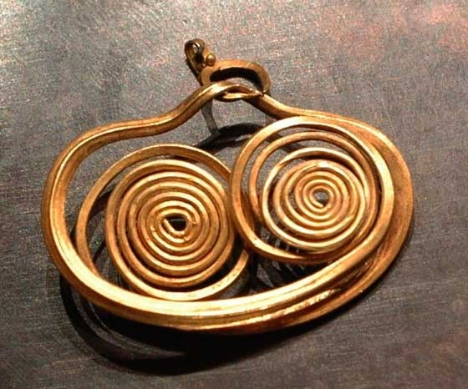
Sumerian Achievements of the Bronze Age
‘Bronze Age’
Neolithic villagers discovered copper, tin, lead, silver, gold from rocks put into hot fire
good for jewelry, bit too soft for weapons….
copper + tin in proportion of about 9 to 1 = bronze, a much harder, stronger material
More technical advances – ‘Specialized Labour’
wheelwrights to make round, strong wooden wheels
boatbuilders and sailmakers
smiths – gold, silver, bronze…..metallurgy
jewel engravers
Ziggarauts
Problems of Civilization
Emergence of different social classes –
How could their different interests and outlooks be made to harmonize?
Relationships between people living in different environments
How could the Sumerians acquire necessary things, such as – timber, stone,
metal ores that could not be found in the floodplain?

Slide 5
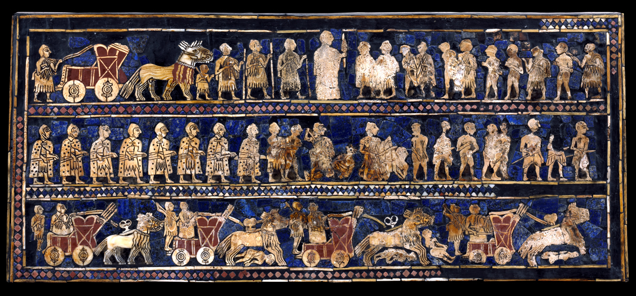
The Problem of Peace and Order – The Rise of Kingship
Rise of Military Chiefs
Beginnings of Empire
King Saragon I of Akkad (c. 2350 BC)
professional army
conquests, but always on the move
challenge is to maintain supremacy, after succession
Q. How could a king make sure of the obedience of landlords and cities scattered far away from the royal person?
The Ur of Dynasty (c. 2050 to 1950 BC)
the power of appointment
rise of bureaucracy (civil servants and fundamental to functioning of government)
a delegation of authority….not obvious in Sumerian times
King Hammurabi of Babylon (c. 1792-1750 BCE)
Hammurabi ‘codified,’ or recorded, the rules and penalties for every aspect of life
bringer of law and order – more systematic in dispersal of troops and regime
To bring about the role of righteousness in the land and to destroy the wicked and evil doers, so that the strong shall not harm the weak.
Ancient Mesopotamia
https://www.youtube.com/watch?v=sohXPx_XZ6Y&t=84s

Slide 6
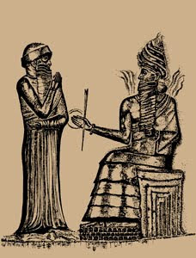
CODE OF HAMMURABI
To bring about the role of righteousness in the land and to destroy the wicked and evil doers, so that the strong shall not harm the weak.
Code of Hammurabi
King Hammurabi of Babylon (c. 1792-1750 BCE)
Hammurabi ‘codified,’ or recorded, the rules and penalties for every aspect of life
Consider the following excerpts:
If anyone is committing a robbery and is caught, then he shall be put to death.
If anyone opens his ditches to water his crops, but is careless, and the water floods the fields of his neighbour, then he shall pay for the loss.
If a man takes a wife and she is seized by disease, and if he then desires to take a second wife, he shall not put away his [first] wife. But he shall keep her in the house and support her as long as she lives.
If anyone brings an accusation of any crime before the elders and does not prove what he has charged, he shall, if it be a capital offence charged, be put to death.
What do these laws tell us about morality and justice in Babylonian society?

Slide 7
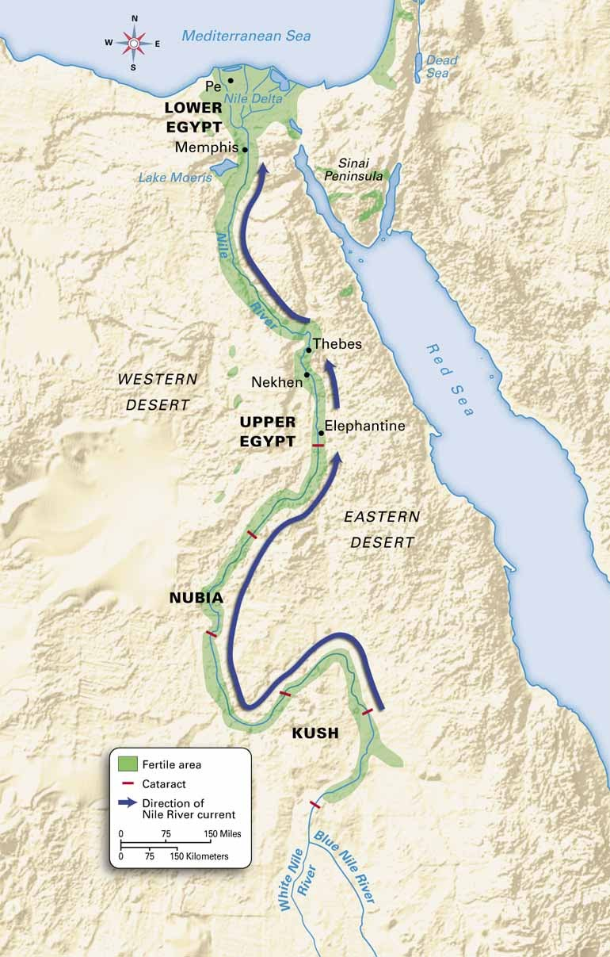
Egyptian Civilization
Valley of the Nile
Nile River differs from Tigris-Euphrates
flows more gently
floods were predictable, slow – less silt & salinization
flows North, but navigable…trade winds allow for sail
basin irrigation – prevents accumulation of salt; still fertile today….
Desert
Valley of the Nile rests between two inhospitable deserts
buffer zone
protected from invasion & outside influences
source for minerals and building supplies
Copper, tin, gold, alabaster, limestone, amethyst, and natron (mummies)
Contact Between Early Civilizations of the Near (Middle) East
Sumer
Caravans
Ships
Sumer
Caravans
Ships
Egypt
Indus

Slide 8
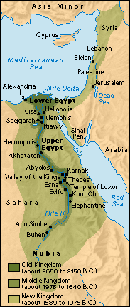
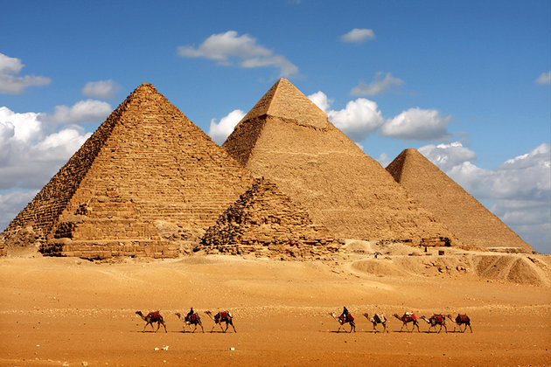
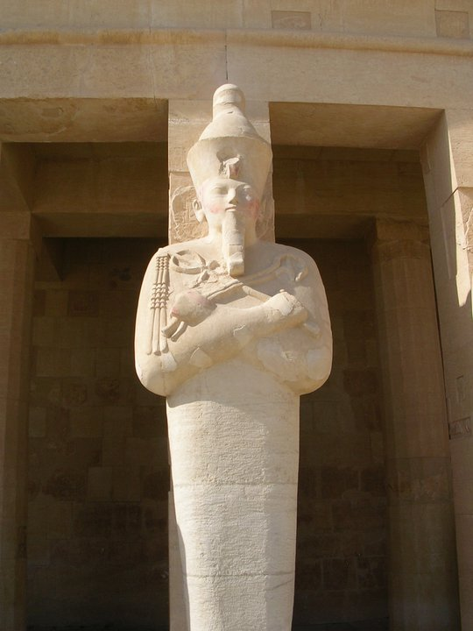
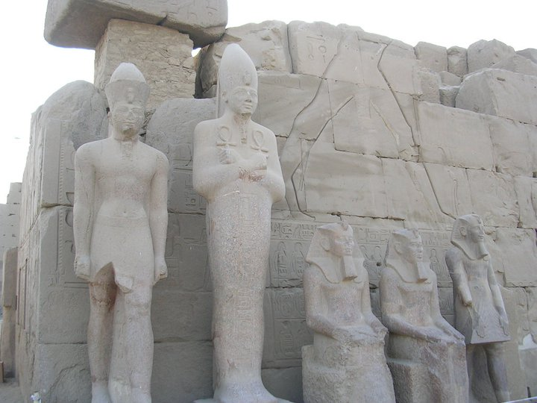
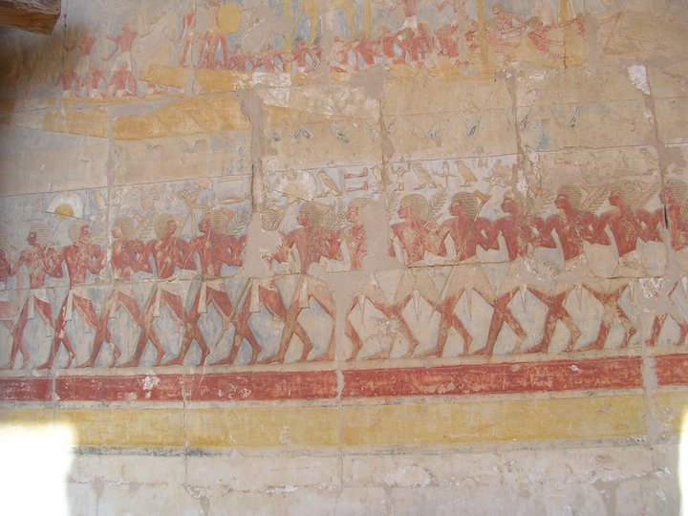
The Kingdoms
Old Kingdom (c. 3100 to 2200 BCE)
King Menes unifies Lower & Upper Egypt
Fourth Dynasty (c. 2650 BCE)
great wealth amassed
timber from Syria, wine and olive oil from Crete, potter’s wheel from Sumeria
Pyramids at Giza (c. 2600-2500 BCE)
Kings - Khufu, Khafre, Menkure
Pharaoh (King)
Immortal – God
Egypt serves the Pharaoh; central gov’t
labour mobilized to build pyramids
artistic perfection

Slide 9
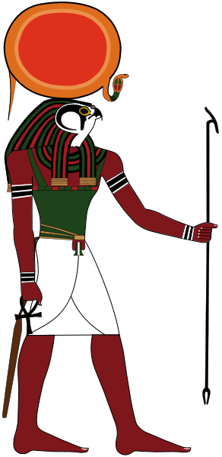
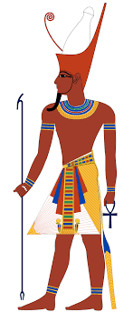
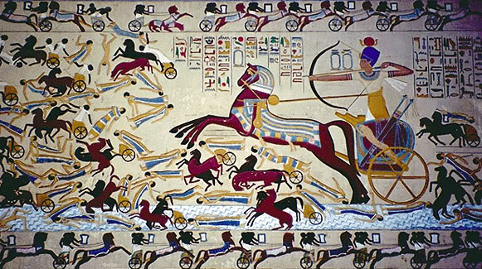
The Kingdoms
Civil Wars or ‘First Intermediate Period’ (c. 2220 to 2050 BCE)
Middle Kingdom (c. 2050 – 1800 BCE)
Theban Kings (from Upper Egypt)
no longer ‘absolute’ in power, like those of the Old Kingdom
no pyramid construction – no longer able to command labour
Nobility – lords, masters share in Pharaoh’s wealth
Also, rise of a middle class brings political/social stability
Rise of ‘Amon’ with that of ‘Re’ – merger to become ‘Amon-Re’
Hyksos Conquest
invaders from Syria
improved weapons
bows
chariots
bronze weapons
Rule for 150 years
Driven out by Egyptians (c. 1570 BCE)

Slide 10
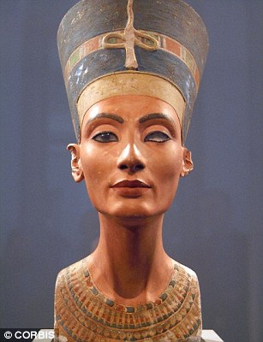
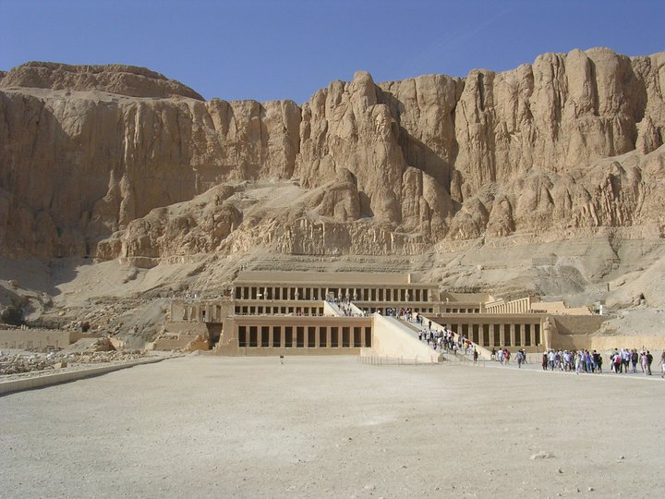
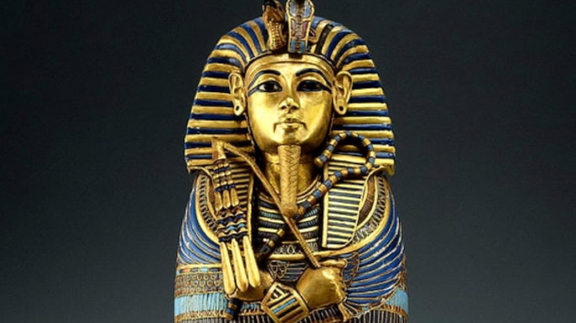
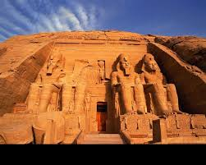
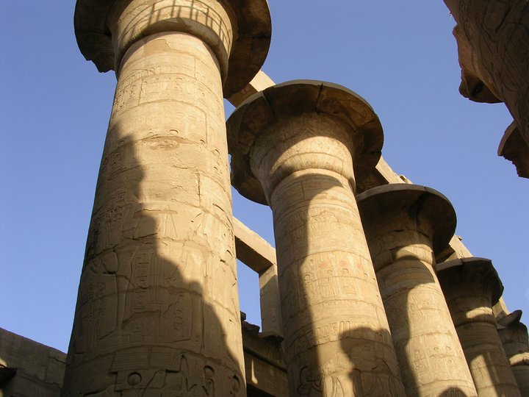
The Kingdoms
New Kingdom (c. 1500 to 500 BCE) – the ‘Golden Age’
Queen Hatshepsut
History’s first powerful female leader?
reign of peace, stability and prosperity
Thutmose III (stepson) – military campaigns
Akhenaton (Amonhotep IV)
Religious Revolution
opposes worship of ‘Amon-Re’ for ‘Aton’
too preoccupied with reforming Egyptian religion?
Tutankhamon (King ‘Tut’)
Ramses II
colossal statues, buildings – more than any other era
Abu Simbel Temples
1960s – moved for Aswan Dam
Ancient Egypt
Royal Tomb of Queen Hatshepsut
Abu Simbel
Court of Ramses II (Temple of Luxor)

Slide 11
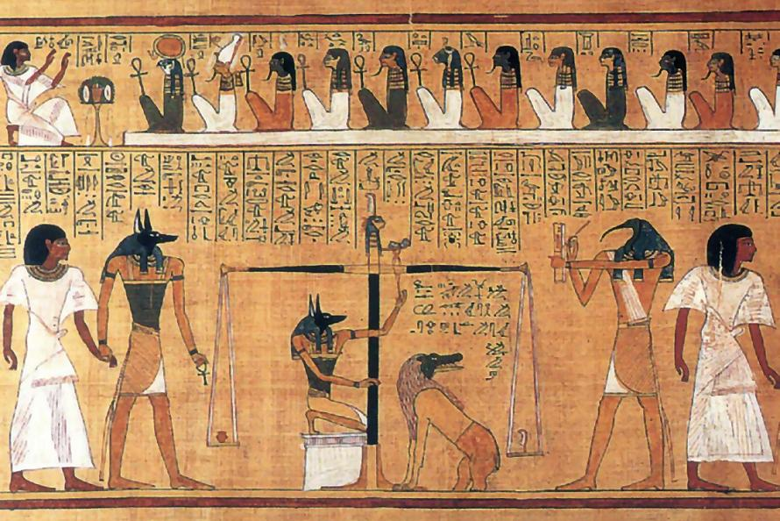
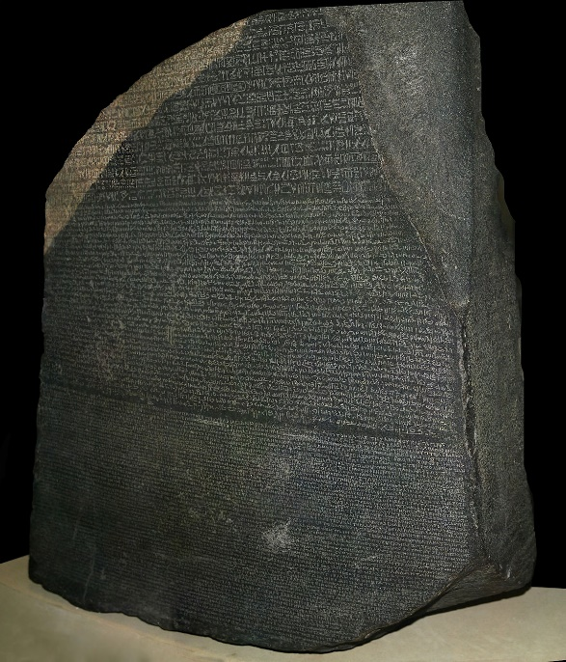
Art, Culture and Science in Ancient Egypt
Egyptian Art
Conservative
Religious Ex. Sculpture representative of this…..
Pharaoh
Reliefs - wall paintings and carvings depict ‘false transparency’
lacking realism
symbolism
Hieroglyphics
Unlike Mesopotamia, Egyptian Hieroglyphics never lose their pictographic nature
By New Kingdom – 700 hieroglyphic in common use; mostly phonetic
‘Hieratic writing’ – simplified and suited for short writing on papyrus
Rosetta Stone
1799 – Napoleon’s Army unearths’ black basalt while digging trenches in Egypt
Hieroglyphic – Demotic – Greek
1822 – Jean Francois Champollion breaks ancient hieroglyphic code
Owed much to known Greek writing
British Museum – Rosetta Stone
https://www.youtube.com/watch?v=yeQ-6eyMQ_o

Slide 12
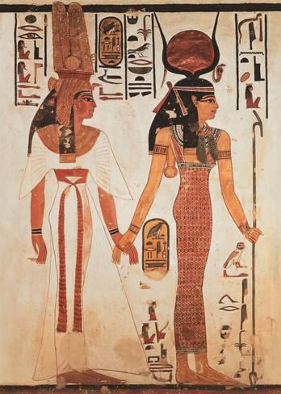
Egyptian Society
Marriage
arranged marriages, though not exclusive
12 year old females, boys a few years older – wealthy family see older daughter
typically one wife, though kings could have more…
Divorce, though rare, was allowed
Women could own land separate from husband, though he usually administers it
Family
Children were treasured and a blessing to families
Slaves and servant for the wealthy (to look after the kids…..and other stuff)
Women were to ‘obey,’ but also ‘equal’ in other respects; some legal rights
Wives and mothers revered in Egyptian society; sometime the ‘real’ power
Men inherited land, Women inherited households
Boys sent to school, girls not – but educated to some extent in reading/writing
Elderly looked after by sons/ daughters
Women raised the children and dealt with household
Women could also hold positions as acrobats, dancers, singers, musicians
Noblewomen could be priestesses

Slide 13
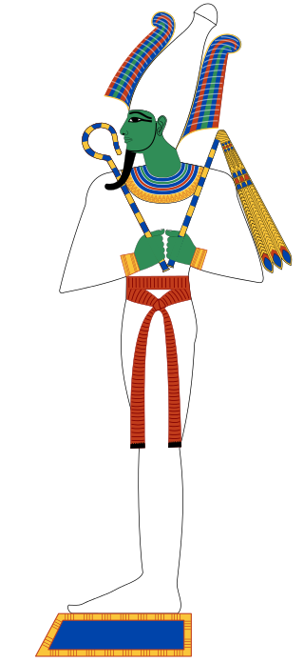
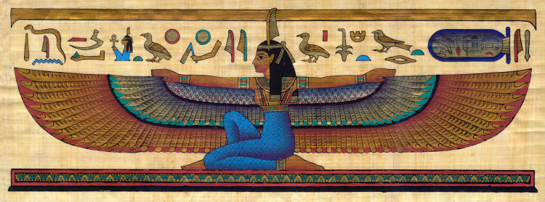
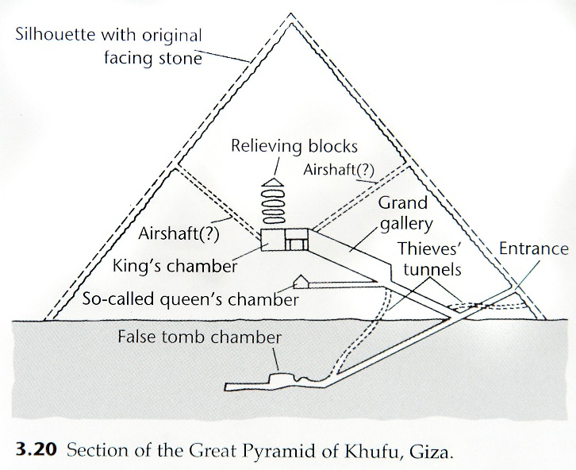
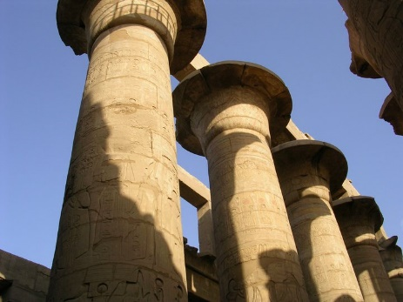
Egyptian Beliefs
Religious society
anthropomorphic
demigods
The Afterlife
body preserved
provided with items needed for the next life
Burial
desiccation
Desert sands and climate prevent decay
embalmers
40-70 days
canopic jars held deceased’s internal organs
material objects buried in tomb with dead
Mastaba – elaborate tomb structure
Built on top of each other….pyramid like
Valley of the Kings (and Valley of the Queens)
isolated – avoidance of thievery?
Temples
Ka, Ba, and Akh
Ka – stored in the heart
Ba – person’s character or personality
Akh – the form - could exist in the afterlife
Maat – order, truth, justice = ‘Divine Will’
Maat
Osiris – God of the dead, afterlife, life and resurrection
Khufu’s Pyramid (Giza)
2.5 million stones
Each weighing 2.5 tonnes
Largest tone structure on planet
Temple of Amon at Karnak

Slide 14
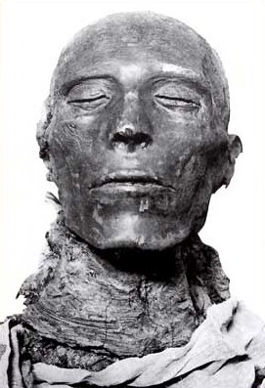
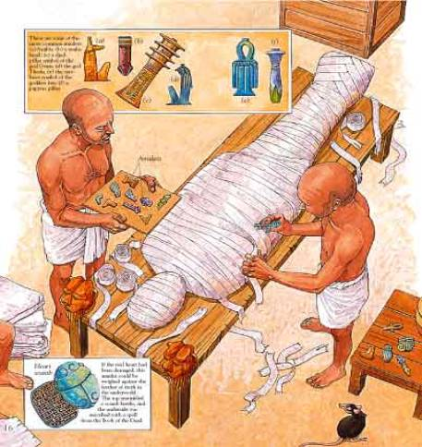
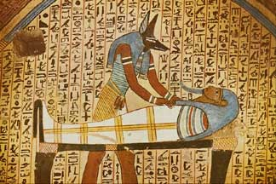
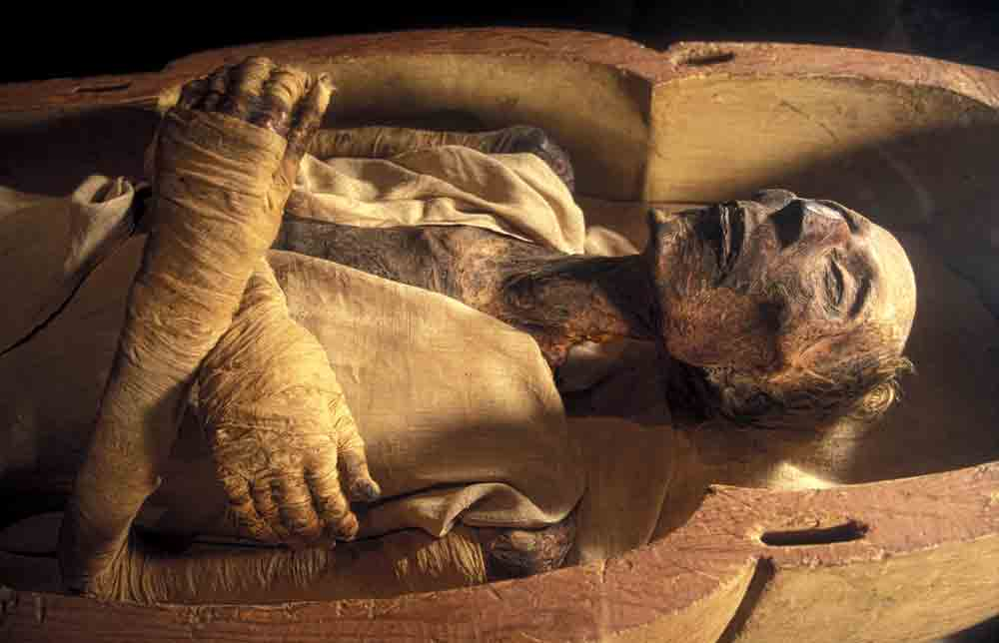
Mummification Process
https://www.youtube.com/watch?v=-MQ5dL9cQX0
How to make a Mummy
https://www.youtube.com/watch?v=9gD0K7oH92U
Egyptian Book of the Dead
https://www.youtube.com/watch?v=1yv_MXNYbAo

Slide 15
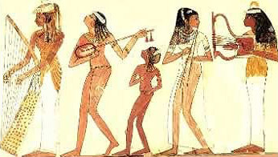
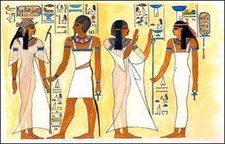
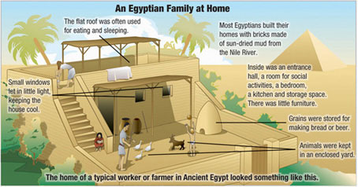
Life Among the Egyptians
Foods and Festivals
slaughtered ox…bon appetite
goat, gazelle, assorted fowl & fish
Vegetables – onions, garlic, beans, chick peas, lettuce, radishes
Fruits – grapes, dates, figs, pomegranates
BREAD
Wine, and of course, BEER!
Musicians, dancers, acrobats…..
Housing (Upper Classes)
Sun dried mudbricks
Timber from Lebanon (Cedar) and Syria
Crafters in joinery and veneering (in gold, silver)
Clothing
jewellery
sandals (aristocracy)
‘elegant simplicity’
Cosmetics
eyeshadow, lipstick
perfumes, wigs
Medicine
Doctors (some women among them….)
Bandages, splints, disenfectants…..
Problems – worms, arthritis, smallpox, tuberculosis (farm animals), gallstones
Remedies – beer, milk,plant, herb & animal concoctions

Slide 16
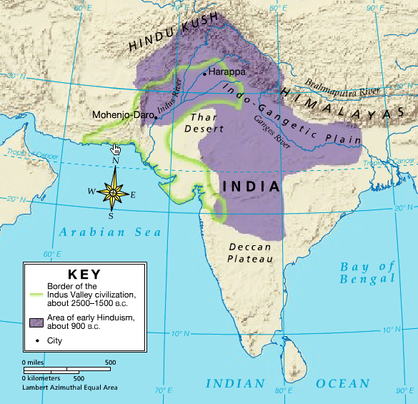
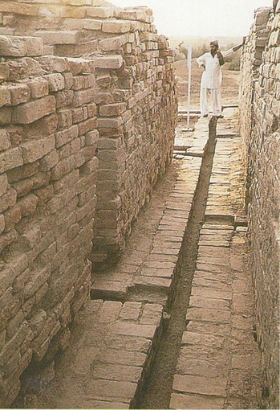
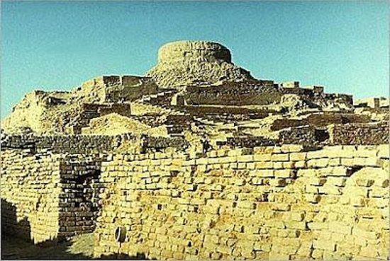
The Indus Valley Civilization (c. 3100BC - ????) ….sometimes called the ‘Harappan Civilization’
the problems of geography
an isolated ‘sub-continent?’
from where do they come?
City-States?
Harappa (‘Hara’…..a later name for Shiva)
Mohenjo-Daro (‘Mound of the Dead’)
....archaeological evidence is scant of this civilization – no recorded events –
City Planning?
both cities share architectural and urban design patterns….
sewage system – brick lined drains to sumps, then carry away
private homes with well (water!), bathing space & toilet (!!)
baked mud bricks – uniform in size and shape
no monumental architectural structure – save for,
citadels built on architectural platform above flood plain
temple granaries?
fortified walls
little sign of social stratification seen in the urban planning
Populations – 40 000 – 200 000 persons…..
So…..
how does one explain these planned cities?
there must have been some kind of coherent social structure? what?

Slide 17
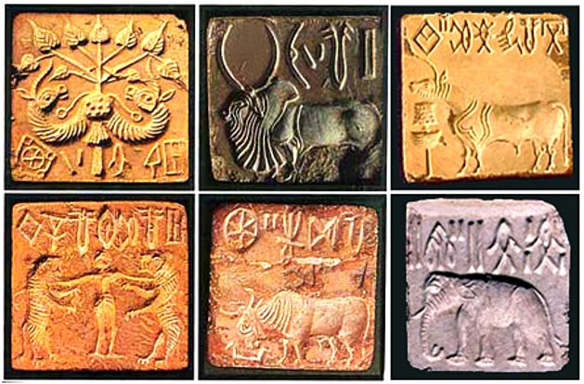
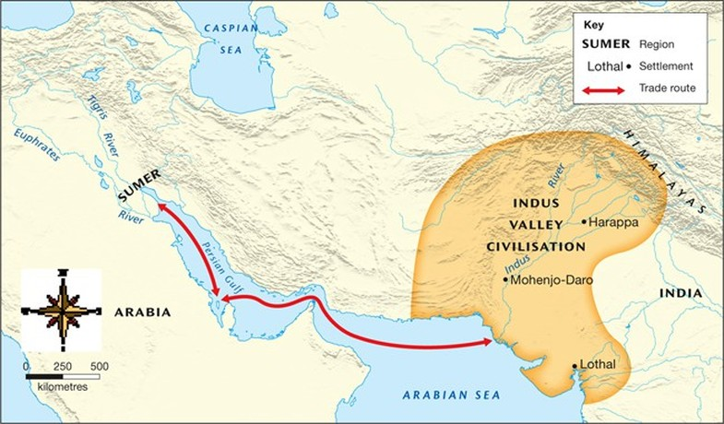
Indus Culture
‘Seals’ – small square/rectangular and cut out of steatite
Much of what we know of Indus culture from these
Script has some 600 characters
Different from Egyptian script - same for 800 years
Its meanings still largely unknown by historians
Animals
Gods – Shiva? – religious symbols become sacred to:
Hinduism
Buddhism
Mesopotamian contacts?
Mesopotamian hero - Gilgamesh – Indus motif
Indus seals found in Ur dated from 2300 BC
Babylonian documents found at Mohen-jo-daro
Trade
Q. What examples of cross-cultural influences are evident in the development of Indian civilization?
i

Slide 18
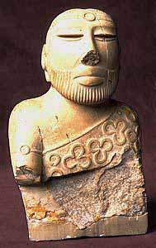
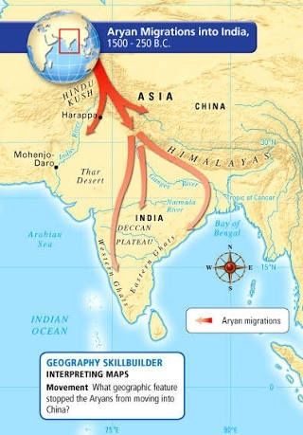
Decline of the Indus Civilization
Static culture?
800 years of continuity w/ little change
Evidence –
potters’ forms/techniques
bronze tools retain older forms
no variation in Indus script
Decline
floods
Indus River changes course?
climate change
population growth
disease
cities become slums
Aryans
from central Asia…..Indo-Iranian peoples?
cattle herders
Aryan language gains ascendancy
Aryans merge with Indus Civilization – Agriculture, for example
the Vedas* – hymns, poems, prayers, a moral code – law?
the Laws of Manu**
the power of Oral Histories/ Tradition
* c. 600BC to Sanskrit, but dates bake millennia ** c. 100BC, ditto…..

Slide 19
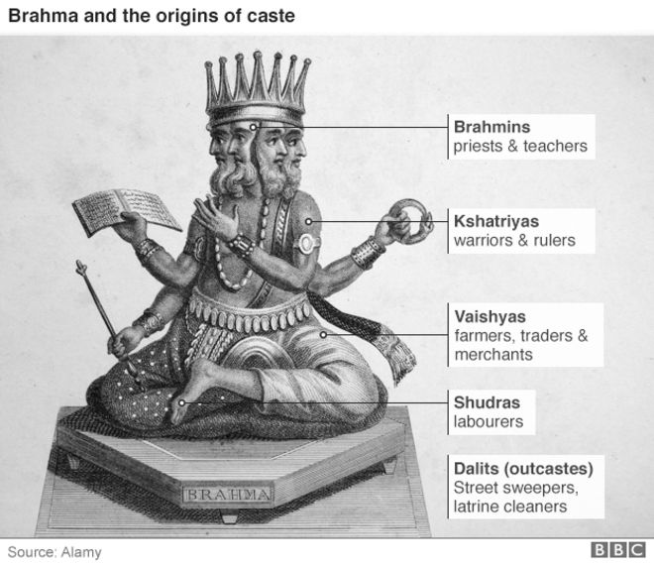
Caste System
What distinguishes one caste from another?
found only in India?
non-economic factors?
inherited…..a ‘closed system’
static
relationships of duty and obligation
an effective socio-political force for organizing?
Brahmins
an elite ‘class’
Based on self-assumed purity, control of sacred texts…..still a force today in India
Buddhist & Hindu reformers?
Dalits
a fifth caste?
‘outcastes’ or ‘untouchables’
What does caste system look like in today’s India?
Do you feel it is necessary to have social classes/caste system to create an organized and well working society?

Slide 20
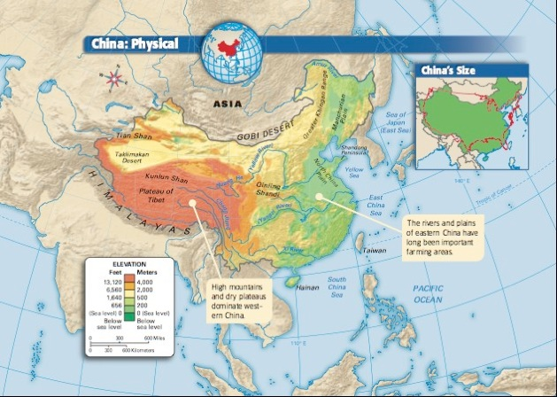
Ancient China
Not the most ancient…..
But, the longest continuous civilization in human history….
For much of history….the wealthiest and most advanced of all civilizations….
Geography
Yellow River
prone to flooding
North China Plain
Yangtze River
Isolated
mountains
deserts, steppe lands
Pacific Ocean
arable land=large population
Think:
Importance of rivers in the development of civilization…..
How do you harness the productive capacity of water?

Slide 21
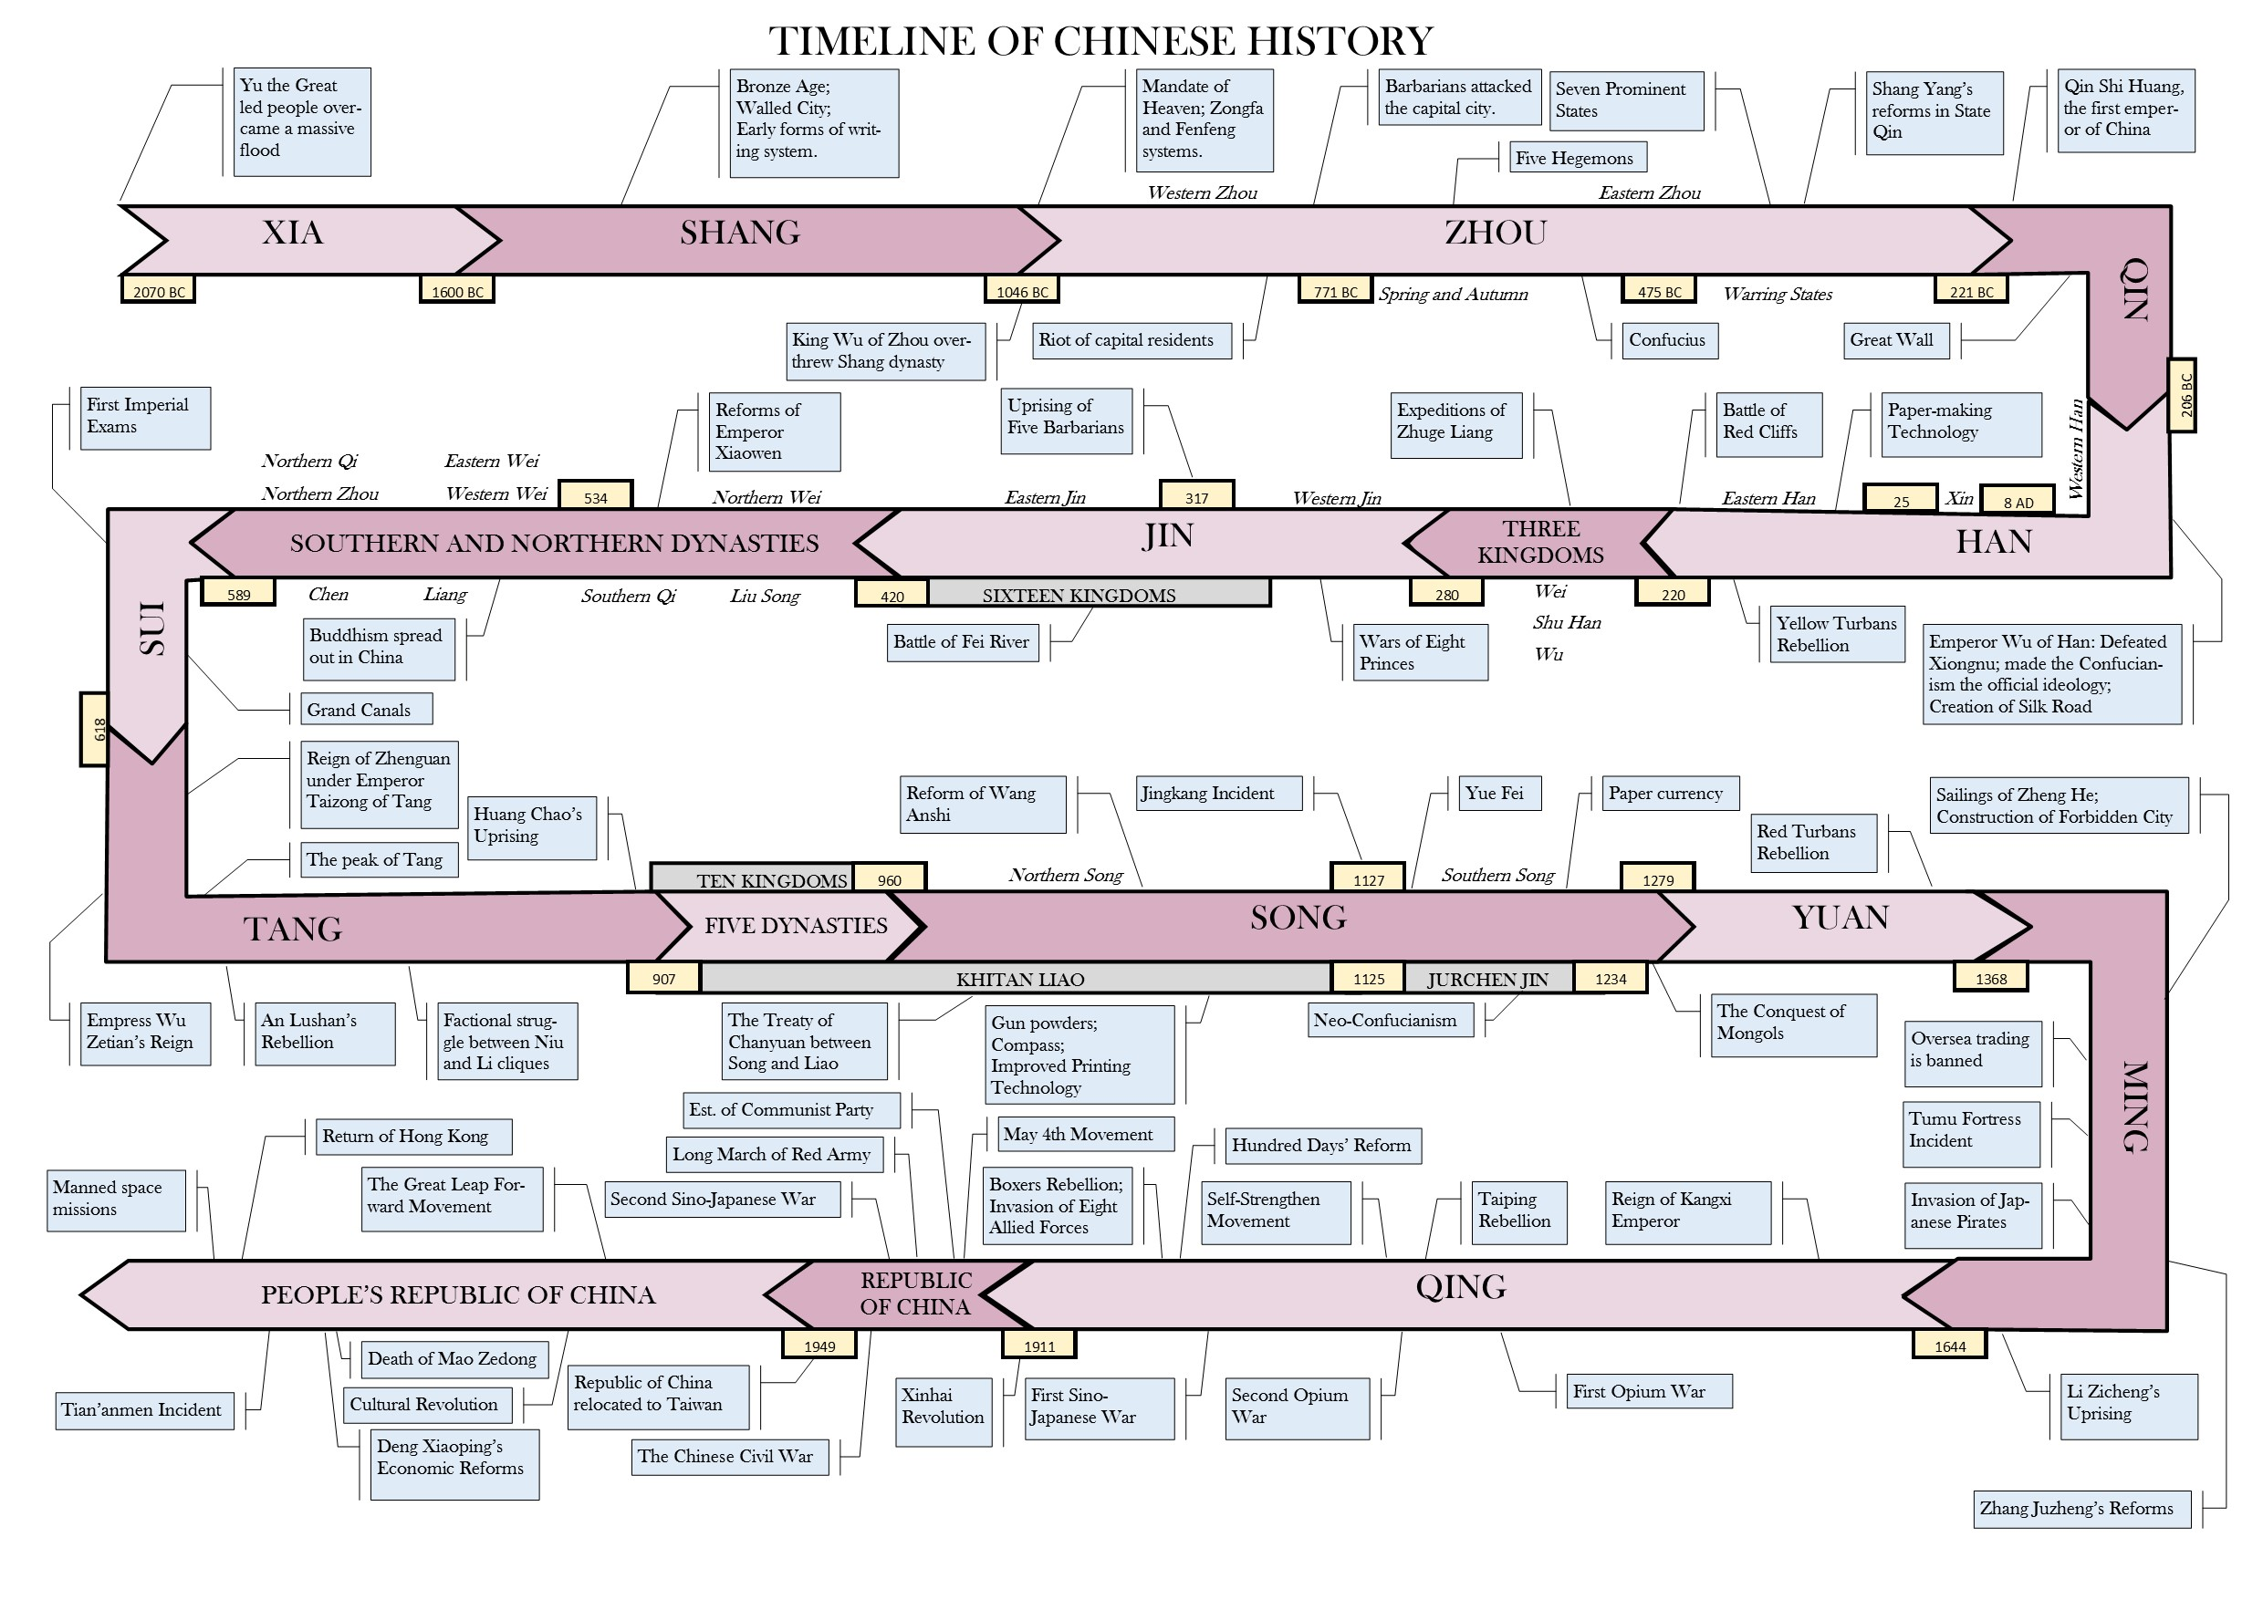
Time and History in China

Slide 22
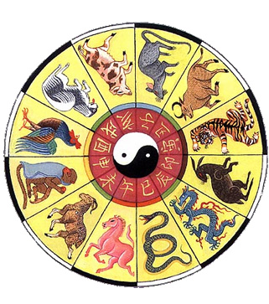
Time and History in China
Chinese New Year – b/w 21 January – 21 February
Lunar Calendar - complexity to calculations
based on the moon’s phases
common year – 12 months (353-355 days)
‘leap’ year – 13 months (383-385 days)
Counting On….
not infinite sequence, but cyclical
60 year cycles in which stems and branches were named
Stems
Jia (associated with growing wood).
Yi (associated with cut timber).
Bing (associated with natural fire).
Ding (associated with artificial fire).
Wu (associated with earth).
Ji (associated with earthenware).
Geng (associated with metal).
Xin (associated with wrought metal).
Ren (associated with running water).
Gui (associated with standing water).
Branches
Zi (Rat).
Chou (Ox).
Yin (Tiger).
Mao (Rabbit).
Chen (Dragon).
Si (Snake).
Wu (Horse).
Wei (Sheep).
Shen (Monkey).
You (Rooster).
Xu (Dog).
Hai (Boar/pig).
Each of the 2 components is used sequentially….
the 11th year is jia-xu (restarting the celestial stem)
the 13th year is bing-zi (restarting the celestial branch).

Slide 23
The Dynasties of China
23 Dynasties
‘Dynastic Cycle’
notion of ‘historical progress’ is a western idea
history is not about ‘change’…..rather it’s about eternal lessons
Ruling Chinese Dynasties
‘wen-hua’ - ‘to transform by writing’……’civilization?’
Shang Dynasty (c. 1600-1027BC)
Linkages to Middle East…..hypothesis?
horses and chariots, bronze weapons, reinforced bow……city planning familiar to charioteer encampments
Shang Writing
Oracle Bones
100 000 at Anyang, writing similar modern Chinese
cattle or sheep shoulder blade/ tortoise shell
writing inscribed asked questions of the spirits…
held over a fire…cracks then ‘interpreted’ by scribes/priests
pictographic
irrigation/flood control…..controlling people? taxation?
millet
rice
plow does not reach China until after c. 400 BCE
How do Chinese create a civilization w/o food prod. plow allowed?

Slide 24
Shang Religion, Society & Family Life
animism
polytheistic
natural forces….sun, moon, wind, clouds, etc
ancestral veneration
‘Shangdi’ – destiny & forces of nature
spirits of ancestors important to family life
cult? limited to upper classes?
family was central to society….more profoundly than other societies?
Youth obeys, age commands….respect, obedience deferred to elders
patriarchal…..by means of trad. rites, practices, & ceremonies
women respected, but less ‘valued’ then men…..
Nobility owned land….peasants worked the land – sharp divisions?
‘tribute’ from nobility to Shang King in exchange for local control….
slavery existed, but no where near that of Meso, Egypt, Greece, Rome…..
‘Heavenly Emperors’……or the ‘Heavenly Mandate’
but, power or Emperor & central gov’t conflicts with nobility….
Real insofar as he was able to ‘command’ obedience
Dragon – representative of Dynastic Rulers

Slide 25
Three Schools of Chinese Thought
respect for ancestral spirits was not enough…….
How to bring order to disorder?
Legalists
concerned with the power of the state…..an administrative theory?
anything done to strengthen the state was good
a ruler must use devious methods to sustain power
commoners must be subject regulations; often harsh….
associated with Shi Huangdi – ‘first emperor’ of China
Taoists
founder Lao Tzu (Zi)
action of ruling by ‘nonactions’….wu-wei
Tao
‘the way’
a supernatural and natural meaning of life …..less about social structure and more about individuality
personal and private doctrine, disregards obligations to family or state
Confucians
founder Confucius (c. 551-579BCE)
the Analects…..the ‘Bible’ of Chinese civilization?
code of values – ‘decorum’ - what is proper?
knowledge – acquired by rigorous study….the classics!
be faithful to the ancients…..training in military arts, but abhor war…..
Taiji or Yin and Yang
by training, study….one becomes virtuous; not inherited
‘peace, order & good government’
reaffirms importance of family & empire
two central realities of ancient as well as modern Chinese society…..

Slide 26
Zhou Dynasty (c. 1028-221BCE)
‘barbarians’ from central Asia....not Chinese?
Western Zhou (to 771BCE)
‘Heavenly Mandate’ or ‘Mandate of Heaven’
one heaven = one God = one emperor
justifies successful revolt?
proof Heaven had withdrawn favour….
decentralized gov’t (opposed to that of Shang…)
feudalism?
patriarchal
the story of Bao Zi….‘femme fatale’
Eastern Zhou (to 221BCE)
no unity….led to ‘Period of the Warring States’
Sun Tzu – ‘Art of War’
but, an expansion of Chinese culture…into ‘barbarian’ lands
improvements in metallurgy….
improvements in livelihood of citizenry
walls, dykes, irrigation works, and canals….
agricultural revolution…..new crops
new forms of expression….music, poetry, fashion
chopsticks!

Slide 27
Han Dynasty (c. 206BC- 220AD)
follows the despotism of Shi Huangdi (‘Chin’)…..
Parallels the Roman Empire in the West…..’The Land of Silk’
Silk Road
Emperor Wu-Ti (Wudi) (c. 140-87BC)
establishes paramountcy of Confucian thought
incursions (invasions?) of Korea, Vietnam, Central Asia…..
Mandate of Heaven (….or Heavenly Mandate….)
Gov’t, Bureaucracy & Law
Inner Court
Empress
the Harem…..
Consort clans
Eunuchs
castrated….why?
servants, but also advisers…volunteers
Outer Court
bureaucrats…… ‘Mandarins’ or Ministers
nobility….later, recruitment thru a vigorous exam system based on Confucian ideals and ancient texts….the classics!
Law – reversal of western trad.
guilty until proven innocent….

Slide 28
Song Dynasty (c. 960-1279)
China reunited?
renaissance?
Neo-Confucianism
blends Taoism, Buddhism & works of Confucius
conservative….
the family, the father, the virtuous
‘chi’ – life force or essence – martial arts
Commercial Revolution
most advanced economy from 10th to 18th century
Industry
smelters
gunpowder
unfettered capitalism
foreign trade
imports – textiles, spices, medicines
exports – silk, copper and most particularly, porcelain
porcelain (ceramics)…..found in Africa, India, Middle East
shows the vigor of 12th C sea trade
Junk
first magnetic compasses
300 years before Europe ‘discovered’ it….
Agriculture
spread of rice farming techniques

Slide 29
Arts & Culture in the Song Dynasty
Landscape painting
nature and humanity’s place in it
three dimensional space
Increase in literacy
paper and printing (c. 756)
histories, encyclopedias, essays, ….
Poetry
Li Po (701-762)
love, longing, despair, self-disgust….self-conscious
his influence on scholars (and examinations….)
85% of pop. were subsistence farmers….
Hangzhou
‘the most notable city in the world’……Marco Polo
notable divisions in social status
foot binding
‘women of the golden lotus’
beautiful and desirable
cont‘d until mid-twentieth century….

Slide 30
The Great Mongol Conquests
Mongols
refers to Mongol peoples of the steppe in East Asia
China – but one of many high cultures in contact with
Mongol Life
hunting
herding
small kinship groups…..result of harsh geoclimate
Temujin
becomes ‘Genghis Khan’…’ruler of all within the seas’
Visionary
disregards kinship & clan ties in building army
embraces other steppe peoples (after invasions)
Turkish and Tungusic-speaking peoples
Expansion into China
Mongol cavalry
China’s walled cities?
Mongols ingenuity - a template for future incursions
By 1227, the Khan’s death…..
raiders and plunders…but rulers?
Successors cont’d campaigns across Eurasia….

