Slide 1
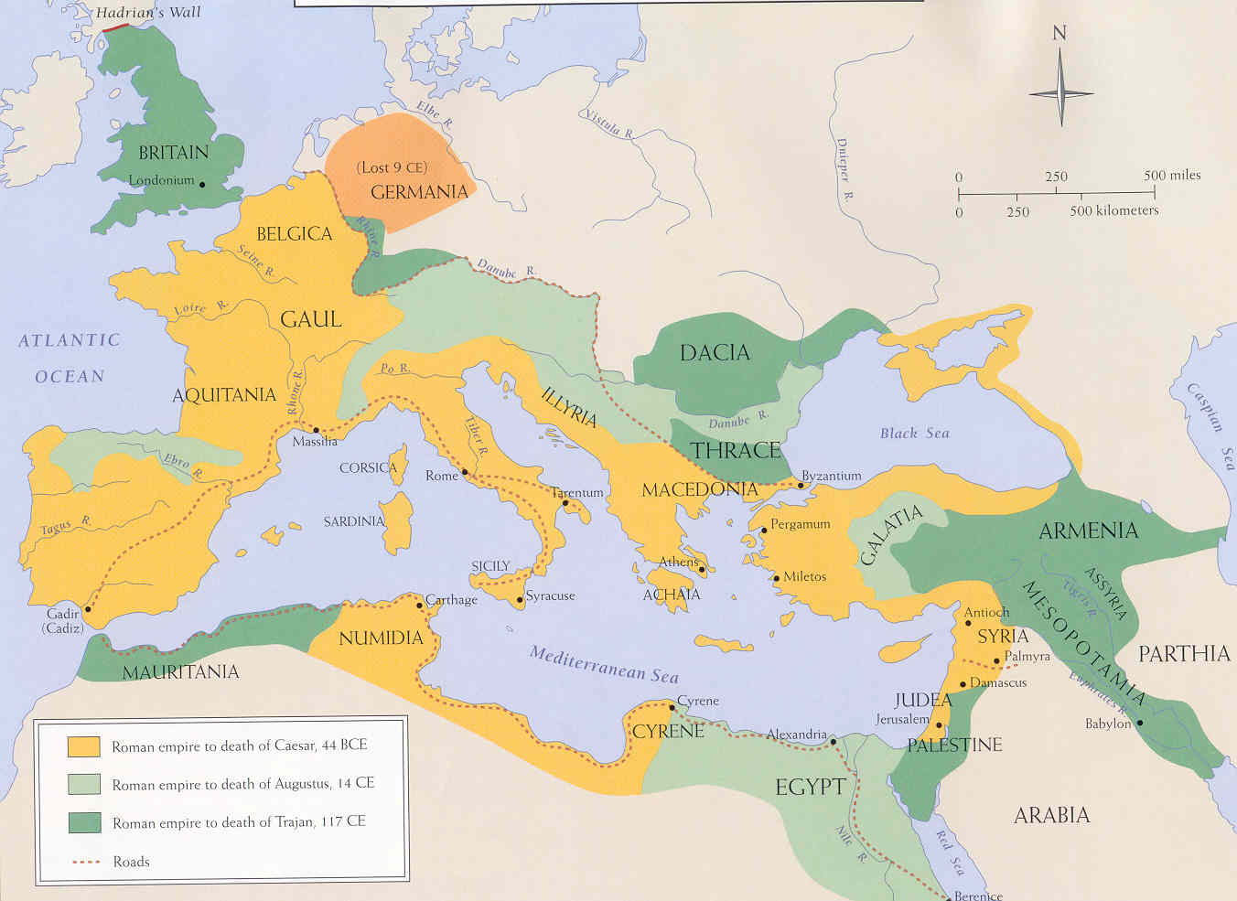
Imperial Rule in Rome and China

Slide 2
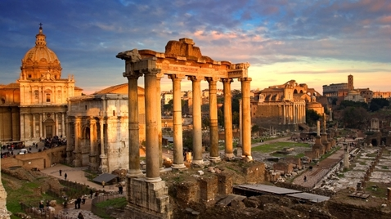
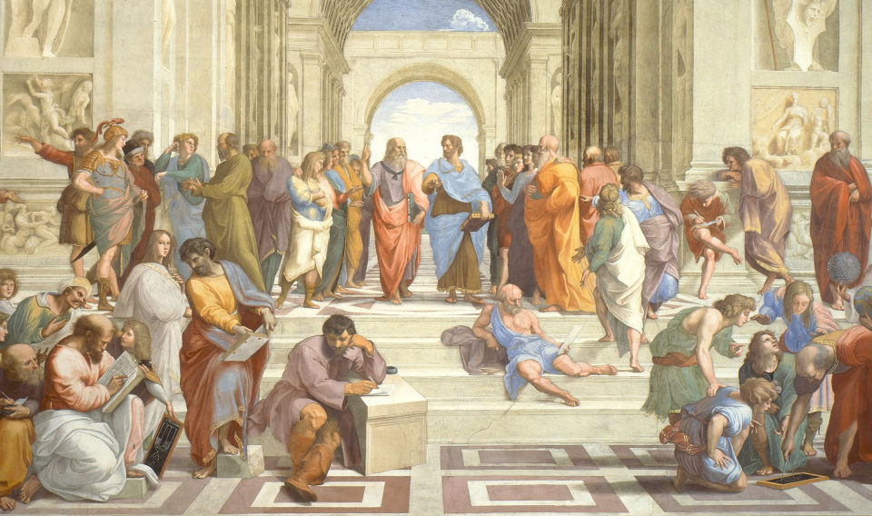
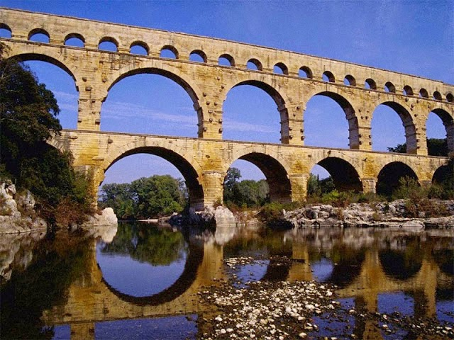
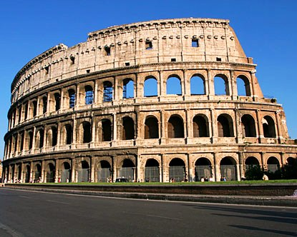
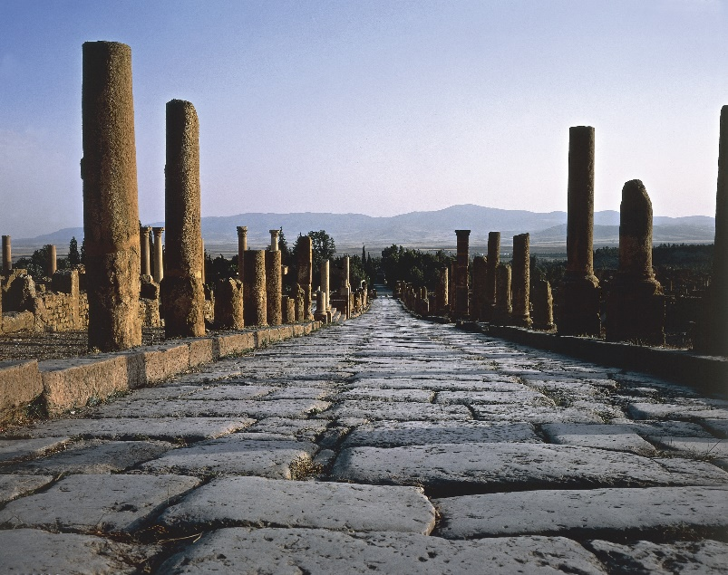
‘On Rome’
What made this civilization so enduring in the history of the world?
politics and government
the Republic
bureaucracy
art and architecture
infrastructure and engineering
law and order
Destiny
‘to spare the conquered and put down the proud’
Empire
A Republic built on War and Order?
Why do we study Roman civilization?
to discover something of ourselves & our societies?
Why Rome?
Why not another city-state – that created a polity around all sides of the sea, uniting most of Europe and the entire north African coast with the lands of ancient empires in the Middle East?

Slide 3
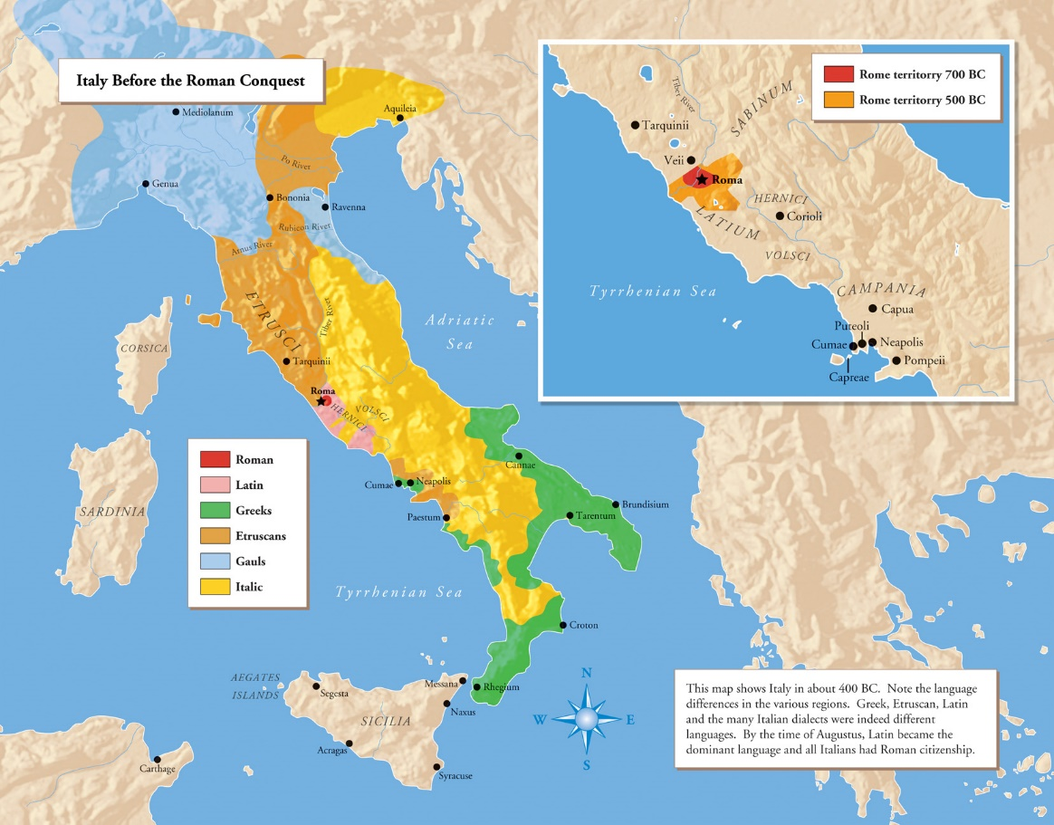
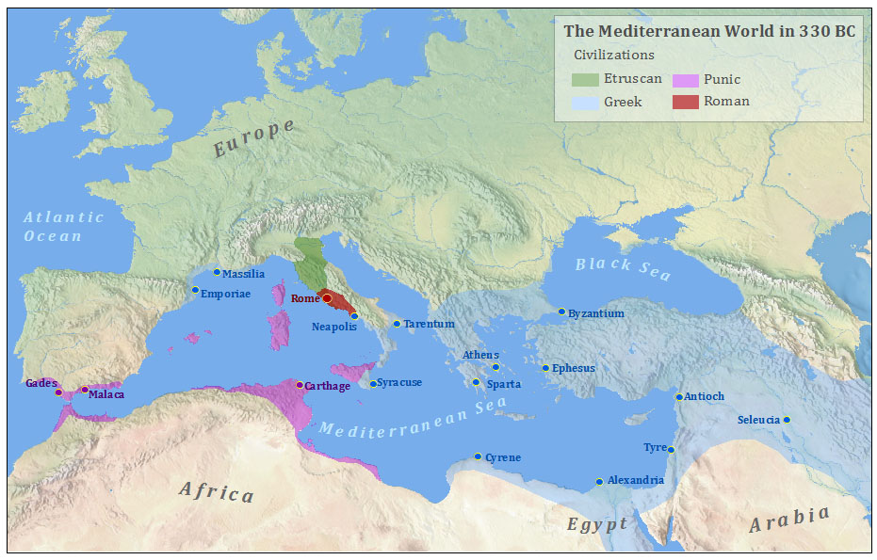
A Republic Built on War and Law
The starting point was conquest, as with most empires.
Romulus – abandoned as a baby to die, nursed to life by a wolf – extolled hardiness, valor, daring, fidelity, and combat as primary virtues. Romulus was said to have killed his own brother (Remus), and a conflict within the political elite would be an ordinary part of Roman life.
500 BCE – Romans replaced their king with a republic –
ruled by elected representatives.
No incompatibility between empire and republican government
Romans conquered and incorporated tribes, cities, and kingdoms in Italy, and later moved on beyond their core area. The centuries of conquest included near defeats, inspired loyalty, and embedded military values deeply in the institutions and spirit of the empire.
As Romans took over more and more places and people, they adjusted their institutions to the tasks of ruling an imperial capital city and distant places.

Slide 4
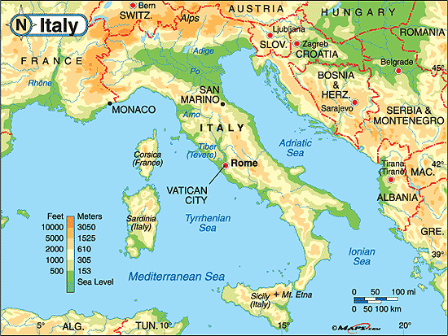
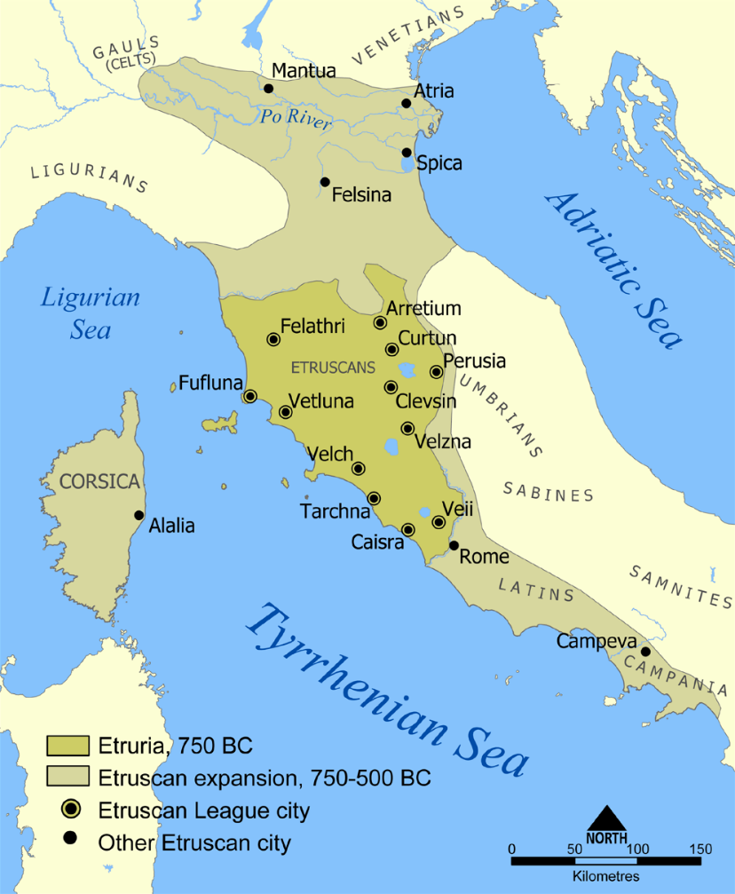
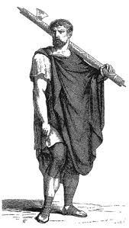
The Rise of Rome
Key features of Italian geography that effect Rome?
Mediterranean location ‘mare nostrum’
Proximity to the sea
Po and Tiber Rivers
Mountain ranges?
Communications between Greece & North Africa
Climate?
Agrarian potential?
Etruscans (c. 750BC – 509BC)
Where from?
Asia Minor?
Artisans, traders …..a sophisticated people….
Buried their dead in tombs
Much learned from these….
Greek city-states & Carthage (N. Africa)
conflict limits/restricts expanse
Confederacy
Symbols of authority Rome inherit
the fasces
Etruscans are defeated, expelled by Romans in 509BC

Slide 5
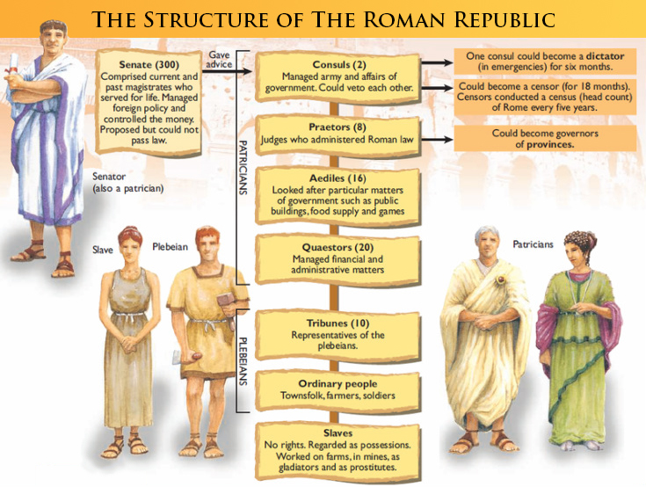
The Roman Republic (509BC-29BC) ….a more democratic republic in response to tyranny of Etruscan rule?
complex constitution centered on the principles of a separation of powers and checks and balances….
elected reps rule….different from ‘democracy,’ in which every citizen is expected to play an active role in governing
the patricians (aristocracy)
the plebeians (landless peasants)
segregated populace
Senate
evolved from advisory assembly to powerful governing body
senators served for life….debated, proposed laws, administrated…
Assemblies
several ‘assemblies’…..hence: ‘complexity of Roman Republic’
Comitia Centuriata – enacted laws, elected consuls, declared war
…….this was an assembly of soldiers
Concilium Plebis …..tribunes or reps of the plebians
‘plebiscite’ – a direct vote of the entire electorate
The Twelve Tables (c. 450 BCE)
promoted the public prosecution of crime
enacted a system of victim compensation
protected the lower class (plebeians) from abuse by ruling class (patricians)

Slide 6
Checks and Balances
Assemblies
Senate
Particians (nobility)
Comitia Centuriata
segregated by wealth
Comitia Curiata
Comitia Tributa
Concilium Plebis
plebiscites
Magistrates
Consuls
Dictator
Praetors
Judges
Censors
Responsible for Citizenry
Aediles
Public works
Quaestors
Finance

Slide 7
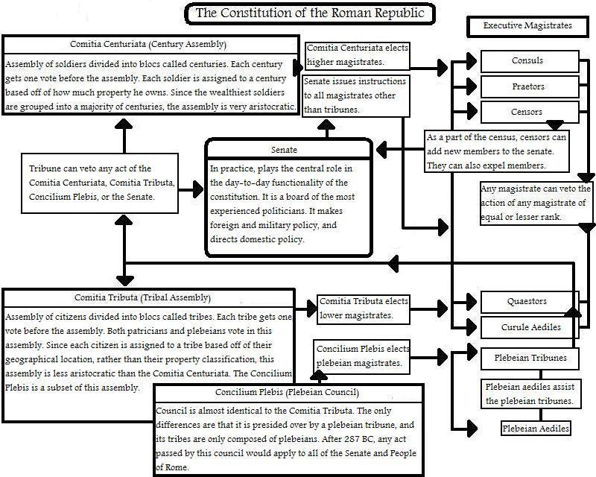
Always Annoying John Green - On Republican Rome - https://www.youtube.com/watch?v=oPf27gAup9U

Slide 8
Institutions for Empire
Imperium – first referred to the king’s power to impose execution or beatings, to draft citizens into armies, and to command armies on campaigns….that power was transferred to the consuls under the republic – tight connections in governance between military and civil matters.
Praetor – (circa 241BCE) created to expand military and judicial command over new areas and to deal with legal matters between Romans and conquered people.
Innovations in government created by the Romans echo in our political vocabulary – patrician, plebian, noble – these concepts configured ways of thinking about status – senates and committees are still with us…..magistrates, tribunals, consuls evolved.
To govern outside their capital, Romans developed strategies that would enter the repertoires of later empire-builders. One of these was the enlargement of the sphere of Roman rights….
By the time the Romans completed their conquest of Italy, they had produced three different ways of attaching land and people to their empire:
annexation, limited citizenship, and eventual assimilation for nearby Latins,
limited self-government for some non-Latin cities and tribes, and
colonies of Latins displaced to frontier regions.
Law and Government – Government, from Rome’s perspective, was mostly about collecting taxes, either as money or produce, mobilizing soldiers, and sustaining the infrastructure – roads, aqueducts – that kept the empire together……legal pluralism evolved…..civil laws…..Romans were good at ‘incorporative activities.’

Slide 9
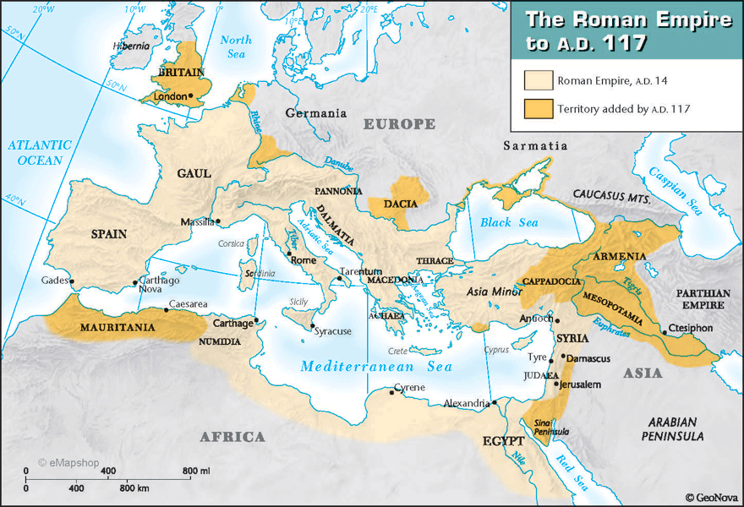
Roman Law
Two basic principles:
Law must be recorded
Justice could not be left to judges alone
The Twelve Tables (c. 450 BCE)
promoted the public prosecution of crime
enacted a system of victim compensation
protected the lower class (plebeians) from abuse by ruling class (patricians)
‘legal advisers’ – a person accused of a crime could seek out legal advice. This practice of having an adviser who specializes in the law first became prevalent during Roman times.
By 100 CE, the Romans had a sophisticated and complex society, and the Roman Empire had spread throughout most of Europe. Society became even more complex, and more laws were devised to decide such matters as what constituted criminal behaviour, how contracts should be regulated, and how everyday disputes with citizens could be resolved.
Justinian’s Code – The word ‘justice’ is derived from Emperor Justinian’s (527-565 CE) name. This code formed the basis of civil law (laws governing personal relationships).

Slide 10
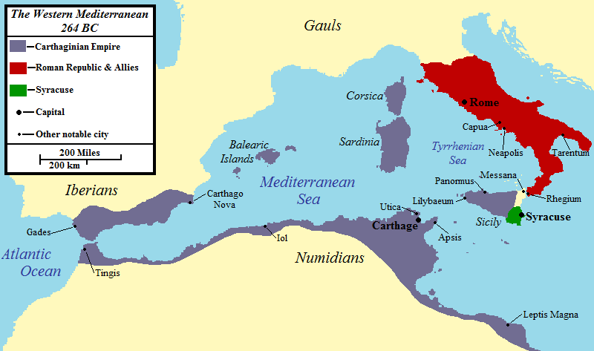
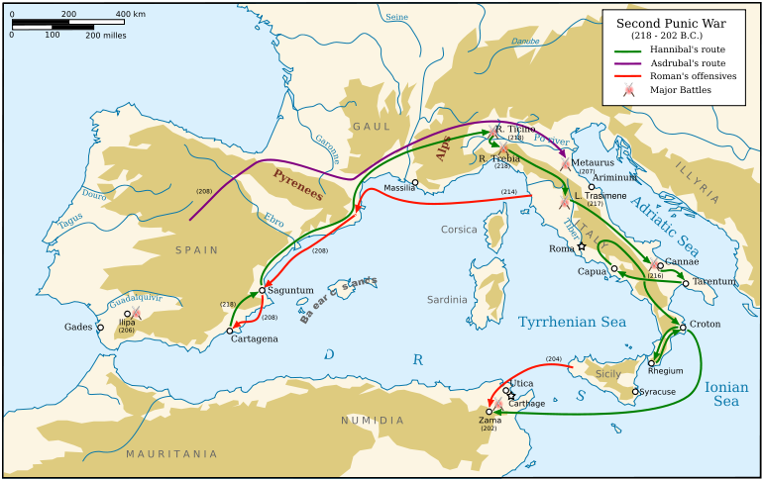
The Punic Wars (c. mid 3rd century BC)
Rome v. Carthage Rome’s greatest test?
264BC – Clashes over Sicily
How to govern? Roman governor?
Carthaginians occupies Spain (Iberia)
Hannibal
land based invasion of Italy from Spain……War Elephants!
bloody battles, significant Roman losses
Cannae – 50 000 Roman soldiers dies in one day
Romans adapt – guerilla warfare
Scipio Africanus
Hero of the Punic Wars?
Defeats Hannibal in Spain, Sicily, Tunisia
Carthage weakened – treats with Rome
Numidians fearful of Carthage – Rome razes, burns Carthage
‘We have made a desert and called it peace’
How does Rome’s conflict with Carthage contribute to their expansion?

Slide 11
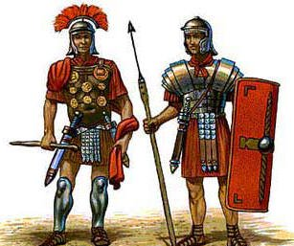
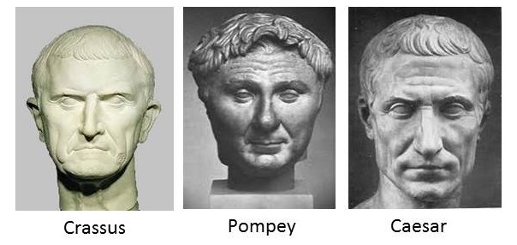
Aftermath of the Punic War
Roman (& Italian) Society Divided
Rich v. Poor
Free v. Slave
Citizen v. Noncitizen
Soldier v. Civilian
The Generals
Gaius Marius……his rival was that of Cornelius Sulla
Evolution of the Roman Army (influence, as well)
problem of land supply…..leads to standing (‘professional’) army
fixed term of service – 16 yrs + 4 yr veteran = pension, gratuity, plot of land
loyalty to Generals rather than Rome…..
Civil War
Generals execute political opponents in the Senate
First Triumvirate (to 53BC) – ‘Rule of Three Men’
Gnaeus Pompey (106-48BC)
M. Licinius Crassus (115-53 BC)
G. Julius Caesar (100-44BC)
Gracchus Brothers (c. 133BC-123BC)
Reform?
Break up the Estates
Divide land among the poor
Murdered……recurring theme in Rome’s politics

Slide 12
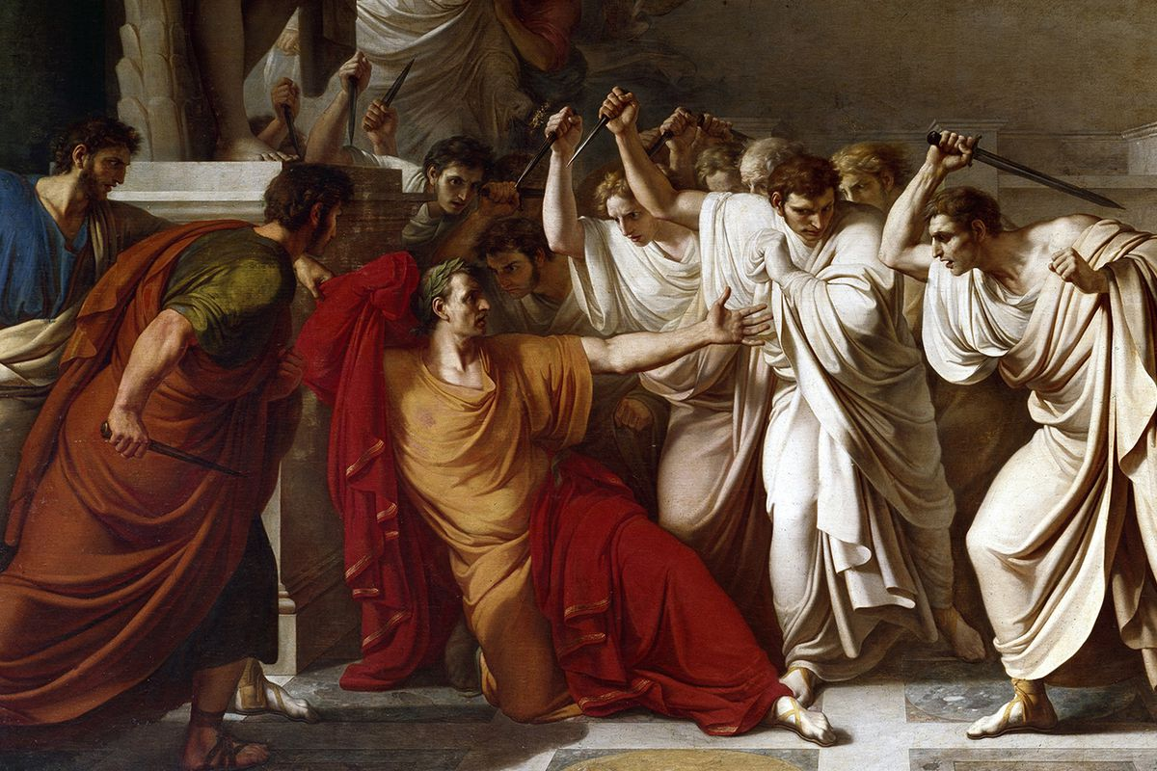
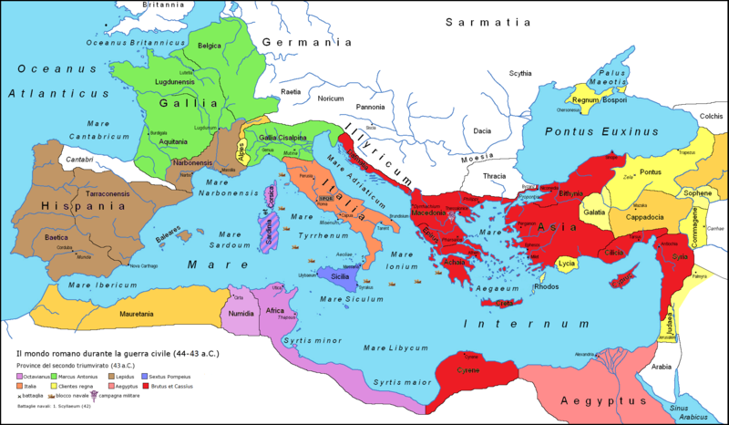
Pompey and Caesar: Rivals for Political Power
Civil War (yeah, again….)
Caesar prevails (c. 45BC)
Senate fearful of Caesar’s military power….
Dictator for life….unconstitutional and unprecedented? Nah.
settles veterans to the colonies…..
Reformer?
‘softened’ Rome’s rule in colonies – ‘citizenship’ & ‘tax burden’
Julian Calendar
Death of Caesar
Et tu, Brutus?
Civil War (OMG, really….)
The Second Triumvirate (43-32BC)
Mark Antony
Octavian (Caesar’s son)
Marcus Lepidus
*** Sextus Pompey
Mark Antony And Cleopatra (of Egypt)
Mark Antony already married to Octavius’ sister
‘a passionate and troubled affair…..’

Slide 13
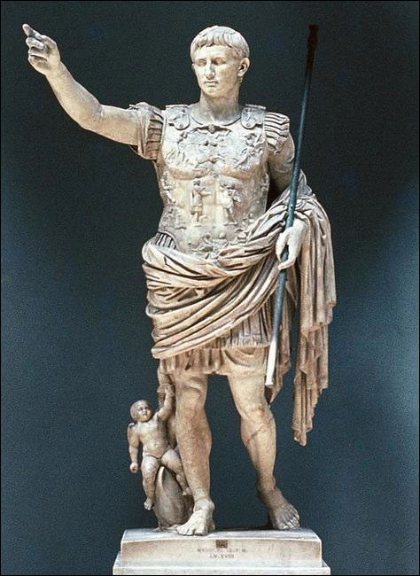
Order from Chaos….the Empire gets an Emperor
Augustus (63BC-14AD)
born Octavian, later adopted by Julius Caesar…
Allying with Mark Antony, they divide the empire, but…..Cleopatra!!
Octavian defeats Egyptian fleet, becomes hero of Rome
Expands empire, but shrewd politician at home in Rome
Restores the ‘Republic’ (really, just pretending)
Augustus accumulates enormous fortune from plunder, gifts, taxes, and revenues from his personal estates and from provinces under imperial control….. ’patrimonium’
Emperor’s power was the military, but a double-edged sword?
Augustus kept the link between citizenship and military service – for the most part, the standing army was to be composed of citizens – but moved troops, with their generals, out of Italy and to the border zones.
A new elite corps – the Praetorian guard – protected the emperor. Augustus also created a standing navy…..In principle, the emperor as the sole, life-long military commander controlled the whole, but this principle was often turned on its head.
this system, its multiple legitimating institutions, the ethos of military glory – these were a recipe for regicide.

Slide 14
Pax Romana (Roman Peace)
Taxation was the key to the whole operation. The Romans taxed land, persons, inheritances, slave owning, imports, and exports. The famous Roman censuses were taken with tax collecting as a goal.
Functionally, the empire was a huge economic space, fostered by peace, security, and political unity. The whole was essential to the well-being of its parts. Africa, Sicily, Sardinia, and Egypt provided grain for Rome; Gaul, the Danube, and the Balkans fed the army; and Italy, Spain, the south of Gaul, and Anatolia – all commercially active areas – paid their taxes in money, which was used to compensate soldiers and officials.
It took a very long time – hundreds of years – for the imperial system to become unhinged from the framework established in the late republic and the first two centuries of the principate.

Slide 15
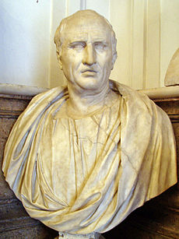
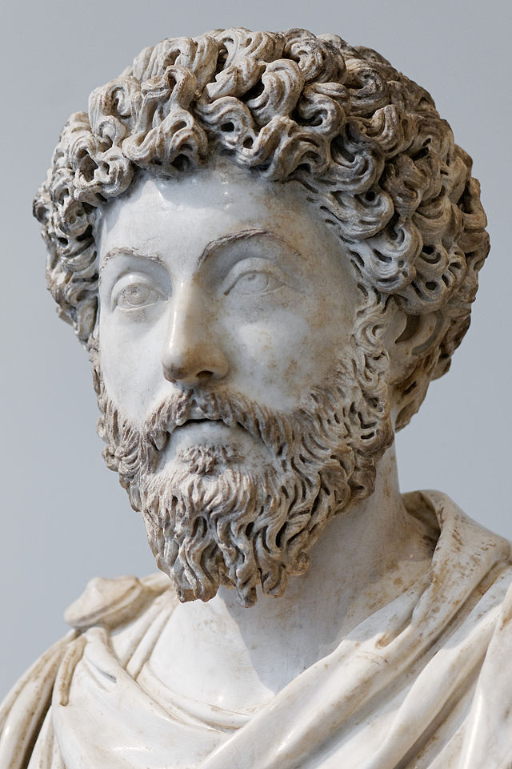
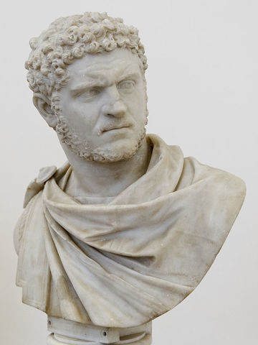
Ancient Roman Philosophy
heavily influenced by the Greeks
much of Roman ‘philosophy’ written in Greek, not just Latin….
Cicero (c. 106BCE-43BCE)
Roman statesman, lawyer, scholar, and academic skeptic
a master of latin prose and its greatest champion – the language of W. Civilization?
Academica – the most extensive source of ‘academic skepticism,’ which maintained
that knowledge of things is impossible. Ideas or notions are never
true; nevertheless, there are degrees of probability, belief that allow one to act.
Epicureanism
the ethical objective was in pursuit of happiness, pleasure with the absence of pain….
people generally strive for indiv. gratification; hence, critiques of it…..
Lucretius – On the Nature of Things: an ethical poem links physical world with supernatural
Stoicism
‘not to worry?’ – all nature is, and whatever ‘is’ is right? (not unlike Buddhism?)
happiness is found in the moment, by not being controlled by the desire for pleasure
…or fear of pain, by using one’s mind (logic, reason) to understand the world…..
Meditations, Marcus Aurelius
Christianity
a set of philosophical ideas initiated by Christians in the 2nd Century AD
(St.) Augustine of Hippo
‘original sin’ – belief in the grace of Christ equates to human freedom…..
profound influence on religion, and as much on philosophy…..
Cicero
Marcus Aurelius
St. Augustine

Slide 16
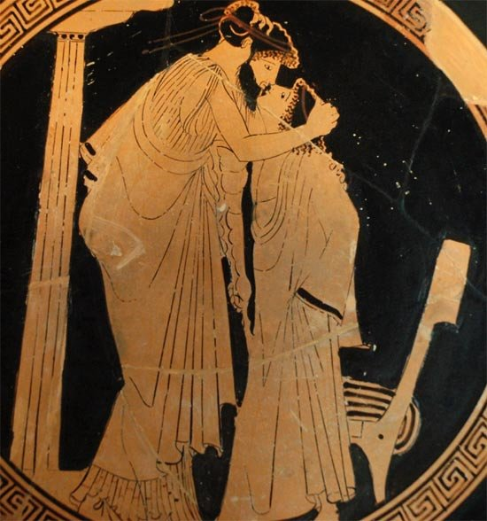
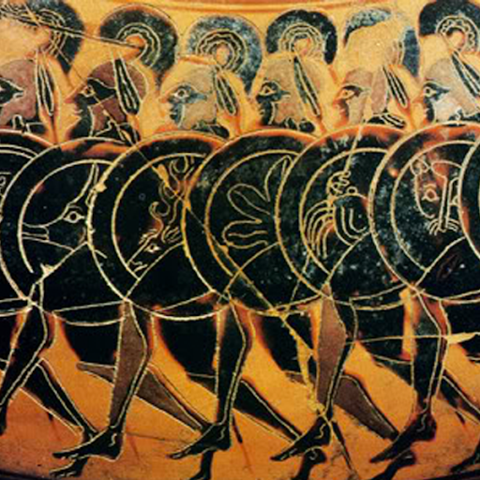
Women and Sexuality ….obscured by the passage of time and the biases of ancient male writers and modern scholars?
in Ancient Greece – from city-state to city-state…..much about Athens, some about Sparta in regards to the role of women
how important are class distinctions?
What did the great thinkers of the time think of women?
And yet, why do myths of the Greco-Roman world paint a different image?
Sex workers?
‘pederasty’
‘relationships’ between adult males and adolescent males, not excluding women either
Sappho of Lesbos (c. 620-570BCE)
possible that she was lesbian, but maybe not….poetry expresses such love, but intimacy
and honesty of her writing dos not mean in itself that she was…was Homer a soldier?
it is believed she wrote on a great many subjects, but that this poetry is what survives her
the Sacred Band of Thebes
an elite force of 150 pairs of male lovers of the Theban Army
the Sacred Band are said to have defeated the Spartans in 371BC at the Battle of Leuctra
And if there were only some way of contriving that a state or an army should be made up of lovers and their beloved, they would be the very best governors of their own city, abstaining from all dishonour, and emulating one another in honour; and when fighting at each other's side, although a mere handful, they would overcome the world. Plato, Symposium

Slide 17
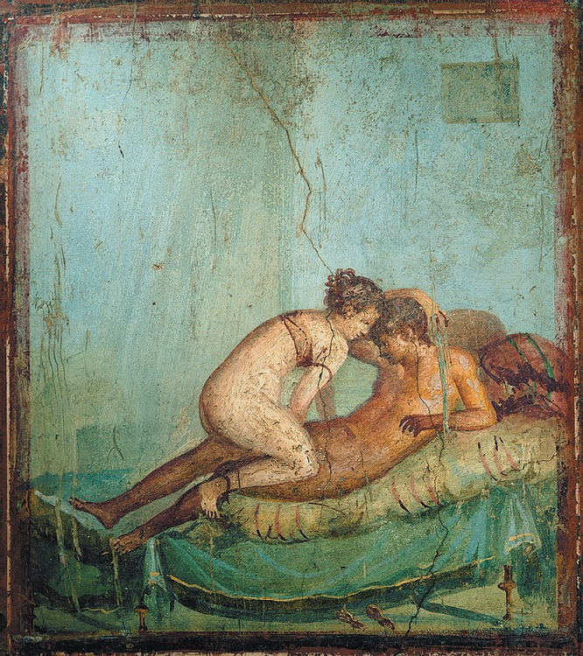
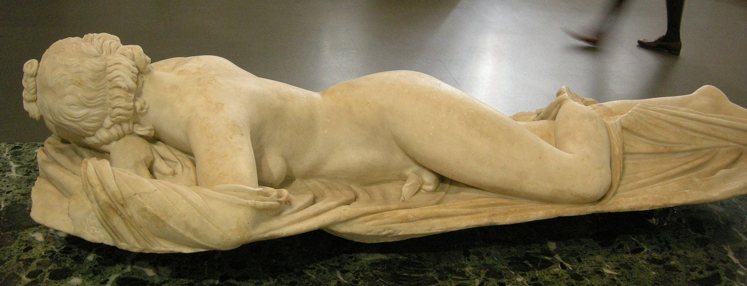
Women and Sexuality
In Ancient Rome – women were legally obliged to have a male of the family act in their interests…..financially, in matters of law
Cicero, not unlike Aristotle, expounded the idea that women were incapable of making sound decisions…
there were few ‘exceptions,’ and women could not play a role in public affairs – other than through their husbands….
Vestal Virgins
selected b/w ages of 6 and 10
30 years of service – chaste
tended the sacred fire in the Roman forum; ritual feasts…..
A seductive society and decadent society?
Roman Sculpture – Sleeping Hermaphrodite (c. 100AD)
Frescoe found in Pompeii

Slide 18
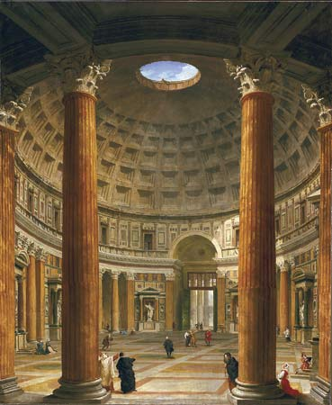
A Seductive Culture
The Roman empire offered people of social standing, both in and outside the capital, an opportunity to participate in a civilization that celebrated its divine origins, earthly grandeur, and superior way of life.
Cities and civilization…..modeled on the Greeks……concrete allowed construction of vaults and domes, adorned with elaborate decoration. Roman improvements included water and sewage systems, adapting Greek models to accommodate large republics……Law was part of this Roman civilization, both a means of governance and a support for the social order. It was only in the sixth century – and in Constantinople, the eastern Roman capital – that the emperor Justinian sponsored the collection of laws in a single code.
What was Roman about Roman law from Republican times, and what became a powerful historical precedent, was professional interpretation, operating in a polity where the manner of making law was itself an ongoing and legitimate political concern.
Paideia – a Greek word, described this right kind of education (of language and learning): one that prepared youth for a life of knowledge and sensitivity to beauty, and taught the social skills to attain calm nobility and civic virtue. Humanitas – ‘civilized behavior.’
The Pantheon
Blends Greek style with Roman features

Slide 19
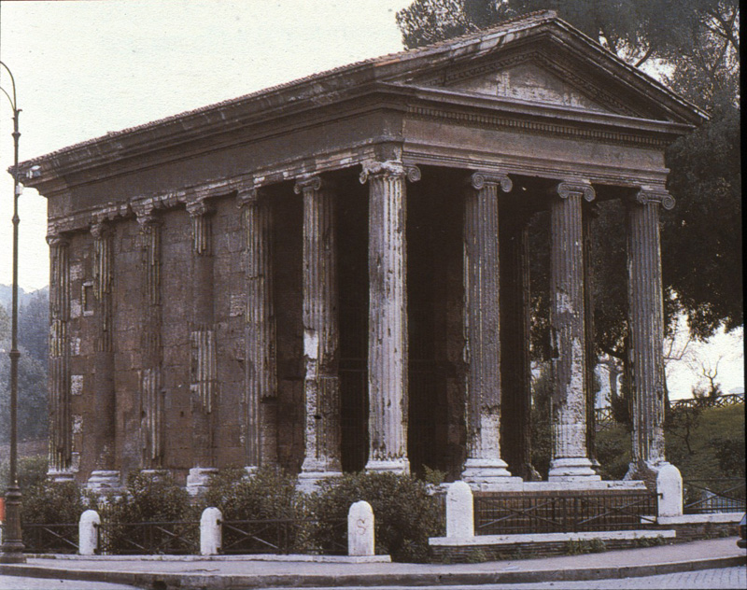
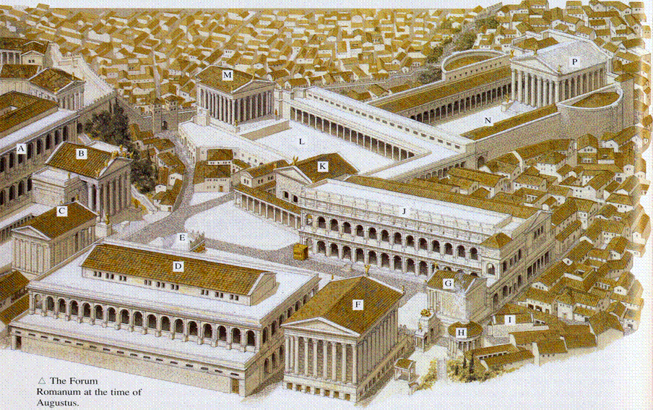
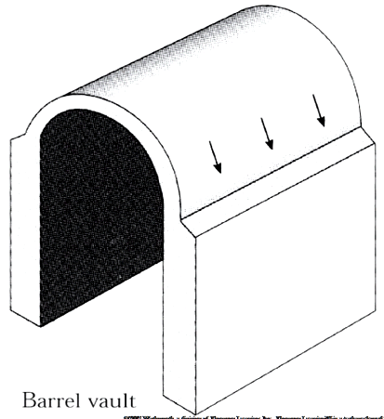
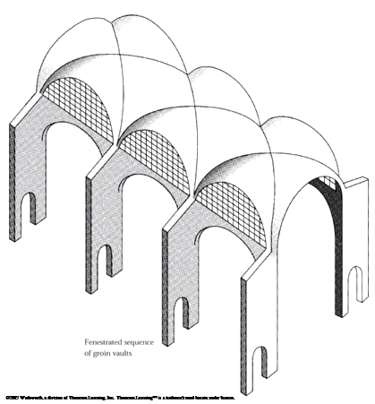
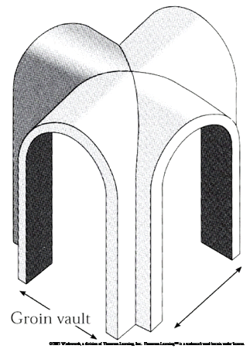
Roman Architecture Temple of Fortuna Virilis
Temple Architecture
blends Etruscan and Greek features
emphasis on the front of the building
Concrete
a revolution in architectural design
allows for larger, heavier designs
Roman Forum
Arch & Vault
Colosseum
amphitheatres
public baths
Race track – Circus Maximus
Barrel Vault
windows
buttresses?
Groin
less buttressing
Multi Groin
clerestories….windows above aisle ceiling allow light
churches
https://www.youtube.com/watch?v=ODLxqz6-ogo

Slide 20
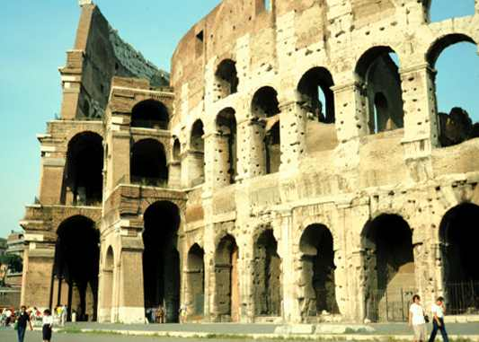
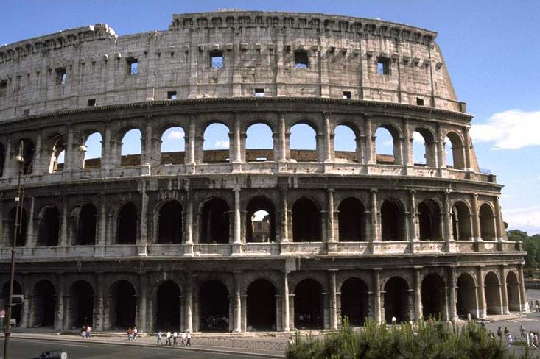
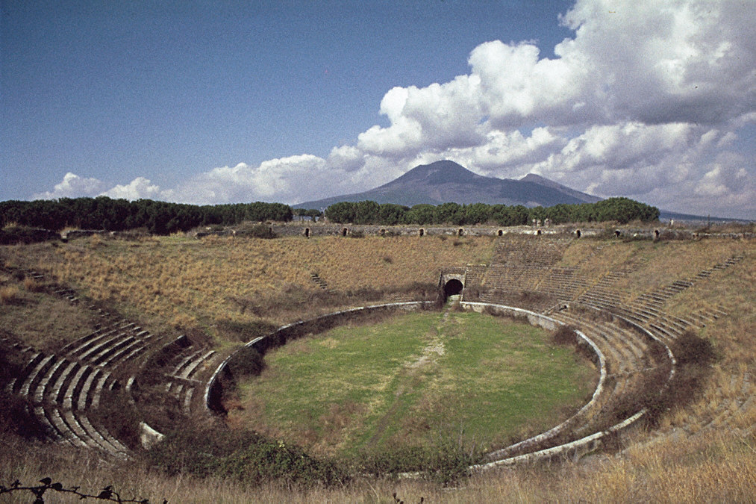
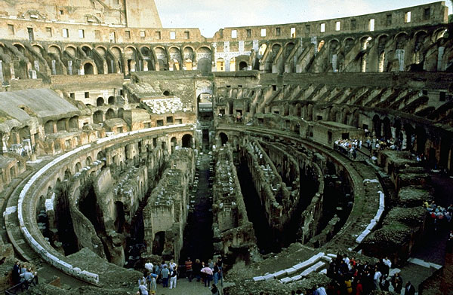
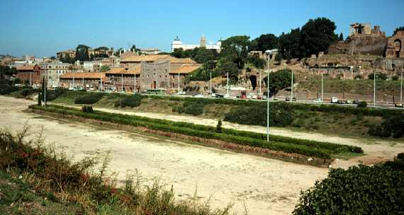
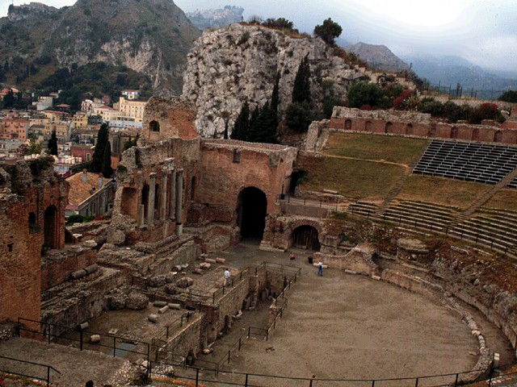
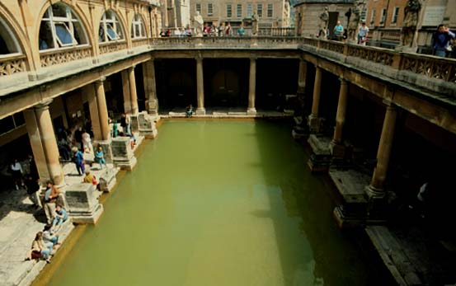
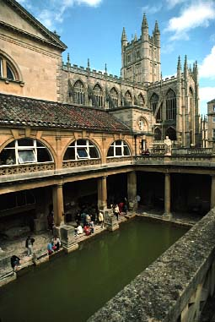

Slide 21
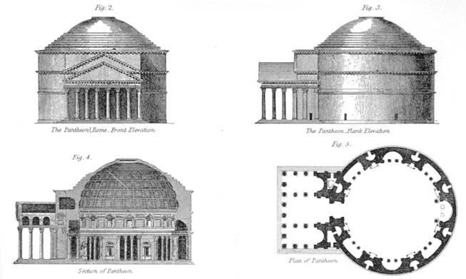
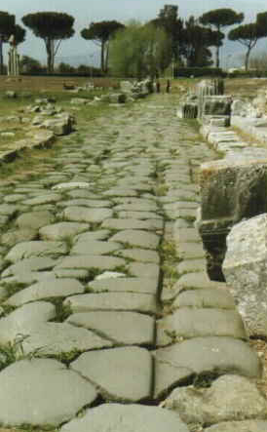
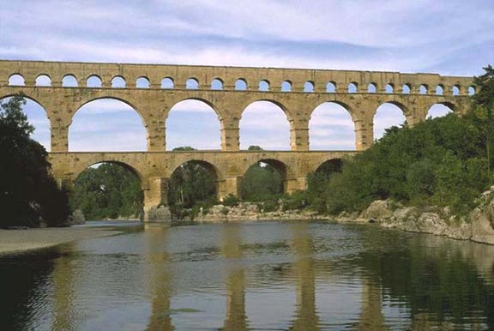
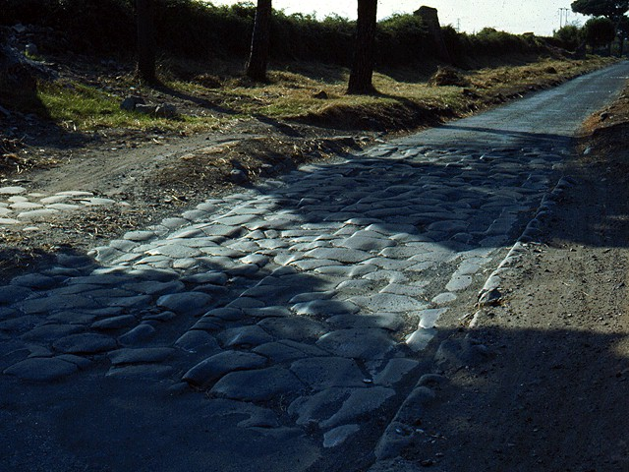
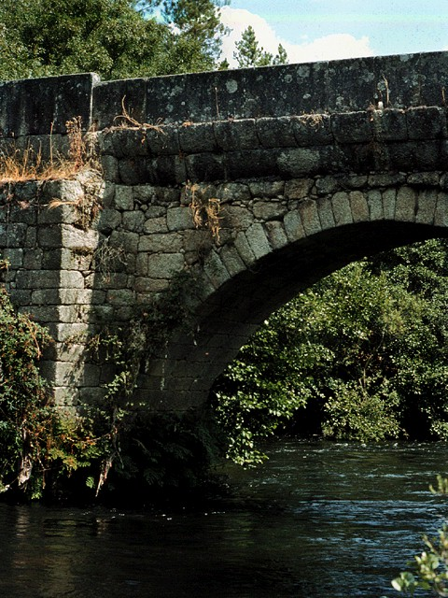
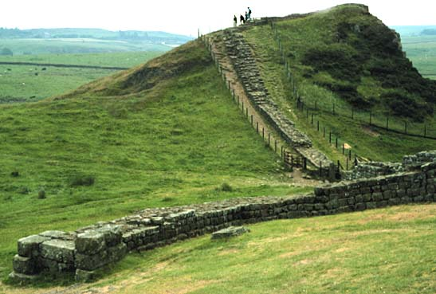
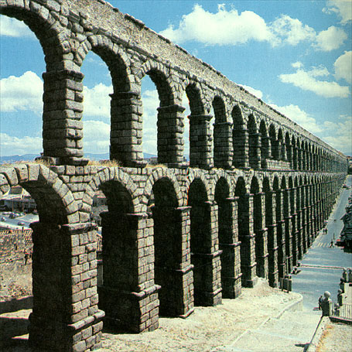
Roman Architecture/Engineering
Dome
large and relatively open spaces
the Pantheon
Marcus Agrippa
early Christian churches
the dome allowed Romans to span space
light entered thru oculus (on top)
Innovative Engineering Techniques
roads
the Via Appia
Aqueducts
testament to Roman ingenuity
arched bridges
Emperor Hadrian (117-138)
Hadrian’s Wall
northern England
the Pantheon
villa at Tivoli
https://www.youtube.com/watch?v=FN1v5FYkTLQ

