Slide 1
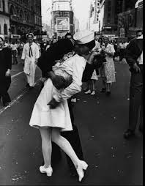
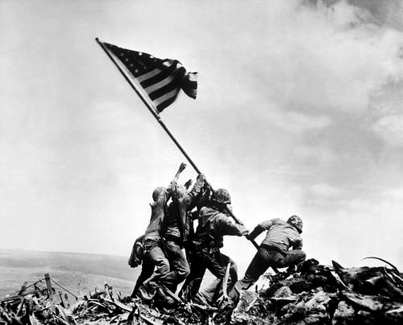
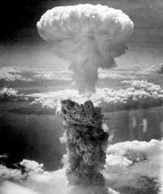
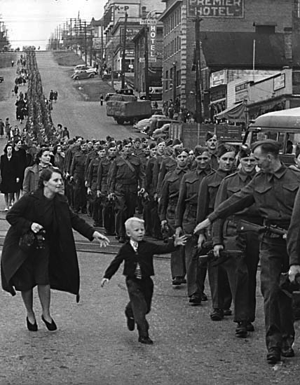
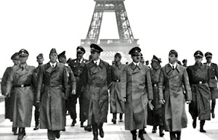
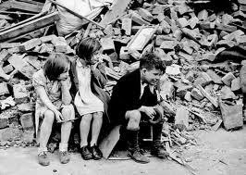
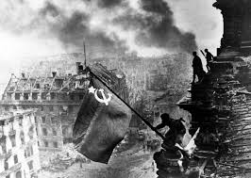
The Second World War

Slide 2
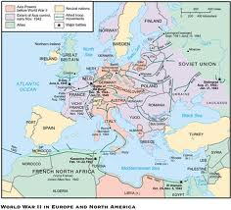
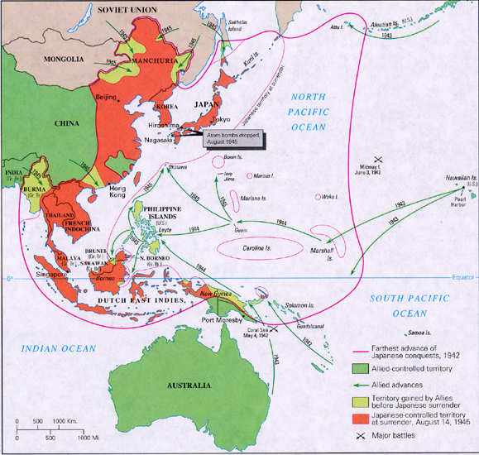
Intro to the Second World War
A series of wars which slowly engulfed the world…
Japanese Invasion of Manchuria, 1931
Italian Invasion of Abyssinia, 1935
Spanish Civil War, 1936
Hitler’s aggression in Europe, 1936-1939
Different from the Great War of 1914-1918
Technology
War of Motion
Ideology
Capitalist & Communist vs. Fascism
Two theatres of War
European (includes N. Africa, Atlantic)
Asia-Pacific
Crimes against Humanity
"War is not merely a political act, but also a real political instrument, a continuation of political commerce, a carrying out of the same by other means.”
On War, Karl Maria Clausewitz

Slide 3
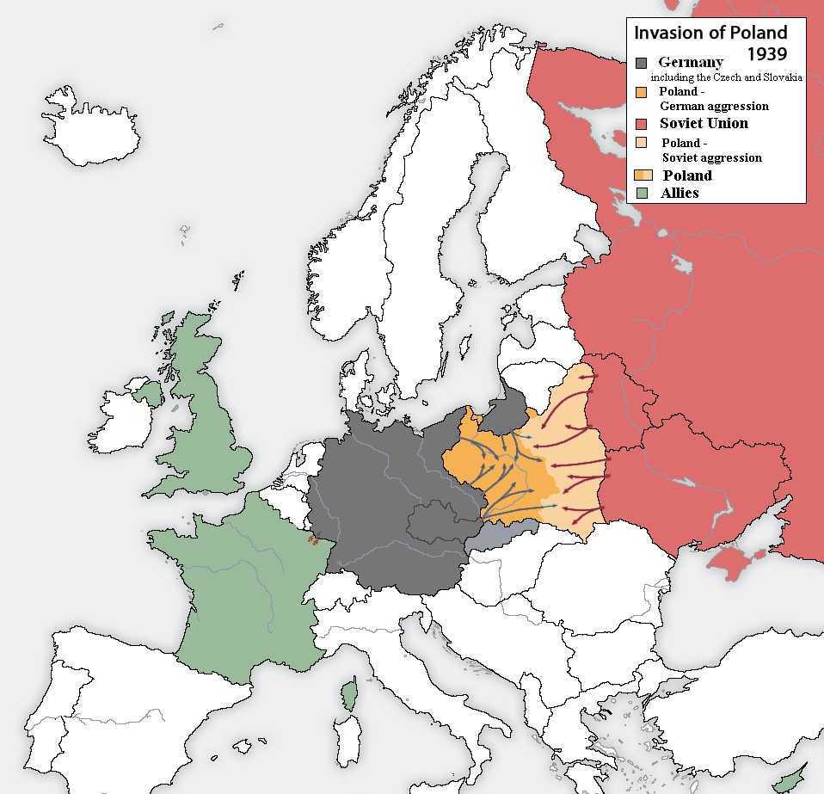
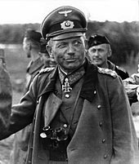
War in Europe
1 Sept 1939 – Invasion of Poland
- Poland falls 10 September
After fabricating a border dispute in the the free port of Danzig in the Polish Corridor, Hitler has the German ‘Wehrmacht’ (army) invade Poland
Could Hitler win Poland by bluster and bluff, as he had won Czechoslovakia, or would his gamble lead to war?
Britain & France pledge support to Poland
Nazi-Soviet Non-Aggression Pact, Aug. ’39
Blitzkrieg (‘lightning war’)
Stuka bombers (Luftwaffe)
Panzers (tanks)
Speed, surprise of combined arms
Wireless radio
How does blitzkrieg work and why was it effective?
https://www.youtube.com/watch?v=gUjrnlMAtQ4
Heinz Guderian

Slide 4
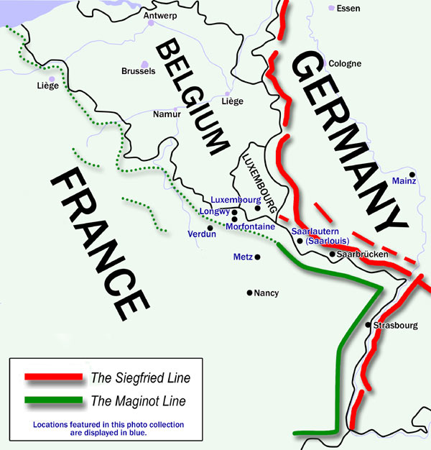
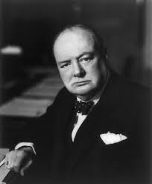
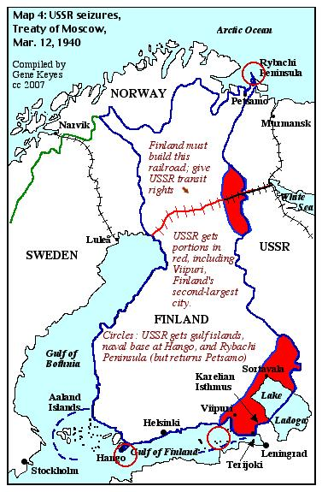
The ‘Phoney War’ – October 1939 to April 1940
Wehrmacht finalizes invasion plans; troops massed along the Siegfried Line
British Expeditionary Force (BEF) on Belgium border
French armies waited behind Maginot Line
Winston Churchill
First Lord of the Admiralty
‘Britain should take Norway’
Russo-Finnish War, Nov. ‘39-Mar. ’40
The Winter War
Soviets attack Finland in order to ‘safeguard’ its weak western border
Victory by Soviets comes at a surprisingly high loss of life
Reveals the true impact of Stalin’s Purges of Red Army during late 1930s

Slide 5
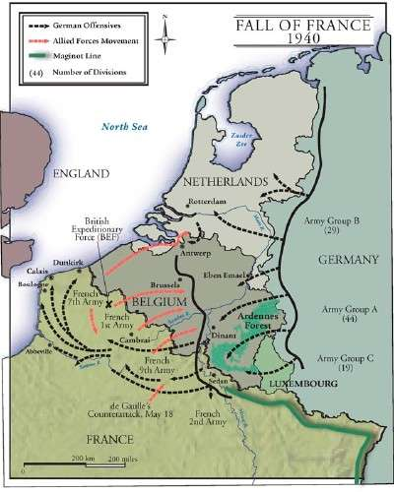
End of the ‘Phoney War’
April 1940
Hitler attacks Denmark, then Norway
Br. & Fr. rush an invasion force to Norway, but later forced to evacuate
Chamberlain resigns
Churchill becomes Prime Minister
May 1940
Wehrmacht blitzkriegs Holland, Belgium, Luxembourg, then France
Germans swarm into France through the supposedly impassable Ardennes Forest; Wehrmacht position drives a huge wedge between Br. & Fr. Forces
Allied forces retreat to Dunkirk
What if?
Pinned down at Dunkirk, but Hitler orders a halt to Panzer divisions
Gave Goering and Luftwaffe job of completing victory
Delayed by poor weather
Operation Dynamo (Miracle at Dunkirk)
British Navy & hundreds of civilian craft rescue 330 000 Allied soldiers; significant loss of equipment however

Slide 6
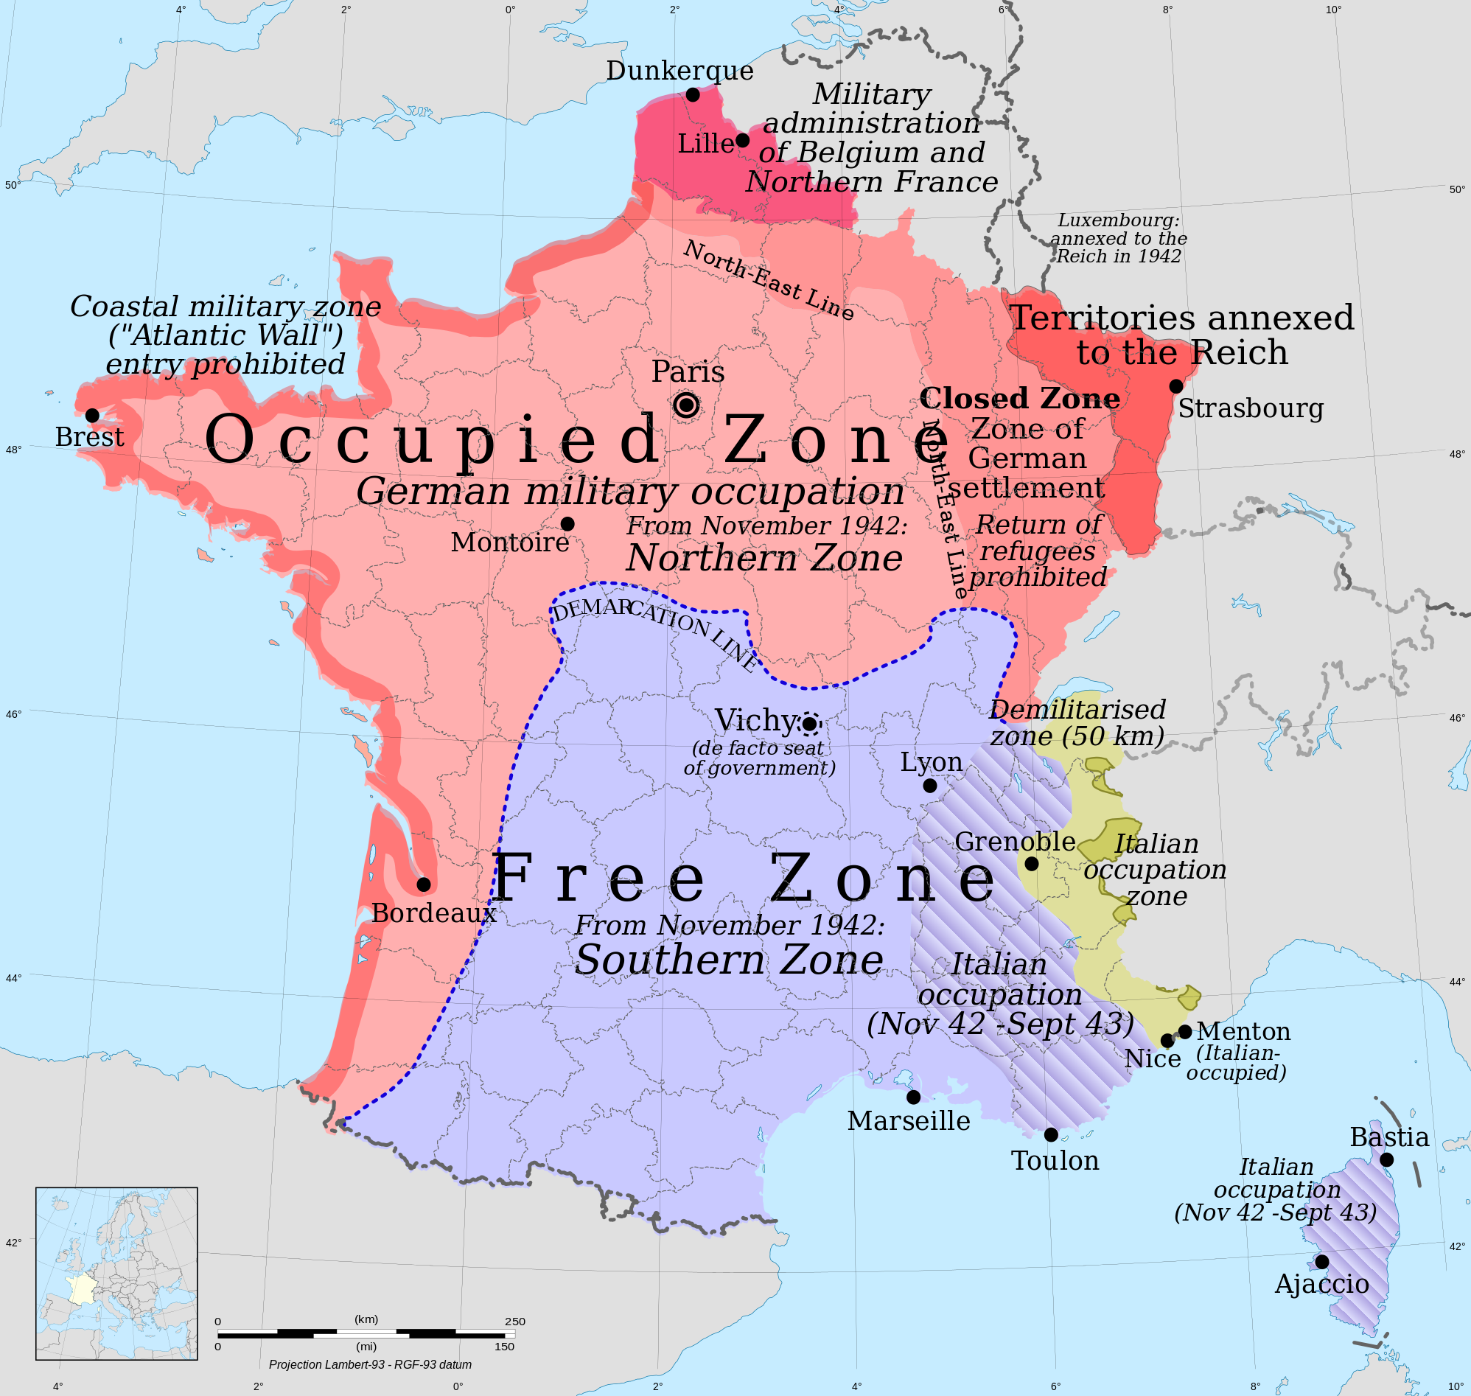
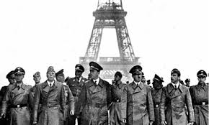
Fall of France
After Dunkirk, Wehrmacht pushes south into France with shocking speed
Paris declares itself a ‘free’ city rather than be destroyed by Hitler
Churchill contemplates a war without France
22 June 1940 – French government capitulates
Vichy government, led by WWI hero, Petain
‘Free-French’ resistence movement, led by Charles DeGualle, established in England
Britain Alone
Britain, the only democratic government left in Europe, faces great uncertainty…
Luftwaffe begins its fight for air superiority over British air space in preparation for the German naval invasion, known as Operation Sea Lion
German U-boats (in ’wolfpacks’) inflict huge losses on convoys of supply ships coming from Canada and the USA (Lend-Lease)

Slide 7
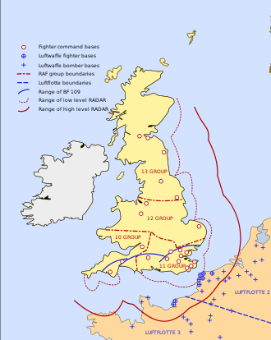
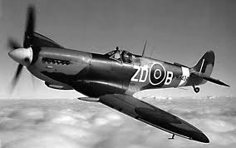
Battle of Britain – Summer, 1940
Stages:
Luftwaffe bomb shipping in English Channel
Luftwaffe bomb RAF airfields & radar stations
Luftwaffe bomb ports and centers of industry
**Errant bombs on London see Churchill retaliate’
sends RAF bombers on mission to Berlin (Aug. ’40)
Goering enraged, so too was Hitler; strategic blunder
Luftwaffe now begins ‘the Blitz’ – heavy bombing of city centres across England – London, Coventry
40 000 civilians die during summer of 1940
Key Factors:
Radar Defense
Central Command
Spitfires & Hurricanes
International Pilots (RCAF too)
Significance: Hitler denied a quick conquest
Allies remain able to launch an advance
into W. Europe

Slide 8
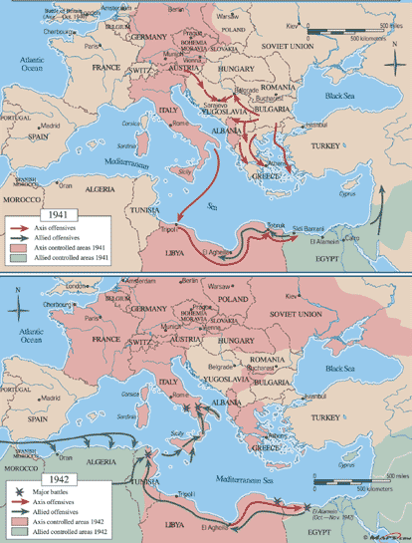
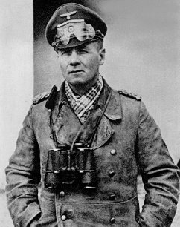
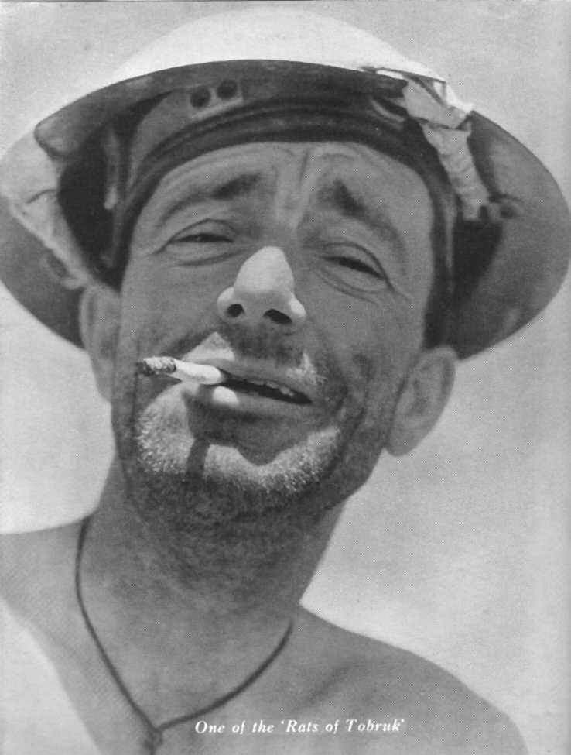
War in the Mediterranean, 1941
Middle East
Oil
Suez Canal
Feb. 1941
Erwin Rommel (Desert Fox) &
Elite Afrika Corps land in Libya
Siege of Tobruk
April 1941
Hitler has concerns of southern flank
Wehrmacht invades Yugoslavia
Intimidate Hungary, Rumania, Bulgaria
Rescue Italians in Greece, later N. Africa
British withdraw to Egypt
May 1941
Wehrmacht paratroopers attack Crete
British break ‘Enigma’ Code
Heavy losses to Wehrmacht

Slide 9
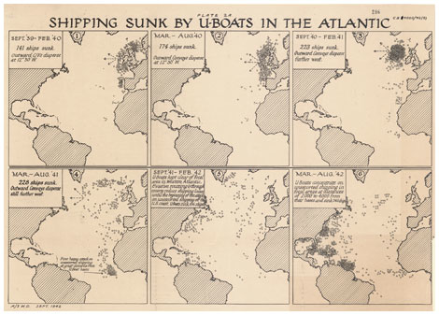
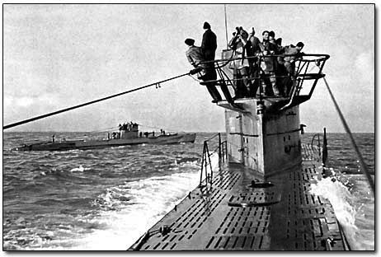
‘Das Boot’
Battle of the Atlantic
Industrialism
N. America as ‘factory’
‘Arsenal for Democracy’
Merchant Navy
Convoy System
U-boats
wolfpacks
German occupation of Norway and French seacoast, allows for much closer access to shipping lanes….
1940-42 –
Britain two weeks from being starved
Long-range capabilities of U-boats
St. Lawrence Seaway
Eastern seaboard (USA)
Caribbean
‘Black Pit’ (Mid-Atlantic)
https://www.youtube.com/watch?v=ISD1hJz53L8

Slide 10
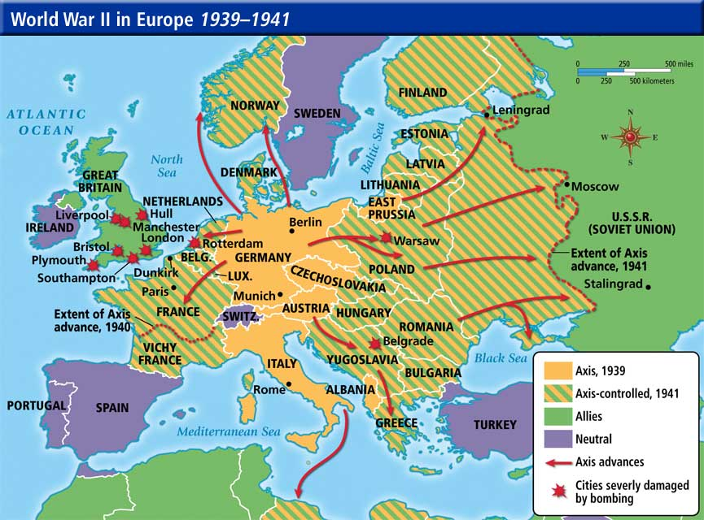
The Eastern Front, 1939-1941
Operation Barbarossa, June ‘41
Two-Front War
Lebensraum
Despite initial success…
the beginning of the end?
Blitzkrieg
3 000 000 soldiers
Stalin’s purges had devastated and demoralized the Red Army
Scorched Earth Policy
Massive Casualties
Three Pronged Attack – to Leningrad, Moscow, Ukraine – to Dec. ’41: Wehrmacht Victory?
Flaws:
Supply lines overstretched
Russian winter
Wehrmacht unable to engage the bulk of the Red Army in a decisive battle

Slide 11
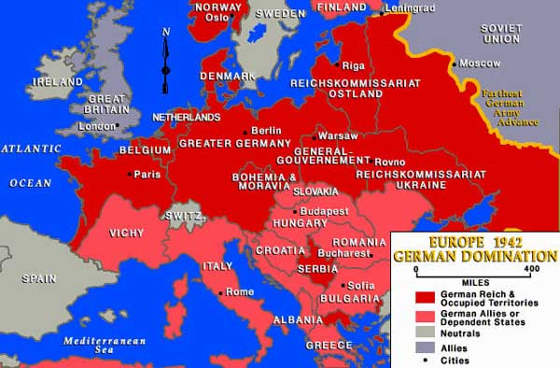

Slide 12
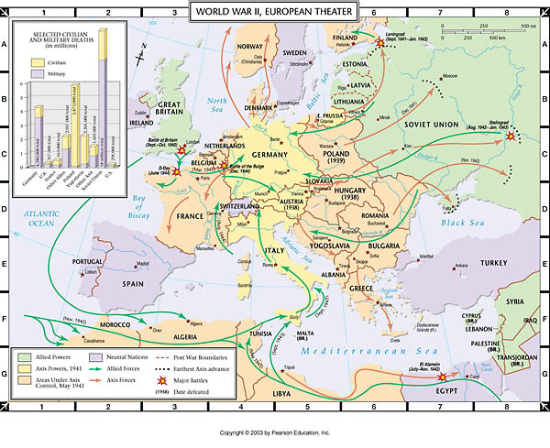
Turning Points in the European Theatre

