Slide 1
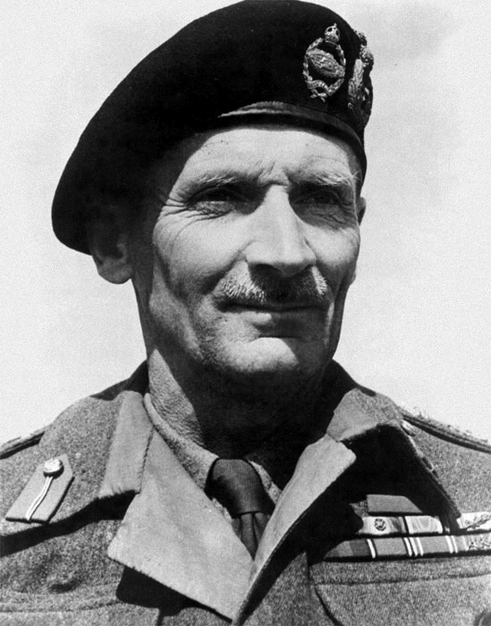
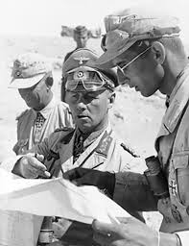
North Africa, 1942
Battle of El Alamein (Egypt): 23 Oct 1942 – 4 Nov 1942
After Tobruk, Rommel’s Afrika Corps appeared poised to take the rich oil fields of the Middle East, as well as shipping ports
Wehrmacht is overstretched, fighting far from home
British Eight Army
Field Marshal Bernard Montgomery
Ends Axis threat to Egypt, Suez Canal & oil fields of Arabia
1st decisive victory by Allies
Revives morale
Operation Torch
British-American Invasion of French North Africa (Morrocco)
General George Patton
General Dwight D. Eisenhower
With the British pushing from the west, the American from the east, the Afrika Corps found themselves surrounded with the final battle taking place in Tunisia.
Afrika Corps retreat, evacuate to Italy

Slide 2
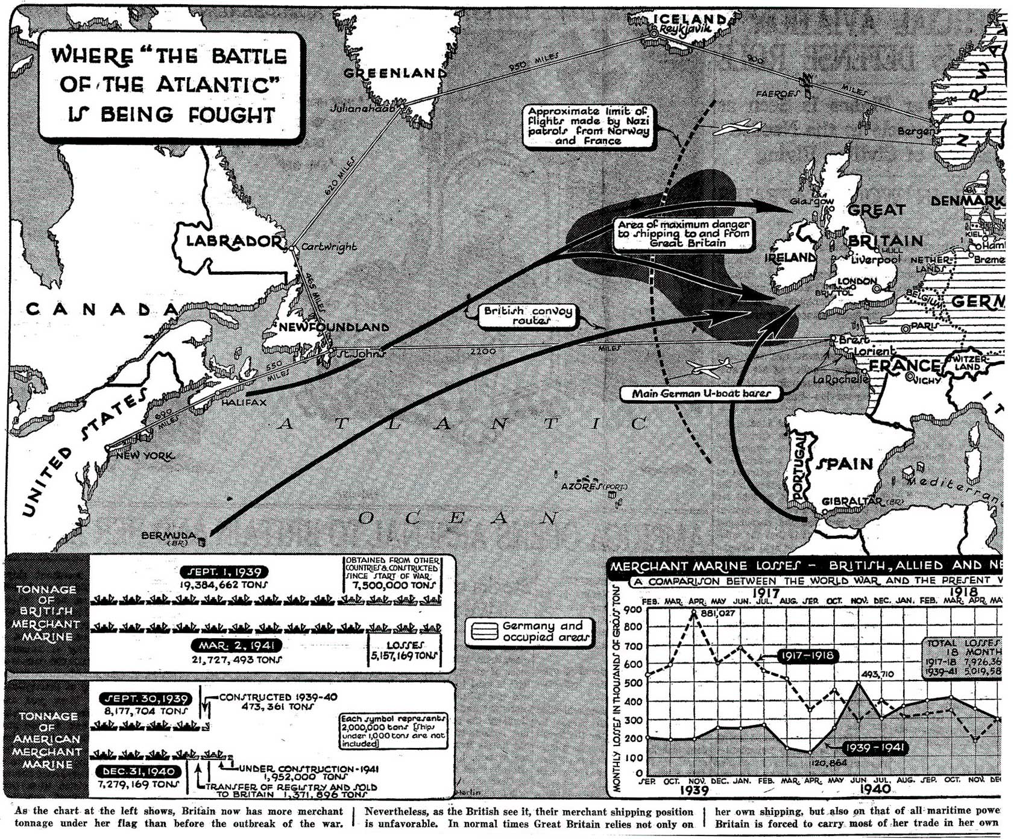
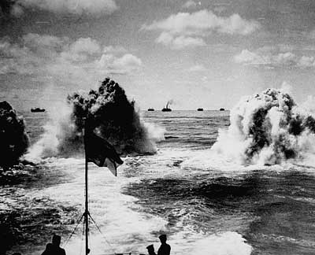
The Battle of the Atlantic, 1942-45 – ‘The Turning of the Tide’
Longest, largest and most complex naval battle in history
Strategic victory for the Allies
3 500 merchant vessels sunk
175 Allied warships sunk
72 200 naval and merchant seamen
783 U-boats lost
30 000 sailors lost
75% of German submariners lost
Radar, Sonar, & long range aircraft
Depth charges
Evasive convoy routing
A consistent theme to the Allied victory of the Second World War in Europe is the development and deployment of new technologies to solve immediate problems
KEY: American ability to out produce the losses caused by U-boat sinking’s.
https://www.youtube.com/watch?v=A-xzcwCZNF8

Slide 3
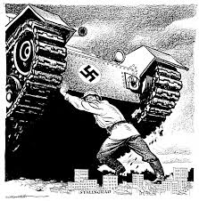
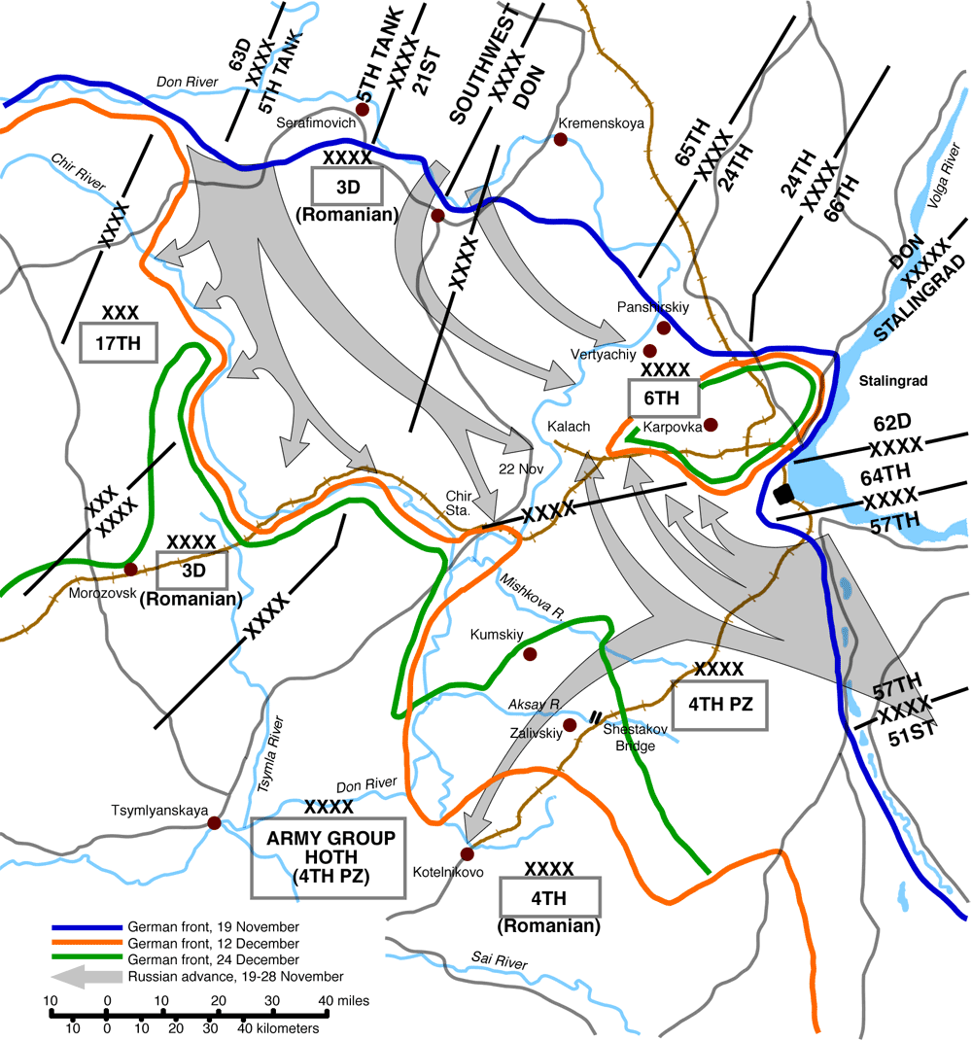
The Eastern Front, 1942-45
Siege of Leningrad (8 Sept 1941-18 June 1944)
Cut-off from USSR/Lake Ladoga ice-bridge
1 000 000 civilians die
Lend-Lease
Archangel
Iran
Hitler desires major victory over USSR
Moves large force from Moscow
Caucasus oil fields
Battle of Stalingrad (23 Aug 1942-2 Feb 1943)
No strategic significance, rather symbolic
Russians retreated to east side of Volga River
Luftwaffe flattens city; thus, very difficult for Panzers to maneuver and creates a kind of ‘no man’s land’
Battle of Attrition
Urban Warfare

Slide 4
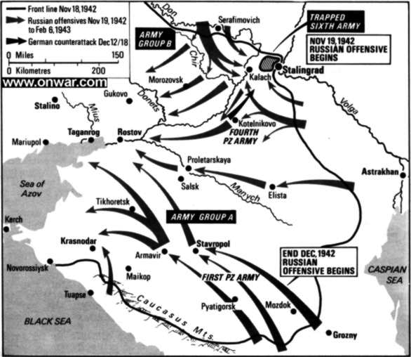
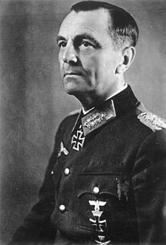
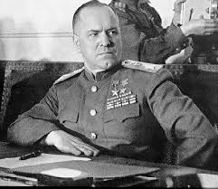
Turning Point on the Eastern Front
Operation Uranus (?!!): Russian counter-attack at Stalingrad (19 Nov 1942)
Marshall Zhukov (USSR)
Russians suck bulk of Wehrmacht forces into city
Wehrmacht flanks poorly defended (Romanians)
Counterattack sees von Paulus request retreat
Hitler refuses
German 6th Army encircled
85% casualty ratio
750 000 killed/wounded
Of 91 000 captured, only
5-6 000 return by 1955
Battle of Kursk (July, 1943)
Hitler’s counterattack
Wehrmacht - 900 000 men – 3000 tanks
vs.
Red Army – 1 900 000 men – 5000 tanks
Stalin has good intelligence (and listens)
‘Stalingrad was the end of the beginning, but the Battle of Kursk was the beginning of the end. Winston Churchill
Germany is now on the defensive on the Eastern Front
http://www.history.com/videos/battle-of-stalingrad#battle-of-stalingrad

Slide 5
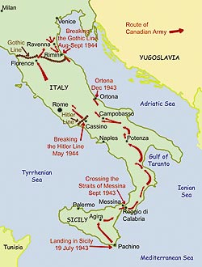
Italian Campaign
Italy=the ‘soft underbelly of Europe’
Operation Husky (9 July, 1943)
Allies land in Sicily
25 July: Italians depose Mussolini
8 September: Italy surrenders
Mussolini arrested, jailed, but rescued by German paratroopers. Set up as puppet dictator in occupied Italy, later recaptured (1945) trying to make the Swiss border with his mistress
Shot and strung up in Milan
9 September 1943
Allies land in Italy [Straits of Messina]
Wehrmacht makes good use of Italian terrain
Hardest and bloodiest fought of the western front
Battle of Ortona

Slide 6
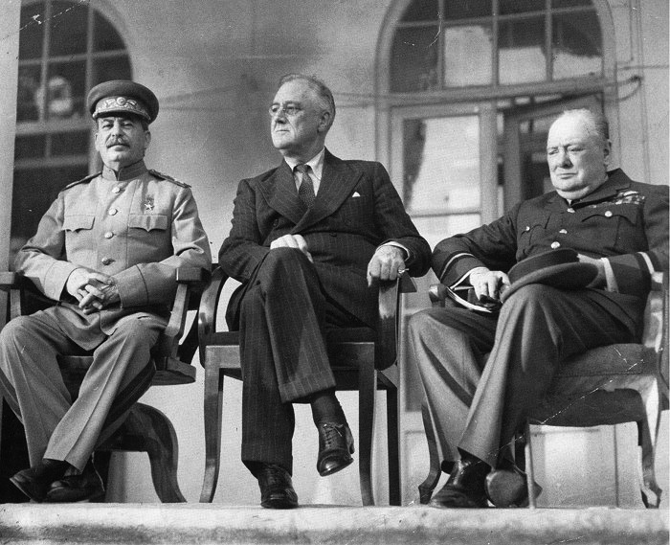
The Big Three:
The Communist, the Democrat and the Imperialist
Tehran Conference, Dec. 1943
Main Outcomes:
Opening of a Second Front
Churchill: Southern Europe
Stalin & FDR: W. Europe
Establishment of Polish borders
Stalin agrees to fight Japanese
Germany’s unconditional surrender
Key: The conference establishes real, if tenuous, diplomatic relations between the West and Communist Russia. Stalin remained skeptical of the West, though he received Lend-Lease aid from the USA, for he suspected the Allies were content to let the Nazis and Soviets struggle to the death in the East. FDR and Churchill were unhappy about doing business with Stalin, but he was the lesser of two evils.

Slide 7
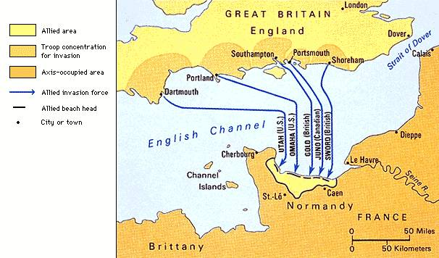
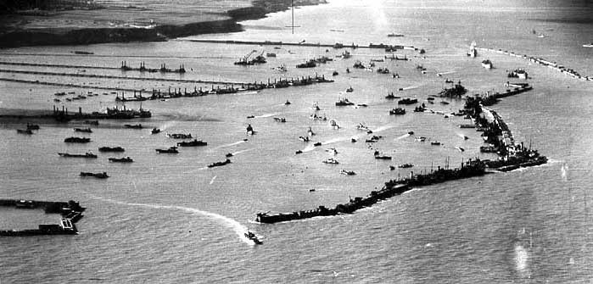
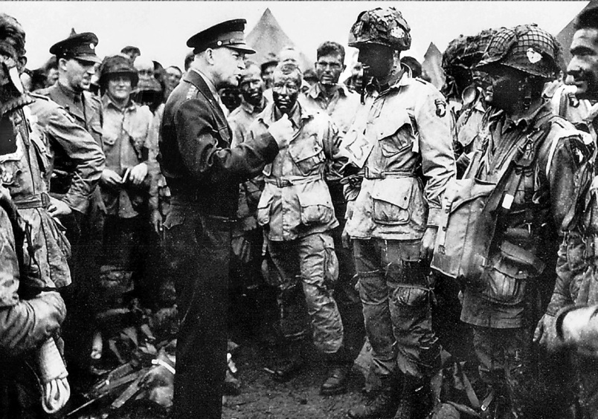
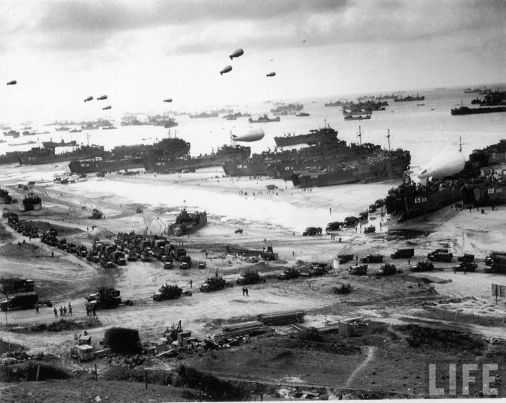
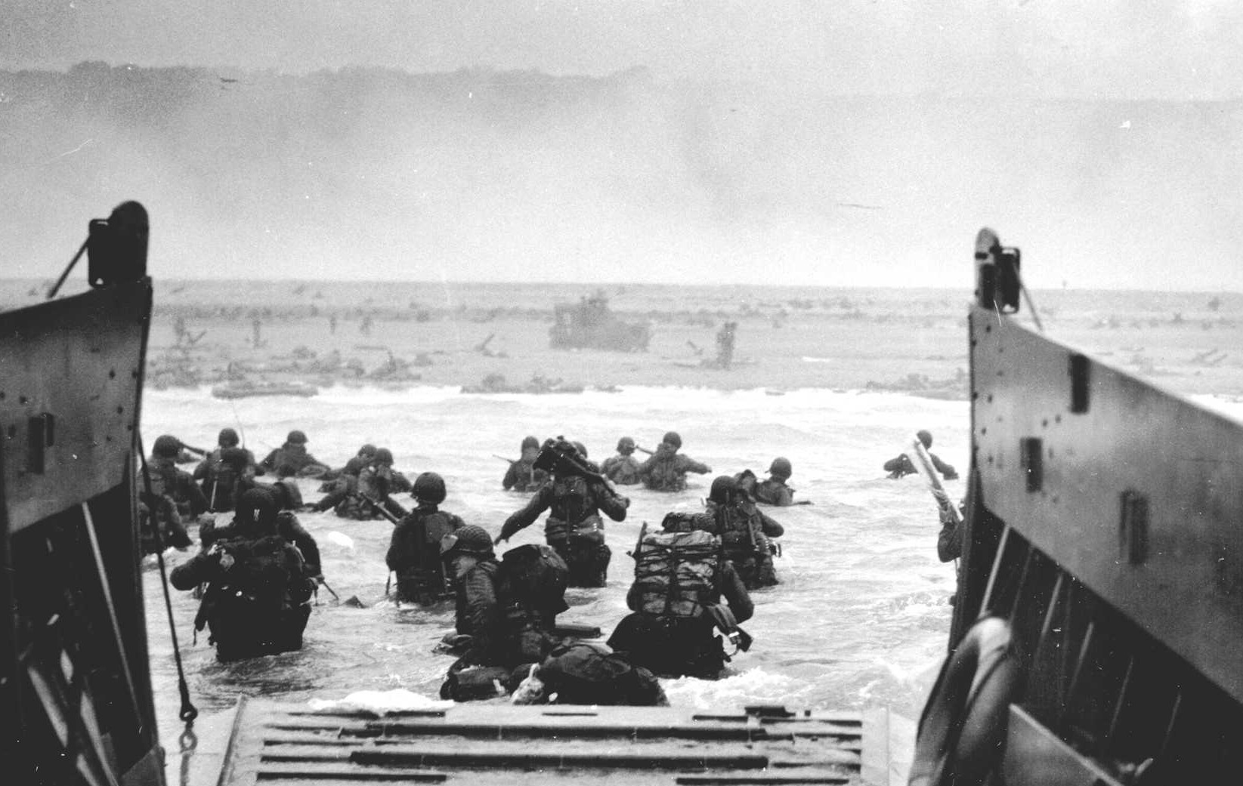
The Second Front, 1944-45 http://www.youtube.com/watch?v=pCLJhxfj608
Supreme Allied Commander –
General Dwight D. Eisenhower
Normandy Invasion (Operation Overlord)
6 June 1944
Allies had built up massive numbers of men and equipment in Britain
1 500 000 men
9 000 vessels
7 500 aircraft
Main Objectives:
Beachheads
Men & Materials
Keys to Success:
Planning
Air superiority
Ingenuity
Mulberry Harbours
Dieppe, 1942

Slide 8
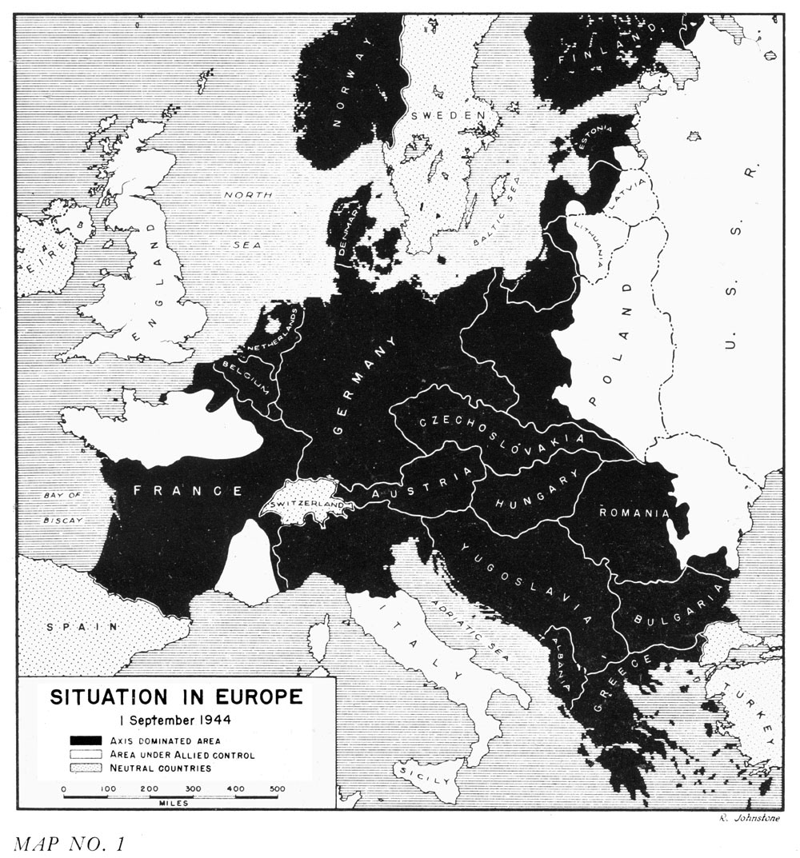
The Road to Berlin
Operation Market Garden (Sept. 1944)
Strain on Allied supply lines
V-1 & V-2 rockets (Belgium/Holland)
The Plan:
Largest airborne operation in history
Capture key bridges in Holland
Aftermath:
Failure to capture the bridge over the Lower Rhine at Arnhem
http://www.ahctv.com/tv-shows/world-war-ii-in-color/videos/world-war-ii-in-color-operation-market-garden.htm
The Battle of the Bulge (Dec. 1944)
Wehrmacht counterattack through the Ardennes Forest (surprise, surprise)
Bastogne
US 101st Airborne surrounded
Wehrmacht short on fuel
last major offensive by Wehrmacht
George Patton’s Third Army
http://www.history.com/topics/world-war-ii/world-war-ii-history/videos/battle-bulge
81 000 US servicemen lost
100 000 Ger. killed/wounded/captured
Malmedy Massacre
86 American prisoners of war executed by Nazi’s

Slide 9
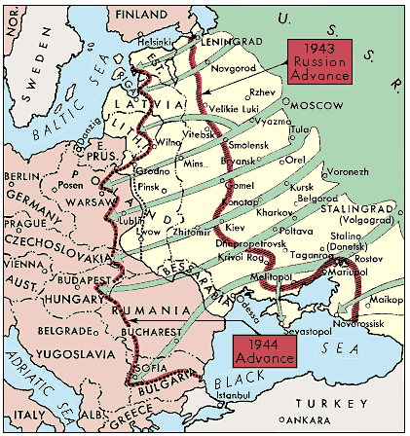
Eastern Front Collapse, 1944-45
Soviets Move West –
Red Army liberates Kiev (Dec. 1943)
Summer Offensive, 1944 – Belarus
Warsaw Uprising (Aug. 1944)
Polish resistance (largest of its kind)
Rebellion to coincide with Red Army advance, but this advance stalls
Soviet attitude ‘one of the major infamies of the war’
Katyn Forest Massacre, 1940
16 000 Polish resistance killed
150 000 – 200 000 civilians perish
Soviet advances into the Balkans
Aftermath –
largest single front in the history of warfare both in terms of size and soldiers
Both sides committed a variety of atrocities, with the Germans rounding up and executing millions of Soviet Jews, intellectuals, and ethnic minorities as well as enslaving civilians in conquered territories. The Soviets were guilty of ethnic cleansing, mass executions of civilians and prisoners, torture, and oppression.
80% of Wehrmacht’s World War II casualties were suffered on Eastern Front

Slide 10
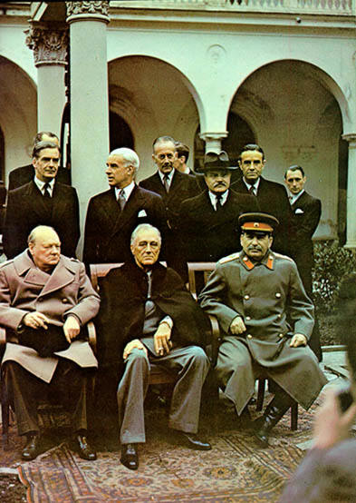
Yalta (Crimea) Conference, Feb. 1945
The Big Three
Nazi Germany has been virtually defeated
Demilitarized & De-Nazified
Germany/ Austria to be divided into four zones
Brits, Americans, French, Soviets
Both capitals – Berlin & Vienna, as well
Stalin demands reparations
Stalin agrees to enter Pacific War
Stalin promises ‘free elections’
Churchill has concerns of Soviet ‘sphere of influence’ in Eastern Europe & Mediterranean
Roosevelt courts Stalin; concerns over invasion of Japan and possible Allied casualties there
Roosevelt is seriously ill; Stalin knows it

Slide 11
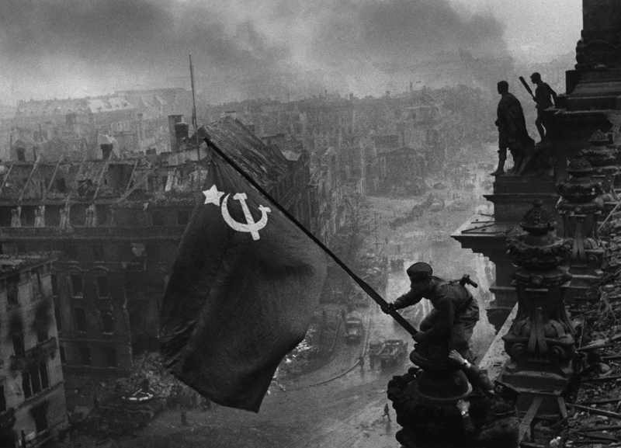
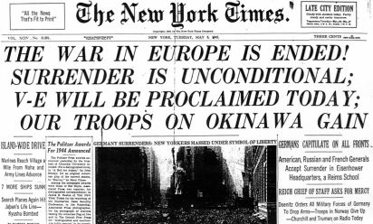
The Prize: Berlin, April 1945
Hitler fights to the last man –
Allies would accept nothing less than an unconditional surrender
Wehrmacht had proven difficult to beat, even in their retreat to Berlin. The only sure way to beat the Wehrmacht was with overwhelming numbers (and casualties).
Q. What was the value of Berlin?
Eisenhower focused on rooting out resistance before rushing into Berlin
Stalin orders final offensive on Berlin
Soviets ruthlessly bombard Berlin
High casualty rates
30 April – Hitler’s suicide
2 May 1945 – Victory in Europe

Slide 12
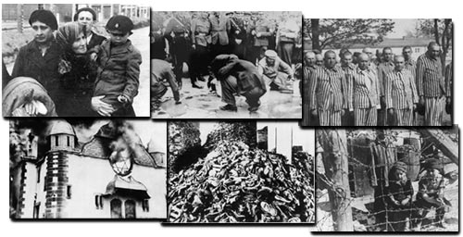
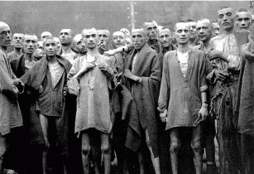
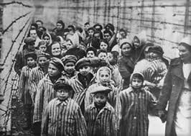
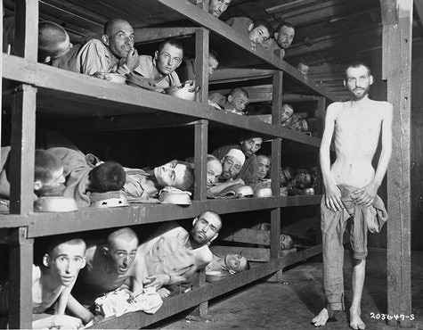
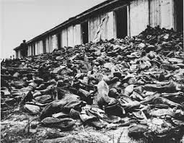
‘Final Solution’ (1942)
Atrocities never before carried out in such a massive & organized scale
Objective: Genocide
Einsatzgruppen (SS):
special squads clear ‘unwanted’
Jews stripped of goods, clothing & marched away to train stations
Death Squads
Warsaw Ghetto (23 April 1943)
SS order destruction of ghetto
In their own words –
The resistance put up by the Jews and bandits could only be suppressed by energetic actions of our troops day and night…I therefore decided to destroy and burn down the ghetto….Jews usually left their hideouts, but frequently remained in the burning buildings, and jumped out of the windows only when the heat became unbearable. They then tried to crawl with broken bones across the street into buildings which were not afire…many times we could hear loud voices in the sewers…Tear gas bombs were thrown into the manholes, and the Jews driven out of the sewers and captured….The longer the resistance continued, the tougher became the members of the Waffen SS, police and Wehrmacht, who always discharged their duties in an exemplary manner. SS Commander Stroop
http://www.youtube.com/watch?v=j1VL-y9JHuI
https://www.youtube.com/watch?v=sHcJtU9dr6I

Slide 13
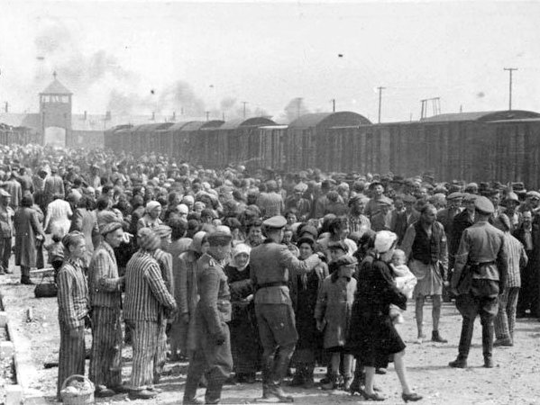
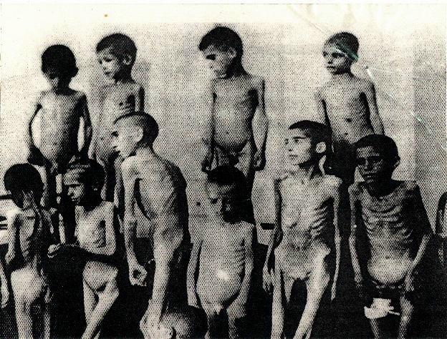
The Holocaust
Death Camps
Auschwitz
Chelmno
Treblinka
Sobibor
Belzec
Commandant Hoess (Auschwitz)
At Treblinka, the Camp Commandant told Hoess that he liquidated 80,000 Jews in six months using monoxide gas.
Hoess did not think that this was very efficient so he decided to use Zyclon B gas instead of monoxide gas because it only took 3 to 15 minutes to kill the people in the death chamber.
Hoess built his gas chambers to accommodate 2,000 people at one time, whereas the ten death chambers at Treblinka only accommodated 200 people each.
Dr. Josef Mengele - the physician of Auschwitz - he performed human experiments

Slide 14
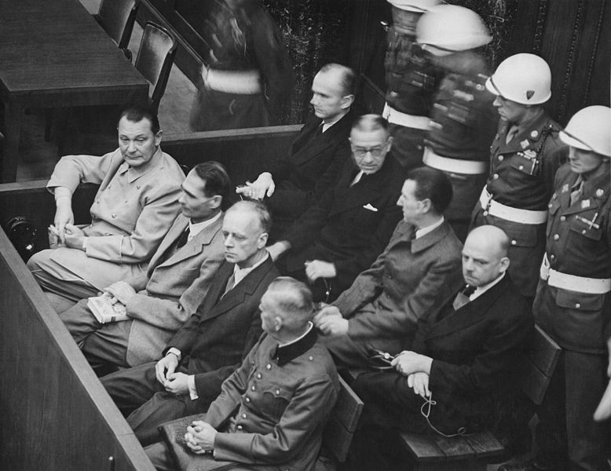
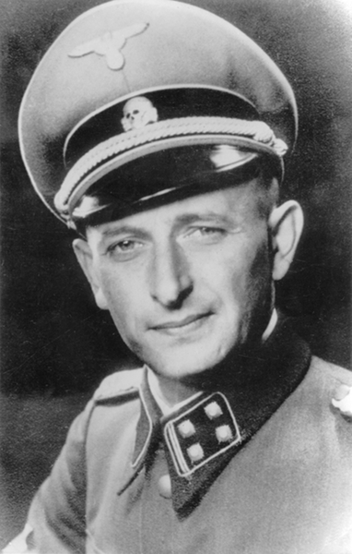
Nuremburg War Crimes Trial
Indictments:
War Crimes
‘violations of the laws and customs of war’
Crimes Against Humanity
Namely, murder, extermination, enslavement, deportation and other inhumane acts committed against civilian population
Defense:
‘just following orders’
We have fought against Jewry, we have fought against it for years: and we have allowed ourselves to make utterances, and my own diary has become a witness against me in this connection – utterances which are terrible…A thousand years will pass and this guilt of Germany will not be erased.
High ranking Nazi testifying against himself
1960 – Adolf Eichman (emodies the ‘banality of evil’) captured in Argentina by Mossad (Israel) for Crimes Against Humannity
http://www.cbsnews.com/news/revisiting-the-horrors-of-the-holocaust/

Slide 15
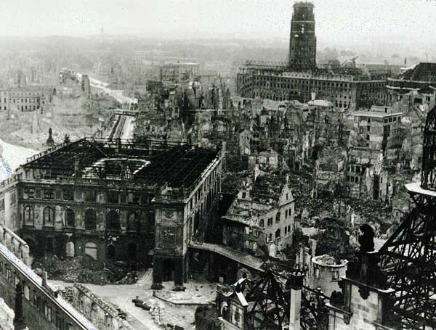
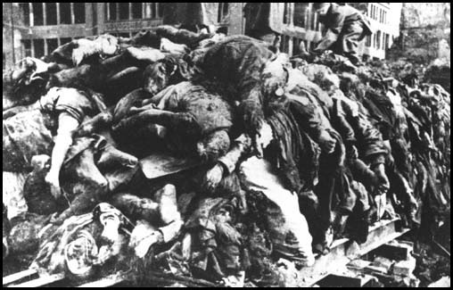
Bomber Command
‘Strategic Bombing’ of Germany
Break industrial capacity
Crush civilian morale
Appease Stalin
Precision, becomes saturation, becomes incendiary
A proportionate response?
Dresden, 1945
By February 1945, the city was filled with refugees – people moving from east to west in an attempt to escape the advancing Red Army
From February 13-15, over three waves of attacks, 3,300 tons of bombs were dropped on the city
Historians generally believe 35,000 to 60,000 people perished in the two days of bombing, but due to the unknown number of refugees in the city that the count could easily be 10 times higher
How ‘ethical’ is it to kill civilians to protect the lives of your soldiers?
Was the bombing effective? Justified?

