Slide 1
What is International Relations? ....emerges as a formal field of study post WWI – a specialized discipline?
Some consideration of terminology……
‘international politics?’
‘world politics?’
‘global politics?’
Definitions
Nation?
a people?
a collective identity …based on a shared history and culture; may (or may not) lay claim to political recognition
nationalism?
self-determination .....a democratic principle that supports the claim of a nation to a state of its own?
State?
a distinctive political community?
a ‘sovereign’ state possesses a ‘legal personality’ and possesses certain rights and duties….
What are the implications of a ‘nation’ and ‘state’ in an international system?
‘International Relations’
the entities that interact in the ‘international’ sphere are not nations in the sense of ‘peoples’ – they are sovereign states.
early on – primarily focused on causes of war and conditions of peace
later on – thinking beyond sovereign states to non-state actors
non-governmental organizations (NGOs) (ex. Red Cross)
multi- or transnational corporations (McDonald’s, for example)
international organized crime (Spectre - Agent 007, anyone?)
international terrorism (ex. Al-Qaeda)

Slide 2
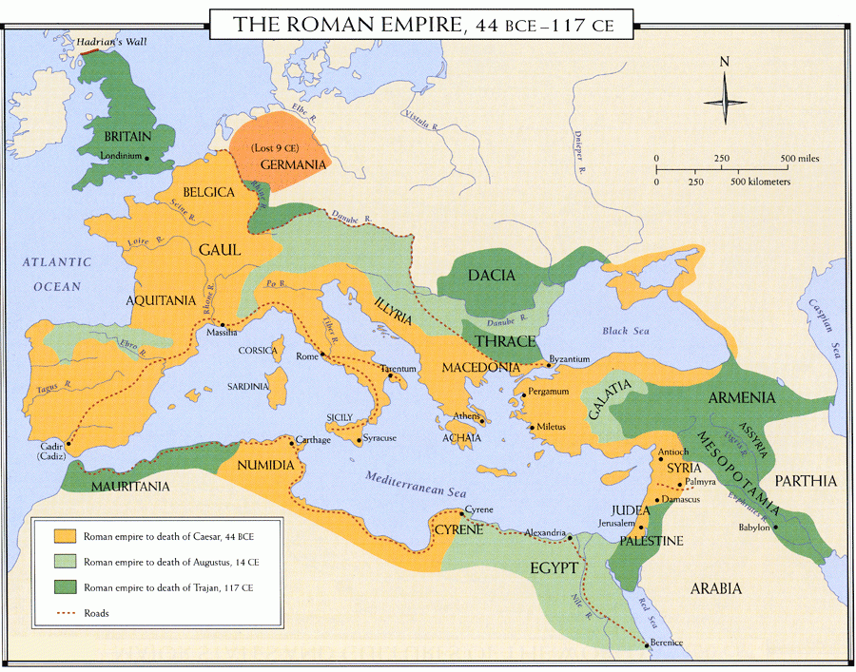
States and International Systems
the ‘state’ as the dominant form and foundation of the int’l system…..
historic context
‘states’ date back to ancient times… …but what of ‘stateless societies?’
beyond relationship b/w a population and a defined territory, the formation of
states has also given rise to ‘state systems’ or ‘international orders’ – ways of
organizing relations between and among political communities either in the
same geographic field or further afield…
Empire(s) as a form of international system….
characterized by relations of domination and subordination to a central power…..held together by force?
Imperialism - as a source of transmission for culture, economics, science & technology, politics and ideas…..
the Roman Empire?
created a polity around all sides of the sea, uniting most of Europe and the entire north African coast with the lands of (former) ancient empires in the Middle East (Mesopotamia, Egypt, Greece, etc)….
how? Or, maybe the more relevant question is – why?
Pax Romana (Roman Peace)
the empire was a huge economic space fostered by peace, security and political unity lasting centuries
the whole was essential to the well-being of its parts too...it took a longtime for the system to be unhinged
the current state of things?
does the US play an imperial role?
what do we make of transnational corporations and their relations to states?
hegemonic powers? …..the USA, China, India, the European Union (EU), Russia, ???

Slide 3
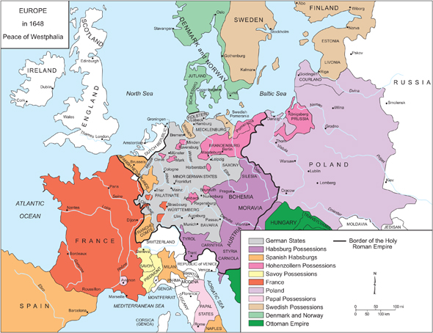
the State System and the Emergence of Sovereignty
Peace of Westphalia (1648)
ends European wars of religion, including Thirty Years War
begins modern international system – ‘sovereignty’
Westphalian Sovereignty
the principle of international law that each nation state has
sovereignty over its territory and domestic affairs, to the
exclusion of all external powers (ex. the Catholic Church)
the state as the supreme law-making body within a territory
an ‘ideology of order?’
evolving context in Europe of ‘nation’ and ‘state’…..democracy?
characteristics of the modern state?
sovereignty
territoriality
nationality …an int’l order based on the state system?
the Concert of Europe –
an agreement among various European powers to meet regularly to resolve diplomatic crises between states…..
began with Congress of Vienna (1815); and thus, ‘diplomacy’ becomes an important aspect of the European state system.
….the rise of Europe through a process of ‘modernity ‘

Slide 4
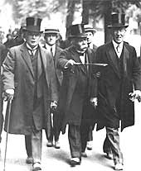
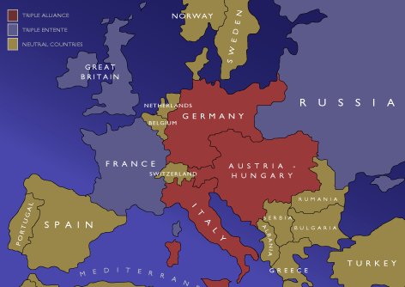
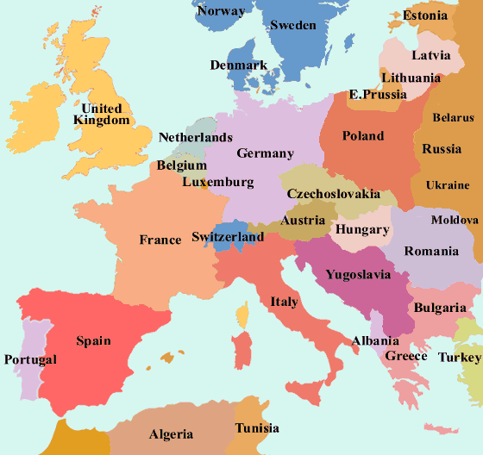
International Relations Theory
Liberalism and the Rise of International Relations
Immanuel Kant, Perpetual Peace (1795)
Democracies are inherently peaceful, both within and with each other
liberal int’l theory promotes strong int’l institutions and int’l law....
acceptance that sovereign states are the key actors in int’l affairs, but maintains that their behaviour, even under conditions of anarchy, can be bettered through such institutions ……the rule of law?
Paris Peace Conference, 1919
a new world order?
Fourteen Points (Woodrow Wilson) ...an idealistic document…..
US justification for entry to WWI...‘make world safe for democracy’
‘self-determination’
the right of states to determine their own policies and practices
the right of citizens to determine their own gov’t
can also refer to the quest of a nationalist movement to secure political autonomy – seceding to form a new sovereign state?
legitimizing the nation-state ideal?
Internationalism
wherein a strong international organization dedicated to preserving int’l peace and security should be established….
the League of Nations
Paris Peace Conference, 1919:
US President Woodrow Wilson
British PM David Lloyd George
French PM Georges Clemenceau
1914
1919

Slide 5
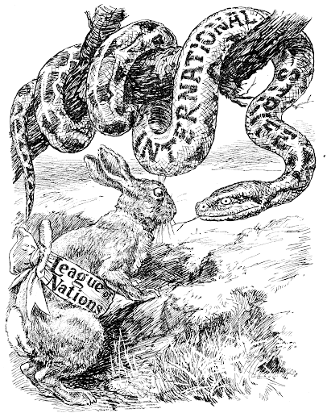
the Realist Turn
Treaty of Versailles (1920) ……the result of negotiations in Paris in 1919…..a future cause of WWII too.
most important treaty of the 20th C?
it was a compromise between idealists (Wilson) and realists (Clemenceau), though heavily punitive….
treaty was forced on Germany via diktat; Germany signed, but under protest
War Guilt Clause
Reparations
Successor States
Mandate System – New Imperialism?
Ex. Middle East – French and British Mandates in Syria and Palestine
League of Nations
a radical departure from traditional politics in Europe
nations would have to make sacrifices in order for this to work
Nationalism needed to turn into Internationalism
Article 10
“the members of the League undertake to respect and preserve against external
aggression the territorial integrity and existing political independence of all members of the League. In case of any such aggression, the Council shall advise upon the means by which this obligation shall be fulfilled.”
Problems:
membership?
lack of enforcement – the problem of ‘collective security’
Isolationism
a return to Nationalism ?

Slide 6
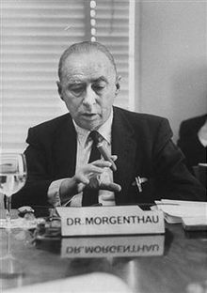
Realpolitik
Realism - an ancient tradition?
Thucydides, History of the Peloponnesian War
power politics is the name of the game
issues of morality are irrelevant
‘amoral,’ in that moral rules can’t be applied, not ‘immoral,’ contrary to existing moral rules
Niccolo Machiavelli, The Prince (1532) – raison d’etre (reason of state)
‘Never attempt to win by force what can be won by deception.’
Thomas Hobbes, Leviathan (1651) – state of nature
‘It is not wisdom but Authority that makes a law.’
Post WWII
Politics Among Nations (1948)
International politics, like all politics, is a struggle for power. Whatever the ultimate aims of international politics, power is always the immediate aim. Statesman and peoples may ultimately seek freedom, security, prosperity, or power itself. They may define their goals in terms of a religious, philosophic, economic, or social ideal. They may hope that this ideal will materialize through its own inner force, through divine intervention, or through the natural development of human affairs. But whenever they strive to realize their goal by means of international politics, they do so by striving for power.
Balance of Power as a deterrent effect?
states rationally weigh pros and cons of declaring war, and usually find it in their interest to maintain peace, in order to preserve themselves……
Is there a ‘community of interests’ in the world?
What do these look like (beyond Int’l organizations…..)?
Hans Morgenthau (1904-1980)

Slide 7
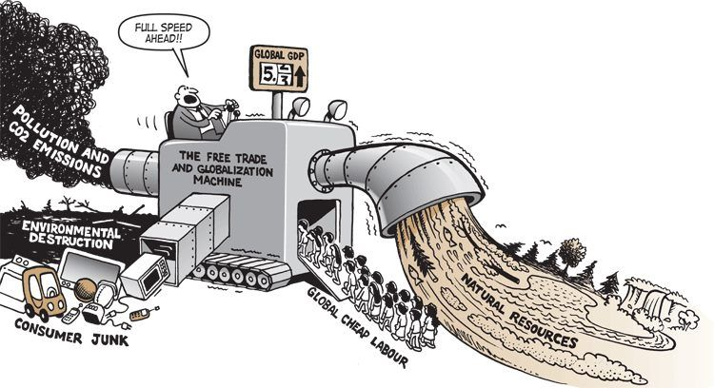
Globalization ……towards ‘global interdependence?
....began with the reach of modern European empires…. ……reduces the autonomy of sovereign states?
distinctions b/w domestic and international politics
are being further eroded by trends in globalization…
at the same time, the domestic politics of individual
nation states are becoming more similar
Evidence?
the response to the coronavirus…..
economic crises spread quickly among nations…
Increasing flows of people across borders….
concerns for the environment…a global issue?
regional organizations….EU, NAFTA, NATO
Democratization?
Arab Spring, 2011, as an example…..though, regimes that toppled have returned to authoritarian ways…Egypt?
Social Media
transnational corporations?
the impact on an International System that has the ‘state’ at is core…….????
Is the state system disappearing?
Can the international system withstand the pressure globalization is imposing on states?

