Slide 1
The Caribou Road

Slide 2
Moving to the Caribou
By the end of 1859 most of the gold deposits in the Fraser River had been found so prospectors moved into the Caribou region.
James Douglas realised that the colony wasn’t receiving any tax revenue.
Decided to build a road to the region.

Slide 3
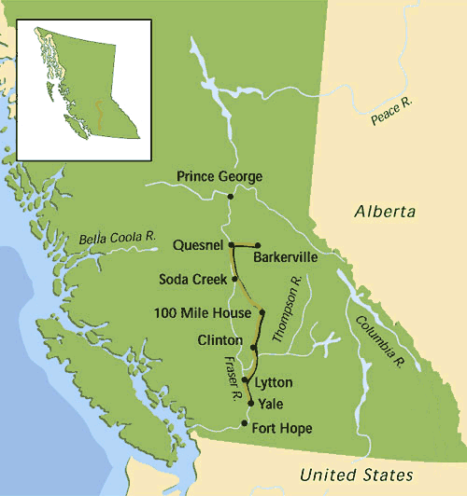
Notes:
http://knowbc.com/var/knowbc/storage/images/books/encyclopedia-of-bc/c/cariboo-wagon-road/maps/cariboo-wagon-road-route/38593-1-eng-GB/Cariboo-Wagon-Road-Route.gif

Slide 4
Expensive and treacherous
The road was built through the difficult Fraser Canyon which required large amounts of blasting of solid rock.
Covered 650 kilometres and cost $750,000.
Was built too late and the province struggled to recover the cost.

