Slide 1
The Oregon Territory

Slide 2
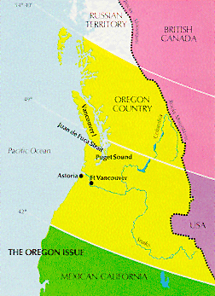

Slide 3
Disputed territory
Russia controlled Alaska and had a fur trading network through North West B.C.
Territory included HBC fur traders and American settlers taking the Oregon trail.
HBC saw it an extension of Rupert’s Land, Americans had the idea of Manifest Destiny.

Slide 4
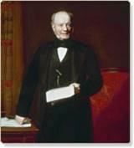
HBC tries to consolidate its position.
Create Fort Vancouver under John McLoughlin.
McLoughlin tries to establish the Columbia River as the boundary.
1839 Russians agree to cease operations south of 54th parallel.

Slide 5
HBC retreats north
McLoughlin and Simpson have a falling out and McLoughlin begins to actively encourage American settlement south of the Columbia River.
Simpson fears the influx of Americans and orders the establishment of Fort Victoria by James Douglas.

Slide 6
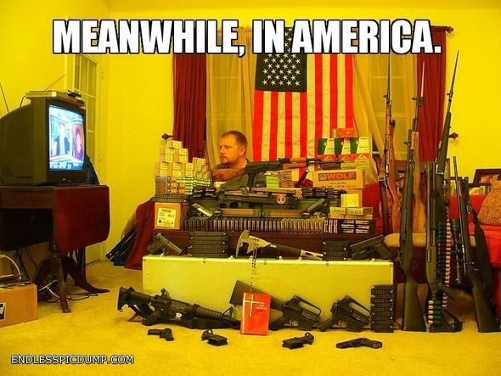
Notes:
http://endlesspicdump.com/original/meanwhile%20in%20america%20gun%20collection.jpg

Slide 7
49th Parallel
James Polk wins the U.S. election with slogan “54° 40’ or fight.”
Tries to negotiate with the British government for the Oregon territory.
Negotiations conclude with the establishment of the 49th parallel as the border with the exception of the southern tip of Vancouver Island.

