Slide 1
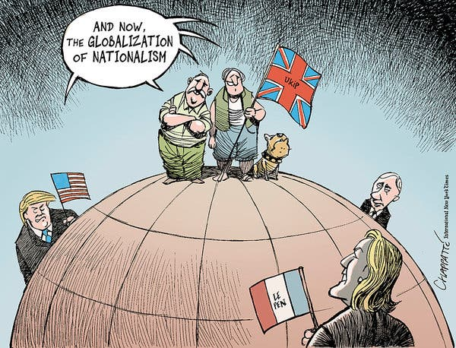
Security, Insecurity and Power Politics
the Realist turn?
Hobbesian state of nature?
a permanent state of anarchy….
but, not a perpetual state of chaos or warfare…..
power politics
‘peace thru strength?’
‘balance of power?’
Ex. Nuclear Arms Race of the Cold War?
the International System
1648-1945 – ‘multipolar’ – balance of power?
1945-1991 – ‘bipolar’ – the Cold War (USA v. USSR)
1991- 2008 – ‘unipolar’ – US a lone superpower?
2008 - ???? – ‘multipolar’ – an underlying insecurity?
the USA remains a significant hegemonic power, though it’s become
more insular (isolationist?), a result of economic problems (2008),
a diminished prestige, particularly in lieu of a questionable foreign policy, and more recently as a result of the Trump presidency.
the emergence of China (both as an economic and military power), the re-emergence of Russia as a security threat, and other regional power brokers and rivalries spanning the globe (the Koreas? Indian subcontinent? the European Union?), plus a rise in nationalism have all occurred at a time when the USA would appear to be disinterested in international affairs…..
States seek to maintain their territorial integrity and the autonomy of their domestic political order. They can pursue other goals like prosperity and protecting human rights, but those aims must always take a back seat to survival, because if a state does not survive, it cannot pursue other goals. John J. Mearsheimer, 2007

Slide 2
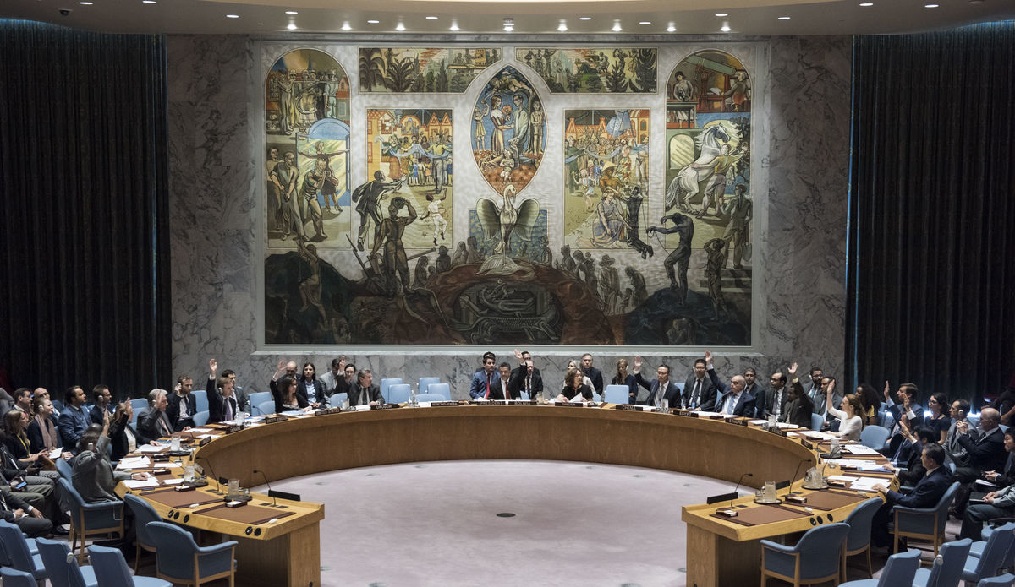
Collective Security …….a hallmark of ‘Internationalism?’
History, prior to the 19th century, affords relatively few examples of international (intergovernmental) organizations…..
the League of Nations (1920)
too idealistic? …a peaceful world? global governance? the need for moral principles?
‘collective security’
member states too afraid of the risk of intervening to stop
acts of aggression (a war?)……so deterrence ceased to exist
members chose not to take action; thus – Second World War
a failed experiment? ….or a template for a future organization?
the United Nations (1945)
UN Charter
principles of order to support international peace and security
affirms
fundamental human rights
‘sovereign equality’ of states
member states commit themselves to
resort to armed force only in the ‘common interest’
work for ‘social progress and better standards of living’
committed to
justice and respect for international obligations
United Nations Security Council
Basic Structure
General Assembly
Security Council
Int’l Court of Justice
the Secretariat
*** Special Agencies – FAO, WHO, UNESCO
*** UN related – UNICEF, UNCTAD, UNEF

Slide 3
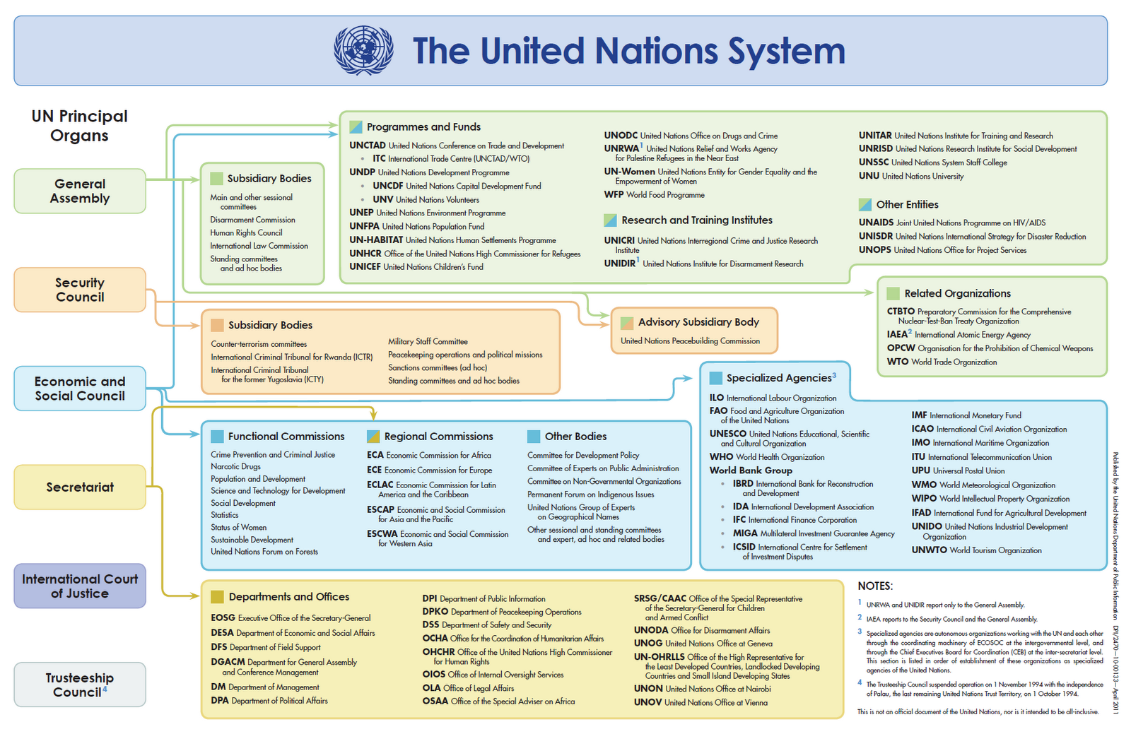
the UN Security Council

Slide 4
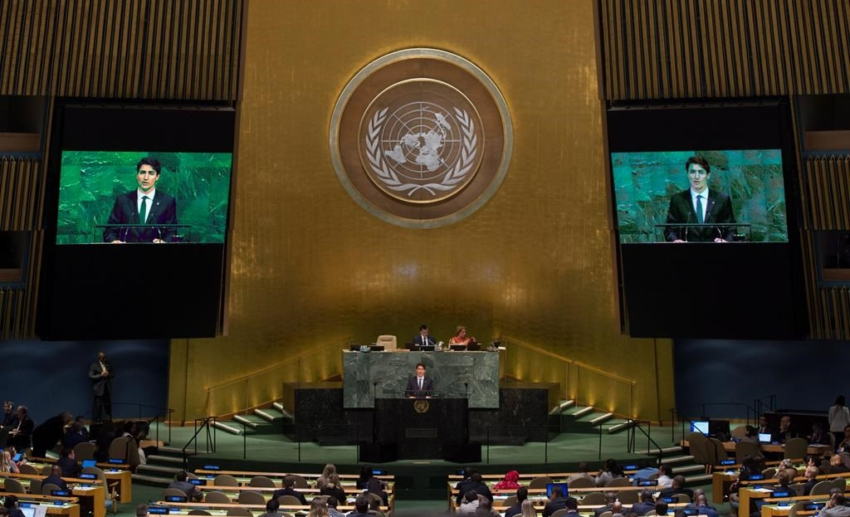
the United Nations
General Assembly
main deliberative, policymaking and representative organ of UN ….and yet; its weakest organ?
the Assembly’s resolutions may guide policy, but it has no legal status (unlike a legislature within an independent state)
a key forum - where views are expressed and debated on int’l politics
every nation has a vote – a moral voice? ….2/3 majority vote
where every state can meet on an equal footing….if not really equal?
Security Council
the ‘P5’ – Britain, France, China, Russia, USA – ‘veto’ power
a reflection of postwar (WWII) power dynamics?
does it no longer reflect the current balance of power?
unfairly skewed to whom? geographic distribution?
10 rotating non-permanent members – 2 yr term
elected by General Assembly
Canada campaigns for a seat (2020-2022?)
Should this be a priority?
how it works –
members (non-permanent too) and Secretary-General can call a council meeting if a threat to peace exists
realpolitik? …..due to the veto powers of the P5, the state of world affairs (balance of power) rarely does agreement occur
economic sanctions – if ordered upon an aggressor, all UN member nations are ‘obliged’ to comply with these….
military action – a rare occurrence that it is authorized – Korean War and Gulf War (1991) – agreement on ‘technicality?’
facilitates cease-fire agreements – since 1956 –UN Peacekeeping (UNEF) forces have been an asset in this regard….
recommends admission of new members to UN, filling post of Secretary-General and judges to Int’l Court of Justice
PM Trudeau addresses the UN General Assembly

Slide 5
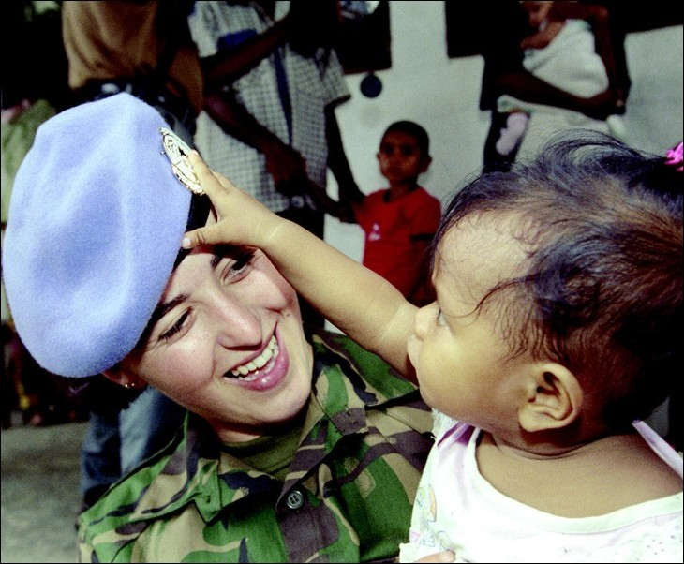
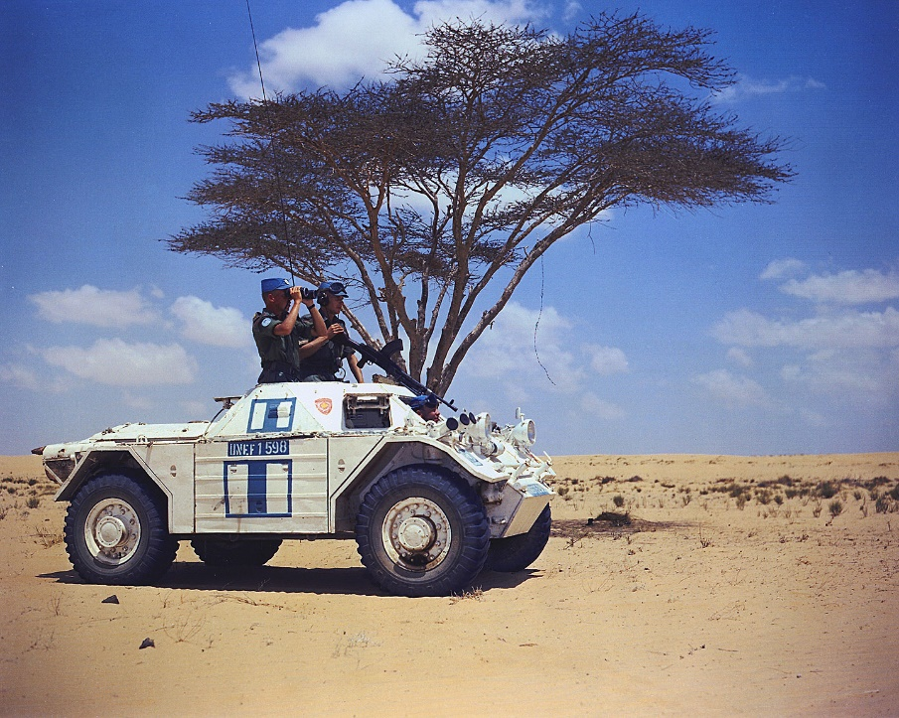
the Role of the UN in Peacemaking and Peacekeeping
‘Peacemaking’ – requires a massive military buildup in intervening to stop a conflict
‘Peacekeeping’ – both sides in a conflict agree to stop fighting and accept a token force to monitor a ceasefire agreement
Examples
Korean War, 1950-53 – ‘Peacemaking’
more by luck than by design?
USSR boycott of UNSC & US role military distinguishes this ‘peacemaking’ exercise (or else USSR vetoes?)
Suez Crisis, 1956 – ‘Peacekeeping’
establishment of UNEF, an int’l police force…..but what of ‘national sovereignty?’ …..must be ‘invited?’
the Bonus – what Canadian diplomat was awarded a Nobel Peace Prize for proposing a UN Peacekeeping force at Suez?
End of Cold War (1980s and beyond…..)
the role of a peacekeeping force had changed dramatically by the end of the 20th Century….
‘peacemaking’ has replaced ‘peacekeeping’ as the dominant form of interventions by UN
the nature of the interventions sees peacemaking within a state
no clear area of conflict…..
fighting spread throughout a nation…
no longer standing between two armies
creating a peace where none exists?
often many actors…..NATO, more recently
Examples
Somalia, 1992-3
Yugoslav Wars, 1992-95; ’99
Rwanda, 1994

Slide 6
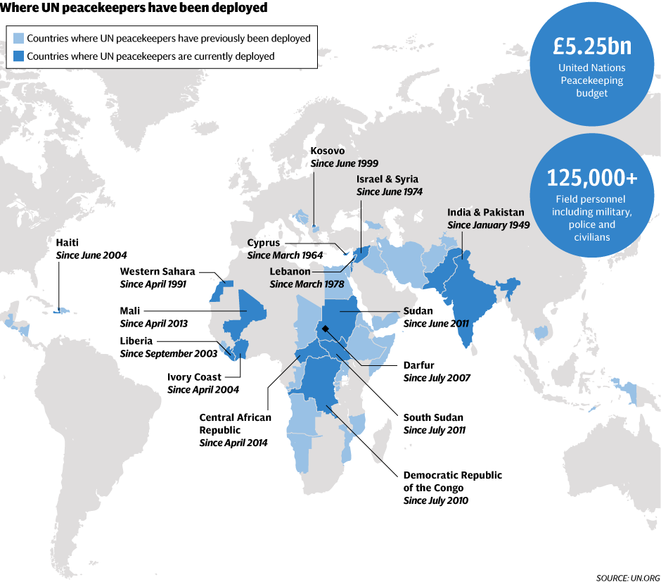
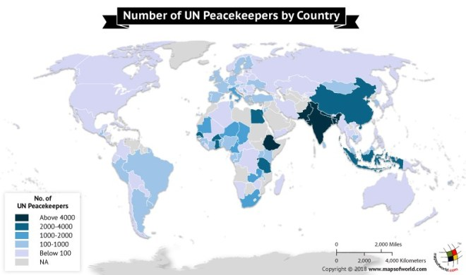

Slide 7
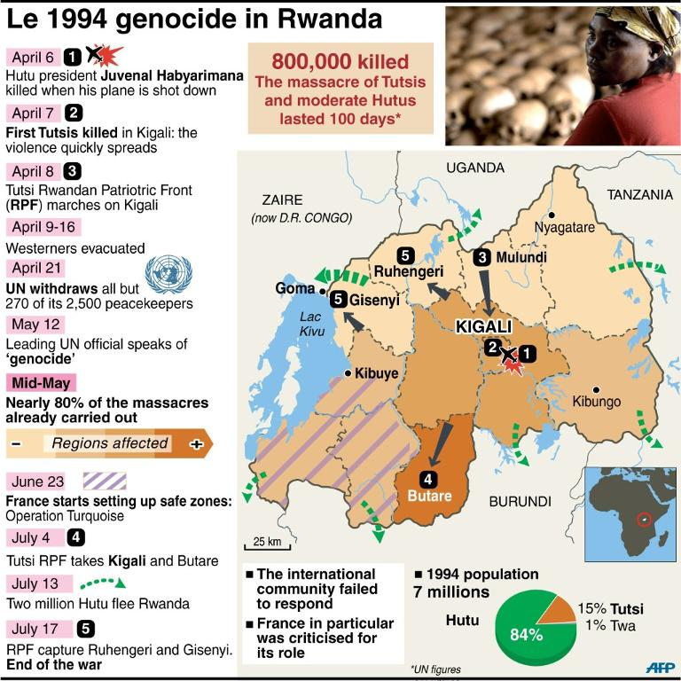
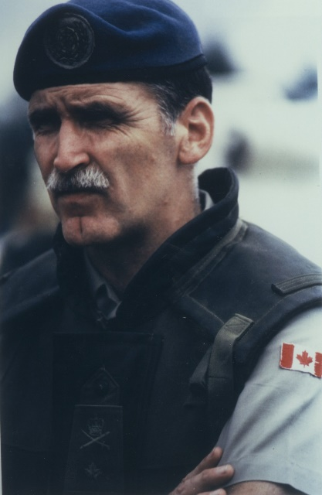
Rwanda, 1994
UNAMIR – United Nations Assistance Mission for Rwanda
2500 UN Peacekeeper sent to preserve a cease-fire while Rwandan and Burundi presidents met in Tanzania
Belgian – Was this a good idea? Sending troops from Belgium?
Bangladesh
Ghana
Tunisia
Rwandan Genocide
April, 1994 - Hutus began an unprecedented killing spree,
while the international community watched in horror and did nothing.
In July 1994, Tutsi rebels defeated the Hutus, stopping the genocide,
which had claimed over 800,000 lives, more than 10% of Rwanda’s population.
10 Belgian Peacekeepers killed by Hutu militia, after having surrendered – tortured, shot, machete (day after Burundi Pres. Killed)
Canadian General Romeo Dallaire, CO of UNAMIR
Implored UN and Canada to intervene, but his mandate was restricted as was assistance from SC
French, American forces brought to Rwanda to evacuate their nationals, while Rwanda became a wasteland of civil conflict and genocide

Slide 8
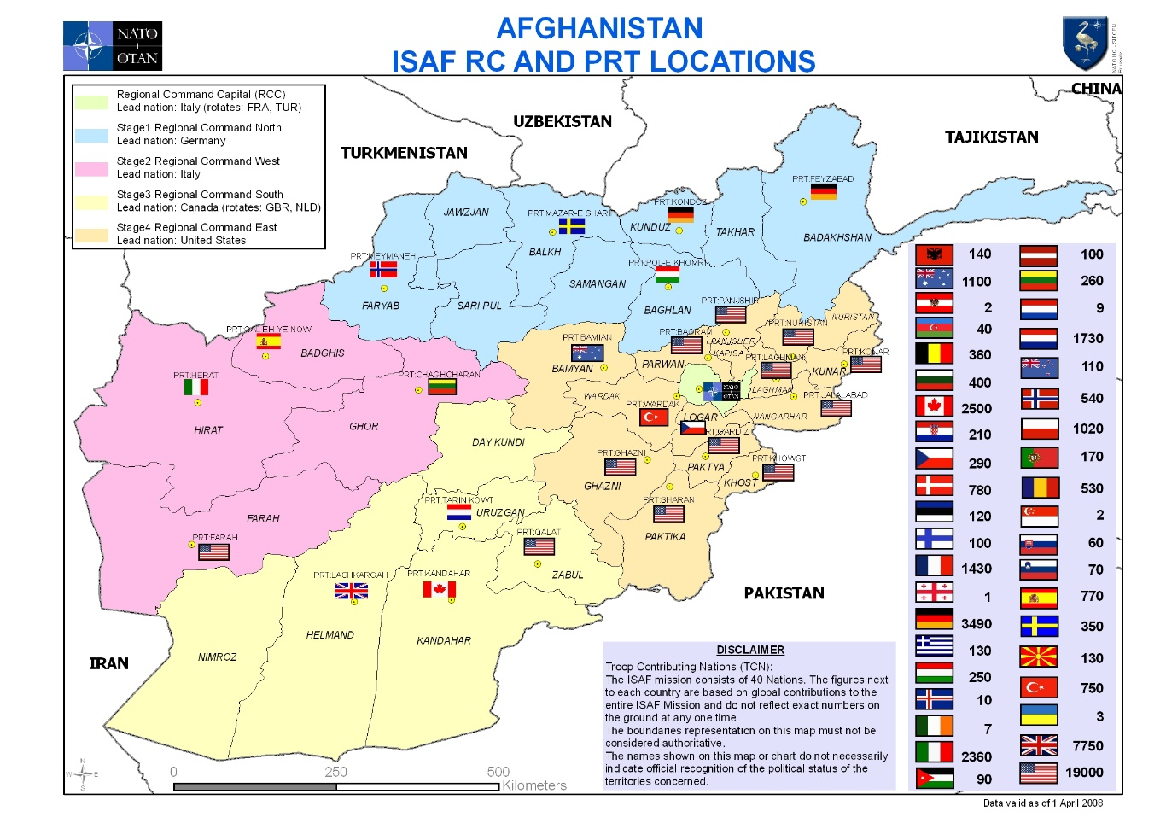
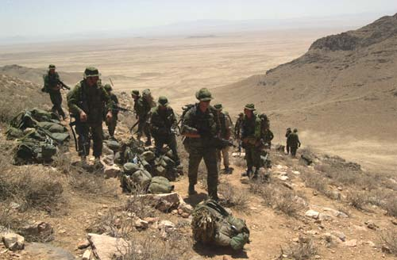
UN Peacekeeping (or is it peacebuilding? Peacemaking?) in Afghanistan
…….After US led ‘Operation Enduring Freedom’ (OCT. 2001), supported by UK and Canada
International Security Assistance Force (ISAF)
NATO-led security mission, authorized by the UN Security Council in December 2001
Tasks:
to train Afghan National Security Forces
rebuild Afghan governmental institutions
to root out Taliban insurgency, Al-Qaeda and ‘warlordism’
intensive combat operations were the norm from 2006 thru 2011
By 2010 – 700 military bases in Afghanistan; 400 NATO to 300 ANSF
Canada
Joint Task Force 2 (JTF2) – ‘Counter-Terrorism’ (Oct. 2001 - ???)
Kandahar Province
From 2005 – took command from US Forces
2500 personnel – 1200 combat forces
Between 2001-2014 – 159 fatalities to soldiers
‘Signature’ projects
Dahla Dam
Education
Polio eradication
Public opinion in Canada
Opposition grew over time
Ideological?

Slide 9
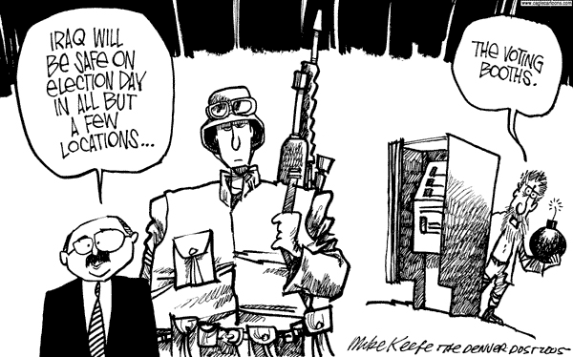
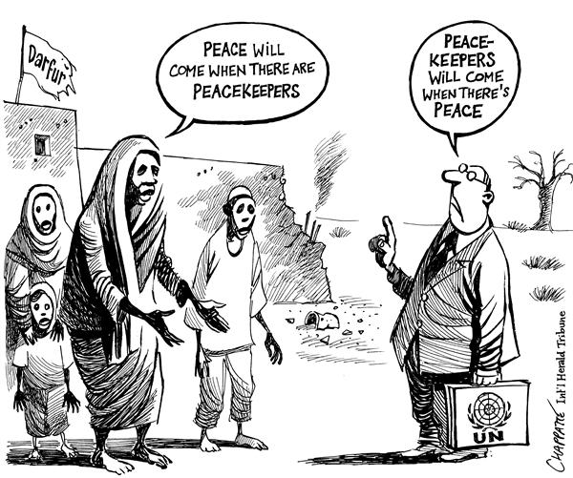
Peacekeeping – A Changing Role?
Modern Peacekeeping involves:
training and restructuring local police forces
de-mining
conducting elections
facilitating the return of refugees
monitoring human rights
demobilizing and reintegrating former soldiers
promoting sustainable democracy and econ. Development
More Diverse Skills
Responding to more complex situations, peacekeepers requires a more diverse set of skills – experts include:
regional and municipal administrators
judges and prosecutors to develop judiciaries or run courts
media, health, tax, and social policy advisors
child protection experts
security experts
facilitators and mediators
Experts to help with sewage treatment plants or railways
Humanitarian Interventions
legality of intervention? …….sovereignty of states?

Slide 10
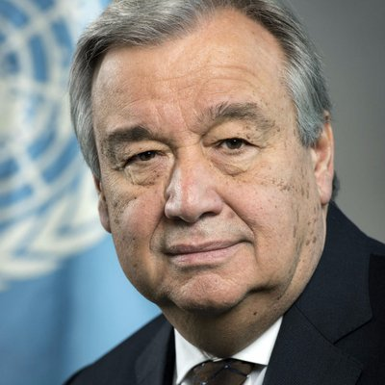
The Secretariat
the Secretary General is the chief administrative officer of the UN, and the secretariat is made up of thousands of clerks, interpreters, translators, and technical experts
Current Secretary General is Antonio Gueterres of Portugal
Was appointed January 1, 2017, and will serve until 2022
"The United Nations is what member nations made it, but within the limits set by government action and government cooperation, much depends on what the Secretariat makes it... [it] has creative capacity. It can introduce new ideas. It can, in proper forms, take initiatives. It can put before member governments findings which will influence their actions". Dag Hammarskjold
Roles and Responsibilities
source of econ. and pol. analysis for the General Assembly and Security Council
it administers operations initiated by UN's deliberative organs
political missions, prepares assessments preceding peacekeeping operations
appoints the heads of peacekeeping operations
conducts surveys and research
communicates with non-state actors, such as media and NGOs
responsible for publishing all of the treaties and international agreements.
Antonio Gueterres

Slide 11
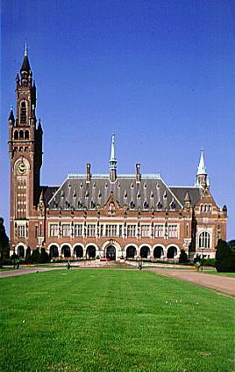
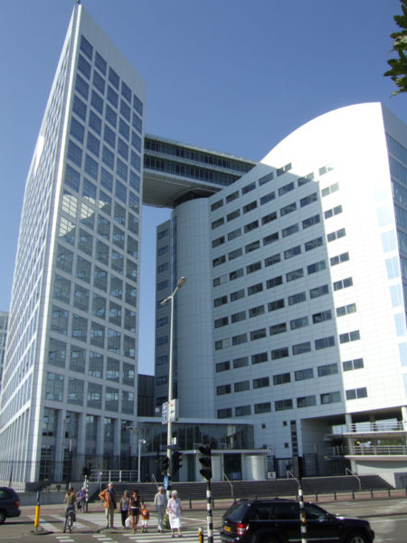
International Court of Justice
Est. 1945
known as the World Court, is located in The Hague (Netherlands)
settles disputes between member nations
International Criminal Court (ICC)
Est. 1998
mass violations of human rights of War Crimes Tribunals
120 nations vote in support
USA did not……why?
ICC consists of 18 judges elected over a 9 year term, and a team of prosecutors and investigators
ICC has jurisdiction over issues such as genocide, war crimes, crimes against humanity and aggression; however, many nations disregard the jurisdiction of the ICC…..
International War Crimes Tribunal (a branch of ICC)
Est. 1993
following Yugoslavian dissolution – ‘Ethnic Cleansing’
to try persons accused of war crimes in that conflict
1998 – Rwandan Tribunal
1st verdict, sentence concerning ‘genocide’

Slide 12
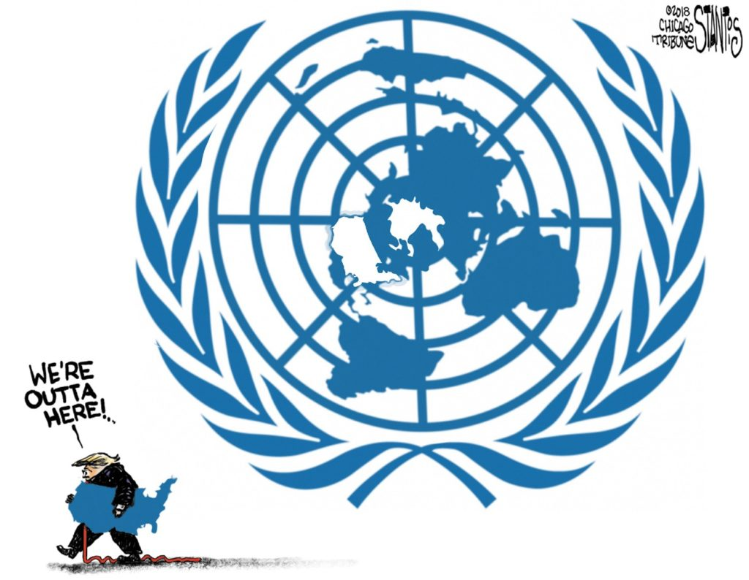
Challenges to the United Nations Internationalism v. National Self-Interest – who wins?
Is the United Nations a useful and effective organization?
Realist views of ‘internationalism’ see states and the state system as the primary focus of which the international system revolves
some Realists dismiss ‘global governance’ as having little relevance to the ‘real world’ of power politics....
Liberal institutionalists see the UN as playing a key role in reducing the dangerous aspects of international anarchy…..
Should the UN take an aggressive role in fulfilling its mission of peace
and security and solving social, economic and humanitarian problems
throughout the world?
Can the UN gather sufficient forces (and resources?) to undertake
major peacemaking and peacekeeping missions?
the key question for the near future, however, is whether the USA will
continue to work with the UN or simply ignore it…..the problem for the
UN is that it needs the US more than the US needs the UN….
…..a rift between the US and UN could have serious implications….
In 1945, the UN was formed t provide peace and security in the world.
It was located in the US to ensure that the US would remain committed
to the ideals and operations of the UN. Only the future will tell if the UN
grows and remains effective or suffers the same fate as the League of Nations.

