Slide 1
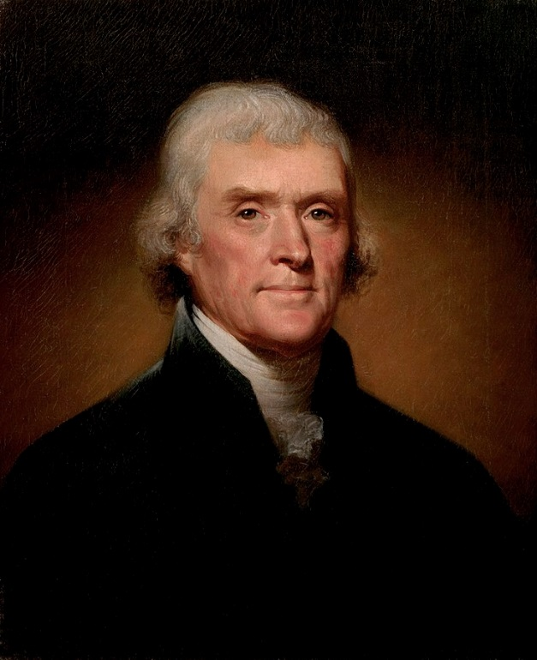
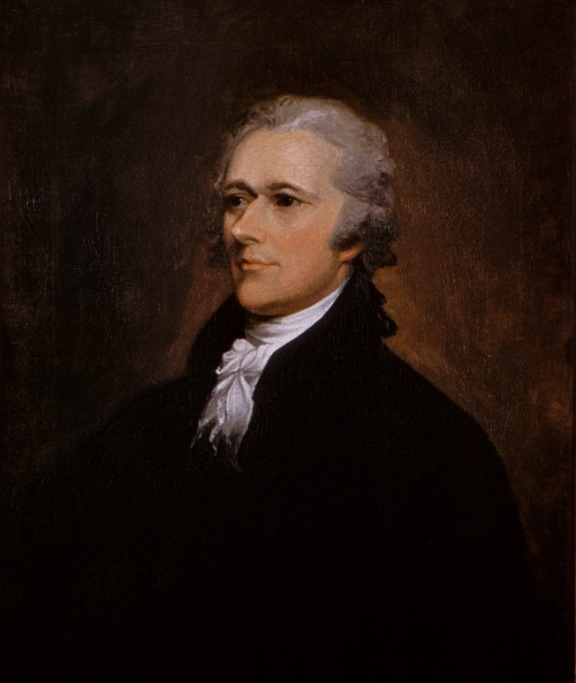
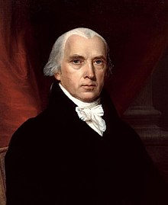
US Political Parties History ….a two party system?
the Constitutional Debate
Federalists Anti-Federalists
stronger federal gov’t limited role of gov’t
‘loose’ interpretation of constitution? strict interpretation…..
‘rich man’ ‘common man’
Alex Hamilton
Disappeared about 1816
Democratic-Republicans
Jefferson/Madison
Democratic Party Republican Party
c. 1828 – Andrew Jackson c. 1854 – Abraham Lincoln
strong central gov’t the party that opposed slavery…..
‘common man’
Third Parties?
Populist Party (1890s)
Bull Moose Party (early 1900s)
What are some American third Parties today?

Slide 2
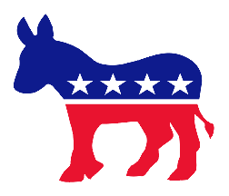
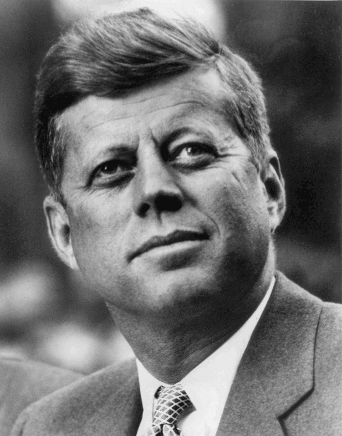
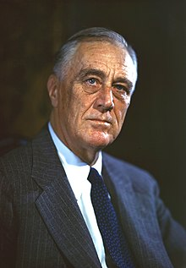
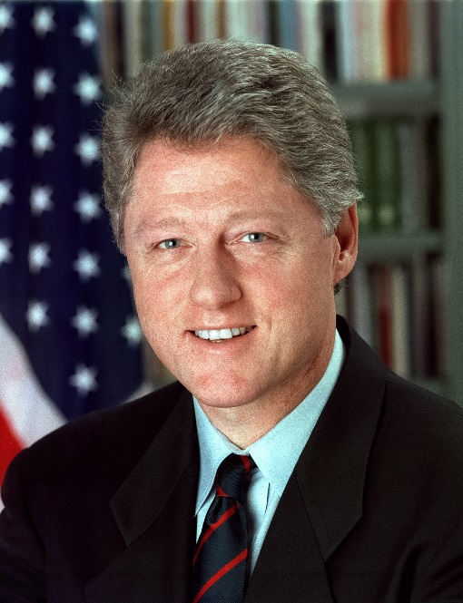
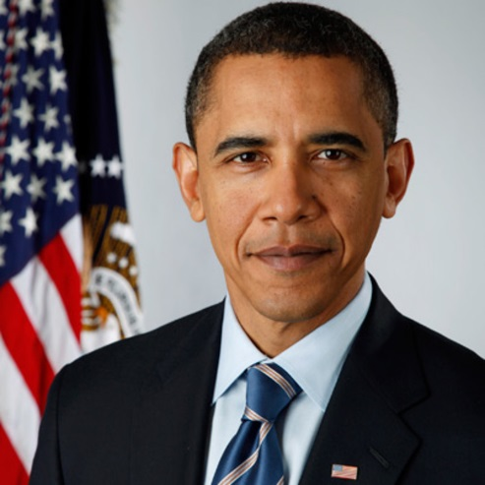
Democratic Party
social liberalism
social democracy
greater federal gov’t intervention….
progressive taxation
tax brackets….leveling society or not?
larger gov’t to serve people’s needs
voter base?
young professionals
organized labour
women
Minorities
academia
working class
LGBTQ
regions?

Slide 3
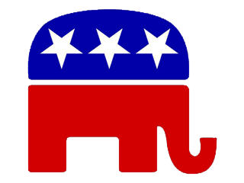
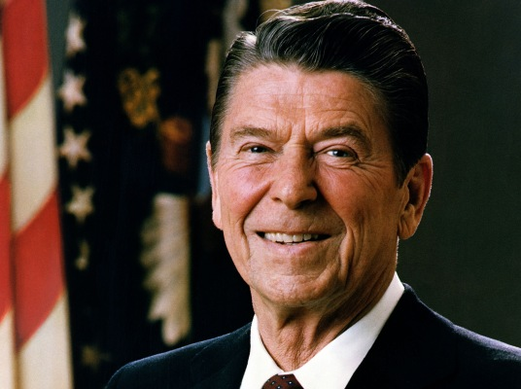
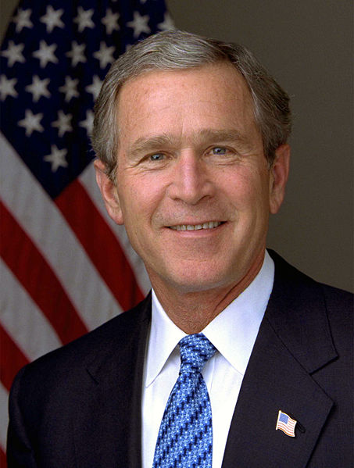
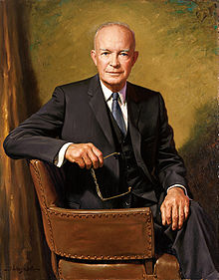
Republican Party
social conservatives
laissez-faire economics
fiscal conservatism
personal responsibility over welfare programs
Voter base:
financial sector
high income
older demographics
church goers
higher ed. but not academic…
military
some (low) minorities
Notable personalities?

