Slide 1
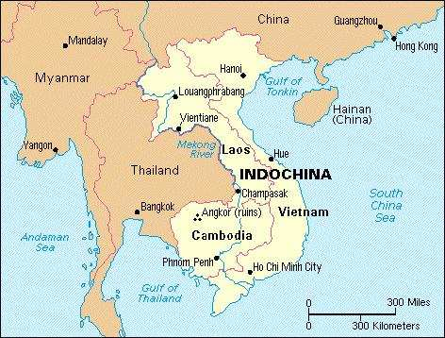
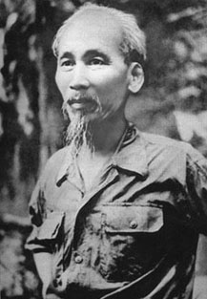
Indochina: The Vietnam War: Decolonization? – Nationalism? – Containment? – Liberation?
Background –
Ho Chi Minh present at Paris Peace Conference (1914), though shut out of discussions on ‘self-determination’ by the French and the West
WWII
French Indochina annexed by Japanese forces
Ho Chi Minh and ‘nationalist’ forces resist
Declare ‘independence’ in 1945
End of War – Return of French colonization?
Ho Chi Minh, North Vietnamese Communists [Extreme Nationalists]
USA supports French – ‘Containment’
80% of French spending originates from USA
‘Communist’ movements viewed by USA within a strict context – a single conspiracy for world domination by the USSR
‘Domino Effect’ in Asia?
Remember that nation that turned communist in 1949?
Key: A movement deeply committed to determining its country’s own organization and boundaries will react to foreign attempts to dominate itself most vehemently.

Slide 2
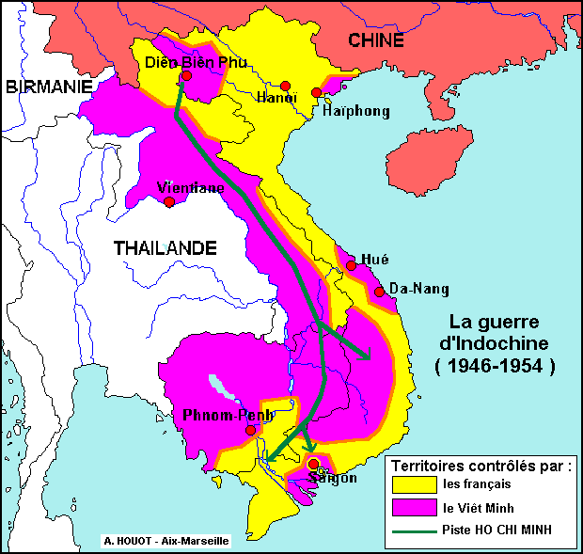
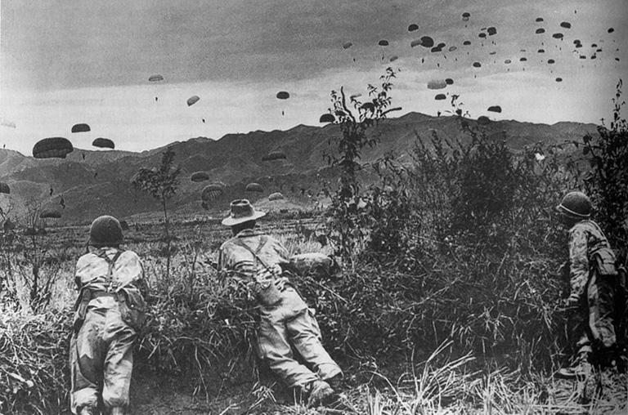
Dien Bien Phu, 1954
French garrison surrenders
Communist victory sees French lose face in Asia
Geneva Agreement (1954)
Laos
Cambodia
Vietnam partitioned – 17th parallel
Korean style settlement
North Vietnam is ruled by Ho Chi Minh
South Vietnam ruled by Ngo Dinh Diem
National Liberation Front
‘Viet Cong’ (Guerillas Warfare) vs. Army of the Republic of Vietnam (ARVN)
1950s – Financial & Military Aid to Vietnam
USA
USSR
China
1956 – USA sends first ‘military advisors’
1963 – Shortly before his death, Kennedy sends 16 000 ‘advisors’ to S. Vietnam
US Army wanted to send 200 000

Slide 3
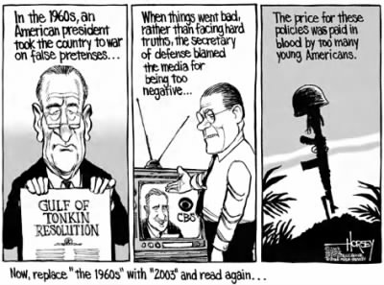
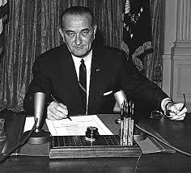
American Escalation, 1954-63
US prop up Ngo Dinh Diem (S. Vietnam)
Oligarchy
Diem assassinated
Rule of the Generals
Gulf of Tonkin Incident, 1964
North Vietnamese Army (NVA) attacks US Navy in Gulf of Tonkin
NVA ‘attack’ is questioned –
A fabricated incident?
https://www.youtube.com/watch?v=1A_X_6_9m2s
Lyndon Johnson (US President)
‘piss ant country’
Gulf of Tonkin Resolution
‘Blank Cheque’
Surge in Presidential Powers
The South Vietnamese are losing the war to the Viet Cong. No one can assure you that we can beat the Viet Cong or even force them to the conference table on our terms, no matter how many hundred thousand white, foreign troops we deploy….Our involvement will be so great that we cannot – without national humiliation – stop short of achieving our complete objectives. Of the two possibilities – I think national humiliation would be more likely than the achievement of our objectives – even after we have paid the terrible price.
George Ball, US Under-Secretary of State, 1964

Slide 4
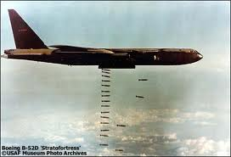
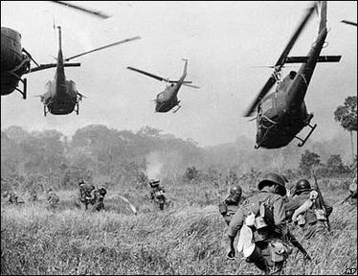
Operation Rolling Thunder
USAF: Bombs North Vietnamese targets
North Vietnamese endure (US perplexed)
US Marines
1965 – 200 000
1968 – 600 000
limited ability to engage enemies; rising casualties
the American military leadership failed to initially propose and develop, or later to adapt, an appropriate strategy for the war.
Political Solution?
Pres. Johnson (US) offers to withdraw
S. Vietnam must remain ‘independent’
Ho Chi Minh rejects such an offer
You can kill 10 of us for every 1 of you and even at those odds we will win.
Perception –
USA: Containment – Domino Theory – ‘Democracy’
Vietnamese: Self-Determination – Independence
For Vietnam – not losing was winning…..

Slide 5
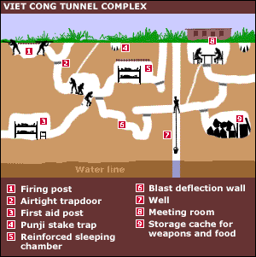
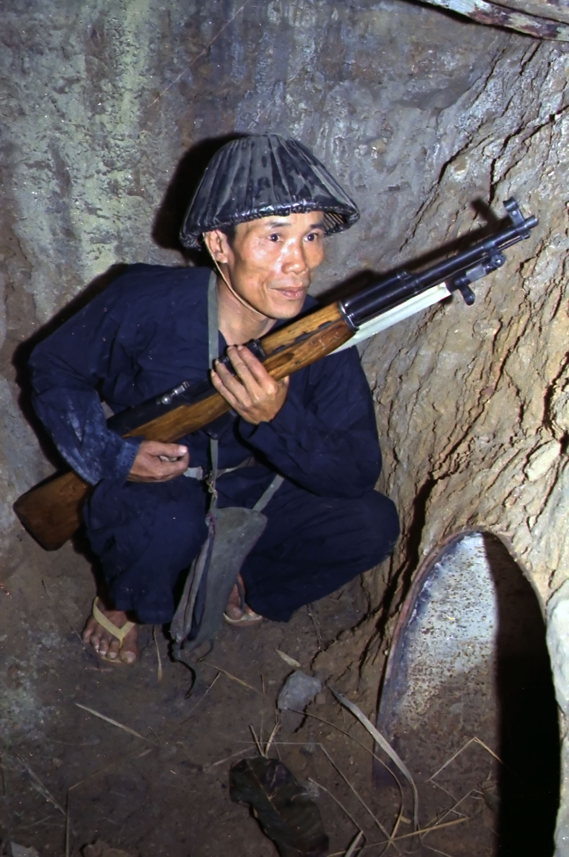
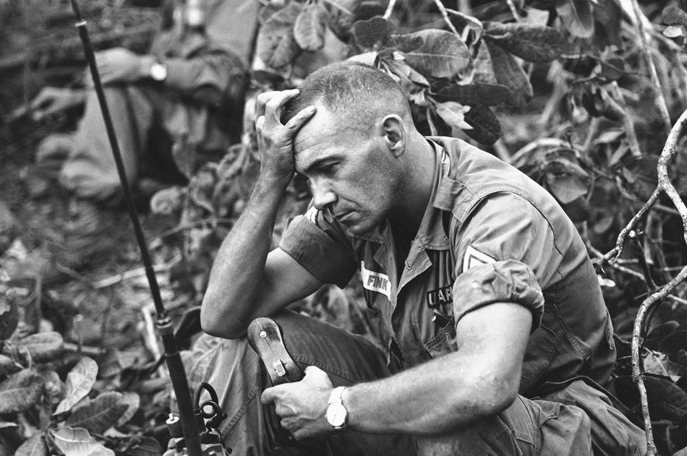
Nature of Warfare
Characteristics?
Helicopters – ‘Airmobile’ – Search & Destroy
War of Attrition
Bombing, Napalm, Firepower
Role of Media (Embedded Journalism), but also ‘body bags’
Guerilla Warfare (tunnels, ambush, booby traps)
Ho Chi Minh Trail
No ‘frontlines,’ but anybody could be an enemy
Vietnamese (Viet Cong)
What type of war were Vietnamese fighting ? Why?
Volunteers
politically conscious
poorer
disciplined
virtually little reliance on supplies
What factors win nations a war?
Politics?
Economics?
Technology?
Strategies?
American Soldiers
Same Question:
What type of war were US fighting? Why
Drafted (mandatory - one year tour)
uneducated
poor
substance abuse
supply oriented

Slide 6
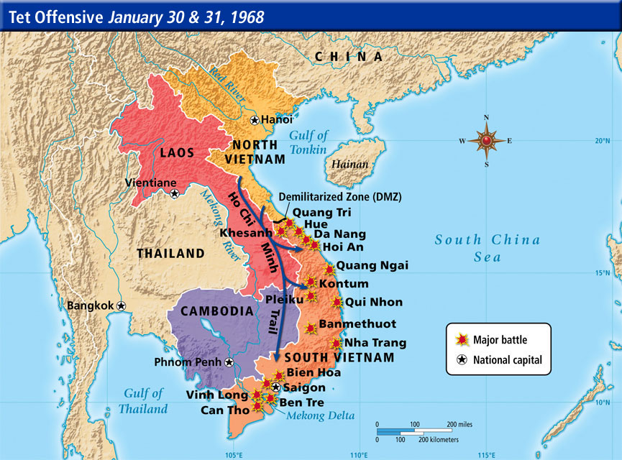
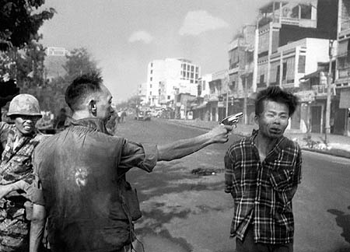
American ‘Hubris’
Tet Offensive (1968)
It was a campaign of surprise attacks (Viet Cong) against military and civilian commands and control centers throughout South Vietnam
Massacre at Hue
Summary execution/mass killings perpetrated by Viet Cong – 5-6 000
My Lai Massacre (March ‘68)
US Army soldiers perpetrate the murder of 350-500 unarmed civilians at Son My
Kept secret until Nov. 1969
Leads to increase in anti-war movement
https://www.youtube.com/watch?v=sL7N-aCtlLo
Battle of Khe Sanh (21 Jan ‘68 – 9 July ‘68)
Both sides claimed victory
Khe Sanh was relieved by ground forces on 6 April
July 1968, Americans destroyed the base complex of Khe Sanh and withdrew from the battle area
North Vietnamese Army gained control of the Khe Sanh region after the American withdrawal
Brigadier General Nguyễn Ngọc Loan fires a bullet through the head of his Vietcong prisoner, as NBC cameraman and photographer Eddie Adams captured the harrowing moment

Slide 7
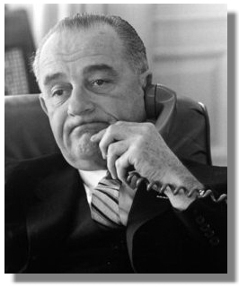
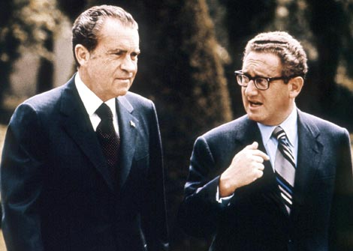
‘Planning to Lose’ – End of Vietnam
1968 – Lyndon B. Johnson decides not to run for President (2nd term)
Before ‘Tet Offensive’: Anti-war protesters viewed as ‘freaks’
After ‘Tet Offensive’: ‘Respectable’ Americans call for an end to war
1968 - Richard Nixon (Pres.) & Henry Kissinger (Sec. of State)
‘Peace with Honour’
http://www.youtube.com/watch?v=lXYAg9mhlmM
‘Vietnamization’
train, recruit Vietnamese soldiers
replace, bring home American soldiers
strengthen S. Vietnamese government
John Kerry, 1971- http://www.youtube.com/watch?v=yixdveuf0GQ
1970 - ‘Peace Offensive’ –
Nixon limits number of US soldier; increases bombing of N. Vietnam/N. Vietnam (B-52s)
1973 – Negotiations with North Vietnamese (Lu Doc Thu)/ Paris Agreement
‘Stay where you are’ ceasefire / US withdraws troops / $$$ to S. Vietnam
1975 – Fall of Saigon
Vietnam becomes a Communist nation

Slide 8
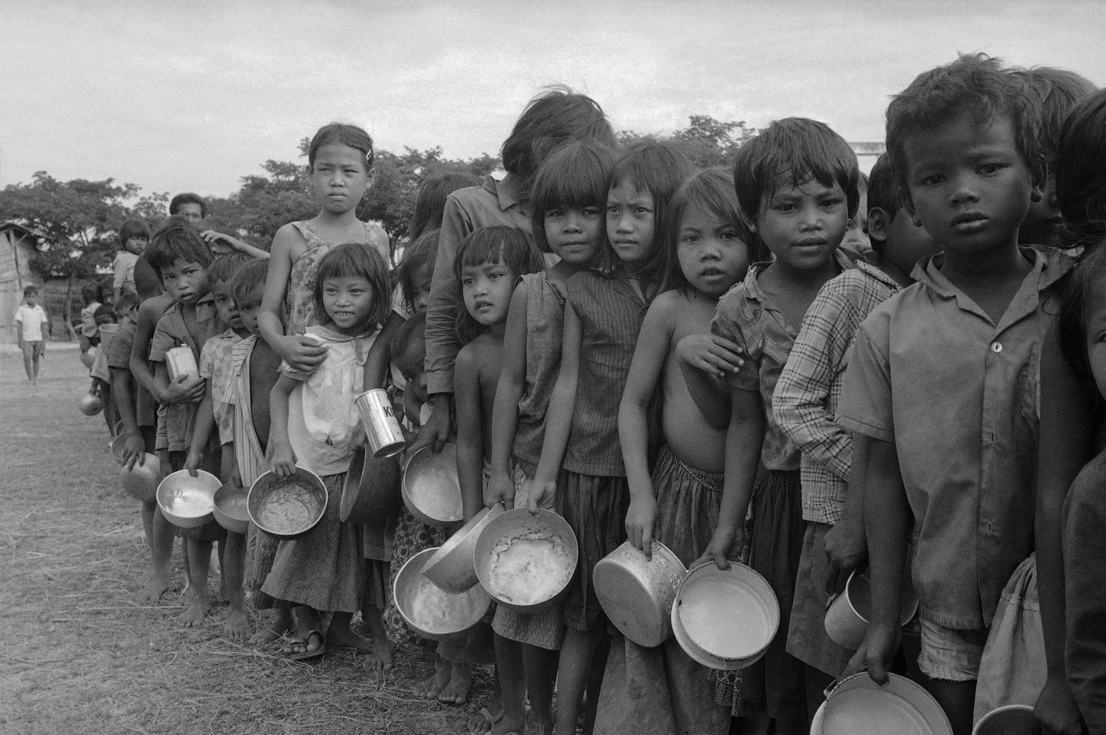
Effects of the Vietnam War
Boat People
Mass exodus by Vietnamese
War in Cambodia
US bombs Cambodia during war
CIA meddles in ‘regime change’
Khmer Rouge (Pol Pot)
Genocide (2 000 000)
Vietnam invades Cambodia
China attacks Vietnam
‘Vietnam Syndrome’ (the US experience)
$150 Billion
57 000 killed
America could no longer claim innocence and moral superiority; she had exercised in Vietnam the type of raw power which had previously been practised by European nations
Why did the USA lose?
a war against nationalist guerrillas
the war was unpopular at home
the war was unpopular in the world and U.S.A. suffered international disgrace for her actions
the U.S.A. could not win the war for the “hearts and minds” of the South Vietnamese people
the US military became disillusioned
the wrong war for the wrong reasons

Slide 9
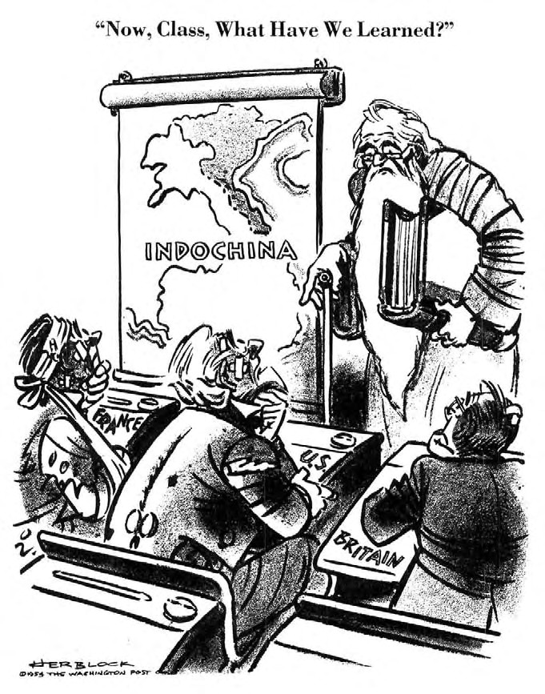
The USA learned that…..
Even superpowers have their limitations.
War without popular support at home is difficult to wage in a democracy.
Military intervention against a popular nationalist uprising can be futile.
Conscript armies are not a reliable military force in wars like this. (Indeed, the U.S.A. soon cancelled the universal draft.)
There should be limitations on the powers of the President to wage war.
The domino theory was more political rhetoric than truth.
Maybe it was hardly worth opposing the spread of communism?

