Slide 1
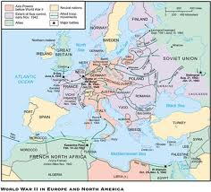
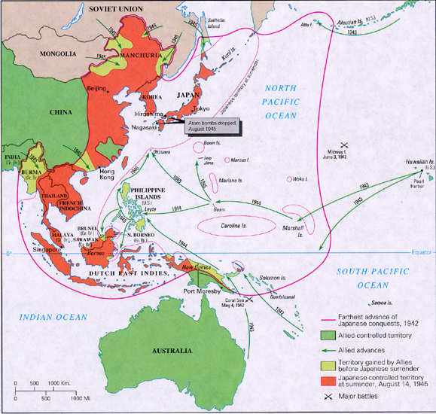
Intro to the Second World War
A series of wars which slowly engulfed the world…
Japanese Invasion of Manchuria, 1931
Italian Invasion of Abyssinia, 1935
Spanish Civil War, 1936
Hitler’s aggression in Europe, 1936-1939
Different from the Great War of 1914-1918
Technology
War of Motion
Ideology
Capitalist & Communist vs. Fascism
Two theatres of War
European (includes N. Africa, Atlantic)
Asia-Pacific
Crimes against Humanity
"War is not merely a political act, but also a real political instrument, a continuation of political commerce, a carrying out of the same by other means.”
On War, Karl Maria Clausewitz

Slide 2
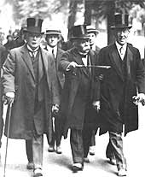
Causes of the Second World War
Treaty of Versailles
most important international agreement of the 20th Century?
a compromise between idealists and realists, though heavily punitive to Germany
Germany was forced to sign the treaty via ‘diktat’ and did so under protest
Major Clauses:
War Guilt Clause – Germany must accept sole responsibility to for the war
Disarmament
Colonies relinquished to British, French and League of Nations
Reparations – paying for the war –crippled Germany’s economy in the early ‘20s
Demilitarization and occupation of Rhineland
Anschluss banned – Germany and Austria forbidden from unification
Successor States – new nations born out of the idea of ‘Self-Determination’
this resulted in significant territorial losses to Germany
Evaluating the Treaty
territorial, economic and military terms were a humiliation to Germany….this encouraged a sense of vengeance
In part – a future cause of World War II – thousands of demobilized German soldiers resenting the terms of the treaty and disgruntled with a weak political system, joined right wing political parties.
The Big Three:
US President Woodrow Wilson
British PM David Lloyd George
French PM Georges Clemenceau

Slide 3
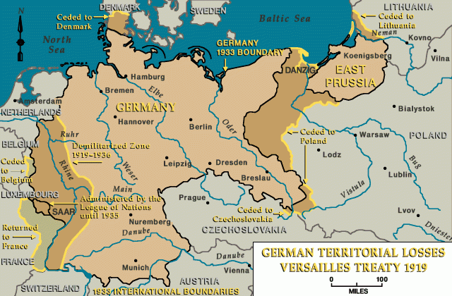

Slide 4
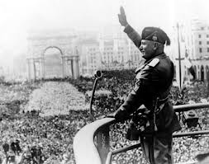
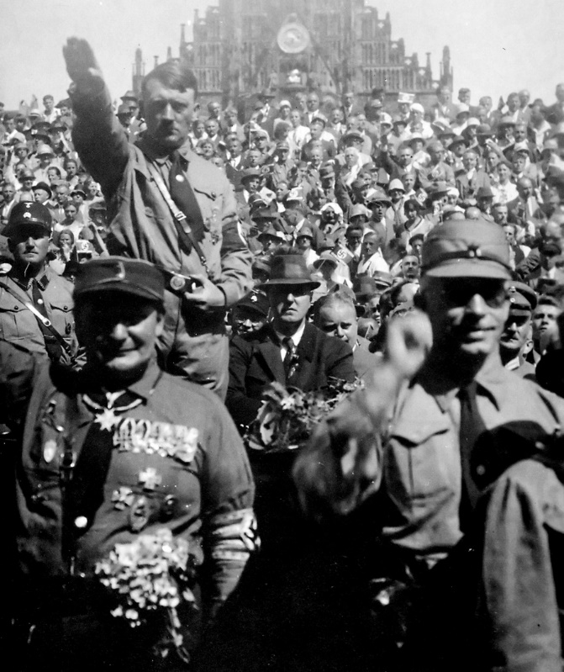
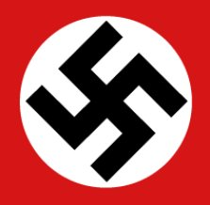
Causes of the Second World War how do ‘civilized’ nations such as Italy and Germany allow the rise of dictators?
Rise of Fascism ……ideas more suited to a dissatisfied populace?
a response to the economic and political upheaval post-WWI
anti-socialist – anti-liberal – anti-democratic – nationalistic – extreme violence
Italian Fascism
Benito Mussolini – ‘the school teacher’ ‘Il Duce’
‘Blackshirts ‘ (ex servicemen of WWI) March on Rome, 1922
German Fascism
Adolf Hitler
‘Brownshirts’ – ‘Storm Troopers’
Aryan myth – the ‘master race’
Anti-Semitism – hatred and prejudice against Jewish people leads to the Holocaust
Lebensraum – ‘living space’ for German speaking peoples…..imperialism?
Rise of Hitler
charismatic speaker ….role and influence of radio and film
Enabling Act, 1934
Our movement must necessarily be anti-Parliamentary and if it takes part in the parliamentary constitution, it is only for the purpose of destroying this institution from within’ Adolf Hitler, Mein Kampf
no freedom of speech, press - political parties banned
Gestapo (secret police)
Individuality overruled by State……Education – the Hitler Youth

Slide 5
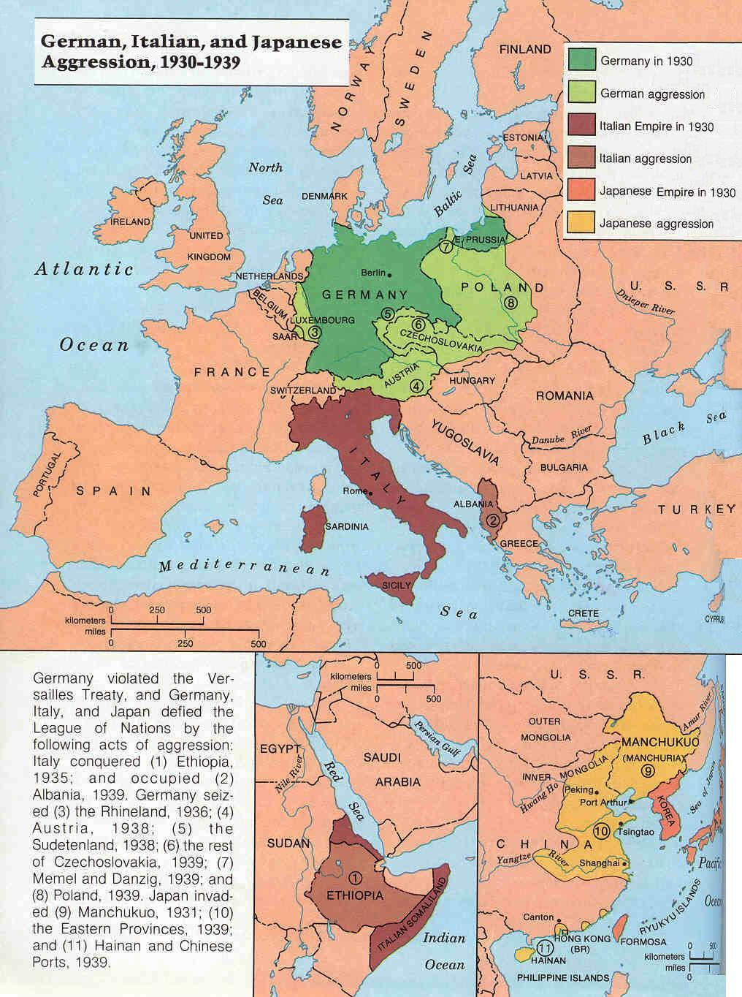
Causes of the Second World War
Failure of the League of Nations
Int’l Organization formed post-WWII
based on idea of ‘collective security’
but – ‘isolationism’ …..USA refused to become involved or a member
Britain and France were reluctant leaders…..
Germany and Russia (communist) were not allowed initial membership
Japanese Invasion of Manchuria, 1931
Japan ruled by military junta – a rising power in Asia – but, imperialistic
L of N too hung up on Europe – ‘Eurocentric’
Japanese delegation would walk out of L of N assembly
Sino-Japanese War, 1937-45
Italian Invasion of Abyssinia (Ethiopia), 1935
Mussolini desires an Italian empire – think Ancient Rome
L of N votes on sanctions…but these have little effect
Br. & Fr. Look the other way (secretly) – Hoare-Laval Plan
Spanish Civil War, 1936-39
Republicans (socialists) v. Nationalists (Fascists)
Italy & Germany support Nationalists w/ arms, air support and volunteers
modern warfare – ‘Guernica’
Soviet Russia supports Republicans with weapons
Britain and France (non-intervention) ….Hitler and Stalin learn that democracies are unwilling to resist Fascist aggression

Slide 6
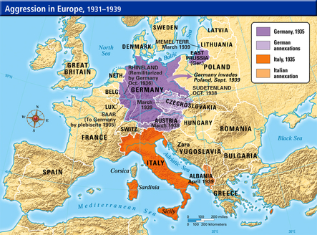
Hitler’s Aggression in Europe, 1936-39 What were Hitler’s foreign policy objective?
Why did Britain and France give in to his demands?
The Failure of ‘Appeasement’
Hitler legislates ‘conscription’ (mandatory military service), 1935
Remilitarization of the Rhineland, 1936
Hitler orders army to march into Rhineland
Anschluss, 1938
Hitler desires unification with Austria
Significant NAZI support within Austria?
Munich Conference, 1938
Sudetenland (borderlands between Germany and Czechoslovakia)
British PM – Neville Chamberlain wants to avoid war….
Agreement to cede Sudetenland to Germany
Note: Czech PM is not invited to conference!!
‘Peace in our time’
Hitler makes more demands in the weeks that follow…
Nazi-Soviet Pact, 1939
Stalin and Hitler agree to divide Poland between them
Britain and France declare war on Germany
‘Appeasers’ wanted to avoid another war….a strengthened Germany is good?!!
Hitler, knowing he would be appeased, changed the ‘status quo’ every time to suit his desires

Slide 7
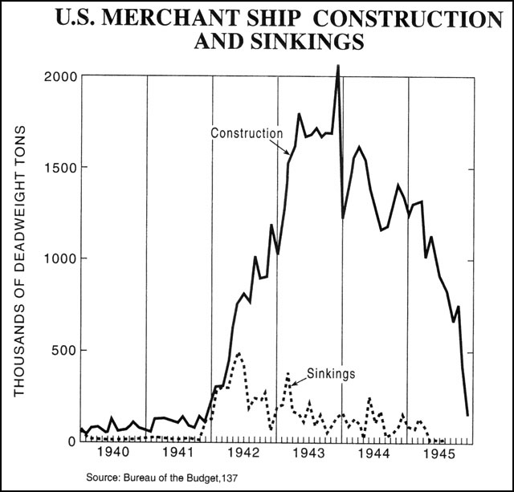
the Nature of Warfare ……what are the keys to winning in modern warfare?
……what are a nation’s war aims?
Total War
the critical importance of both the home front and battle front
a nation’s resources are marshalled to winning the conflict
for some, the brutal reality of the destructive nature of warfare
Industrial Production
the economics of nations is vital, particularly in producing war materials
re-tooling and organizing industry to deliver and deploy new technologies
mobilizing the workforce – how important was the role of women?
Mobilization
Enlistment – 16 000 000 American soldiers (example)
Allied Strategy
control shipping lanes
naval blockades of Japan and Germany
Propaganda
an influential force with both positive and negative outcomes……
Churchill’s speeches, Roosevelt’s ‘fireside chats’ ….these were radio addresses....that boosted morale
it also created invalid assumptions of race, gender and culture that were hurtful to societies
………American portrayals of the Japanese, as examples

Slide 8
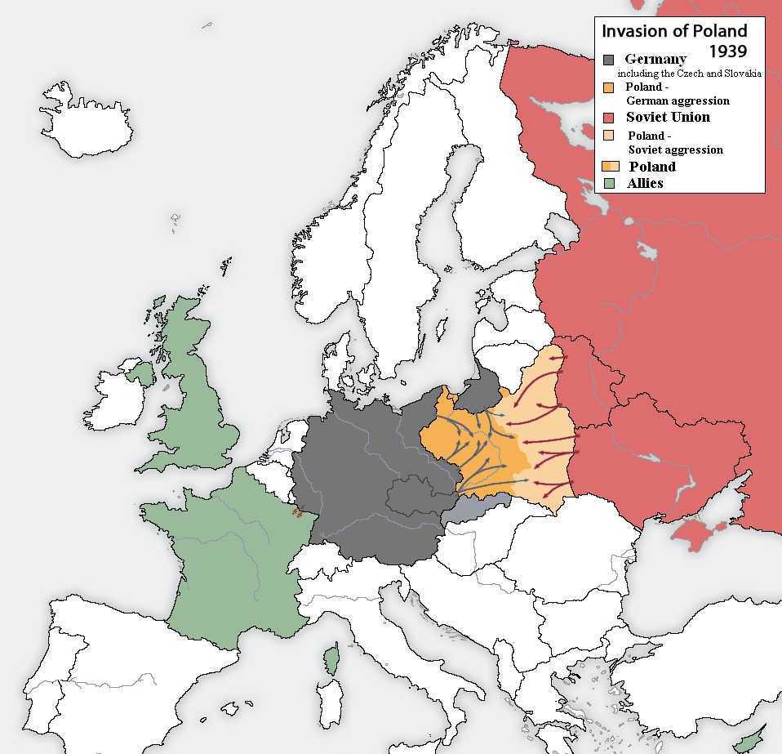
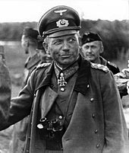
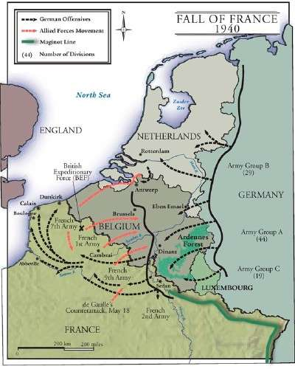
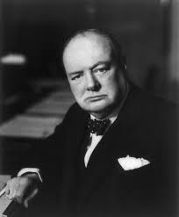
the War in Europe How does blitzkrieg work and why was it effective?
https://www.youtube.com/watch?v=gUjrnlMAtQ4
‘Blitzkrieg’ (‘Lightning War’)
Stuka bombers (Luftwaffe) Invasion of Poland, Sept. 1939
Panzers (tanks)
Speed, surprise of combined arms……cut off enemy’s supply lines & communication
Wireless radio …..allowed for the coordination of combined arms
new method of warfare?
Do early success lead to overconfidence? Poland? Western Europe?
Keys:
environment?
air superiority?
counter-tactics?
logistics?
Fall of France, June 1940
April, 1940 – Denmark, Norway fall – Winston Churchill (British PM)
May, 1940 – Holland, Belgium, Luxembourg fall to Wehrmacht
Operation Dynamo – Allied retreat to Coastal town, Dunkirk
some 330 000 soldiers (mostly Brits) rescued
June, 1940 – Britain the only remaining democracy in Europe
Luftwaffe begins its fight for air superiority over British airspace….
Heinz Guderian

Slide 9
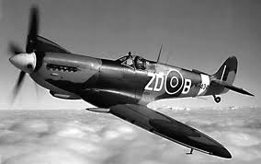
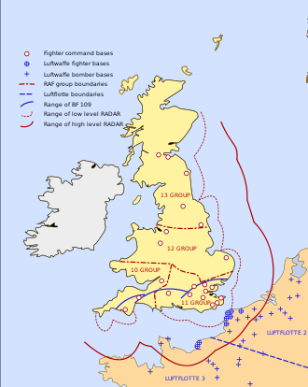
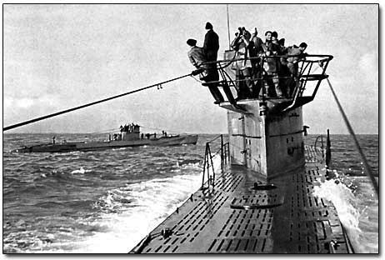
the War in Europe
Battle of Britain, Summer 1940
Stages:
Luftwaffe bomb shipping in English Channel
Luftwaffe bomb RAF airfields & radar stations
Luftwaffe bomb ports and centers of industry
Luftwaffe now begins ‘the Blitz’ – heavy bombing of city centres across England – London, Coventry
40 000 civilians die during summer of 1940
Spitfire
**Errant bombs on London see Churchill retaliate’ sends RAF bombers on mission to Berlin (Aug. ’40)
Key Factors:
Radar Defense
Central Command
Spitfires & Hurricanes v. BF 109 Messerschmitts
Hitler denied a quick conquest Allies remain able to launch an advance into W. Europe
Battle of the Atlantic, 1939-45
the U-Boat threat ……submarine warfare
Industrialism
North America as an ‘arsenal for democracy’
merchant navies
Convoy system
wolfpacks
the longest, largest and most complex naval battle in history…….
also, a strategic victory for the Allies
radar, sonar, & long range aircraft
depth charges
evasive convoy routing

Slide 10
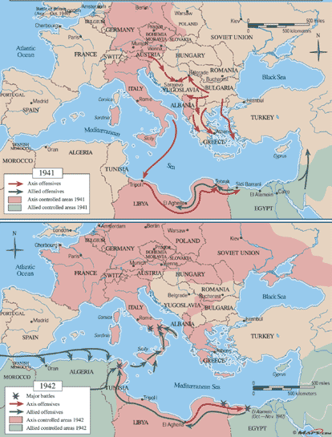
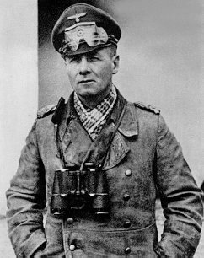
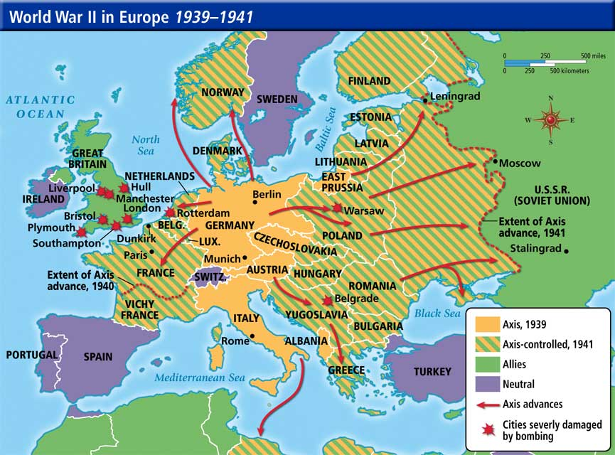
the War in Europe
War in the Mediterranean
the Middle East…….strategic significance? Oil? Suez Canal?
Italians are weak allies for Nazi Germany….militarily, that is….
Hitler has concerns about his southern flank
…’soft underbelly of Europe?’
Hitler sends Wehrmacht to secure Balkans and North Africa
Erwin Rommel (the Desert Fox) leads the Afrika Korps to early victories
Wehrmacht is overstretched, far from home …….logistics?
the Eastern Front
Operation Barbarossa, June 1941
two-front war (actually, three front…..)
Lebensraum
Stalin’s purges of Red Army in late 1930s weaken Soviet military
Hitler’s overconfidence at play?
Blitzkrieg …..3 000 000 Wehrmacht soldiers
Scorched Earth Policy
Soviet retreat includes sabotage of resources
Wehrmacht, again, overstretching supply lines
Hitler learns the mistakes of Napoleon?
sweeping savagery, soaring casualty figures on both sides…..
Did the Soviet Union win the Second World War?

Slide 11
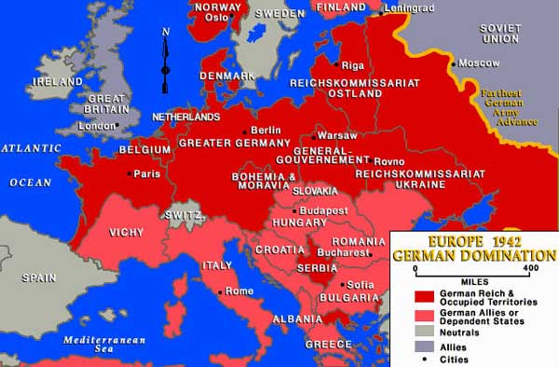

Slide 12
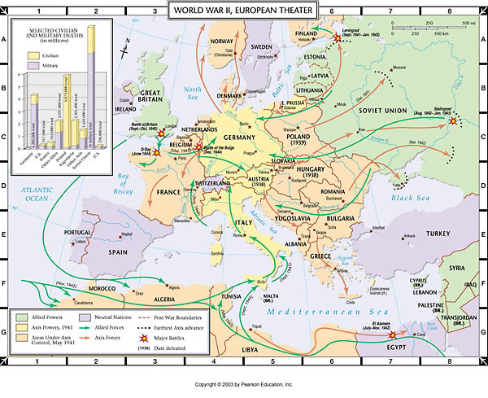

Slide 13
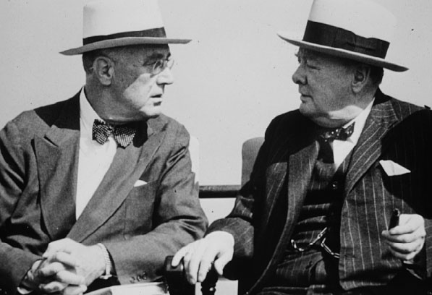
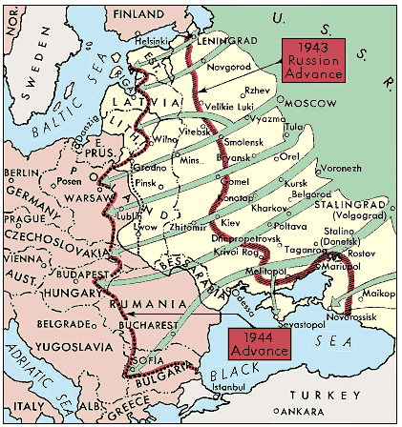
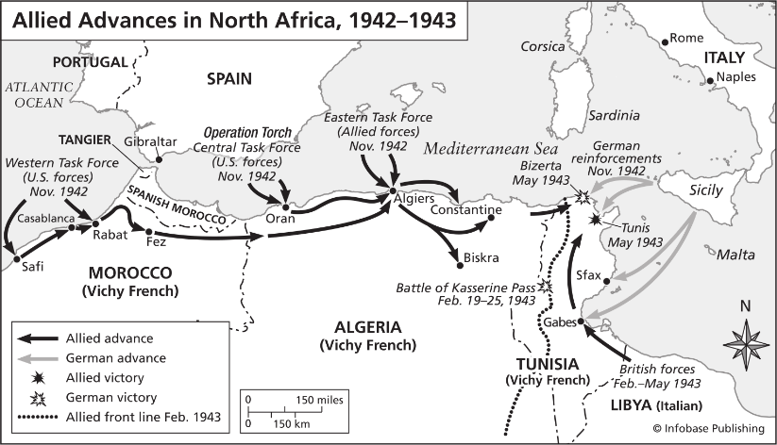
Turning Point in the European Theatre
US Entry into WWII (Dec. 1941)
Britain gains the ally she needed….
American foreign policy shift – the end of isolationism in the 20th Century
Eastern Front
Battle of Stalingrad, August 1942-February, 1943
the key turning point of the war in Europe?
massive casualties to both sides – urban warfare, battle of attrition
Wehrmacht turn tail and on the run…..Red Army advances westward herein
Battle of Kursk – Hitler’s counter-offensive fails……largest tank battle in history
Eastern Front Collapse, 1944-45
largest single front in the history of warfare both in terms of size and soldiers
both sides committed a variety of atrocities, with the Germans rounding up and executing millions of Soviet Jews, intellectuals, and ethnic minorities as well as enslaving civilians in conquered territories. The Soviets were also guilty of ethnic cleansing, mass executions of civilians and prisoners, torture, and oppression.
80% of Wehrmacht’s World War II casualties were suffered on Eastern Front
US President Franklin & British PM Winston Churchill
War in Mediterranean
US-British advance in North Africa
Americans from the West, British from Egypt
Afrika Korps (Germans) retreat from Tunisia to Sicily, then Italy…..
Demonstrates the alliance between US-Brits and coordination of military force

Slide 14
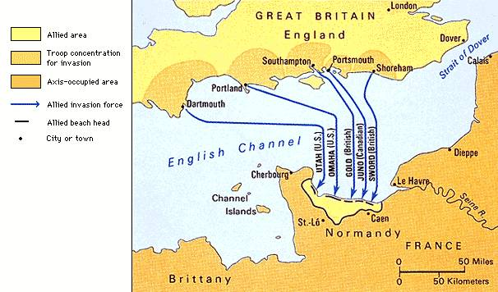
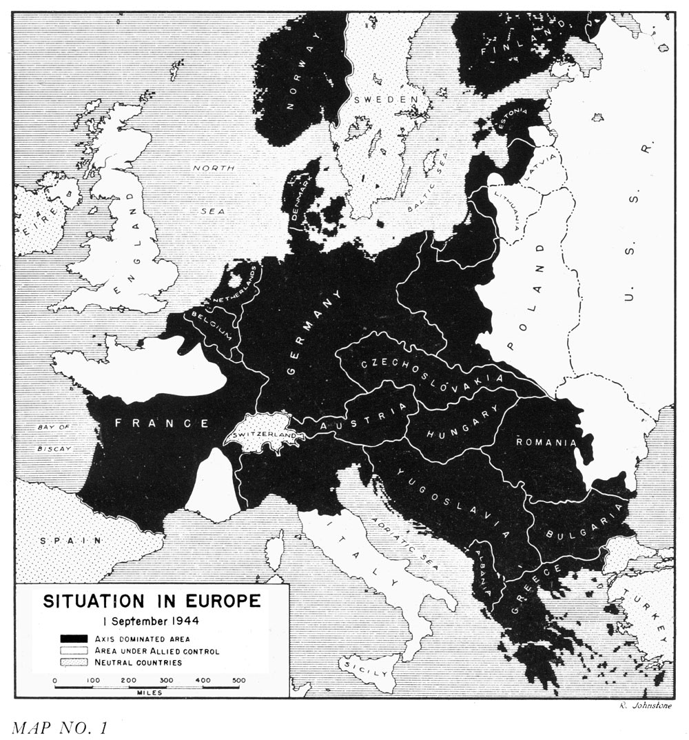
Allied Advance
Italian Campaign, Summer 1943
Civil War erupts in Italy…..Mussolini ousted in July, 1943
Hitler rescues Mussolini…..props him up till ’45
Wehrmacht makes good use of Italian terrain in retreat
Hardest and bloodiest fought of the western front
the Second Front?
Supreme Allied Commander – Gen. Dwight D. Eisenhower
Normandy Invasion – D-Day: June 6, 1944
Objective:
Beachheads
Men & Materials
the Road to Berlin
Operation Market Garden (Sept. 1945)
largest airborne operation in history
set back for the Allies ….strain on Allied supply lines
Battle of the Bulge (Dec. 1944)
last major offensive by the Wehrmacht
Allied bombing runs on German industry finally taking an effect….
Berlin, 1945
Hitler fights to the last man…..Allies desire ‘unconditional surrender’
Soviets aiming to take Berlin first
Hitler suicide, April 30, 1945 V-E Day – May 2nd, 1945
Keys to Success:
Planning
Air superiority
Ingenuity
Mulberry Harbours
Dieppe, 1942

Slide 15
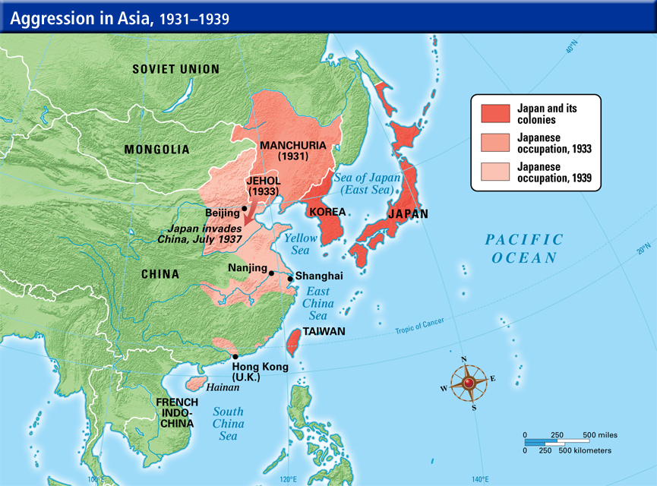
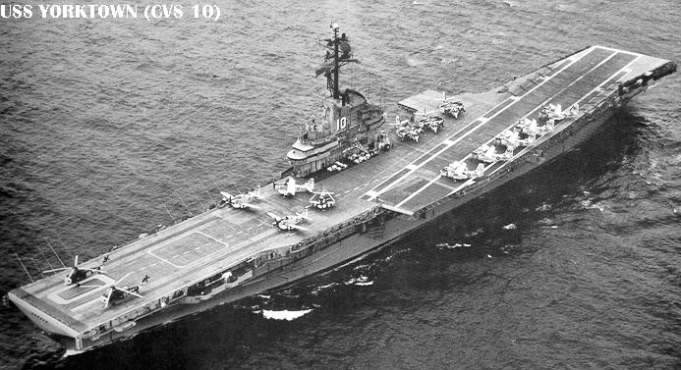
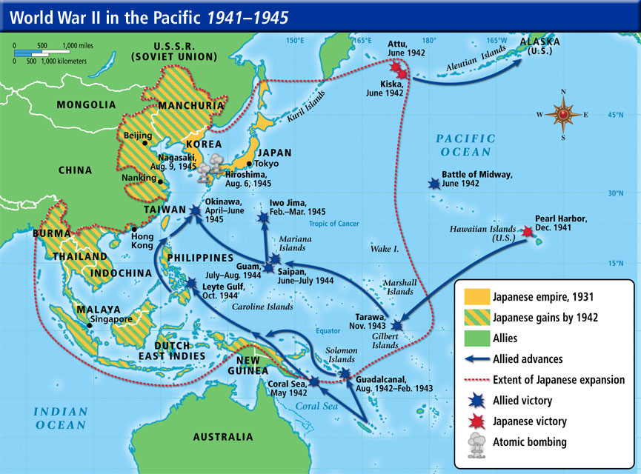
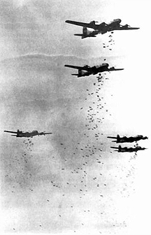
the Pacific Theatre …..the largest theatre of war in WWII
Japanese Imperialism
Manchuria, 1931
2nd Sino-Japanese War, 1937-45
freehand in China? Indochina (Fall of France)?
US and Japan have competing interests in the Pacific…
Pearl Harbour – December 7th, 1941 ……’A Day that will live in Infamy’
surprise Japanese attack on US Naval Base at Pearl Harbour
Key: US Aircraft carrier fleet undamaged
Technology & Warfare
Aircraft Carriers
allowed for extension of air power
US Industrialism
Total War
Strategy
American strategy of ‘Island Hopping’ ….take key islands, not all….
US ‘strategic’ bombing of Japan ese urban centres (1944-45)
B-29 Superfortress…….’precision-bombing?’
break industrial capacity?
crush civilian morale?
revenge for Pearl Harbour?

Slide 16
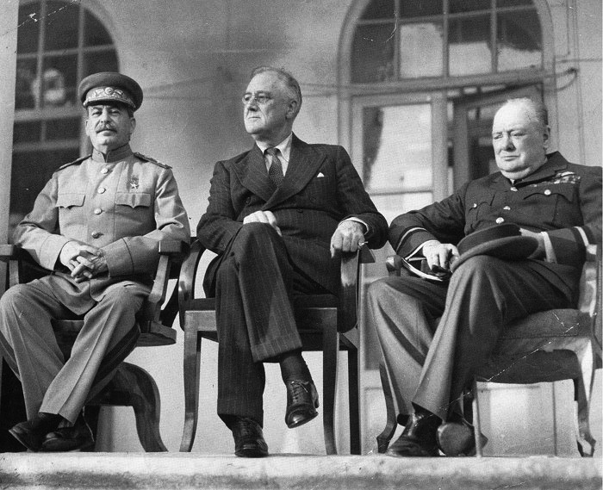
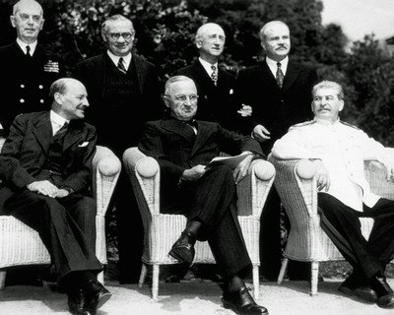
Wartime Conferences
establishes real, if mutually suspect ties between Stalin (USSR) and the West
Tehran Conference, Dec. 1943
the ‘Big Three’ agree that Germany must surrender ‘unconditionally’
a second front in Europe is decided on….to relieve pressure on Eastern Front
Yalta (Crimea) Conference, Feb. 1945
Roosevelt is quite ill by this point in the war……Dies in April 1945
Nazi defeat imminent…..Denazification & Demilitarization of Germany
Division of Germany – Britain, France, USA & USSR zones – Berlin, too
Stalin agrees to enter Pacific War
Stalin promises ‘free elections’ in Red Army liberated Europe…..
Churchill concerned of Soviet ‘sphere of influence’ in Easter Europe
Potsdam Conference, July/August, 1945
Changes:
Churchill defeated in British Election - PM Clement Attlee (Labour Party)
US President Harry Truman (formerly Vice under Roosevelt) takes office
Nuremburg Trials – ‘Crimes Against Humanity’
Unconditional surrender of Japan
US detonate ‘new powerful weapon’ in New Mexico
Emergent Bipolar World –
Mutual suspicion between West and Stalin
‘Superpowers’ – USA vs. USSR Britain a spent nation – WWI & WWII?
Stalin, Roosevelt & Churchill – Tehran, Dec. 1943
Attlee, Truman and Stalin – Potsdam, Aug. 1945

Slide 17
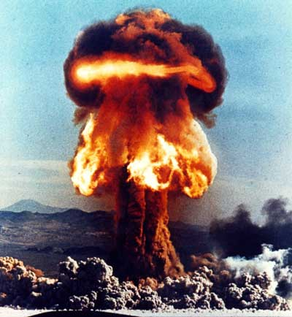
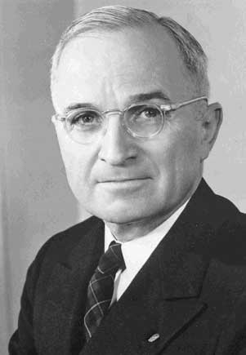
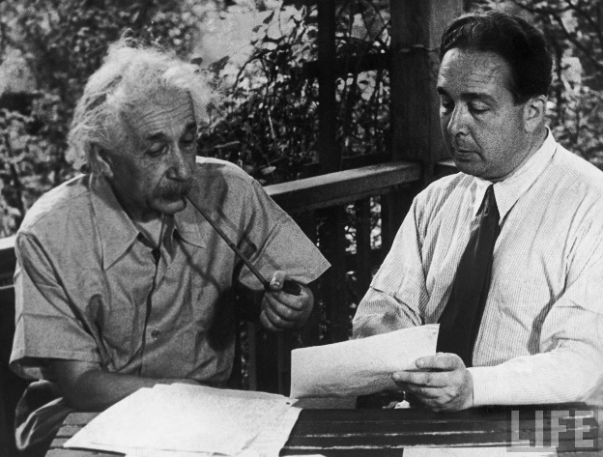
Final Stages of the War
Hiroshima – Aug. 6th, 1945
Nagasaki – Aug. 9th, 1945
Manhattan Project
Secret, expensive plan to develop Atomic weapons
Los Alamos, New Mexico (1945)
Truman’s decision
June 1, 1945 – US Secretary of War recommended that the bombs be dropped without prior warning on Japanese military targets in an urban setting
Prominent scientists disagreed – urged giving the Japanese a demonstration explosion over an isolated area, using the bomb only as a last resort
Truman rejected their views as “impractical” and made the “military decision” to shorten the war and save American lives
Some historians claim also the decision to drop the bomb was based on a desire to show Stalin the might of the US as the preeminent power postwar
Japanese surrender after Hiroshima and Nagasaki bombings – Aug. 14th, 1945
Einstein & Leo Szilard
‘The search for a revolutionary weapon was one of the most immediate and persistent outcomes of the industrialization of war in the mid-nineteenth century, and both a logical and inevitable extension of the revolution in war which preceded.’
John Keegan, The Second World War

Slide 18
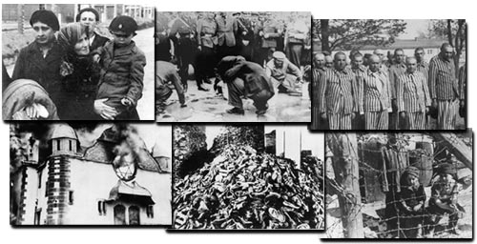
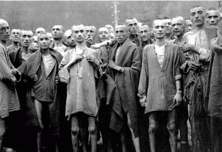
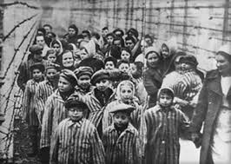
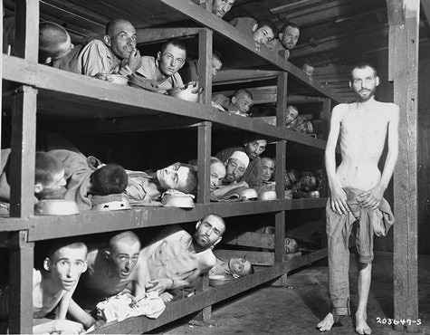
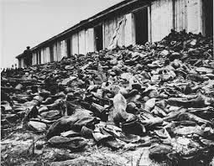
The Holocaust
‘Final Solution’ (1942)
Atrocities never before carried out in such a massive & organized scale
Objective: Genocide
Einsatzgruppen (SS):
special squads clear ‘unwanted’
Jews stripped of goods, clothing & marched away to train stations
Death Squads
Warsaw Ghetto (23 April 1943)
SS order destruction of ghetto
In their own words –
The resistance put up by the Jews and bandits could only be suppressed by energetic actions of our troops day and night…I therefore decided to destroy and burn down the ghetto….Jews usually left their hideouts, but frequently remained in the burning buildings, and jumped out of the windows only when the heat became unbearable. They then tried to crawl with broken bones across the street into buildings which were not afire…many times we could hear loud voices in the sewers…Tear gas bombs were thrown into the manholes, and the Jews driven out of the sewers and captured….The longer the resistance continued, the tougher became the members of the Waffen SS, police and Wehrmacht, who always discharged their duties in an exemplary manner. SS Commander Stroop
Anti-Semitism in Germany in the 1930s
Nuremberg Laws, 1935
Kristallnacht, 1938
http://www.youtube.com/watch?v=j1VL-y9JHuI
https://www.youtube.com/watch?v=sHcJtU9dr6I

Slide 19
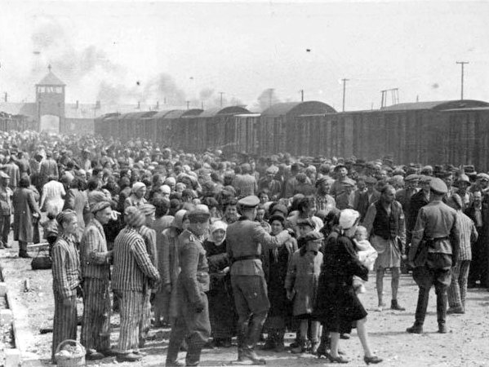
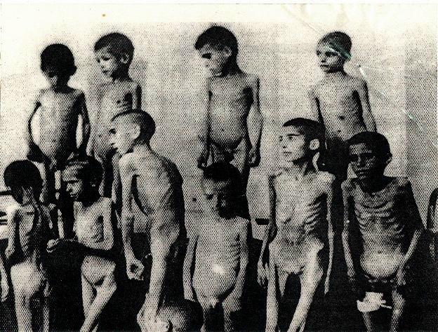
The Holocaust
Death Camps
Auschwitz
Chelmno
Treblinka
Sobibor
Belzec
Commandant Hoess (Auschwitz)
At Treblinka, the Camp Commandant told Hoess that he liquidated 80,000 Jews in six months using monoxide gas.
Hoess did not think that this was very efficient so he decided to use Zyclon B gas instead of monoxide gas because it only took 3 to 15 minutes to kill the people in the death chamber.
Hoess built his gas chambers to accommodate 2,000 people at one time, whereas the ten death chambers at Treblinka only accommodated 200 people each.
Dr. Josef Mengele - the physician of Auschwitz - he performed human experiments

Slide 20
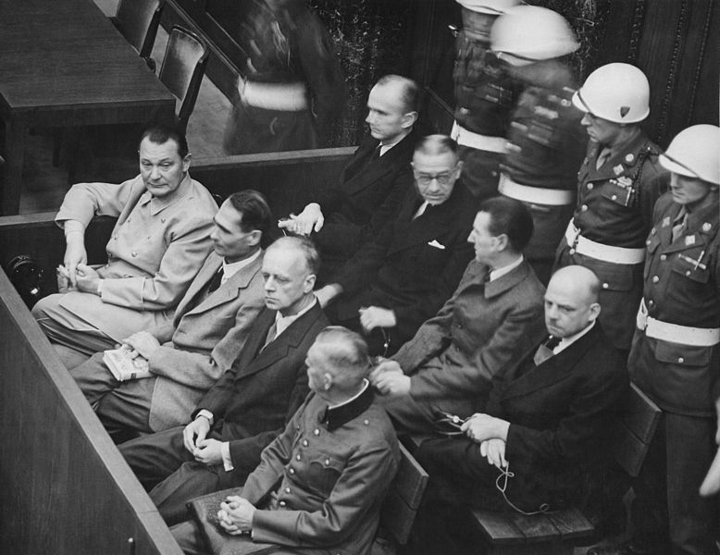
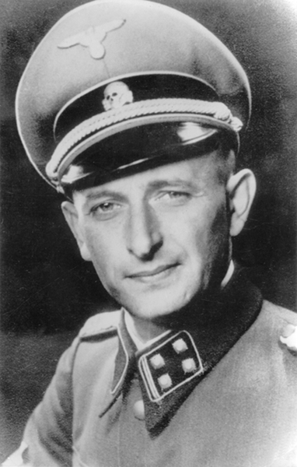
Nuremburg War Crimes Trial
Indictments:
War Crimes
‘violations of the laws and customs of war’
Crimes Against Humanity
Namely, murder, extermination, enslavement, deportation and other inhumane acts committed against civilian population
Defense:
‘just following orders’
We have fought against Jewry, we have fought against it for years: and we have allowed ourselves to make utterances, and my own diary has become a witness against me in this connection – utterances which are terrible…A thousand years will pass and this guilt of Germany will not be erased.
High ranking Nazi testifying against himself
1960 – Adolf Eichman (emodies the ‘banality of evil’) captured in Argentina by Mossad (Israel) for Crimes Against Humannity

